Slide 1
WARM UP
Play game:
Simon says

Slide 2
Play game: Simon says
I’m Simon: When Simon says and do action, you do follow. Example: Simon says Touch your nose and I touch my nose. You do follow me. If Simon don’t says, just act You don’t act. If you act you will lose.Loser will sit down.
5 people at the end will win the game. Each student get 10 mark for your team.
Do you understand?
Before starting, We review the part our bodies. Hair, ears, eyes, mouth, nose, legs, hands, body, shoulder,..
Are you ready? Stand up, please!

Slide 3
You watch a video and try to remember what you hear and see in the video
-Do you understand?

Slide 5
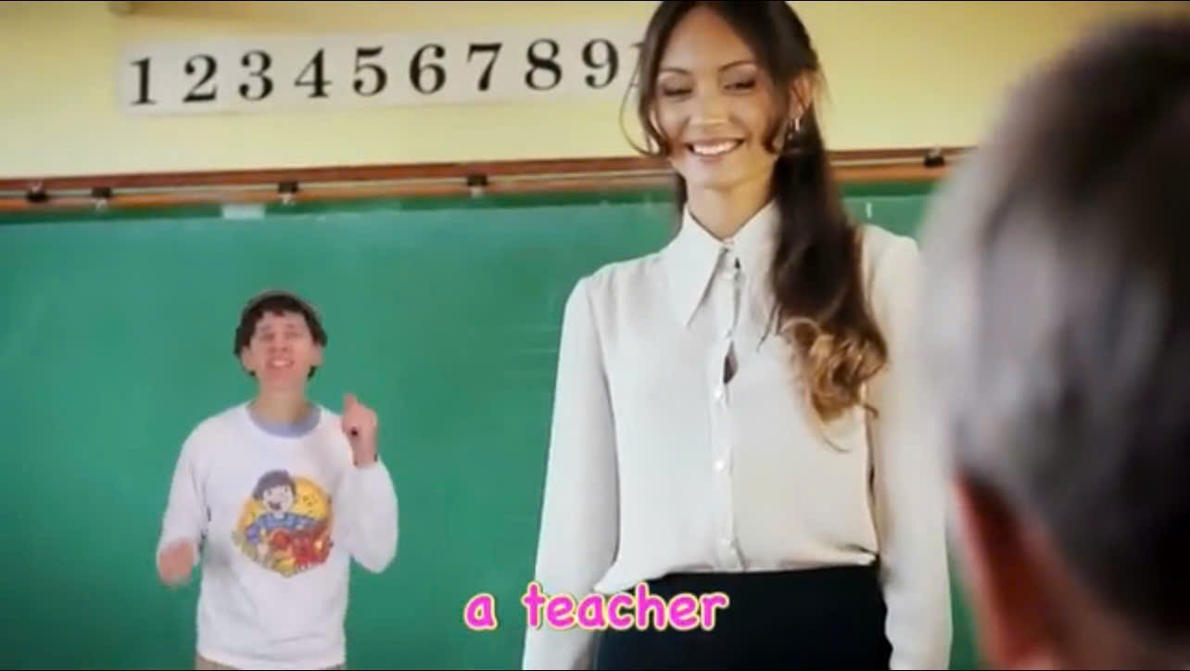
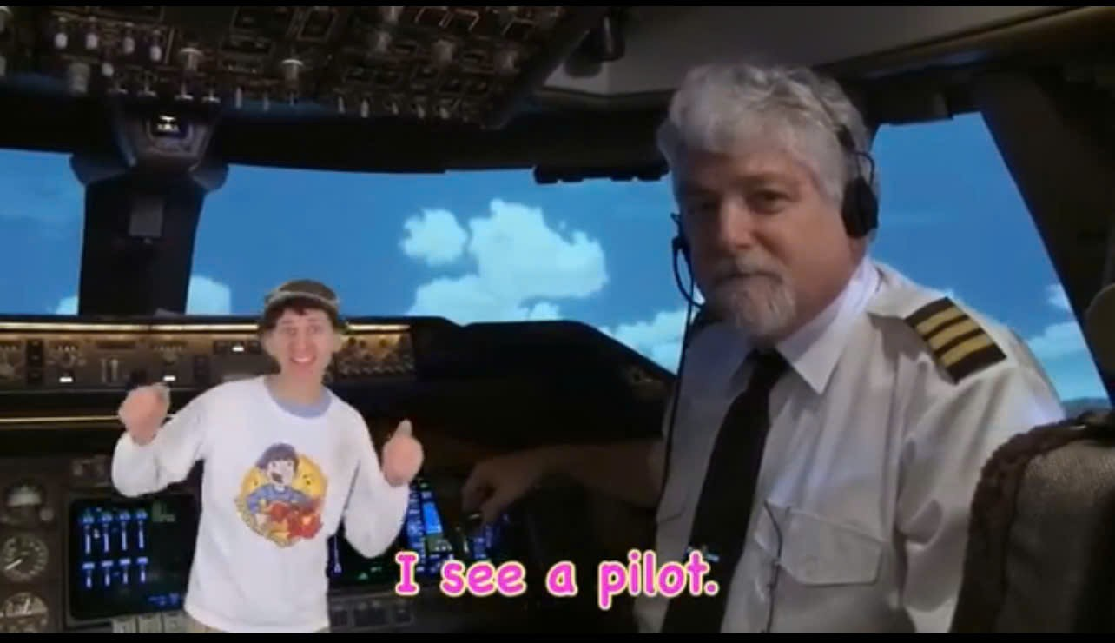
What can you see?
I can see…..
Who can list other jobs?

Slide 6
Today, We are going to learn the topic about JOBS.
We ask and answer the question: What does your father/ mother/ your family members do?He/ she is a/ an…..

Slide 7
It’s time to learn …

Slide 8
Friday March 14th, 2025
Unit 7 MY FAMILY
LESSON 1.1
Part A, B (SB) page 92 + Part A, B (WB) page 62

Slide 9
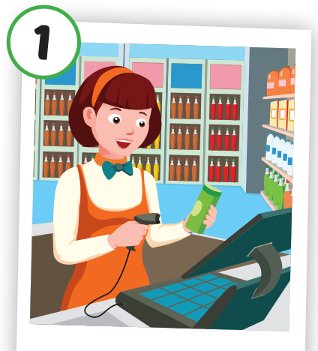
Friday March 14th, 2025
cashier
Thu ngân
Click each English word to hear the sound.

Slide 10
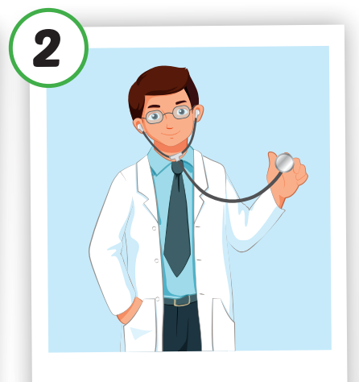
Friday March 14th, 2025
doctor
Bác sĩ
Click each English word to hear the sound.

Slide 11
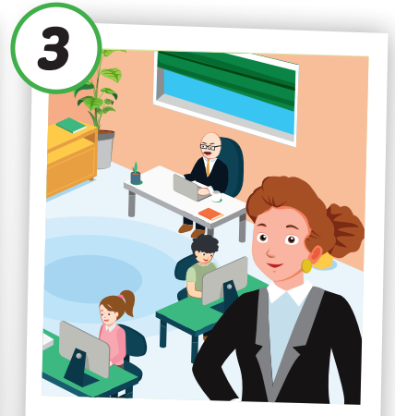
Friday March 14th, 2025
office worker
Nhân viên văn phòng
Click each English word to hear the sound.

Slide 12
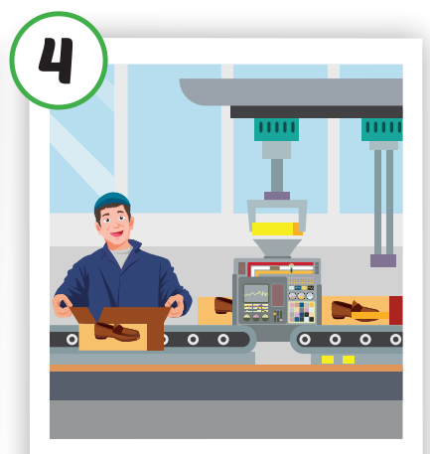
Friday March 14th, 2025
factory worker
Công nhân nhà máy
Click each English word to hear the sound.

Slide 13
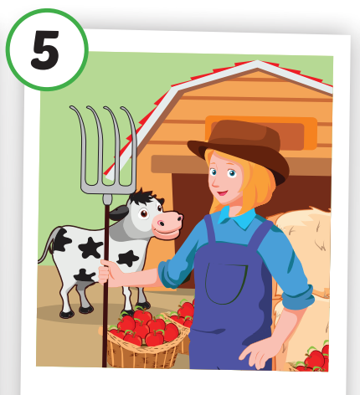
/ˈfɑːrmər/
Nông dân
Friday March 14th, 2025
farmer
Nông dân
Click each English word to hear the sound.

Slide 14
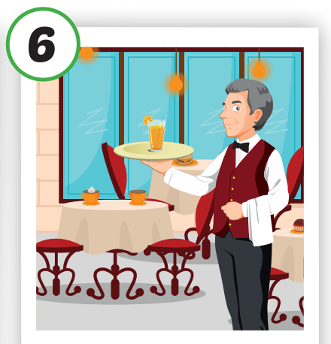
/ˈfɑːrmər/
Nông dân
Friday March 14th, 2025
waiter
Nhân viên phục vụ bàn
Click each English word to hear the sound.

Slide 15
Friday March 14th, 2025
Click each English word to hear the sound.
cashier
doctor
office worker
factory worker
farmer
waiter
Thu ngân
Bác sĩ
Nông dân
Nhân viên phục vụ bàn
Nhân viên văn phòng
Công nhân nhà máy

Slide 16
Friday March 14th, 2025
Play game: What’s missing?

Slide 17
factory worker
office worker
doctor
cashier
farmer
waiter

Slide 18
Asks some ss” What does your father/mother do?
To lead new sentence pattern

Slide 19
waiter
factory worker
doctor
farmer
office worker
cashier

Slide 20
Friday March 14th, 2025
Lucy
Charlie

Slide 21
Make a model with a ss, take turn to practice. Then ask ss to role play to practice in 3 minutes
Call 2 pairs to present.

Slide 22
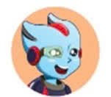
Friday March 14th, 2025
What does your father/mother do?
He’s/ she’s a/an …
cashier
doctor
office worker
factory worker
farmer
waiter

Slide 23
Call 2 pairs to present

Slide 24
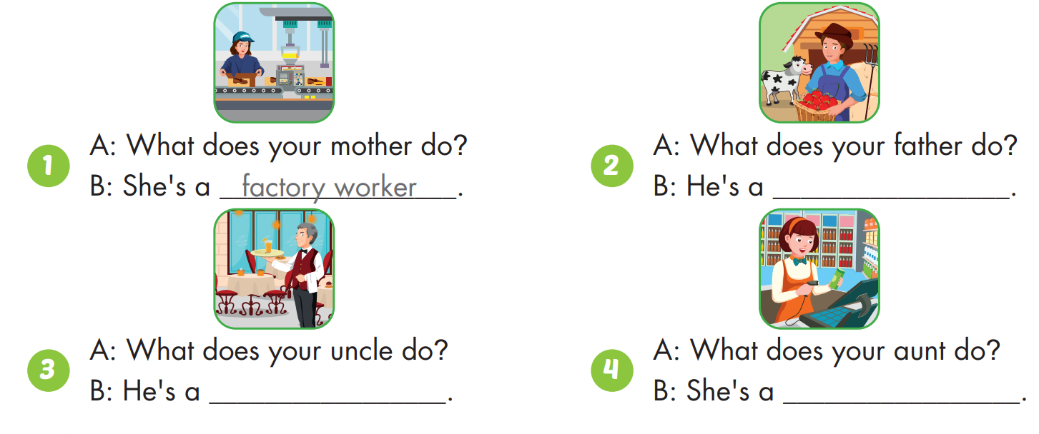
Friday March 14th, 2025
farmer
waiter
cashier

Slide 25
62/WB
Friday March 14th, 2025

Slide 26
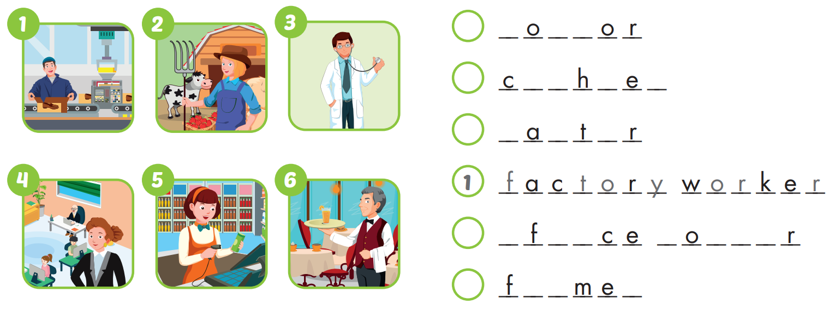
Friday March 14th, 2025
62/WB
3
d
c
t
5
a
s
i
r
6
w
i
e
4
o
f
i
w
r
k
e
2
a
r
r

Slide 27
Friday March 14th, 2025
Make a survey
What does your father/mother do?
He’s/she’s a ………
Name
1. Hieu father/mother
2.Linh father/mother
3. Father/mother
tour guide
factory worker
designer
farmer
doctor
cashier

Slide 28
Invite 2 students to go to the board to present their survey.

Slide 29
Friday March 14th, 2025
Unit 7 MY FAMILY
LESSON 1.1
Part A, B (SB) page 92 + Part A, B (WB) page 62
1. Vocabularies
a cashier,
a doctor,
an office worker,
a factory worker,
a farmer,
a waiter.
2. Structures
-What does your father do?
He's a doctor.
-What does your mother do?
She's an office worker.

Slide 30
Lesson 3
Homework
Practice the vocabularies and structure, and make sentences using them.
Do the exercises in Tiếng Anh 4 i-Learn Smart Start WB (page 62)
Do the exercises in Tiếng Anh 4 i-Learn Smart Start Notebook (page 40)
Prepare the next lesson (page 93 SB)
Play the consolidation games in Tiếng Anh 4 i-Learn Smart Start DHA App on www.eduhome.com.vn

Slide 31
Have a nice day!

Slide 32
Objectives
By the end of this lesson, students will be able to talk about what jobs their family members do.
Vocabulary: cashier, doctor, office worker, factory worker, farmer, waiter.
Structure: What does your father do?
He's a doctor.
What does your mother do?
She's an office worker.

