Slide 1
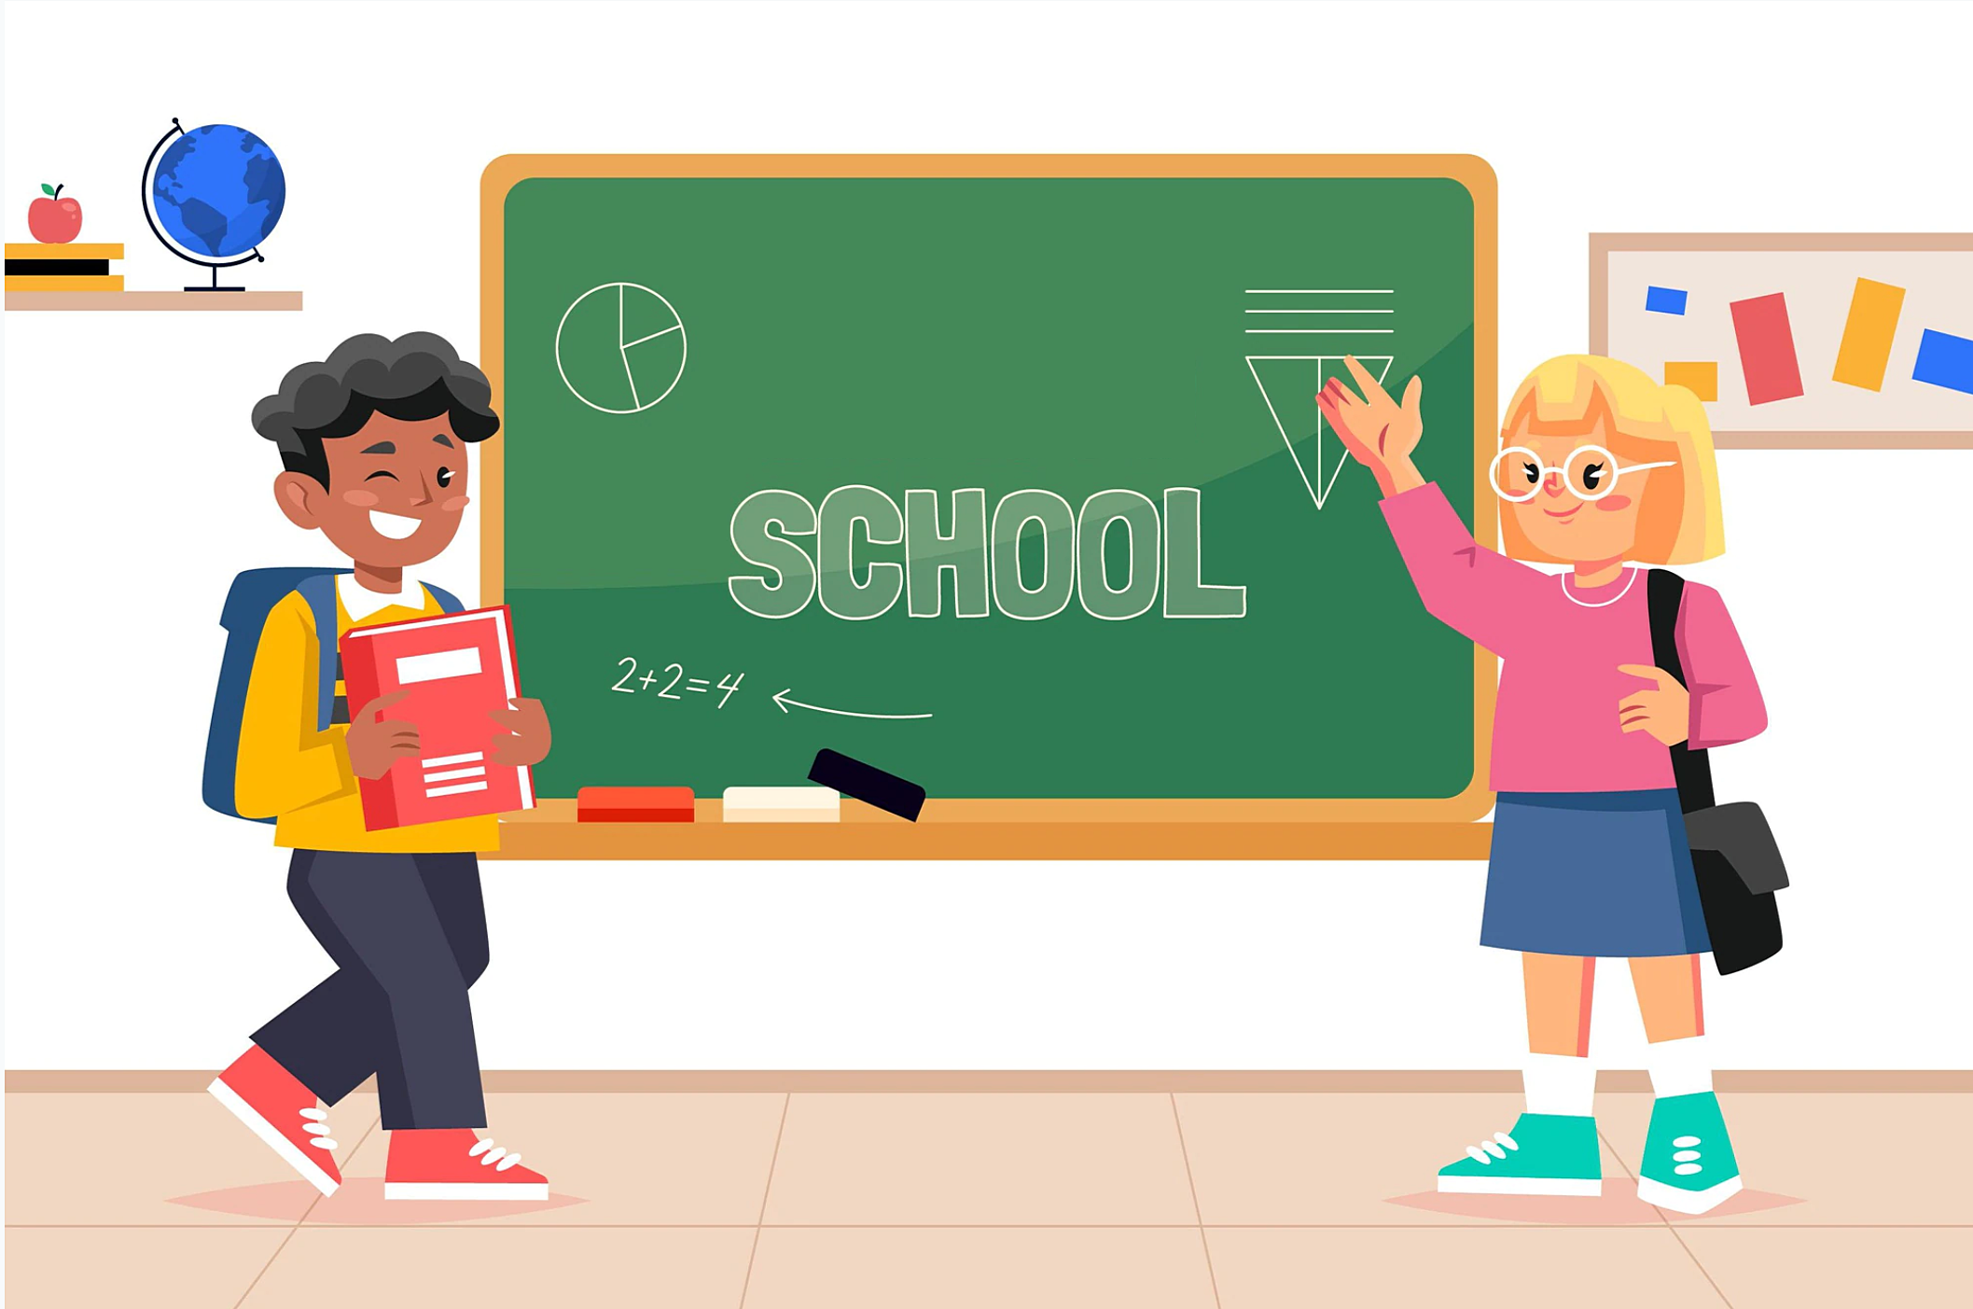
Unit 3
Lesson 1
Teacher: Nguyễn Nhật Anh
Tiếng Anh 3 – I learn smart start

Slide 2
Content
1. Warm Up
3. Sentence
2. Vocabulary
4. Speaking

Slide 3
Warm Up

Slide 5
Vocabulary

Slide 7
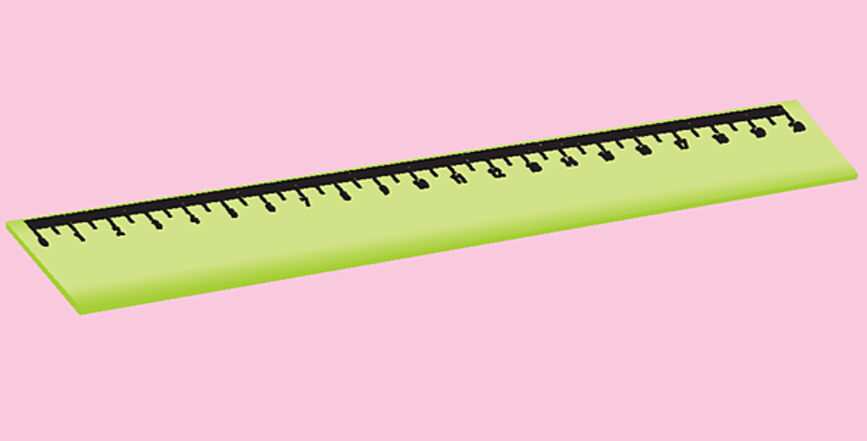

Slide 10
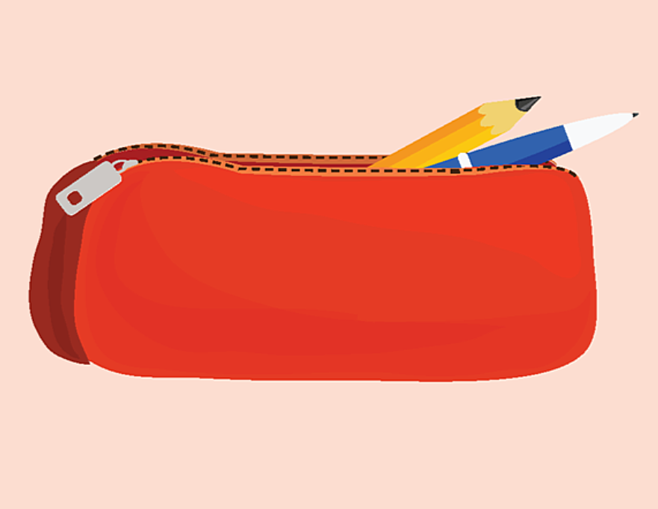

Slide 12
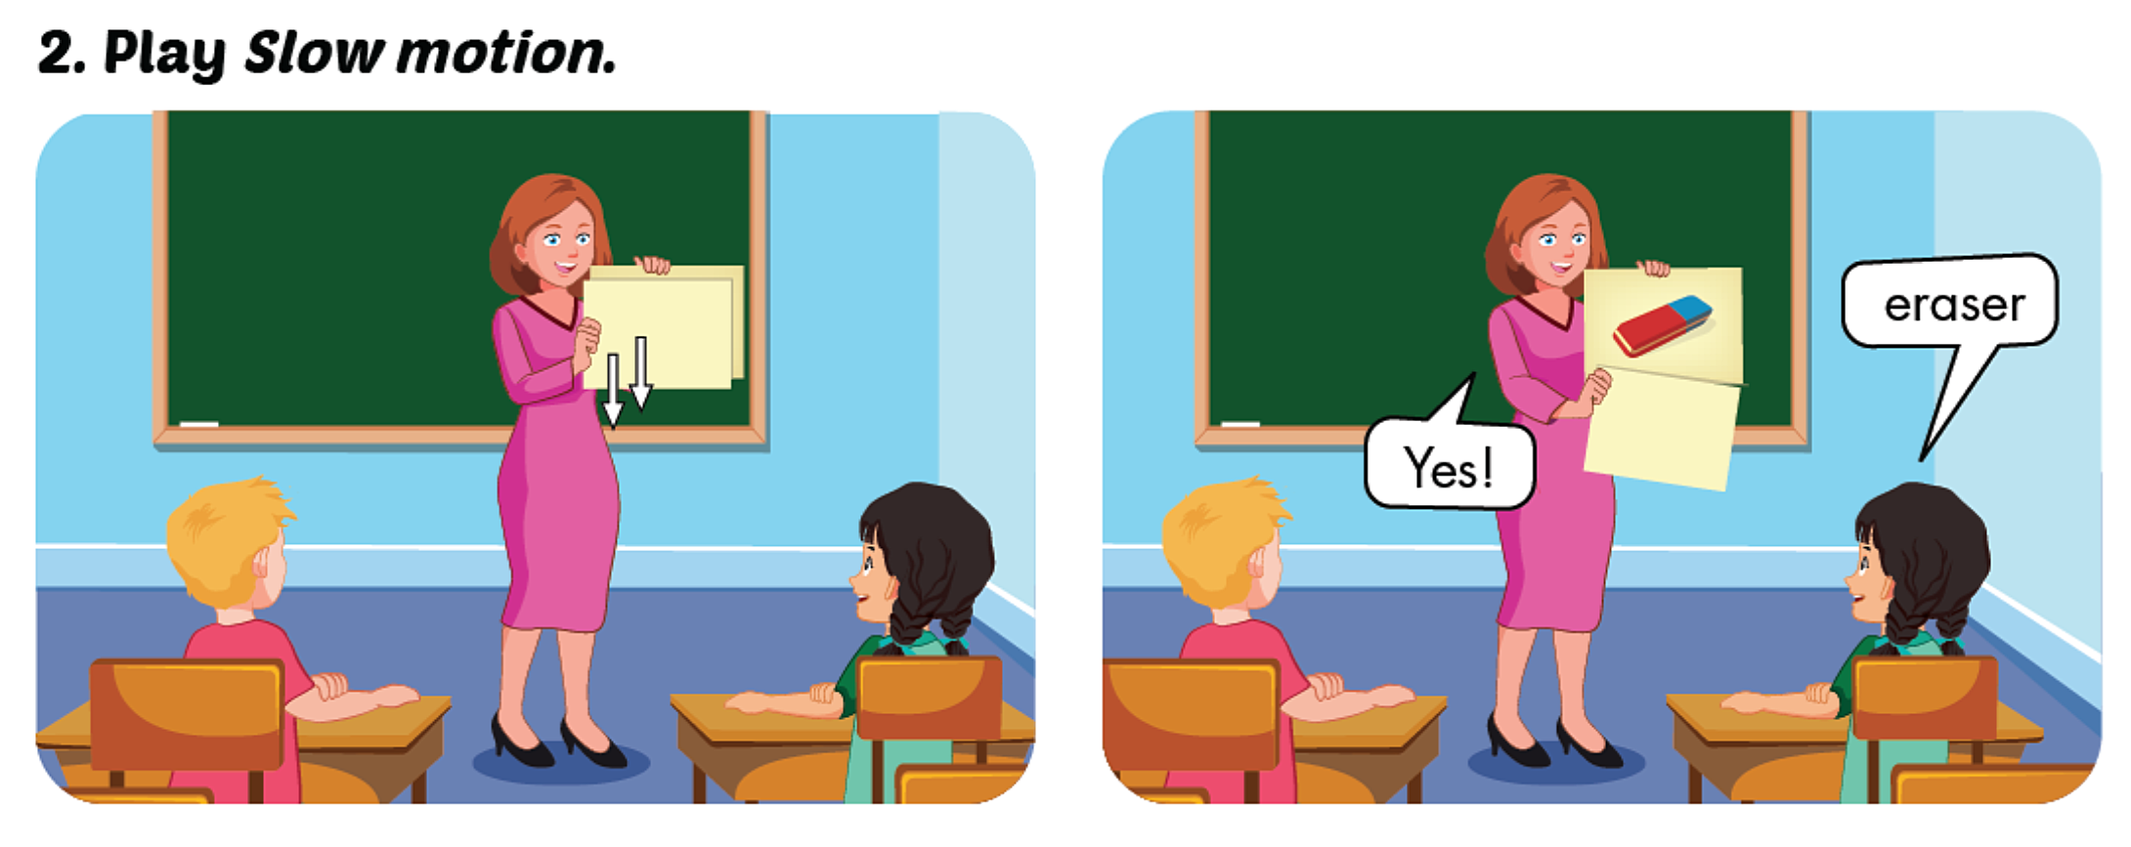

Slide 13
Review
Game

Slide 15
What is it ?
?
?
?
?
?
?
A pencil!
answer

Slide 16
What is it ?
?
?
?
?
?
?
A ruler!
answer

Slide 17
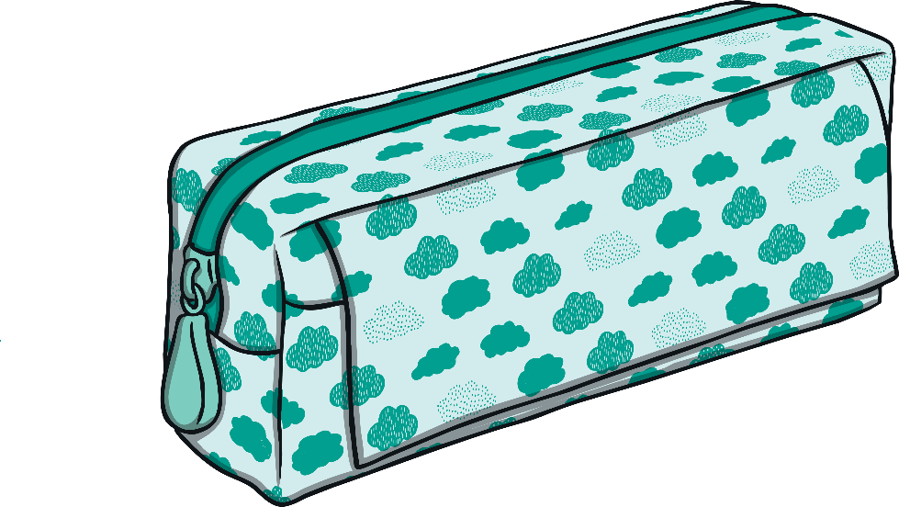
What is it ?
?
?
?
?
?
?
A pencil case!
answer

Slide 18
What is it ?
?
?
?
?
?
?
An eraser!
answer

Slide 19
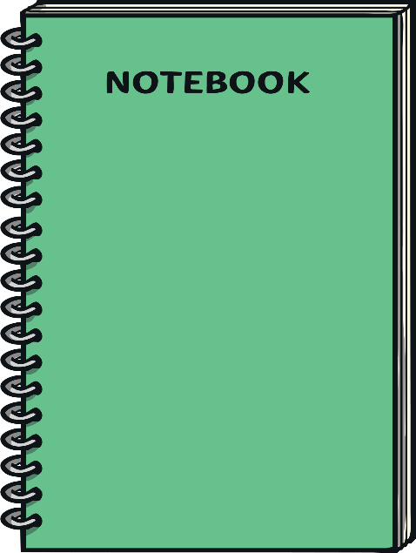
What is it ?
?
?
?
?
?
?
notebook
answer

Slide 21
Sentence

Slide 22
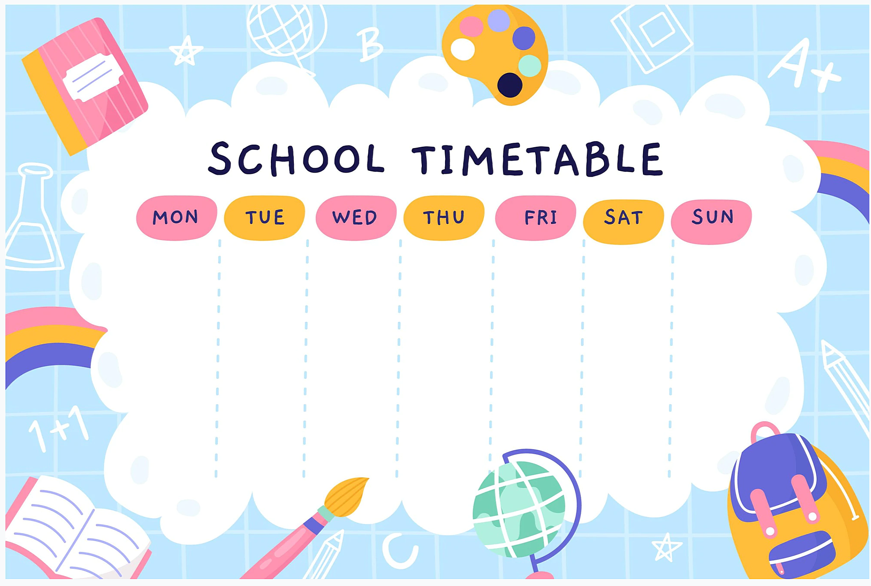

Slide 23
Is this/that your + N (singular) ?
Yes, it is/ No, it isn’t
Example:
Is this your ruler ?
Yes, it is.
Is that your ruler ?
No, it isn’t.

Slide 24
Are these/those your + N (plural) ?
Yes, they are/ No, they aren’t.
Are these your pencils ?
Example:
Yes, they are.
Are those your notebooks ?
No, they aren’t.

Slide 25
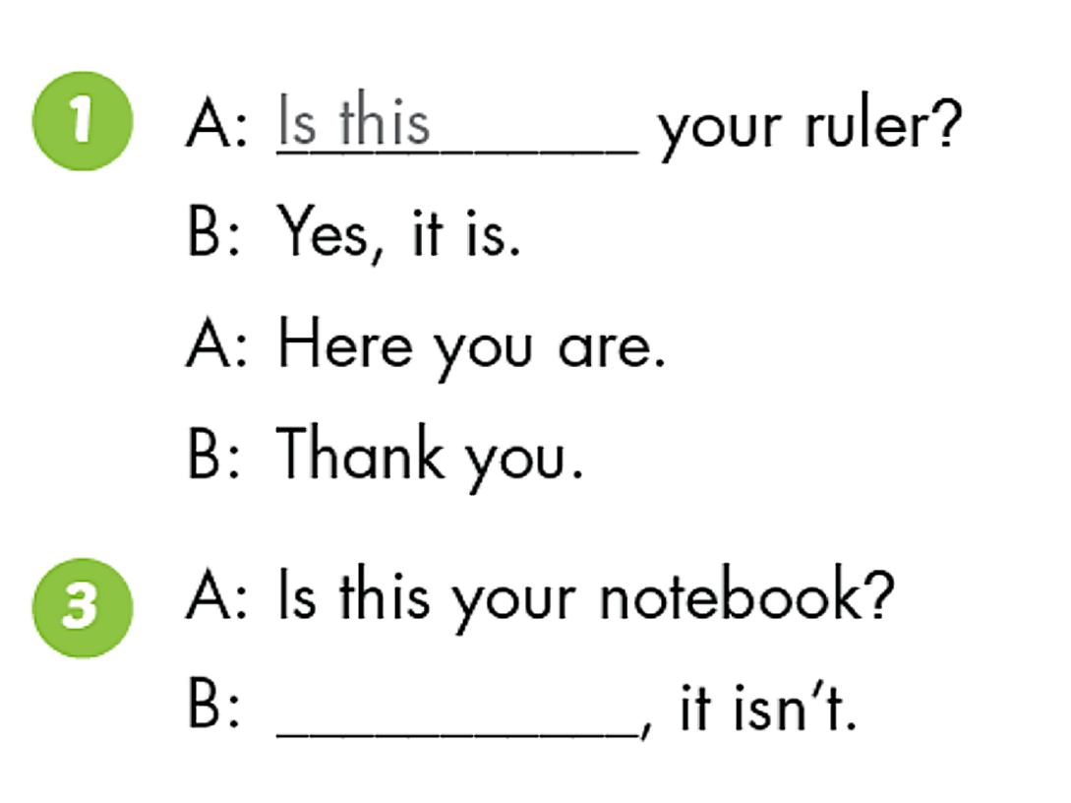
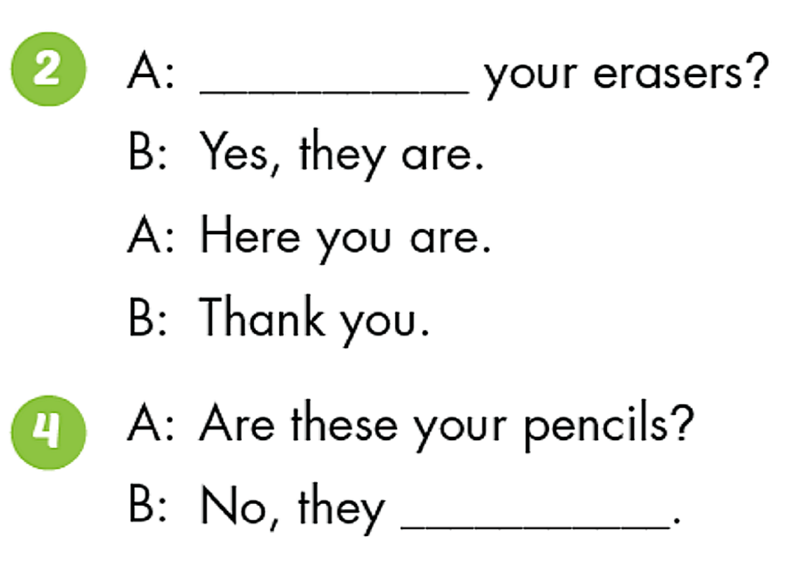
Are these
No
aren’t

Slide 26
Quiz

Slide 27
Grammar
Quiz

Slide 28
Is this your pencil ?
Yes, it is.
No, it isn’t.

Slide 29
Is that your ruler ?
Yes, it is.
No, it isn’t.

Slide 30
Are these your pencil case ?
No, they aren’t.
Yes, they are.
Yes, it is.

Slide 31
Are those your books?
No, it isn’t.
Yes, they are
No, they aren’t.

Slide 32
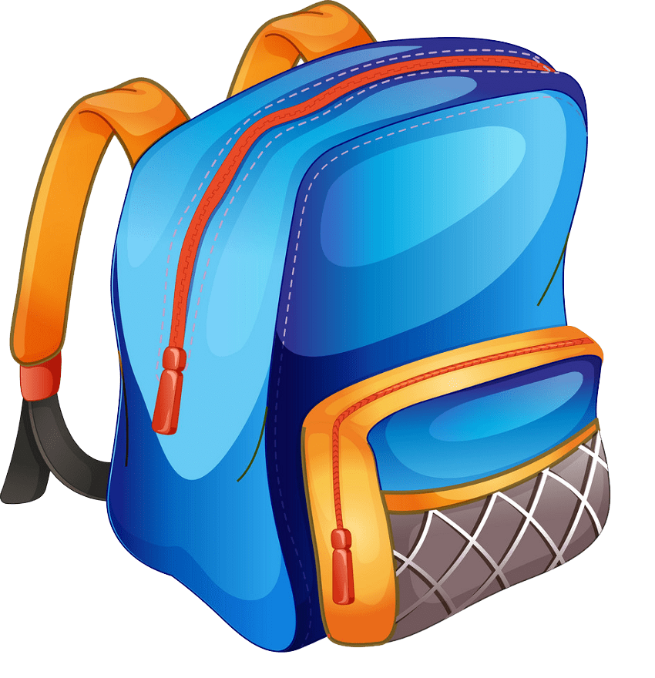
Is ….your notebook ? No, it isn’t.
this
that
those

Slide 33
Is ….your pencil ? Yes, it is.
these
this
that

Slide 34
Are ….your erasers ? No, they aren’t.
this
those
these

Slide 35
Are ….your erasers ? No, they aren’t.
these
those
that

Slide 36
……. these your rulers ?
No, they ………
Are- aren’t
Is-isn’t
Are-isn’t

Slide 37
……. this your bag ?
Yes, it ………
Is-isn’t
Is-are
Is-is

Slide 38
Good Job

Slide 39
Sounds

Slide 40
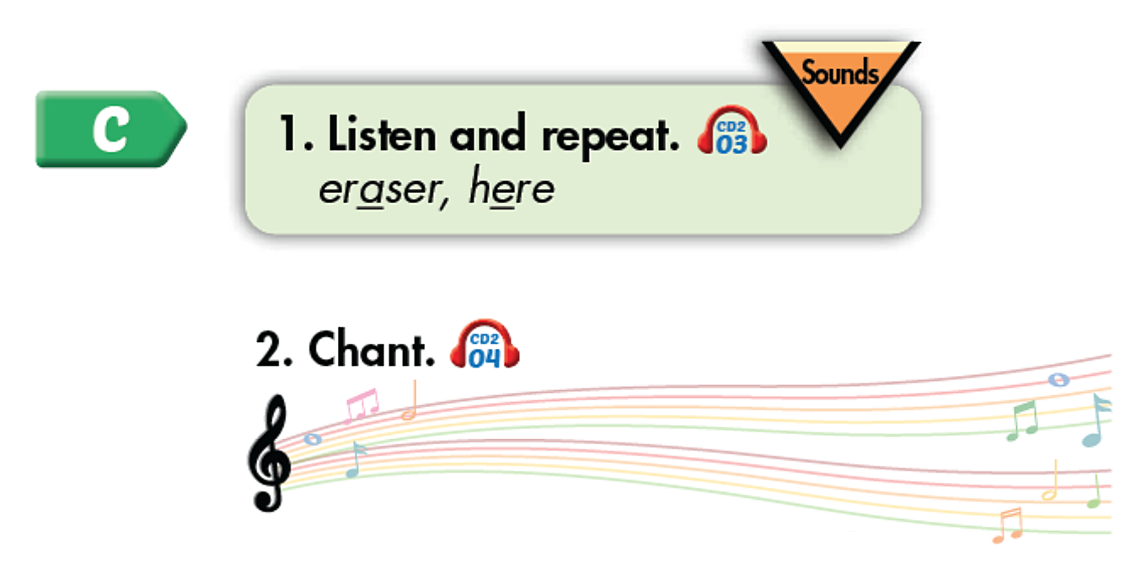

Slide 41
Story

Slide 42
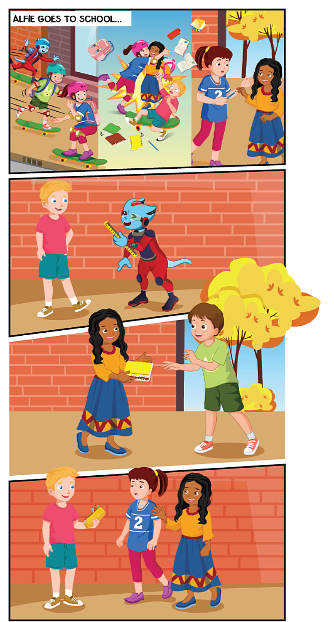

Slide 43
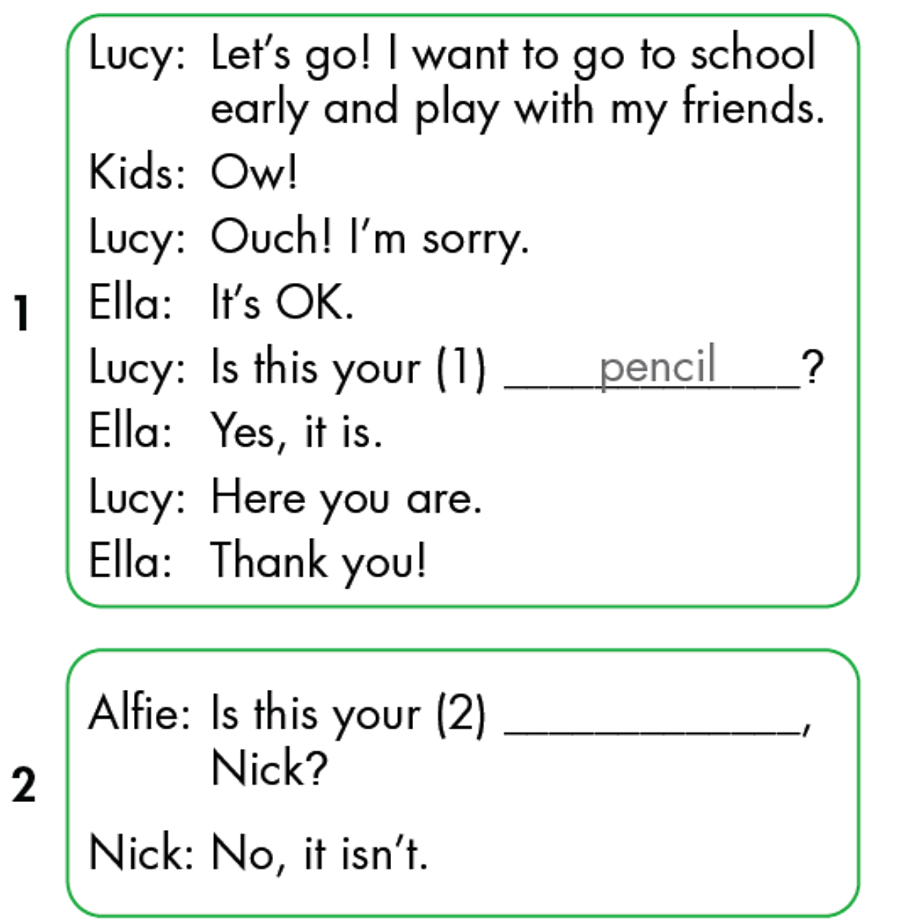
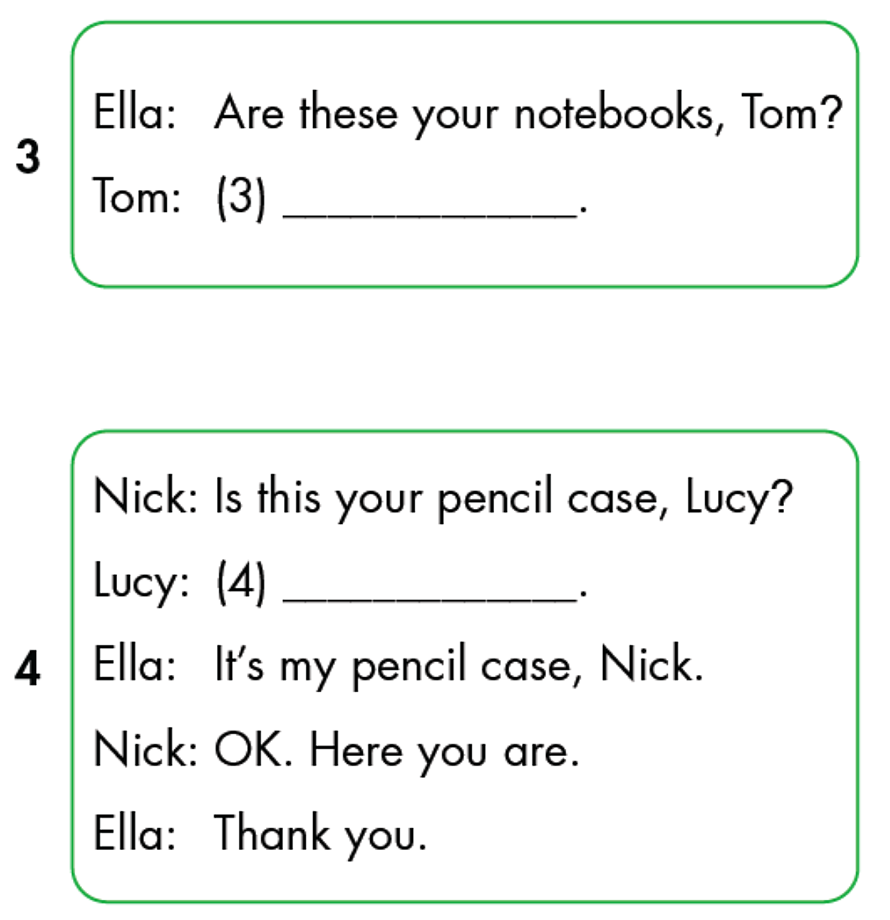
Yes, they are.
No, it isn’t
ruler

Slide 45
Speaking

Slide 47
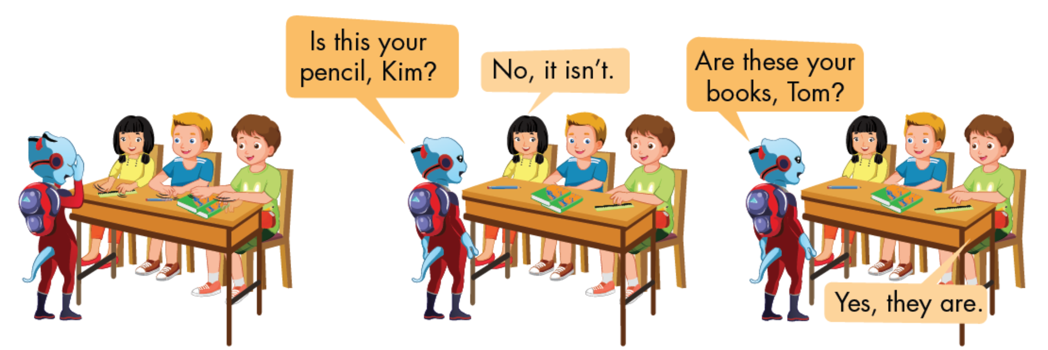

Slide 48
Good Bye

