Slide 1

Unit 2: Holidays
Lesson 3.1
Page 26

Slide 2
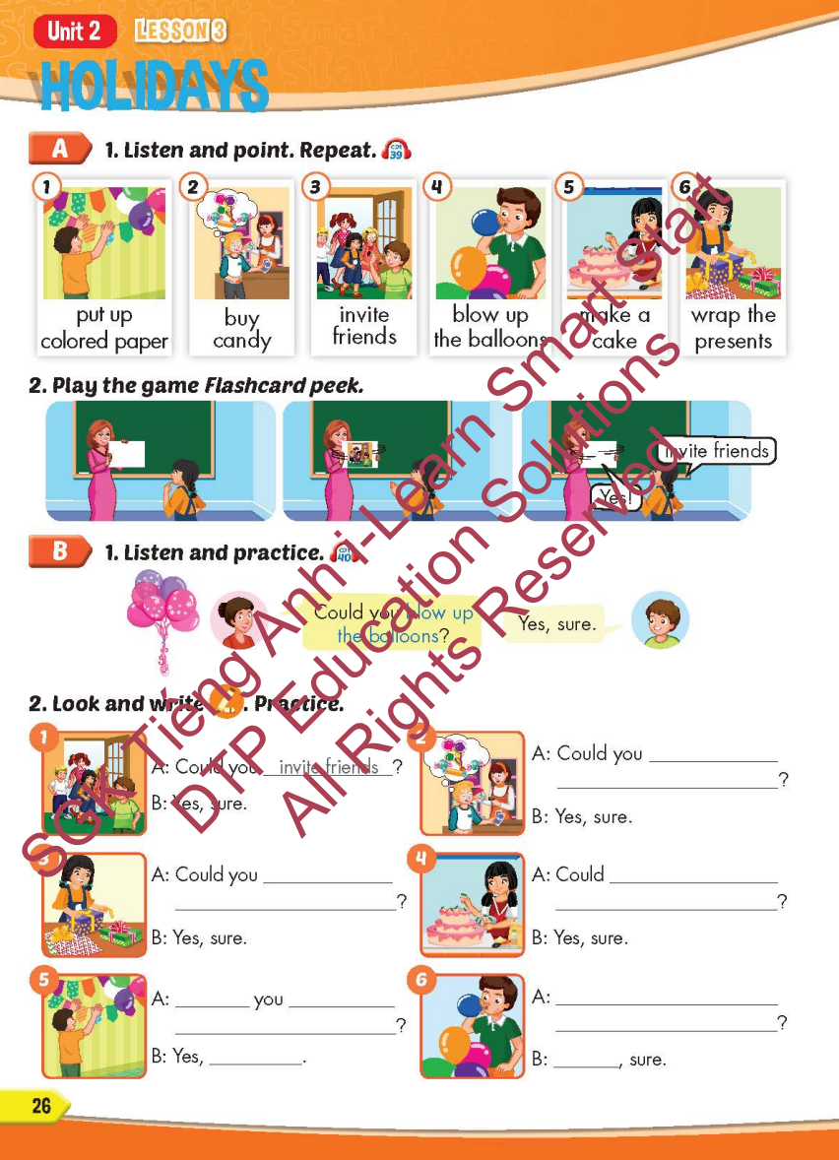
Lesson Outline
Warm-up
Vocabulary
Structure
Consolidation
Wrap-up

Slide 3
Objectives
By the end of this lesson, students will be able to…
Vocabulary: Pronounce and use the words related to the topic properly: put up colored paper, buy candy, invite friends, blow up the balloons, make a cake, wrap the presents.
Structure: Could you blow up the balloons? - Yes, sure.

Slide 4

WARM-UP

Slide 5

Colored papers
YES
NO

Slide 6

balloons
YES
NO

Slide 7

papers
YES
NO

Slide 8

candy
YES
NO

Slide 9

presents
YES
NO

Slide 10
balloons
YES
NO

Slide 11

cake
YES
NO

Slide 12

It’s time to learn …

Slide 13

New words
put up colored paper,
buy candy, invite friends,
blow up the balloons,
make a cake,
wrap the presents.

Slide 14

Presentation

Slide 15

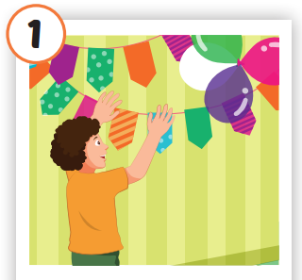
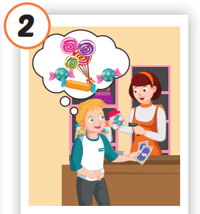
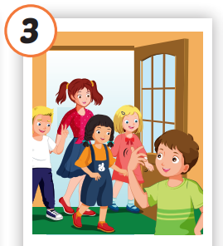
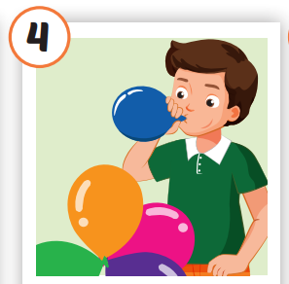
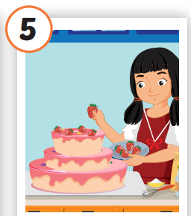
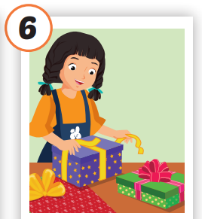






/pʊt ʌp
ˈkʌlərd ˈpeɪpər/
treo giấy màu
/baɪ ˈkændi/
mua kẹo
/ɪnˈvaɪt
frendz/
mời bạn bè
/bloʊ ʌp ðə bəˈluːnz/
thổi bóng bay
/meɪk ə keɪk/
làm bánh
/ræp ðə ˈprezənts/
gói quà
Notes:
Click vào hình A. 1. Listen and point. Repeat để cho cả audio full chạy

Slide 16
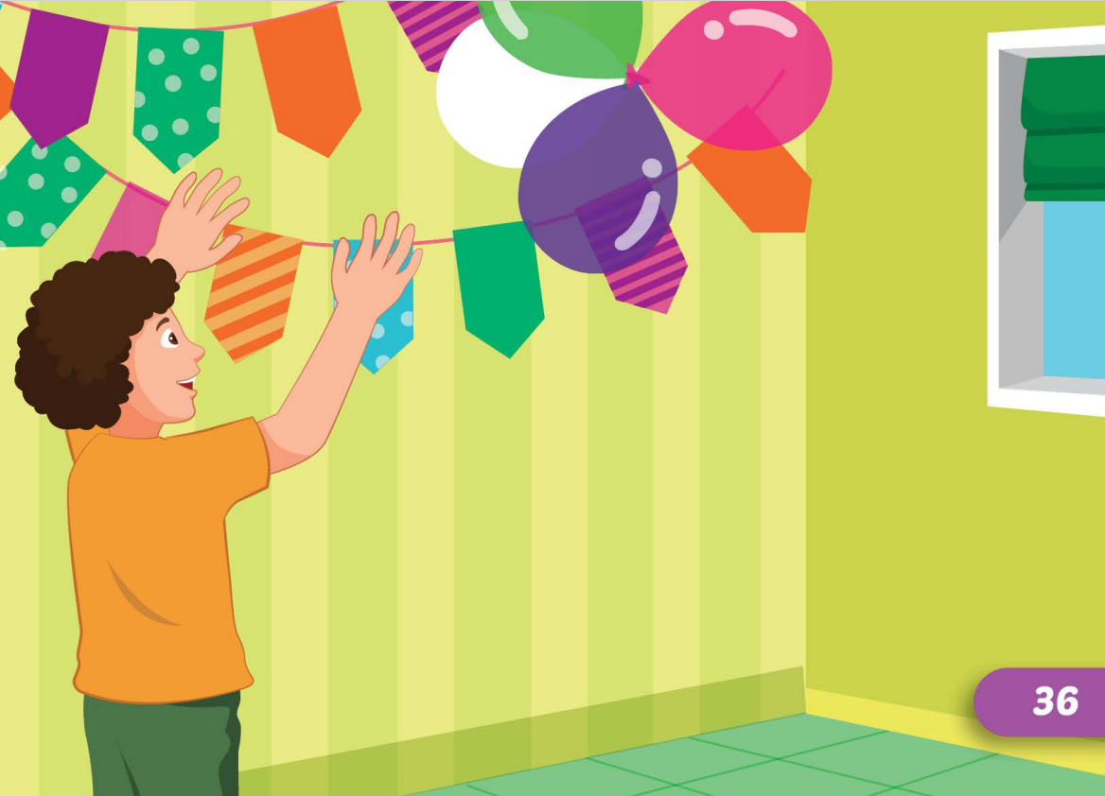
/pʊt ʌp
ˈkʌlərd ˈpeɪpər/
treo giấy màu

Slide 17
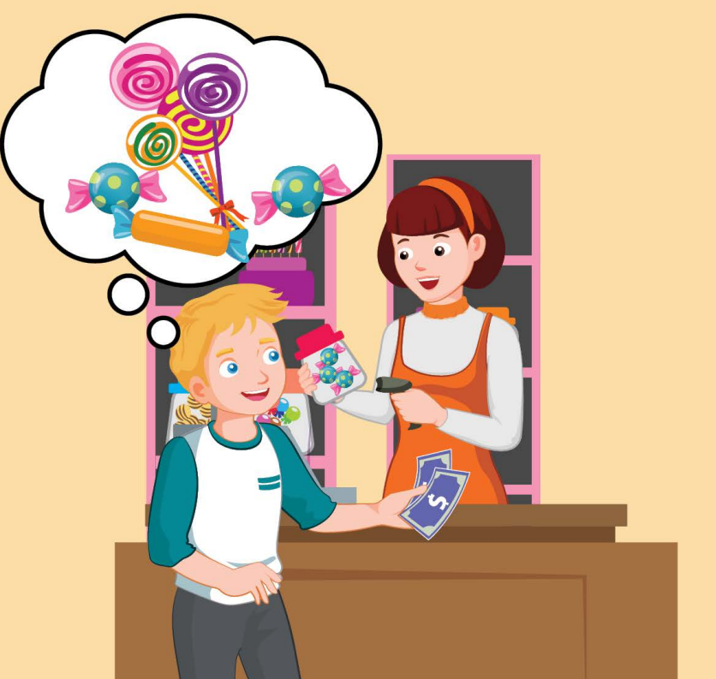

/baɪ ˈkændi/
mua kẹo

Slide 18
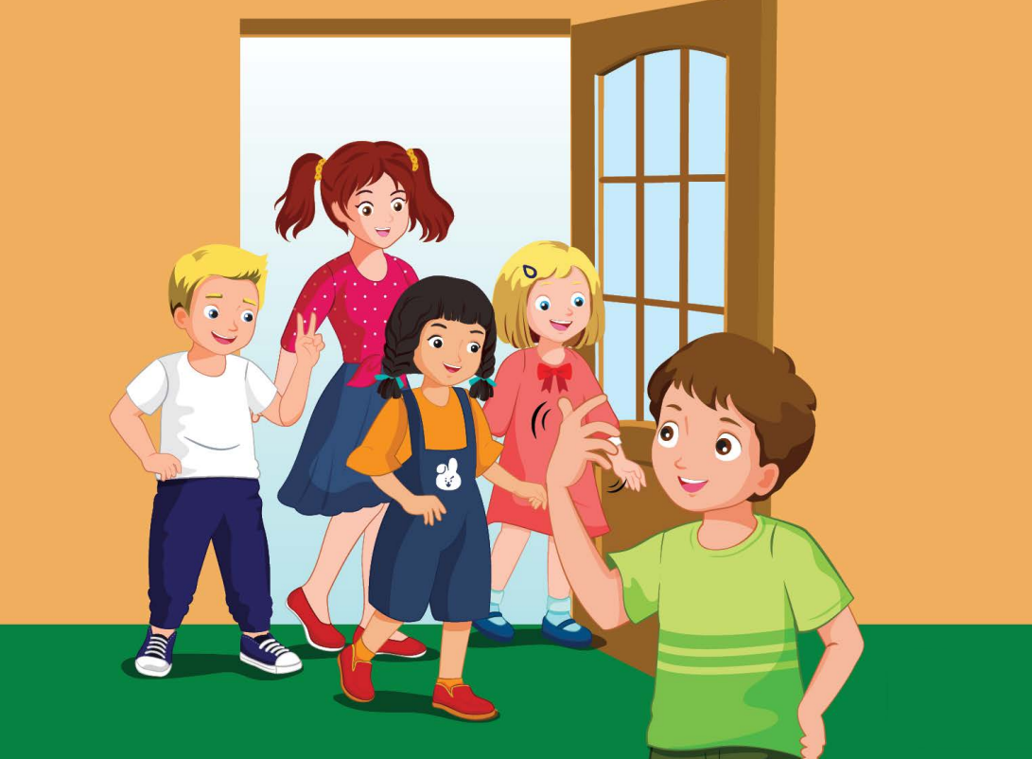
/ɪnˈvaɪt
frendz/
mời bạn bè

Slide 19
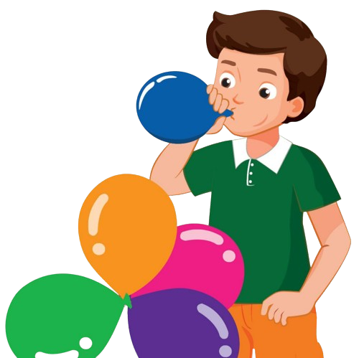
/bloʊ ʌp ðə bəˈluːnz/
thổi bóng bay

Slide 20
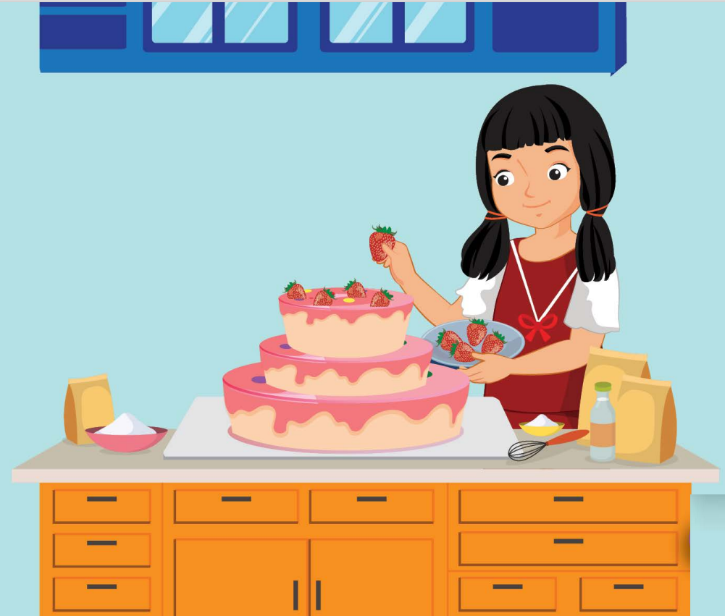

/meɪk ə keɪk/
làm bánh

Slide 21
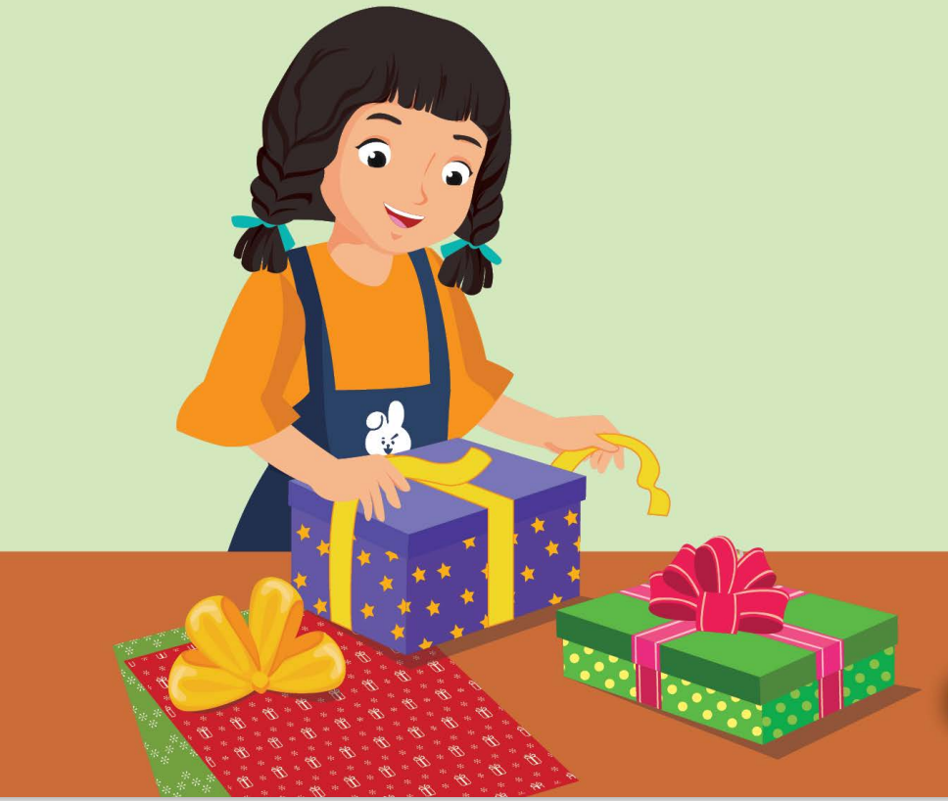
/ræp ðə ˈprezənts/
gói quà

Slide 22
Practice

Slide 23
CHECK YOUR MEMORY

Slide 24

FLASH NOTE
Look and choose

Slide 25

Click on the correct option.
put up colored paper
buy candy
make a cake
wrap the presents

Slide 26

Click on the correct option.
buy candy
make a cake
blow up the balloons
wrap the presents

Slide 27

Click on the correct option.
blow up the balloons
buy candy
make a cake
invite friends

Slide 28

Click on the correct option.
buy candy
make a cake
invite friends
wrap the presents

Slide 29
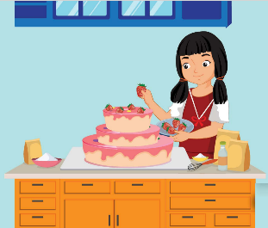
Click on the correct option.
make a cake
buy candy
wrap the presents
invite friends

Slide 30
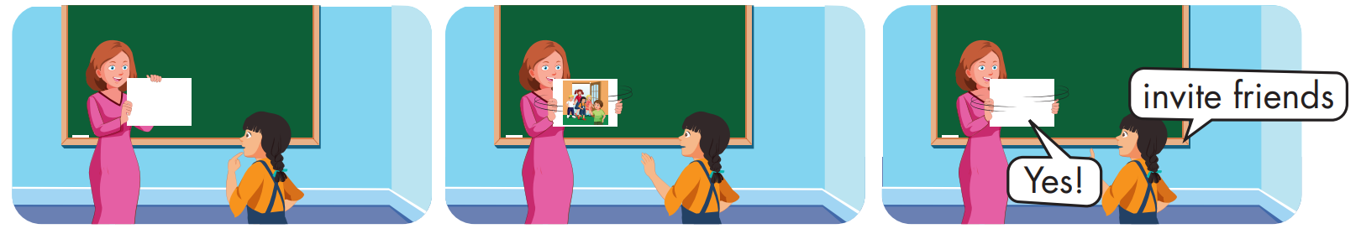

Slide 31
Structure
Could you blow up the balloons?
- Yes, sure.

Slide 32
Presentation

Slide 33
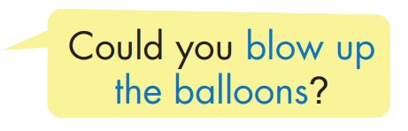


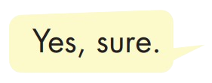
Structure

Slide 34

Practice

Slide 35


Slide 36
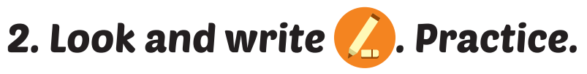
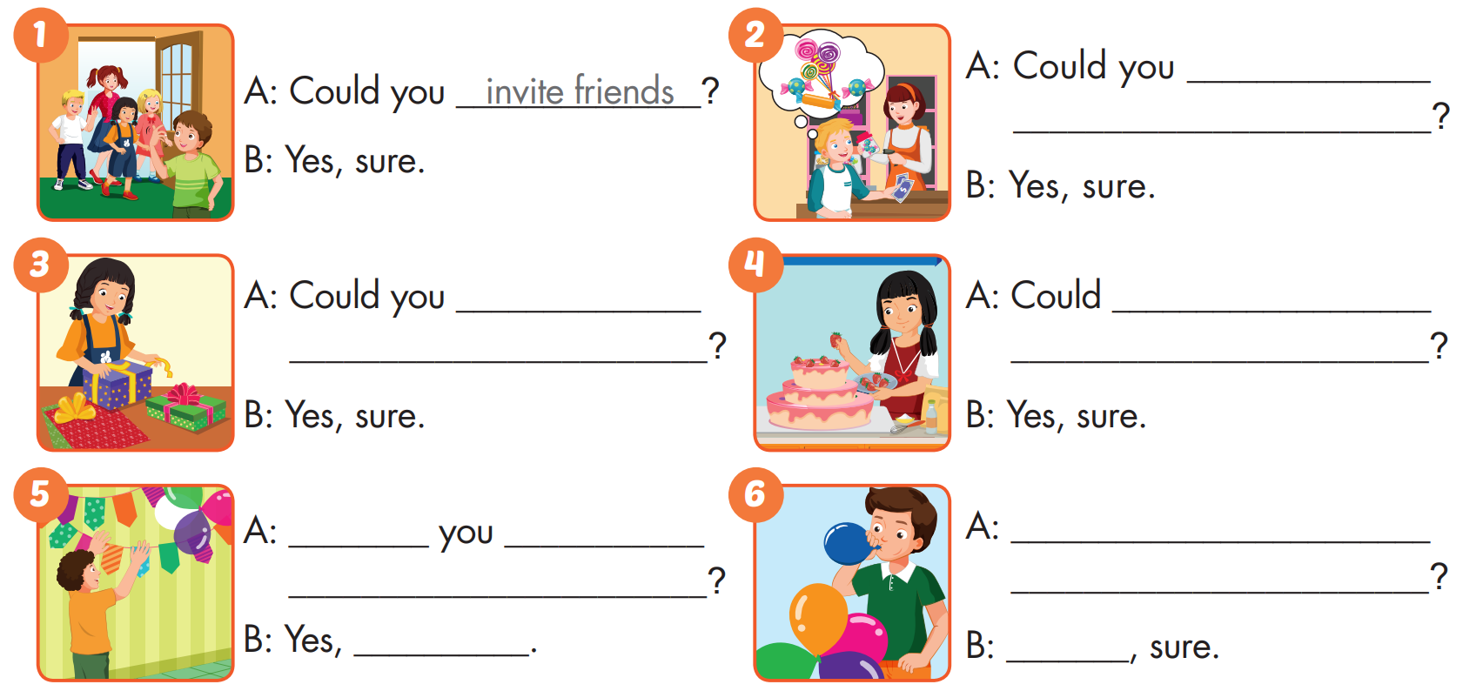
buy
candy
wrap
the presents
you make
a cake
Could
put up
Could you blow up
colored paper
the balloons
sure
Yes

Slide 37

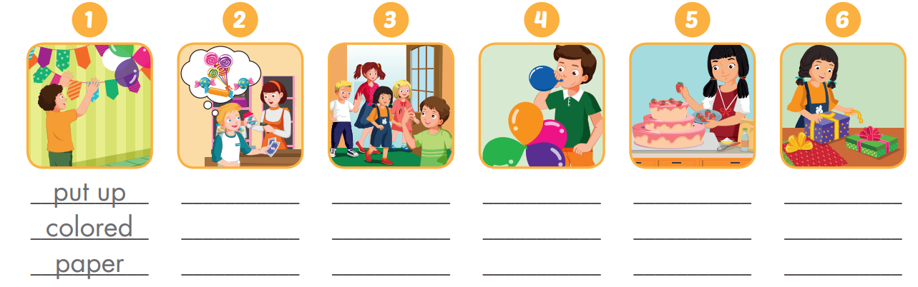
Extra Practice
WB, page 16
buy candy
invite
friends
blow up the balloons
make a cake
wrap the presents

Slide 38

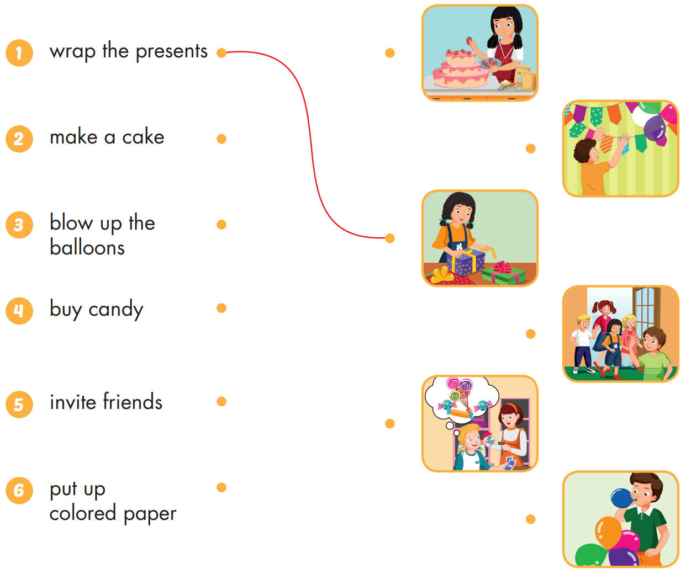
Extra Practice
WB, page 16

Slide 39

Production

Slide 40

CONSOLIDATION

Slide 41
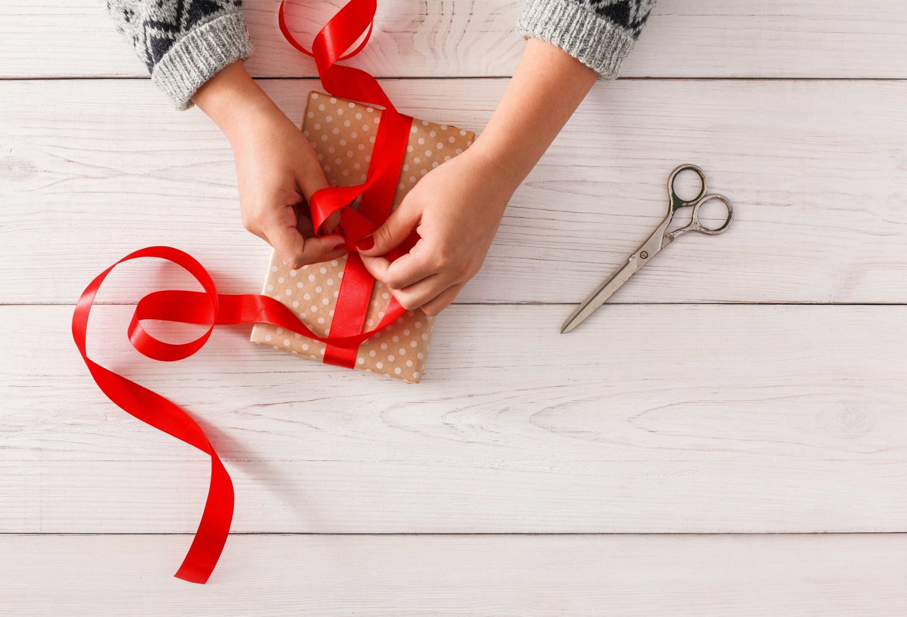
WRAP-UP

Slide 42
Today’s lesson
Vocabularies
put up colored paper, buy candy, invite friends, blow up the balloons, make a cake, wrap the presents.
Structures/ Sentence patterns
Could you blow up the balloons? - Yes, sure.

Slide 43
Homework
Practice the vocabularies and structure, and make sentences using them.
Do the exercises in Tiếng Anh 5 i-Learn Smart Start WB (page 16)
Do the exercises in Tiếng Anh 5 i-Learn Smart Start Notebook (page12)
Prepare the next lesson (page 27 SB)
Play the consolidation games in Tiếng Anh 5 i-Learn Smart Start DHA App on www.eduhome.com.vn

Slide 44

Enjoy your day!

Slide 45

Lesson 3
Stay positive and have a nice day!

