Slide 1

Unit 7: Toys
Lesson 3.1
Page 102

Slide 2
Objectives
By the end of this lesson, students will be able to…
Vocabulary: Pronounce and use the words related to the topic properly: under, on, in, toy box, wardrobe
Structure: Instruct someone to put an item somewhere else by using:
Put the ball on the chair.

Slide 3

WARM UP

Slide 4









GAME WITH
DOREAMON
Start
Notes:
Thanh Yến Trần 0967 255 149 zalo/ FB https://www.facebook.com/thanhyentrananhngutaymy/

Slide 5



Trò chơi gồm 4 câu hỏi trắc nghiệm
Ở mỗi câu hỏi, các em sẽ có thời gian 10 giây
để đưa ra đáp án.
Để trả lời, em sẽ giơ thẻ màu tương ứng với
màu đáp án:
Cam
Xanh
dương
Xanh
lá
Đỏ
Các em có thời gian 1 phút để chuẩn bị các thẻ màu nhé!
Notes:
Thanh Yến Trần 0967 255 149 zalo/ FB https://www.facebook.com/thanhyentrananhngutaymy/

Slide 6








Yeahhh,
That’s right!
Huhu,
That is wrong.
Try your best
How many dolls?
Seven dolls.
Ten dolls.
Eight dolls.
Nine dolls.
Notes:
Thanh Yến Trần 0967 255 149 zalo/ FB https://www.facebook.com/thanhyentrananhngutaymy/

Slide 7



Yeahhh,
That’s right!
Huhu,
That is wrong.
Try your best
.
How many robots?
Eight robots.
Nine robots.
Six robot.
Ten robots.

Slide 8


Yeahhh,
That’s right
Huhu,
That is wrong.
Try your best
How many dice?
Seven dice.
Ten dice.
Nine dice.
Eight dice.

Slide 9


Yeahhh,
That’s right
Huhu,
That is wrong.
Try your best
How many cars?
Five cars.
Seven cars.
Six cars.
Eight cars.

Slide 10





GAME WITH
DOREAMON
THANKS
SO MUCH!

Slide 11

It’s time to learn …

Slide 12
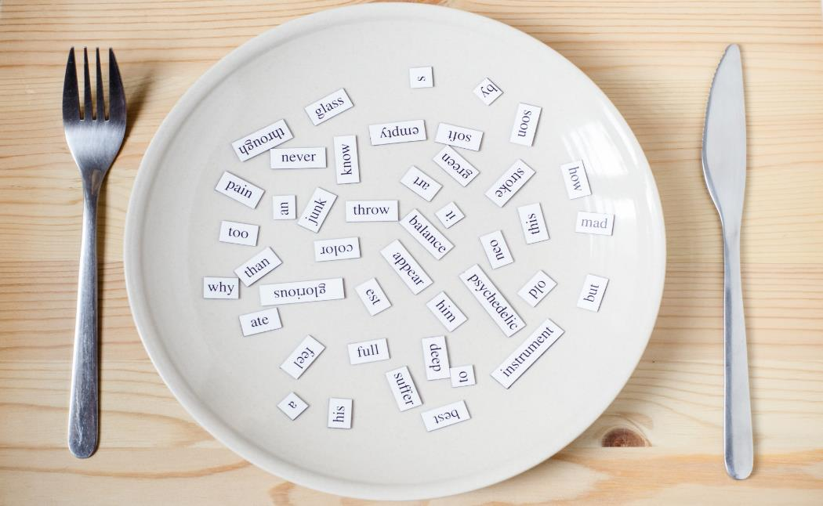
New words
under,
on,
in,
toy box,
wardrobe

Slide 13

Presentation

Slide 14

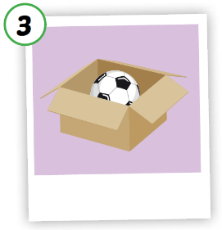
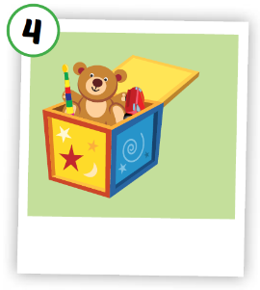
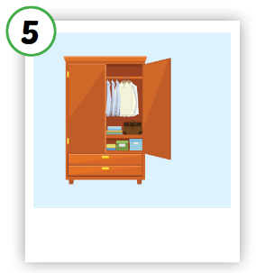
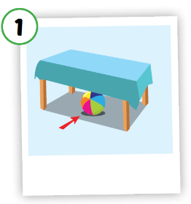
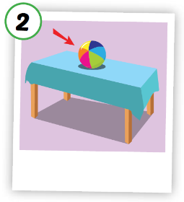





Click A to hear the sound
Notes:
Click vào hình A. 1. Listen and point. Repeat để cho cả audio full chạy

Slide 15
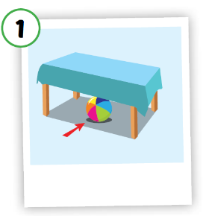




Click on each picture to hear the sound.
/ˈwɔːrdrəʊb/
tủ đồ,
tủ quần áo
/ˈʌndər/
ở dưới
/ɑːn/
ở trên
/ɪn/
ở trong
/tɔɪ bɑːks/
hộp đồ chơi
Notes:
Click vào hình A. 1. Listen and point. Repeat để cho cả audio full chạy

Slide 16

Click on each picture to hear the sound.
/ˈʌndər/
ở dưới
Notes:
Click vào hình A. 1. Listen and point. Repeat để cho cả audio full chạy

Slide 17

Click on each picture to hear the sound.
/ɑːn/
ở trên
Notes:
Click vào hình A. 1. Listen and point. Repeat để cho cả audio full chạy

Slide 18

Click on each picture to hear the sound.
/ɪn/
ở trong
Notes:
Click vào hình A. 1. Listen and point. Repeat để cho cả audio full chạy

Slide 19

Click on each picture to hear the sound.
/tɔɪ bɑːks/
hộp đồ chơi
Notes:
Click vào hình A. 1. Listen and point. Repeat để cho cả audio full chạy

Slide 20

Click on each picture to hear the sound.
/ˈwɔːrdrəʊb/
tủ đồ,
tủ quần áo
Notes:
Click vào hình A. 1. Listen and point. Repeat để cho cả audio full chạy

Slide 21

Practice

Slide 22
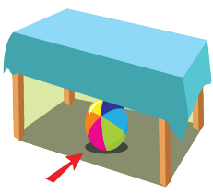
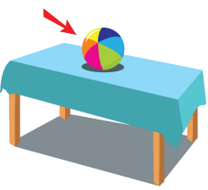









1
2
3
4
5
a
b
c
d
e

Slide 23

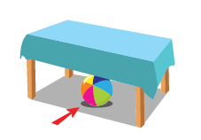

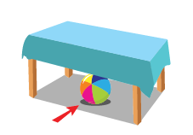
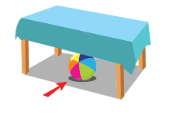
Extra Practice
WB, P. 72
1
in

Slide 24


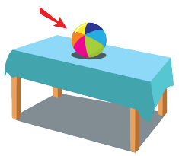
Extra Practice
WB, P. 72
2
wardrobe

Slide 25

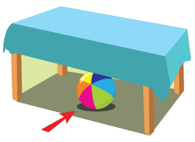
Extra Practice
WB, P. 72
3
under

Slide 26

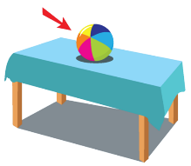
Extra Practice
WB, P. 72
4
on

Slide 27


Extra Practice
WB, P. 72
5
toy box

Slide 28
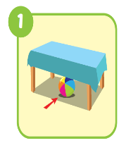
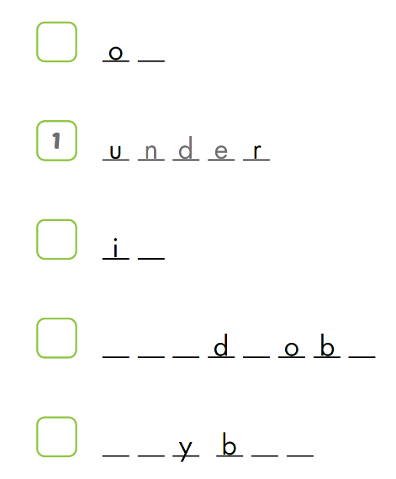

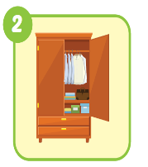
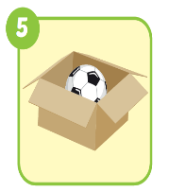
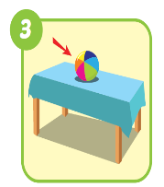
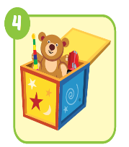
Extra Practice
WB, P. 72
n
n
w a r r e
t o o x

Slide 29
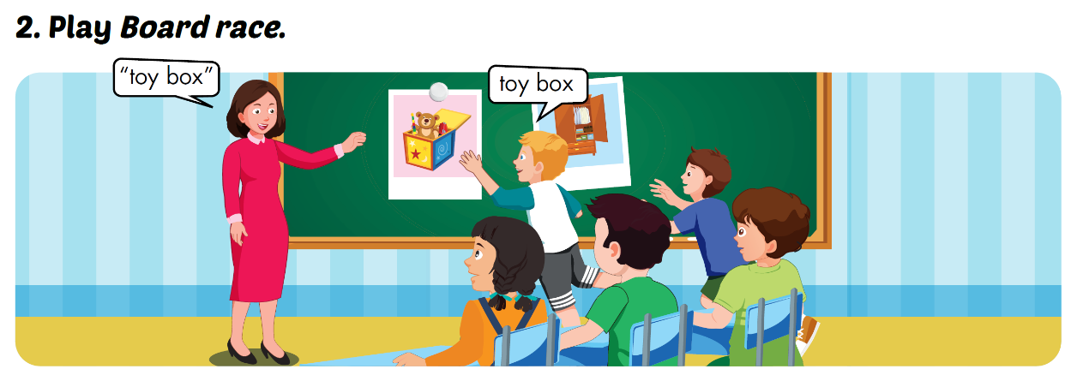

Slide 30
Structures
Put the ball on the chair.

Slide 31

Presentation

Slide 32




Click on each sentence to listen

Slide 33

Practice

Slide 34
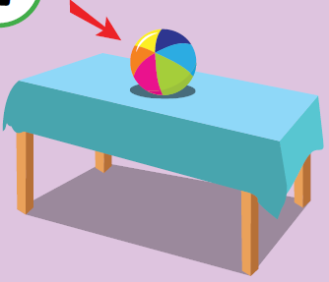
Put the ball on the table.
Practice

Slide 35

Put the ball in the box.
Practice

Slide 36

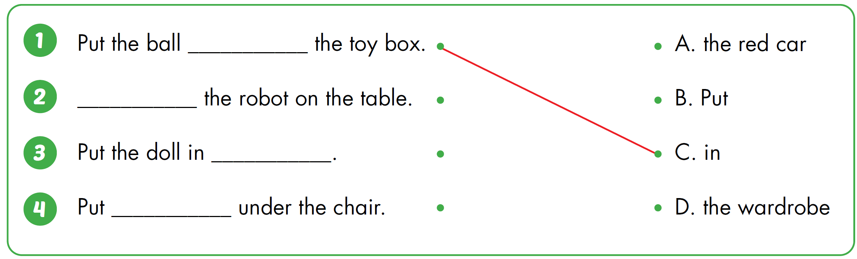




Slide 37

CONSOLIDATION

Slide 38
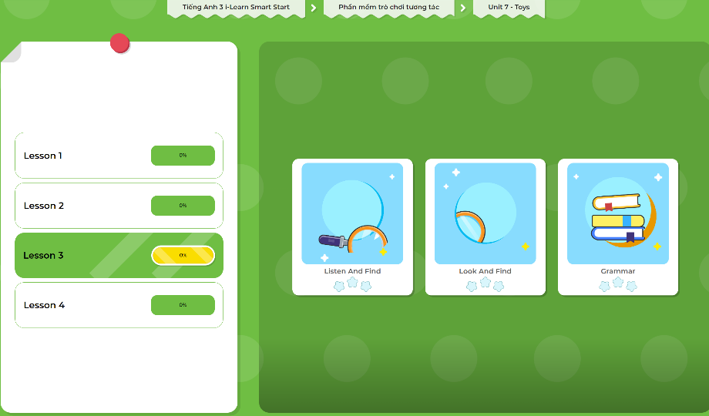
Extra Practice
DHA App
LET’S PLAY!
Click here to play the games

Slide 39

WRAP-UP

Slide 40
Today’s lesson
Vocabularies
under, on, in, toy box, wardrobe
Structures/ Sentence patterns
Put the ball on the chair.

Slide 41
Homework
Practice the vocabularies and structure; and make sentences using them.
Do the exercises in Tiếng Anh 3 i-Learn Smart Start WB (page 72)
Do the exercise in Tiếng Anh 3 i-Learn Smart Start DHA Notebook (page 48)
Prepare the next lesson (page 103 SB)
Play the consolidation games in Tiếng Anh 3 i-Learn Smart Start DHA App on www.eduhome.com.vn

Slide 42

Enjoy your day!

