Slide 1
UNIT 2 WHAT I CAN DO
LESSON 3. A,B

Slide 2
01
WARM UP

Slide 5
Y
Can she jump rope?
CHECK
Notes:
5

Slide 6
Can he run?
CHECK
Notes:
6

Slide 7
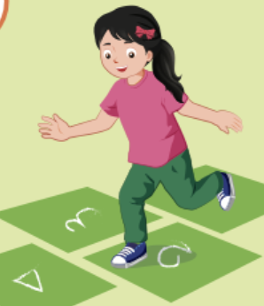
Can she hop?
CHECK
Notes:
7

Slide 8
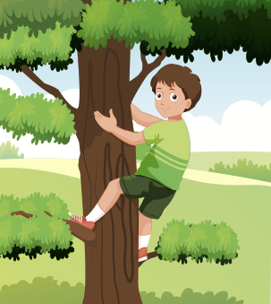
Y
Can he climb a tree?
CHECK
Notes:
8

Slide 9
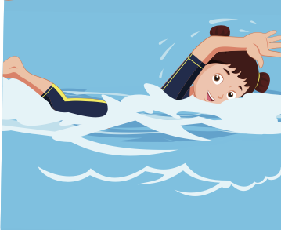
Y
Can she swim?
CHECK
Notes:
9

Slide 10
02 VOCABULARY

Slide 12
REVIEW VOCABULARY

Slide 13
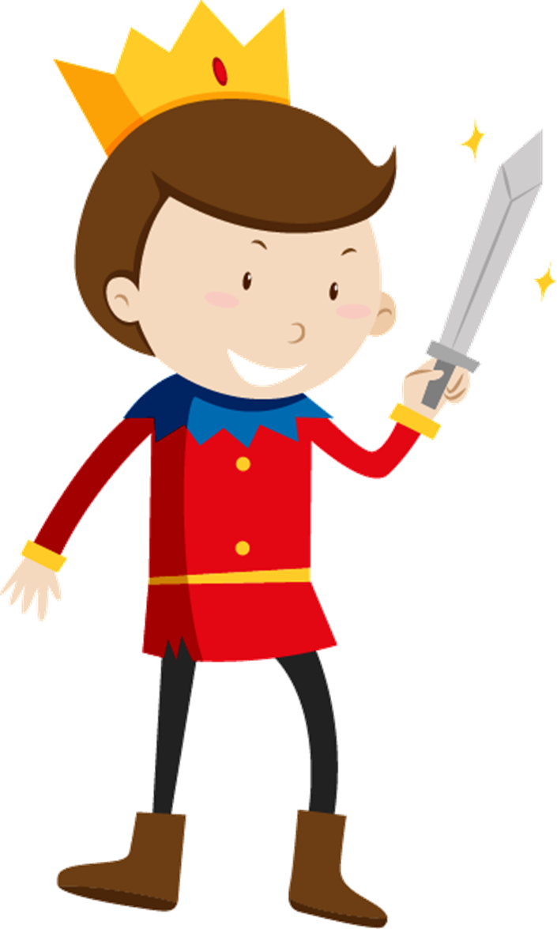
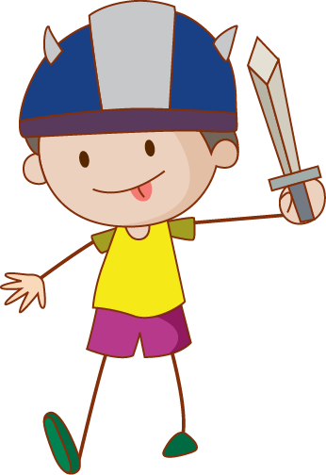
Children’s
acting team
Notes:
Thanh Yen Tran 0967 255 149 /081 811 4340 zalo / FB https://www.facebook.com/thanhyentrangiaoandientu

Slide 14
Notes:
Thanh Yen Tran 0967 255 149 /081 811 4340 zalo / FB https://www.facebook.com/thanhyentrangiaoandientu

Slide 15
Look and choose
A. play the piano
B. drive a car
C. play the guitar
D. ride a bike
Notes:
Thanh Yen Tran 0967 255 149 /081 811 4340 zalo / FB https://www.facebook.com/thanhyentrangiaoandientu

Slide 16
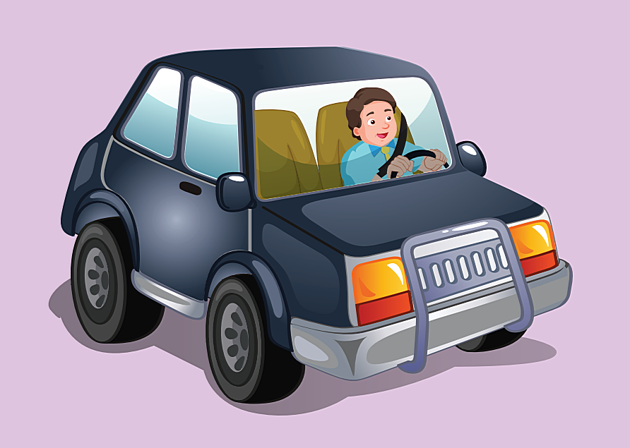
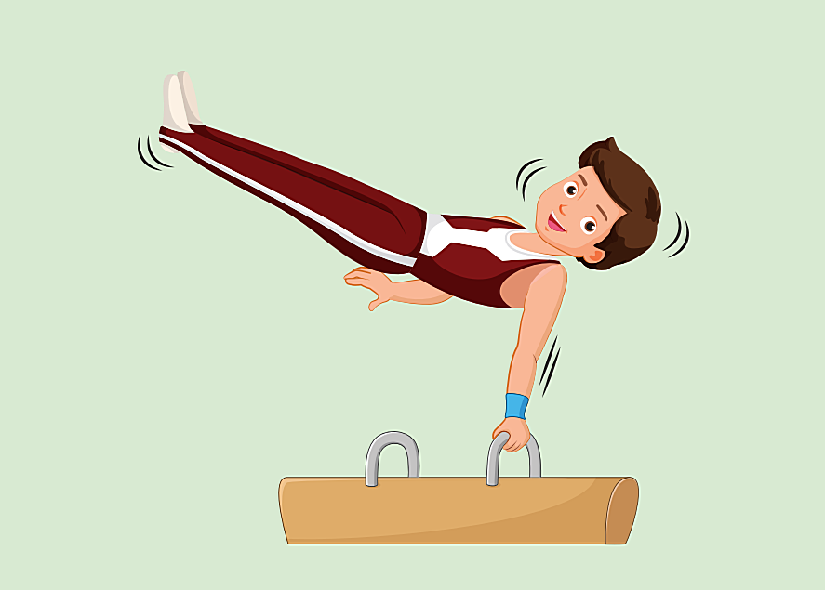
Choose the correct picture: play the piano
A.
B.
C.
D.
Notes:
Thanh Yen Tran 0967 255 149 /081 811 4340 zalo / FB https://www.facebook.com/thanhyentrangiaoandientu

Slide 17
Listen and choose the correct answer
A. drive a car
B. play the drums
C. ride a bike
D. do gymnastics
Notes:
Thanh Yen Tran 0967 255 149 /081 811 4340 zalo / FB https://www.facebook.com/thanhyentrangiaoandientu

Slide 18
Listen and choose the correct picture
A.
B.
C.
D.
Notes:
Thanh Yen Tran 0967 255 149 /081 811 4340 zalo / FB https://www.facebook.com/thanhyentrangiaoandientu

Slide 19
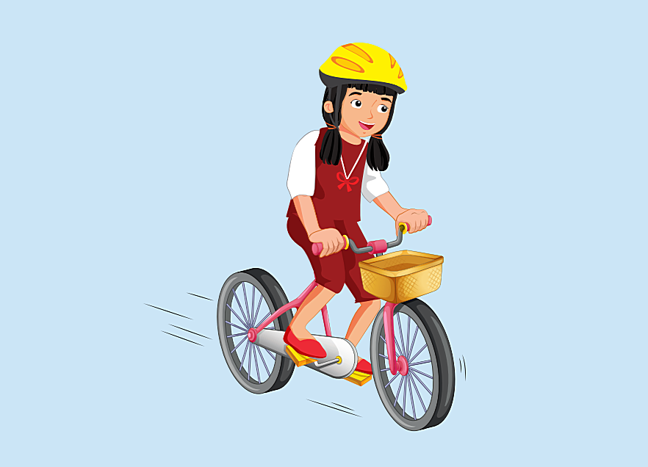
Look and choose the correct answer
A. do gymnastics
B. drive a car
C. play the drums
D. ride a bike
Notes:
Thanh Yen Tran 0967 255 149 /081 811 4340 zalo / FB https://www.facebook.com/thanhyentrangiaoandientu

Slide 20
O3 GRAMMAR

Slide 21
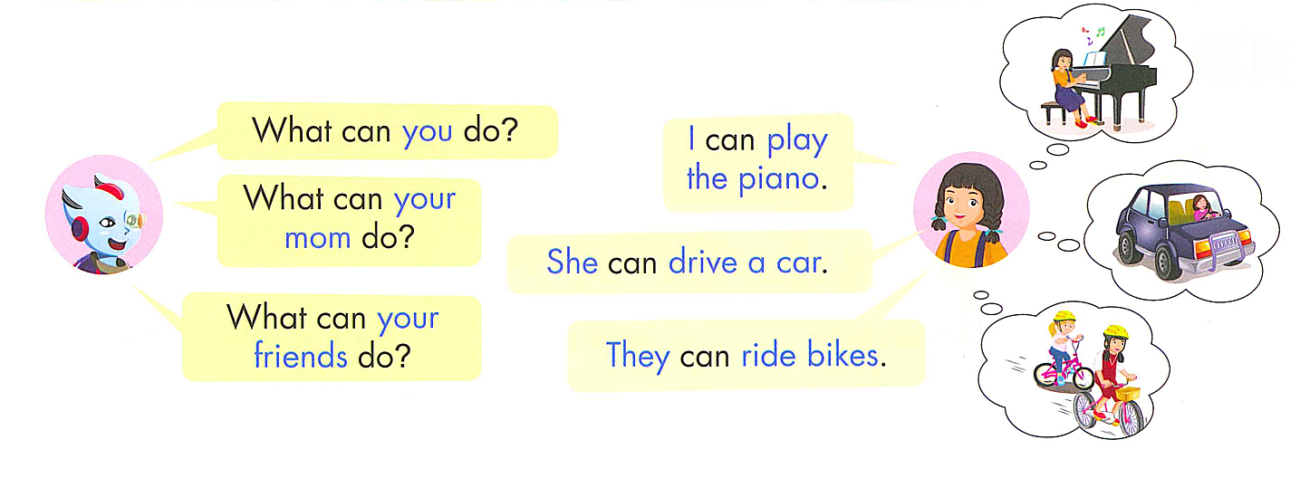

Slide 22
PRACTICE

Slide 23
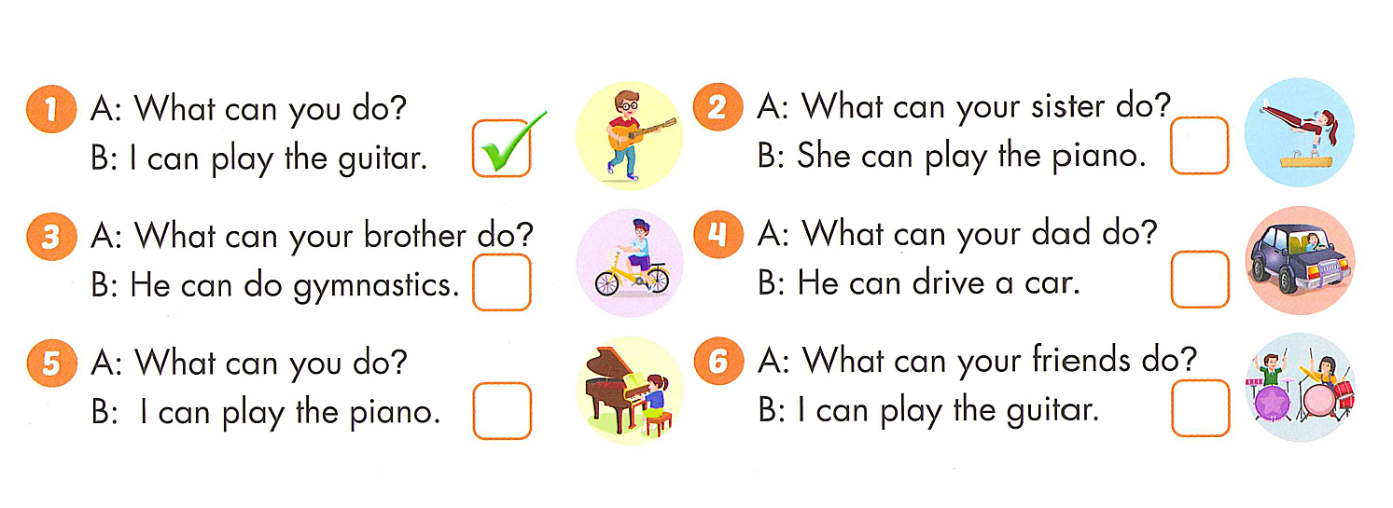
X
X
X

Slide 24
REVIEW GRAMMAR

Slide 25
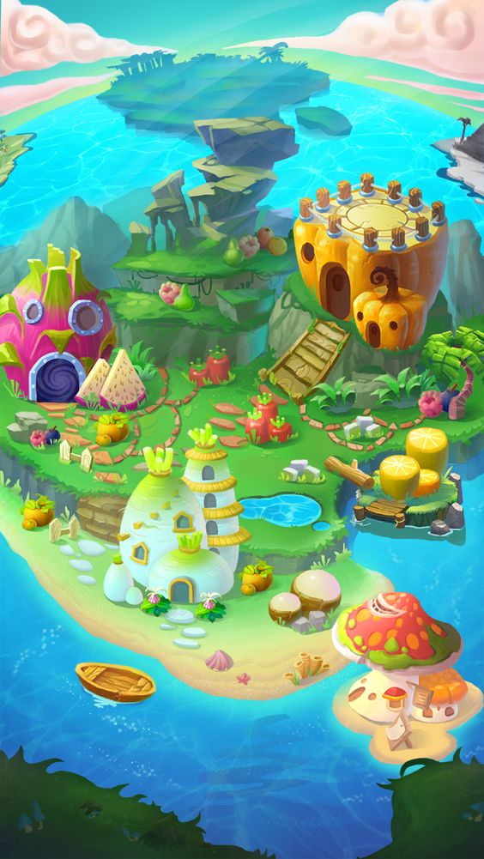
Notes:
Thanh Yen Tran 0967 255 149 /081 811 4340 zalo / FB https://www.facebook.com/thanhyentrangiaoandientu

Slide 26
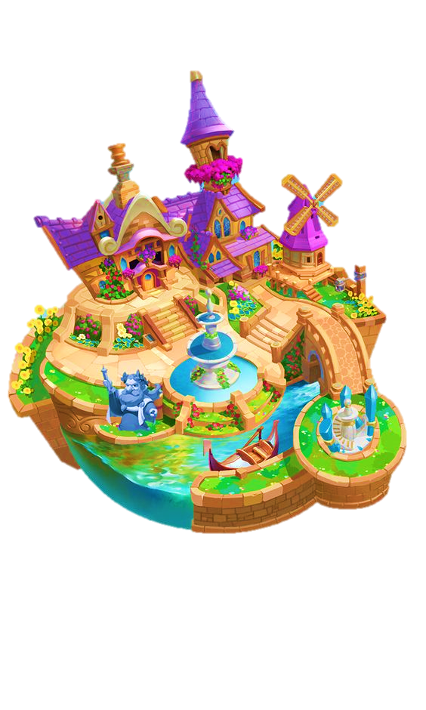
Build A City
Notes:
Thanh Yen Tran 0967 255 149 /081 811 4340 zalo / FB https://www.facebook.com/thanhyentrangiaoandientu

Slide 27
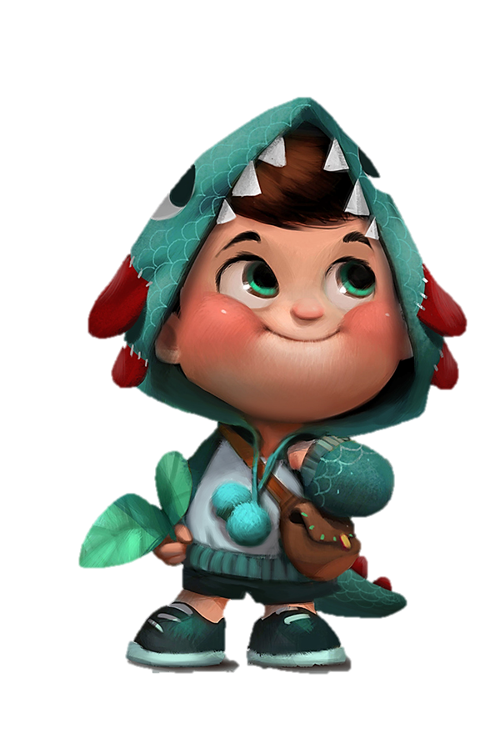
1
Let’s help him to answer the question correctly to unlock the decorations for his city!
Tom wants to build his own city.
Notes:
Thanh Yen Tran 0967 255 149 /081 811 4340 zalo / FB https://www.facebook.com/thanhyentrangiaoandientu

Slide 28
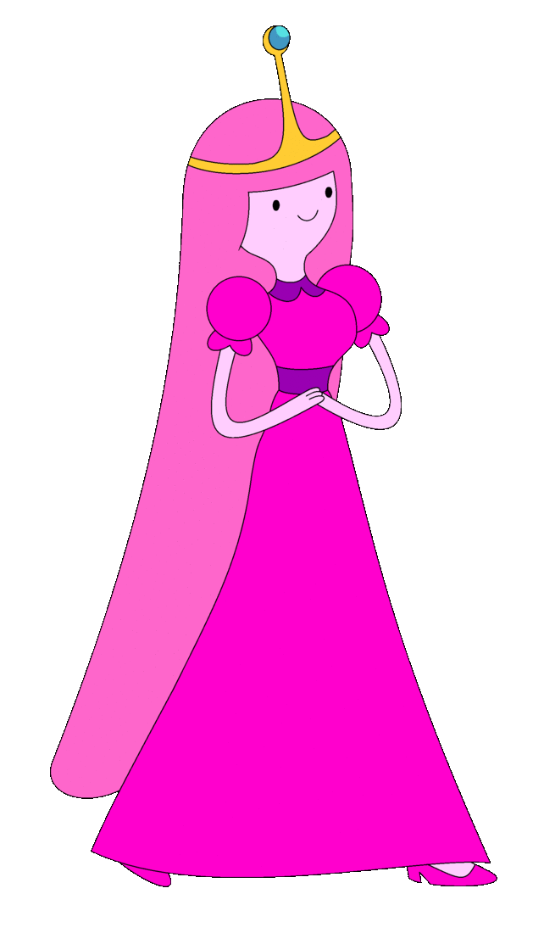
Done! Press “BACK” to return MAIN SECTION.
Notes:
Thanh Yen Tran 0967 255 149 /081 811 4340 zalo / FB https://www.facebook.com/thanhyentrangiaoandientu

Slide 29
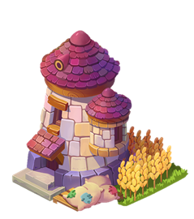
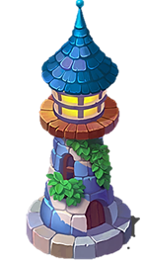
1
5
Fantastic !
Excellent !
Perfect !
Excellent!
Ggood job !
Well done !
Well done!
Good job!
2
6
3
7
4
8
Start to build
NEXT
Notes:
Thanh Yen Tran 0967 255 149 /081 811 4340 zalo / FB https://www.facebook.com/thanhyentrangiaoandientu

Slide 30
What can you do?
A
I can play the piano.
B
I can play the guitar.
C
I can play the drums.
Notes:
Thanh Yen Tran 0967 255 149 /081 811 4340 zalo / FB https://www.facebook.com/thanhyentrangiaoandientu

Slide 31
What can your father do?
A
He can drive a car.
B
She can drive a car.
C
I can drive a car.
Notes:
Thanh Yen Tran 0967 255 149 /081 811 4340 zalo / FB https://www.facebook.com/thanhyentrangiaoandientu

Slide 32
……………………?
She can ride a bike.
A
What can your brother do?
B
What can you do?
C
What can your sister do?
Notes:
Thanh Yen Tran 0967 255 149 /081 811 4340 zalo / FB https://www.facebook.com/thanhyentrangiaoandientu

Slide 33
What can they do?
A
They can play the guitar.
B
They can play the drums.
C
They can play the piano.
Notes:
Thanh Yen Tran 0967 255 149 /081 811 4340 zalo / FB https://www.facebook.com/thanhyentrangiaoandientu

Slide 34
What can………do?
She can play the piano.
A
your sister
B
your mother
C
your grandma
Notes:
Thanh Yen Tran 0967 255 149 /081 811 4340 zalo / FB https://www.facebook.com/thanhyentrangiaoandientu

Slide 35
What can………do?
She can play the piano.
A
your sister
B
your mother
C
your grandma
Notes:
Thanh Yen Tran 0967 255 149 /081 811 4340 zalo / FB https://www.facebook.com/thanhyentrangiaoandientu

Slide 36
What can you do?
………………..
A
I can ride a bike.
B
I can play the drums.
C
I can do gymnastics.
Notes:
Thanh Yen Tran 0967 255 149 /081 811 4340 zalo / FB https://www.facebook.com/thanhyentrangiaoandientu

Slide 37
………………….?
……..can ride bike.
A
What can your dad do?
- He….
B
What can you do?
- I….
C
What can they do?
- They…
Notes:
Thanh Yen Tran 0967 255 149 /081 811 4340 zalo / FB https://www.facebook.com/thanhyentrangiaoandientu

Slide 38
What can………do?
…….can play the guitar.
A
your mom- I
B
your friends- They
C
you- She
Notes:
Thanh Yen Tran 0967 255 149 /081 811 4340 zalo / FB https://www.facebook.com/thanhyentrangiaoandientu

Slide 39
WRAP-UP

Slide 40
Today’s lesson
Vocabulary
play the guitar,
play the piano,
drive a car,
ride a bike,
do gymnastics,
play the drums.
Grammar
What can you do?
- I can play the piano.
What can your mom do?
- She can drive a car.
What can your friends do?
- They can ride bikes.

Slide 41
Homework
Practice the vocabulary and structure; and make sentences using them.
Do the exercises in Workbook(page 16).
Prepare the next lesson.

Slide 42
GOOD BYE

