Slide 1

Unit 4: Travel
Lesson 3.1
Page 54

Slide 2
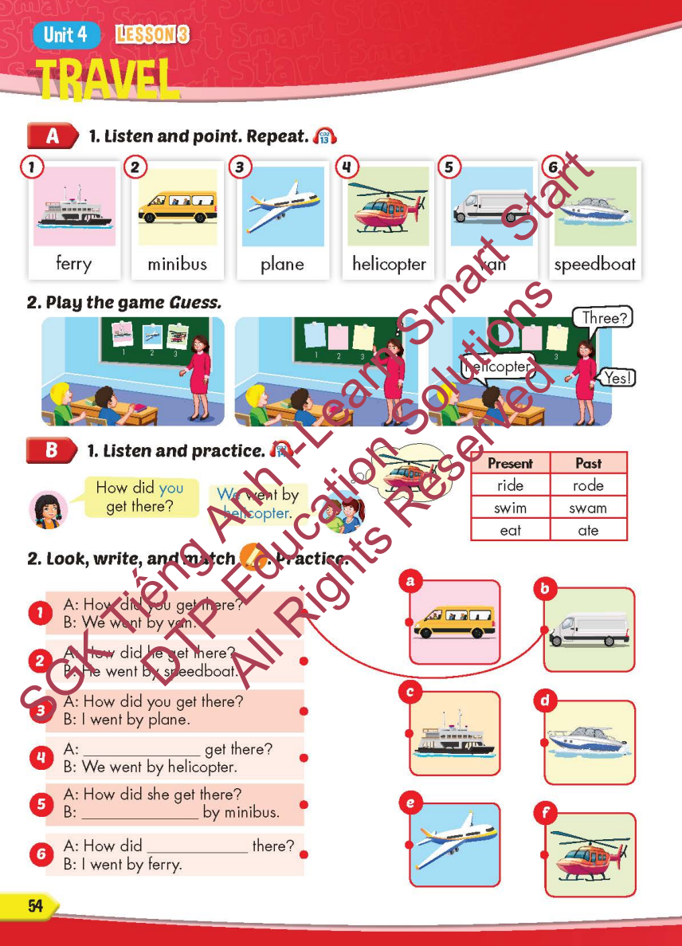
Lesson Outline
Warm-up
Vocabulary
Structure
Consolidation
Wrap-up

Slide 3
Objectives
By the end of this lesson, students will be able to…
Vocabulary: Pronounce and use the words related to the topic properly: ferry, minibus, plane, helicopter, van, speedboat
Structure: How did you get there? - We went by helicopter.

Slide 4

Nguyen Van Cu Primary School
Unit 4 TRAVEL
Lesson 3: Part A,B (page 54) + WB: A,B (page 36)
Teacher : Nguyen Thi Diem Phuc
Quy Nhon Nam, Wednesday, December 10th , 2025

Slide 5


Slide 6

WARM-UP

Slide 7

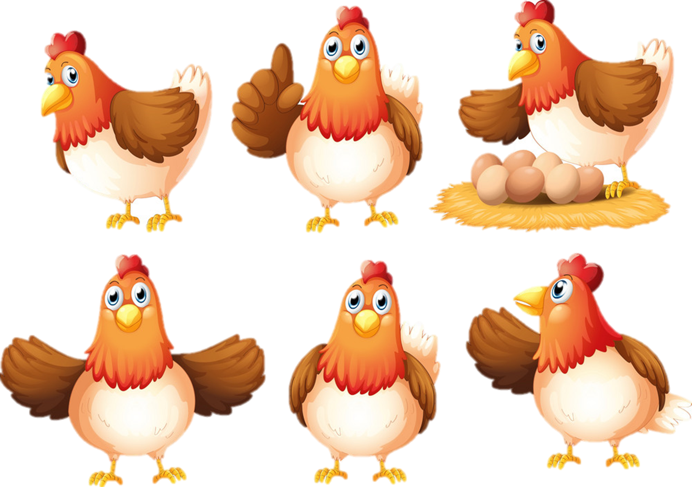


FIND THE GOLDEN EGGS

Slide 8




Canada
A.
B.

Slide 9


South Korea
A.
B.

Slide 10


Spain
A.
B.

Slide 11


France
A.
B.

Slide 12


Germany
A.
B.

Slide 13
Choose the right word.
A.
B.
Garmany
Germany

Slide 14
Choose the right word.
A.
B.
Spain
Span

Slide 15


Choose the right word.
A.
B.
Brazil
Brazin

Slide 16
GOODBYE

Slide 17

Wednesday, December 10th , 2025
Unit 4 TRAVEL
Lesson 3: A,B (page 54) + WB:A,B(page 36)
It’s time to learn …

Slide 18

New words
ferry, minibus, plane,
helicopter, van, speedboat

Slide 19

Presentation

Slide 20


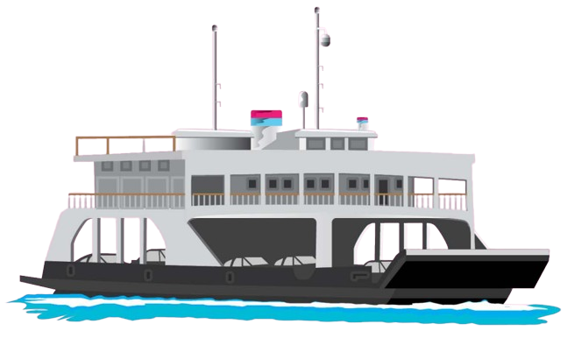

/ˈferi/

Slide 21
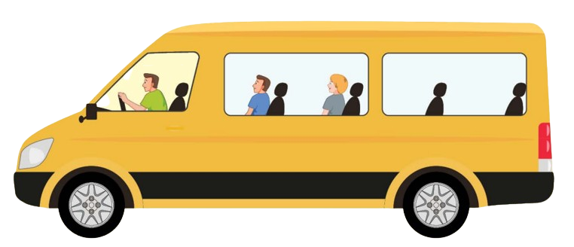

/ˈmɪnibʌs/

Slide 22
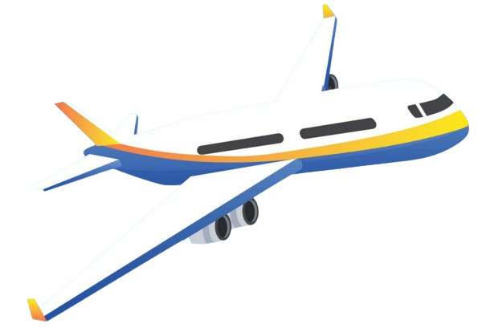

/pleɪn/

Slide 23
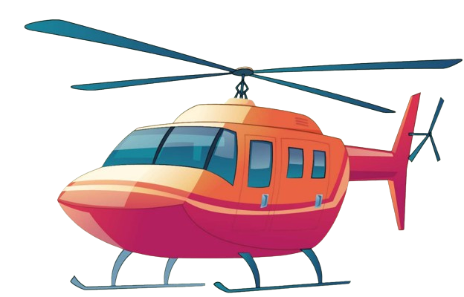

/ˈheləˌkɑːptə/

Slide 24
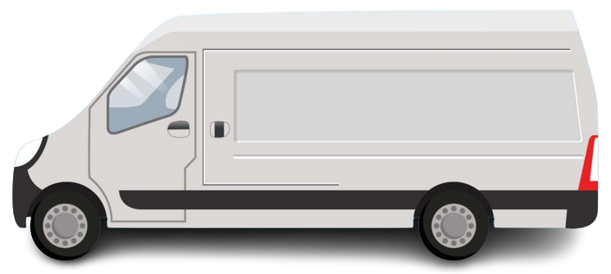

/væn/

Slide 25
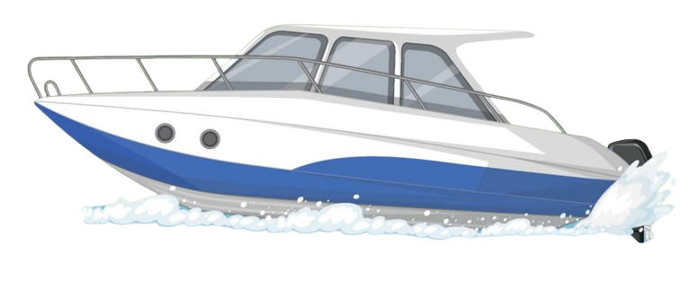

/ˈspiːdboʊt/

Slide 26
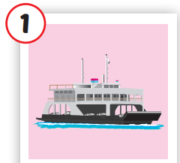
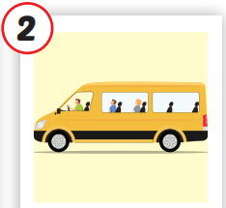
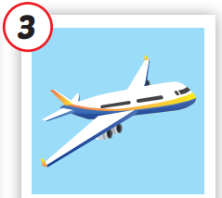
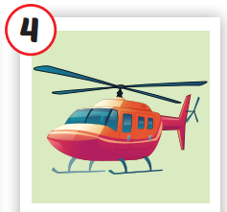
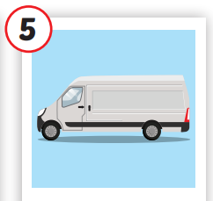
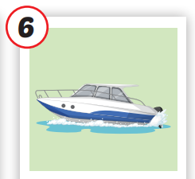


Click on each picture to hear the sound.
/ˈferi/
phà
/ˈmɪnibʌs/
xe buýt nhỏ
/pleɪn/
máy bay
/ˈheləˌkɑːptə/
trực thăng
/væn/
xe tải nhỏ,
có mui
/ˈspiːdboʊt/
tàu thủy cao tốc
Notes:
Click vào hình A. 1. Listen and point. Repeat để cho cả audio full chạy

Slide 27
Practice

Slide 28
Check your memory
?

Slide 29



ferry
van
speedboat

Slide 30
helicopter
ferry
plane

Slide 31
plane
ferry
van

Slide 32
helicopter
plane
van

Slide 33
plane
minibus
van

Slide 34
plane
van
speedboat

Slide 35

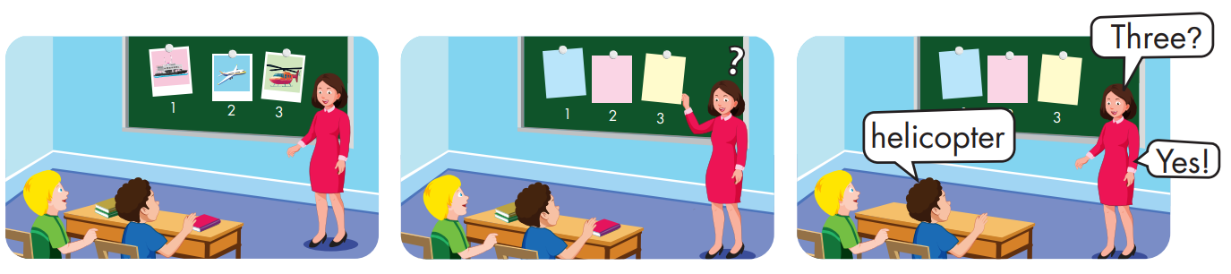

Slide 36
Structure
How did you get there?
- We went by helicopter.

Slide 37
Presentation

Slide 38
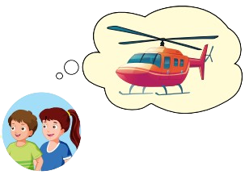
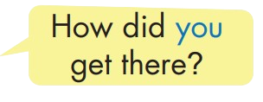

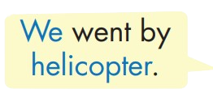
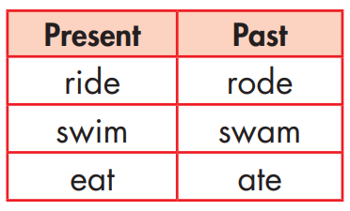
Structure

Slide 39

Practice

Slide 40


Slide 41
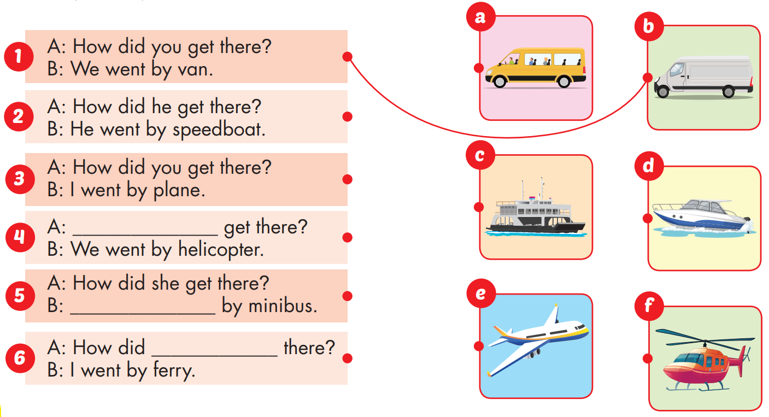
How did you
She went
you get

Slide 42

Production

Slide 43
Make sentences using these words. Then read your sentences to a partner.
How .............?
We went ............................

Slide 44

CONSOLIDATION

Slide 45

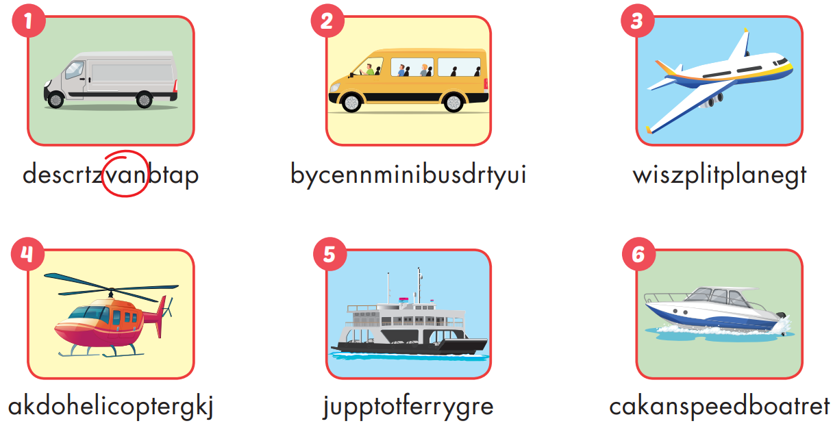

Extra Practice
WB, page 36

Slide 46

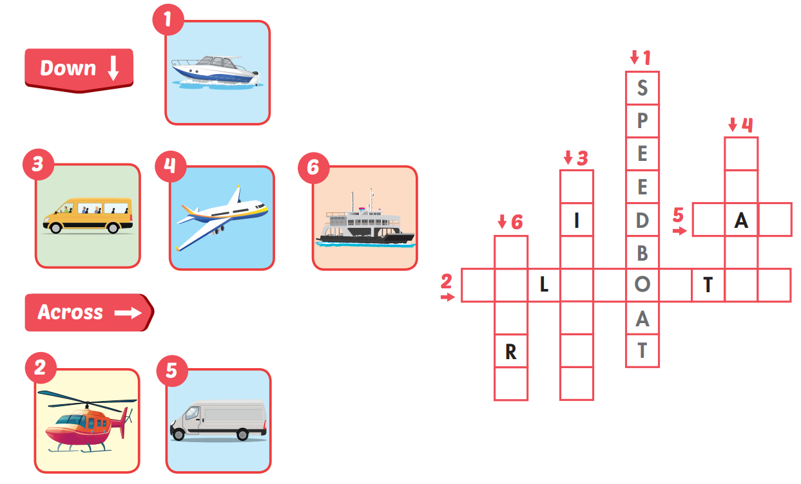
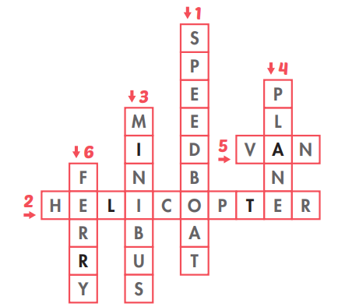
Extra Practice
WB, page 36

Slide 47

WRAP-UP

Slide 48
Wednesday, December 10th, 2025
Unit 4 TRAVEL (Lesson 3:A,B +WB:A,B)
I. New words
ferry : phà
minibus : xe buýt
plane : máy bay
helicopter : trực thăng
van : xe tải
speedboat : tàu thủy cao tốc
II. Structure
How did you get there ?
We went by helicopter

Slide 49




The bye bye song
The bye bye song
Bye, bye.
See you tomorrow.
Bye, bye.
See you tomorrow.
Bye, bye.
See you tomorrow.
Bye, bye. Bye, bye.

Slide 50
Homework
Practice the vocabularies and structure, and make sentences using them.
Do the exercises in Tiếng Anh 5 i-Learn Smart Start WB (page 36)
Do the exercises in Tiếng Anh 5 i-Learn Smart Start Notebook (page 24)
Prepare the next lesson (page 55 SB)
Play the consolidation games in Tiếng Anh 5 i-Learn Smart Start DHA App on www.eduhome.com.vn

Slide 51

Enjoy your day!

Slide 52

Lesson 3
Stay positive and have a nice day!

