Slide 1



NGUYEN VAN CU PRIMARY SCHOOL
WELCOME TO OUR CLASS
CLASS 4G

Slide 2

Warm Up
01

Slide 3
Thursday, October 30th,2025
UNIT 3
WEATHER
LESSON 1 : A,B + WB: A,B

Slide 4
Vocabulary

Slide 5


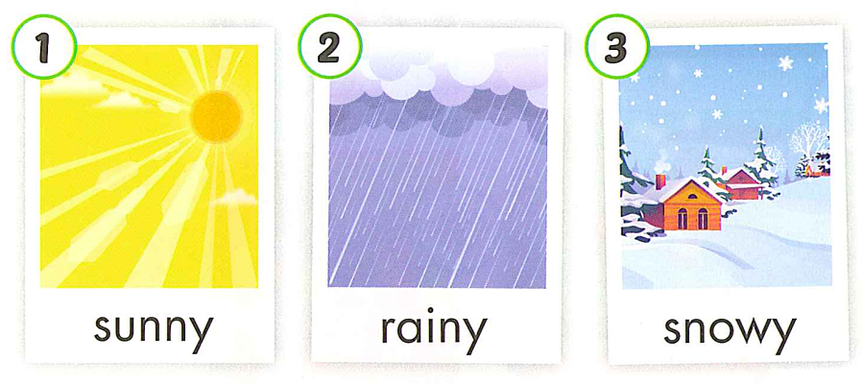
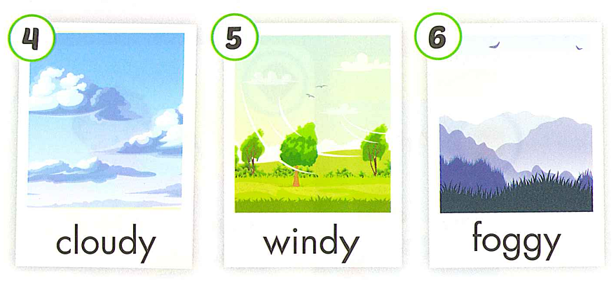

Slide 6

sunny
Notes:
Thanh Yến Trần 0967 255 149 zalo/ FB https://www.facebook.com/thanhyentrananhngutaymy/

Slide 7

rainy

Slide 8

snowy

Slide 9

cloudy

Slide 10

windy

Slide 11

foggy

Slide 13
Review
Vocabulary
Game:“Heads up. What's missing?”

Slide 14
Structure

Slide 15




Slide 16
Review structure

Slide 17
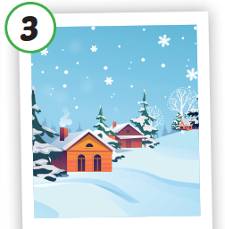
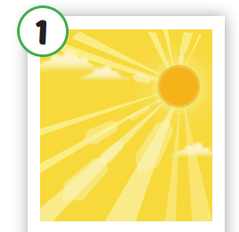
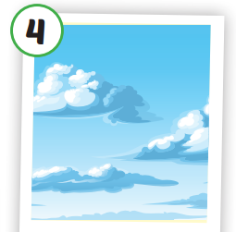

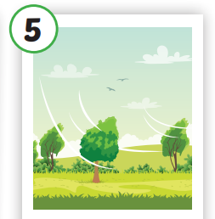
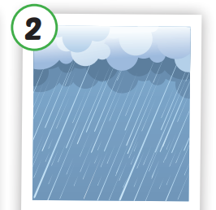


What's the weather like today?
It's cloudy.

Slide 18
What's the weather like today?
It's snowy.

Slide 19
What's the weather like today?
It's rainy.

Slide 20
What's the weather like today?
It's foggy.

Slide 21
What's the weather like today?
It's windy.

Slide 22
Practice

Slide 23

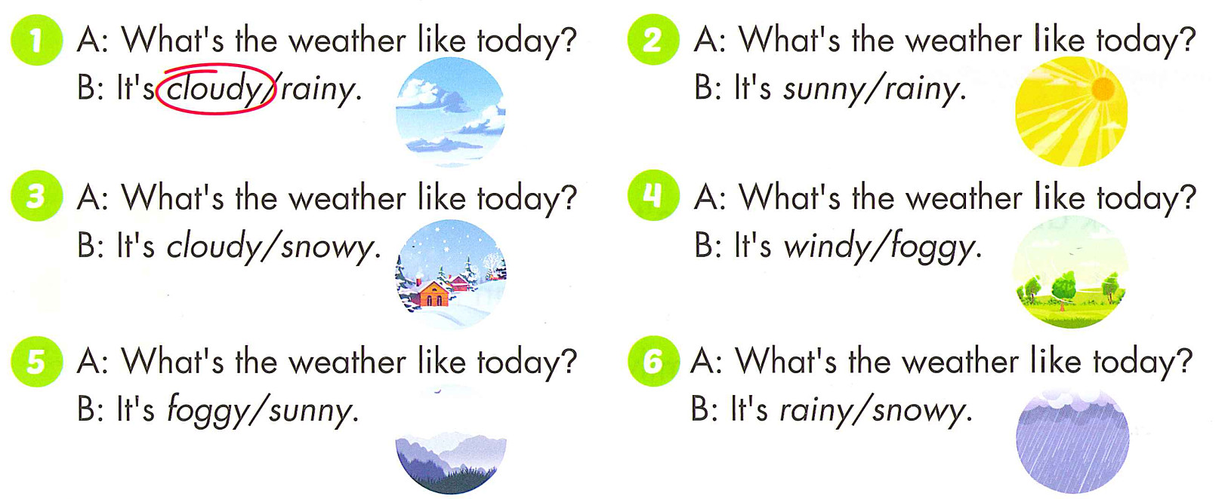

Slide 24





What’s the weather like today?
A. cloudy.
B. sunny.
C. windy.
It’s…

Slide 25

What’s the weather like today ?
A. windy.
B. rainy.
C. sunny.
It’s…

Slide 26

What’s the weather like today?
A. windy.
B. cloudy.
C. sunny.
It’s…

Slide 27

What’s the weather like today?
A. windy.
B. cloudy.
C. snowy.
It’s…

Slide 28
What’s the weather like today?
A. windy.
B. cloudy.
C. foggy.
It’s…

Slide 29
What’s the weather like today?
A. cloudy.
B. windy.
C. sunny.
It’s…

Slide 30
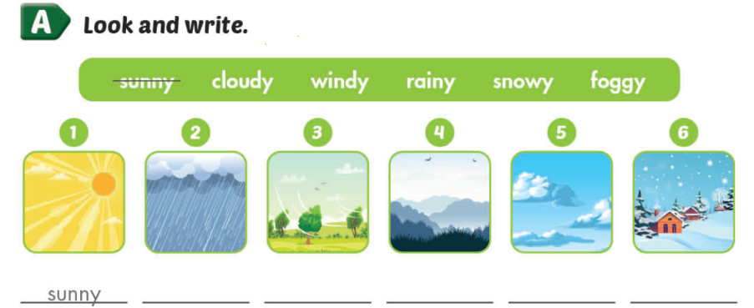
rainy
windy
foggy
cloudy
snowy

Slide 31
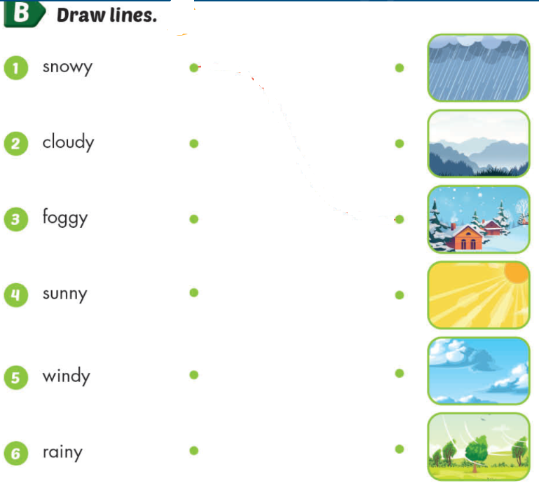
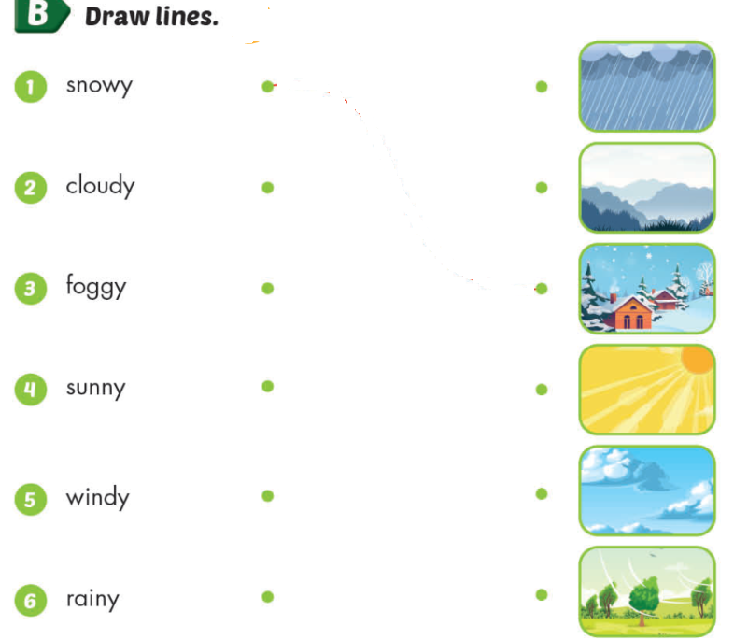

Slide 32
Reorder:
1. like / What’s / weather / today / the/ ?
….…………………….……………………...
2. is / cloudy / It /
….…………………….……………….

Slide 33
Reorder:
1. like / What’s / weather / today / the/ ?
What’s the weather like today?
…………….………………………...
2. is / cloudy / It /
It is cloudy.
…………….………………….

Slide 34
Thursday, October 30th , 2025
Unit 3: Weather (Lesson 1: A,B + WB: A,B)
*New words:
- sunny : có nắng
- rainy : có mưa
- snowy : có tuyết
  - cloudy : có mây
- windy : có gió
- foggy :có sương mù
*Structure: Hỏi và trả lời về thời tiết hôm nay thế nào:
What’s the weather like today?
- It’s sunny.

Slide 35
Good Bye

