Slide 1

WELCOME TO OUR CLASS !
Class: 4K
Teacher: Tran Thi Hien
Nguyen Van Cu Primary School

Slide 2
Thursday, October 16th, 2025
I. Warm up “Lucky Numbers”
1
2
3
5
6
4

Slide 3
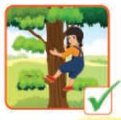
Thursday, October 16th, 2025
I. Warm up “Lucky Numbers”
Can Mai
climb a tree
?
Yes,
she
can.

Slide 4
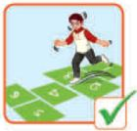
Thursday, October 16th, 2025
I. Warm up “Lucky Numbers”
Can
he
hop?
Yes
, he can.

Slide 5
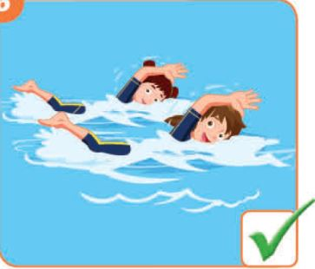
Thursday, October 16th, 2025
I. Warm up “Lucky Numbers”
Can you
swim
?
Yes,
we
can.

Slide 6
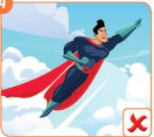
Thursday, October 16th, 2025
I. Warm up “Lucky Numbers”
Can
you
fly?
.
can’t
No, I

Slide 7
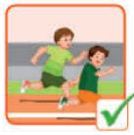
Thursday, October 16th, 2025
I. Warm up “Lucky Numbers”
run
?
Can Tom and Ben
Yes,
they
can.

Slide 8
Thursday, October 16th, 2025
I. Warm up “Lucky Numbers”
LUCKY NUMBER

Slide 9

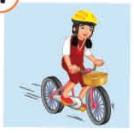
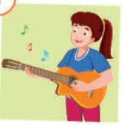
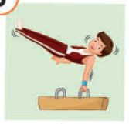
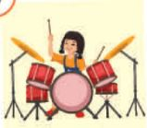
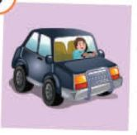
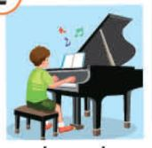

Thursday, October 16th, 2025
Unit 2: WHAT I CAN DO [Lesson 3 – AB (SB) + AB (WB)]
II. Presentation
* New words:
ride a bike :
tập thể dục dụng cụ
đi xe đạp
do gymnastics :
chơi trống
play the guitar:
chơi đàn pi-a-nô
chơi đàn ghi-ta
drive a car :
lái xe ô tô
play the piano :
play the drums :

Slide 10

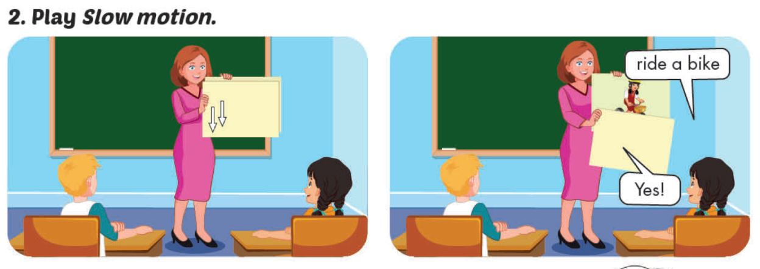
Thursday, October 16th, 2025
Unit 2: WHAT I CAN DO [Lesson 3 – AB (SB) + AB (WB)]
II. Presentation

Slide 11

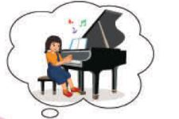

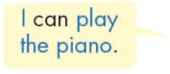
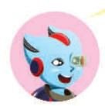
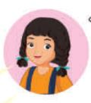
Thursday, October 16th, 2025
Unit 2: WHAT I CAN DO [Lesson 3 – AB (SB) + AB (WB)]
II. Presentation
* Model sentences:

Slide 12
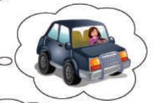


Thursday, October 16th, 2025
Unit 2: WHAT I CAN DO [Lesson 3 – AB (SB) + AB (WB)]
II. Presentation

Slide 13
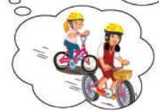
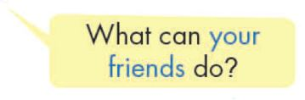
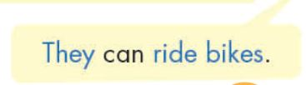
Thursday, October 16th, 2025
Unit 2: WHAT I CAN DO [Lesson 3 – AB (SB) + AB (WB)]
II. Presentation

Slide 14

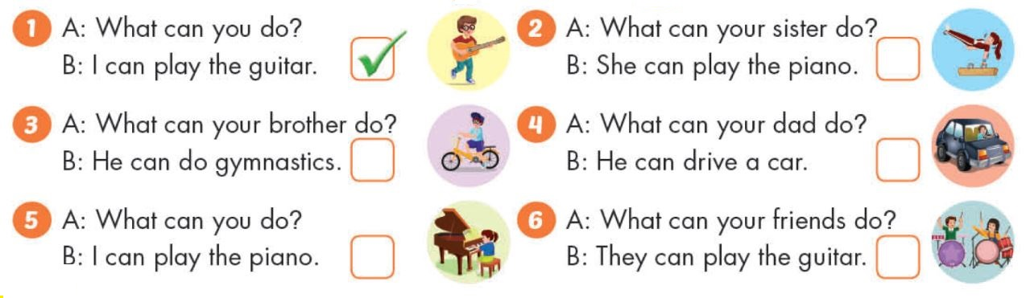


Thursday, October 16th, 2025
Unit 2: WHAT I CAN DO [Lesson 3 – AB (SB) + AB (WB)]
III. Practice

Slide 15
Thursday, October 16th, 2025
Unit 2: WHAT I CAN DO [Lesson 3 – AB (SB) + AB (WB)]
IV. Production
Talk about what you and your family members can do
- What can you do ?
+ I can _______.
- What can your ______do ?
+ She can ________.
- What can your ______do ?
+ He can ________.

Slide 16
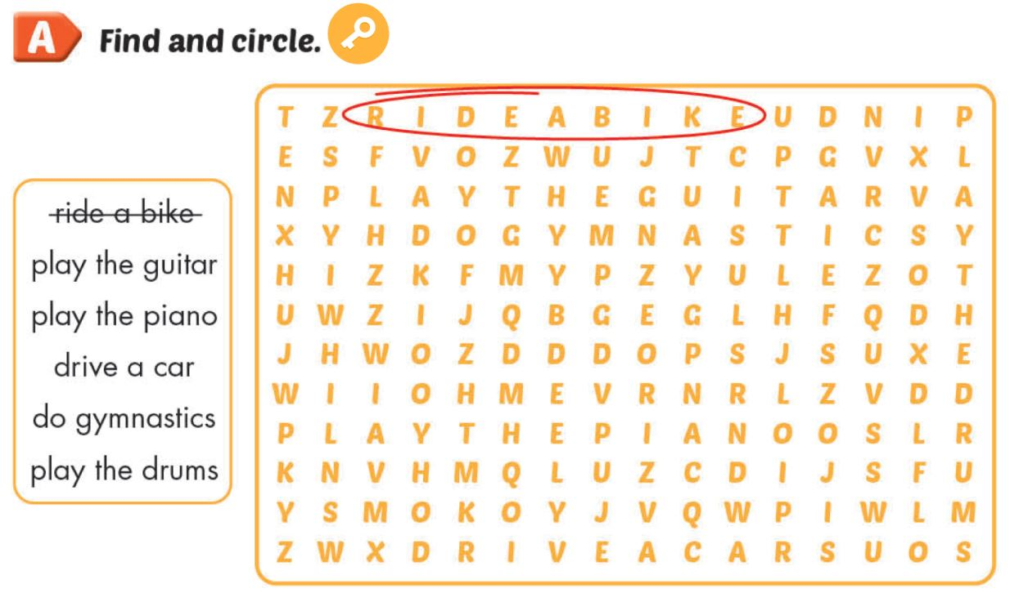
Thursday, October 16th, 2025
Unit 2: WHAT I CAN DO [Lesson 3 – AB (SB) + AB (WB)]
V. Consolidation.
* Workbook

Slide 17
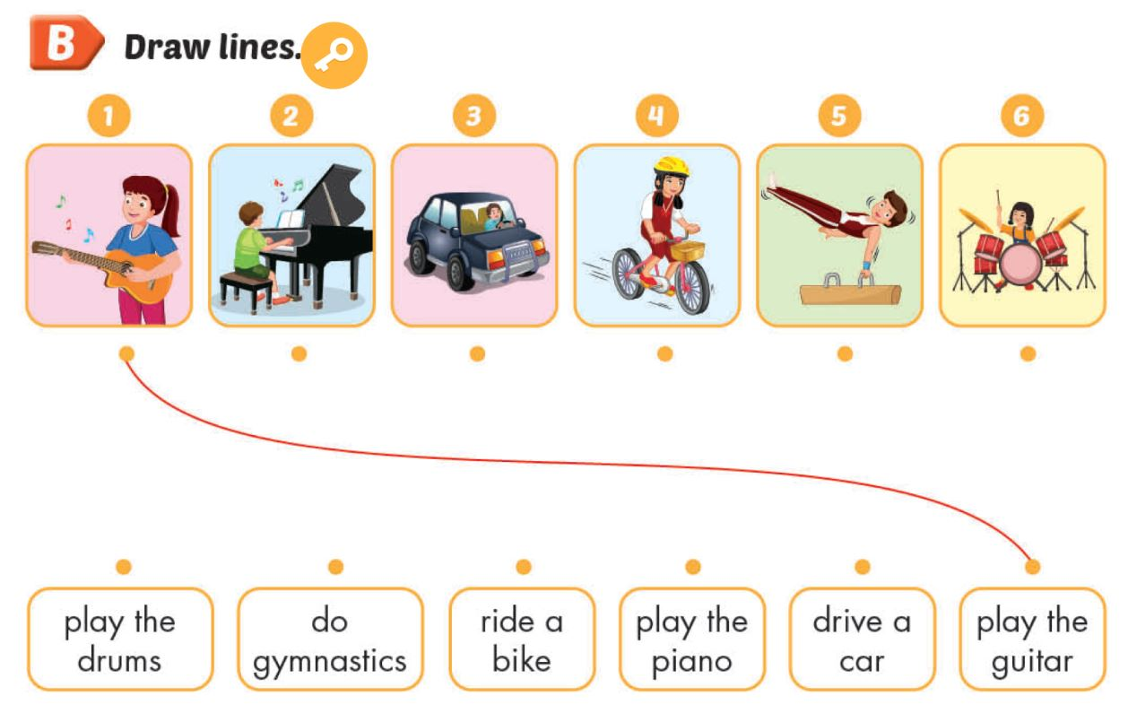
Thursday, October 16th, 2025
Unit 2: WHAT I CAN DO [Lesson 3 – AB (SB) + AB (WB)]
V. Consolidation.

Slide 18
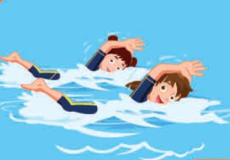
Thursday, October 16th, 2025
Unit 2: WHAT I CAN DO [Lesson 3 – AB (SB) + AB (WB)]
V. Consolidation.
* Circle
1. What can your sister do ?
A. She can ride a bike.
B. She can rides a bike.
C. He can ride a bike.
2. What can you do ?
A. They can play the drums.
B. He can play the drums.
C. I can play the drums.
3. What can your brother do ?
A. She can play the guitar.
B. He can play the guitar.
C. I can play the guitar.
4. What can your friends do ?
A. They can swim.
B. She can swim.
C. He can swim.

Slide 19
Thursday, October 16th, 2025
Unit 2: WHAT I CAN DO [Lesson 3 – AB (SB) + AB (WB)]
* New words:
play the guitar :
chơi đàn ghi-ta
play the piano :
chơi đàn pi-a-nô
drive a car :
lái xe ô tô
ride a bike:
đi xe đạp
do gymnastics:
tập thể dục dụng cụ
play the drums :
chơi trống
* Model sentences:
- What can you do ?
+ I can play the piano.
- What can your mom do ?
+ She can drive a car.
- What can your friends do?
+ They can ride bikes.

Slide 20




The bye bye song
The bye bye song
Bye, bye.
See you tomorrow.
Bye, bye.
See you tomorrow.
Bye, bye.
See you tomorrow.
Bye, bye. Bye, bye.

