Slide 1


WELCOME TO OUR CLASS
CLASS: 3G
TEACHER: DANG THI BAO HIEN
GOOD AFTERNOON

Slide 2

WARM UP

Slide 3
Let’s play
Slow motion

Slide 4

It’s time to learn …

Slide 5

Unit 4: HOME
Lesson 4.1 Review and practice
Page 64

Slide 6
Wednesday, December 24th, 2025
Unit 4: Review and Practice (A, B)

Slide 7
Review of vocabulary:

Slide 8
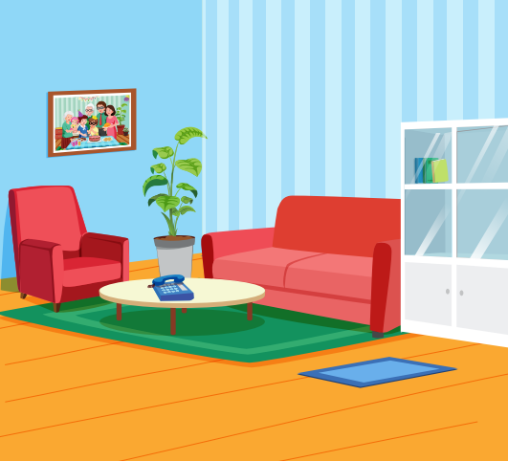

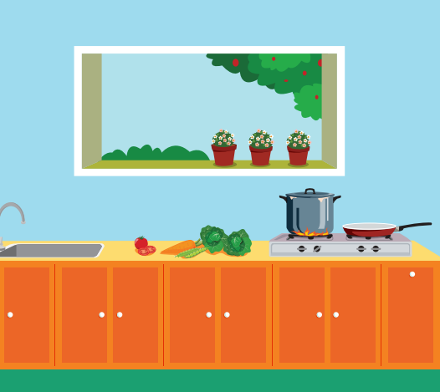

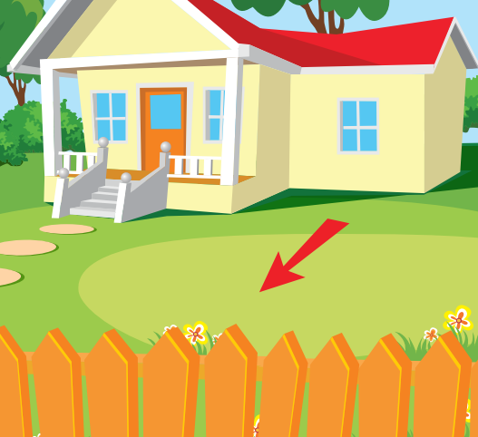
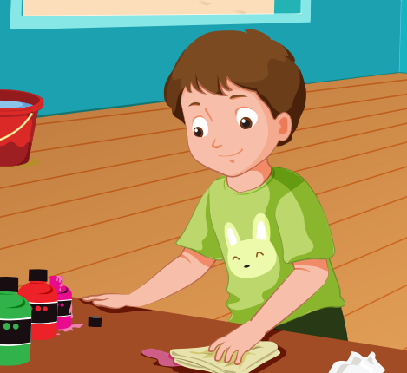


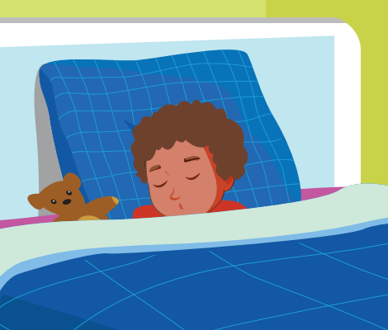
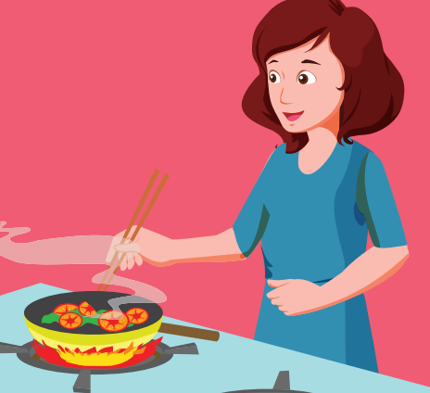
living room
bedroom
kitchen
bathroom
yard
cleaning
playing
eating
sleeping
cooking

Slide 9



mirror
picture
sofa

Slide 10
Review of sentence patterns:

Slide 11
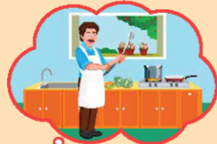
Where’s Dad?
kitchen
He’s in the …………….........
What’s he doing?
cooking
He’s ……………

Slide 12
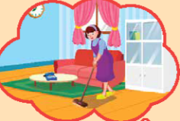
Where’s Mom?
living room
She’s in the …..……………
What’s she doing?
cleaning
She’s ……………

Slide 13

sofa
living room
Is the ………… in the ……………………..?
Yes, it is.

Slide 14
picture
living room
Is the ………… in the ……………………..?
No, it isn’t.

Slide 15
Wednesday, December 24th, 2025
Unit 4: Review and Practice (A, B)
A/ Listen and tick the box.

Slide 16
Page 64

Slide 17

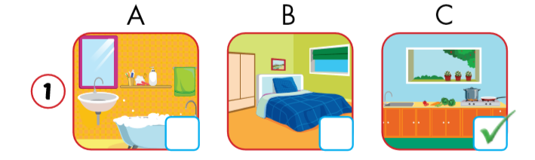

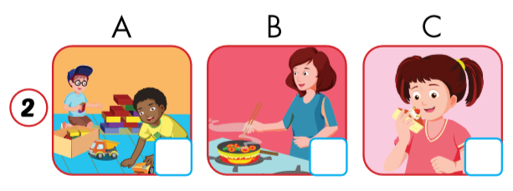

Click on the earphone to hear the sound.
Notes:
2 A

Slide 18
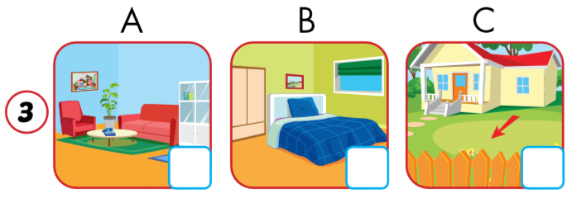
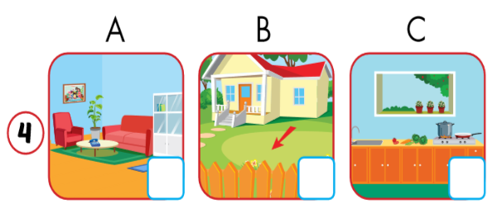
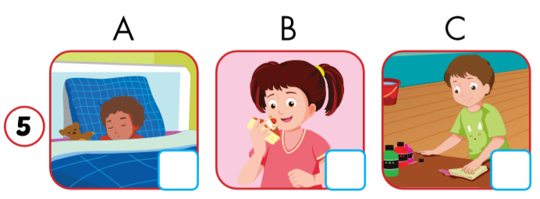
Click on the earphone to hear the sound.
Notes:
3 - B 4 - C 5 C

Slide 19
Wednesday, December 24th, 2025
Unit 4: Review and Practice (A, B)
A/ Listen and tick the box.
B/ Look and read. Put a (✓) or a (û).

Slide 20

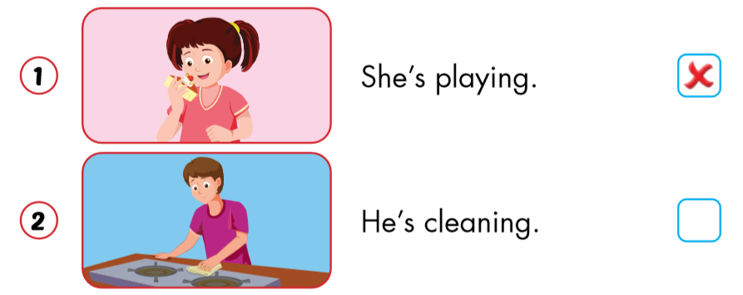

Slide 21
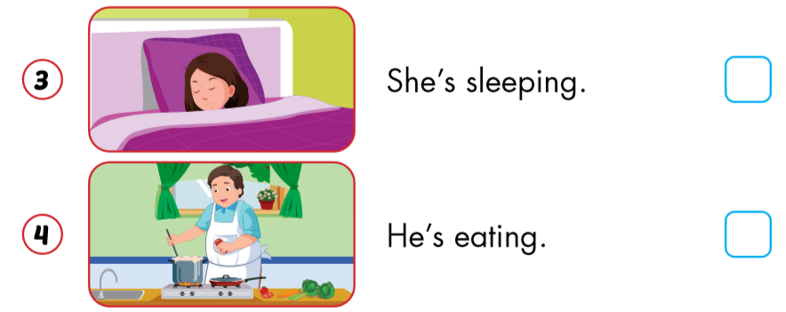


Slide 22
Page 46
Workbook
p. 46

Slide 23
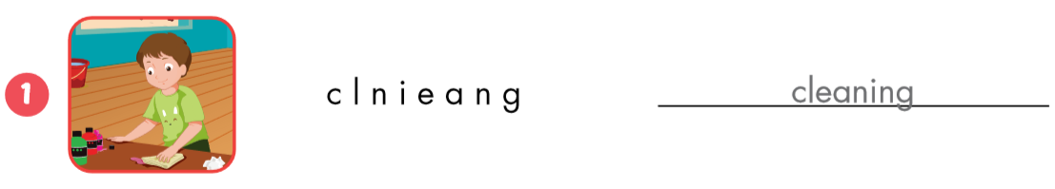
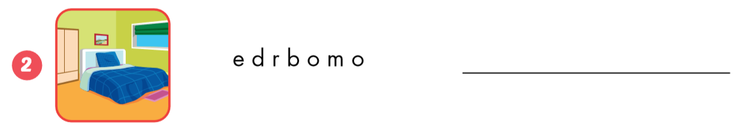
cleaning

Slide 24
cleaning
bedroom

Slide 25
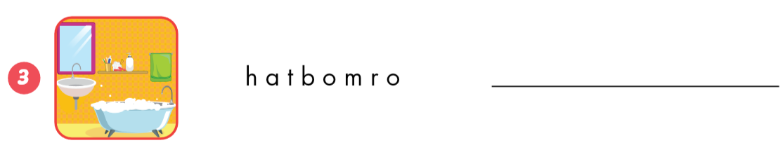
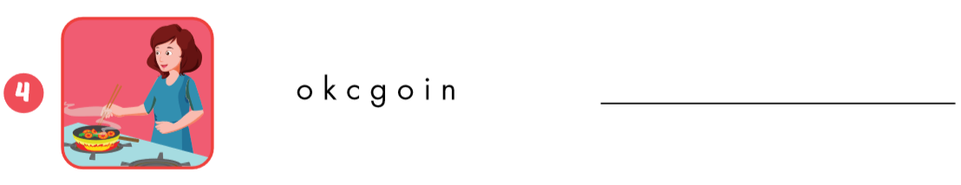
bathroom
cooking

Slide 26
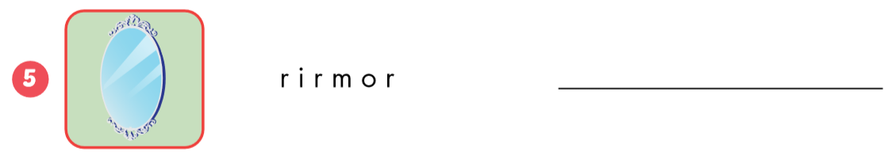
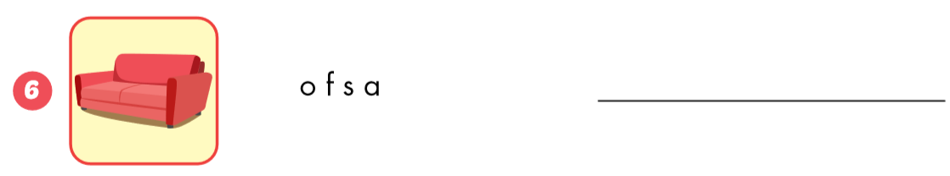
mirror
sofa

Slide 27
Let’s play
Memory game

Slide 28

bedroom
eating
kitchen
playing
cleaning
sleeping
sofa
picture
yard
mirror

Slide 29

Memory game
00:40
START

Slide 30
Memory game
40
39
38
37
36
35
34
33
32
31
30
29
28
27
26
25
24
23
22
21
20
19
18
17
16
15
14
13
12
11
10
09
08
07
06
05
04
03
02
01
00
STOP

Slide 31
bedroom
eating
kitchen
cleaning
sleeping
playing
yard
mirror
picture
sofa

Slide 32
Wednesday, December 24th, 2024
Unit 4: Review and Practice (A, B)
A/ Listen and tick the box.
B/ Look and read. Put a (✓) or a (û).

Slide 33
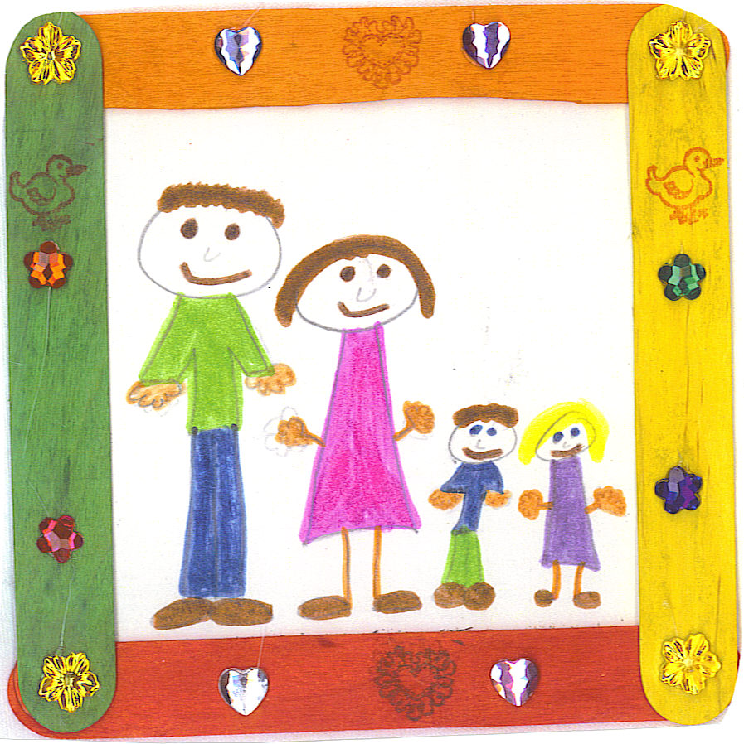


GOODBYE
SEE YOU LATER

Slide 34

Enjoy your day!

