Slide 1

Friday, January 16th , 2026
NGO QUYEN
PRIMARY SCHOOL

Slide 2


WELCOME TO OUR CLASS
CLASS: 5C
TEACHER: LE CAO THUY NGA
GOOD AFTERNOON

Slide 3
LET’S PLAY
WORD RACE

Slide 4

Word Race
00:40
START

Slide 5
Word Race
40
39
38
37
36
35
34
33
32
31
30
29
28
27
26
25
24
23
22
21
20
19
18
17
16
15
14
13
12
11
10
09
08
07
06
05
04
03
02
01
00
STOP

Slide 6

Unit 4: Travel – Lesson 1 (C)
Page 49

Slide 7
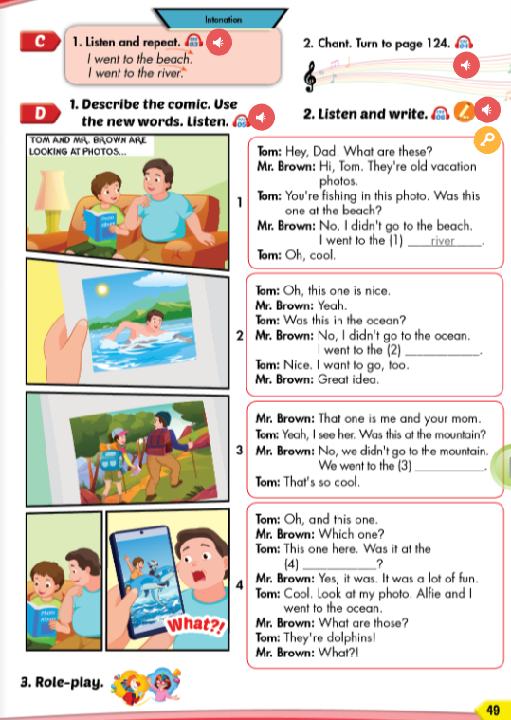

Slide 8
Friday, January 16th, 2026
Unit 4: Travel – Lesson 1 (C)
C/ Intonation
I went to the beach.
I went to the river.

Slide 9
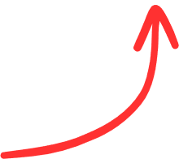

Friday, January 16th, 2026
Unit 4: Travel – Lesson 1 (C)
C/ Intonation
I went to the beach.
I went to the river.
Falling intonation

Slide 10
Put the correct intonation for each sentence:
1/ I went to the market.
2/ I was at the coffee shop.
3/ Was this at the lake?
4/ He planted some flowers.

Slide 11


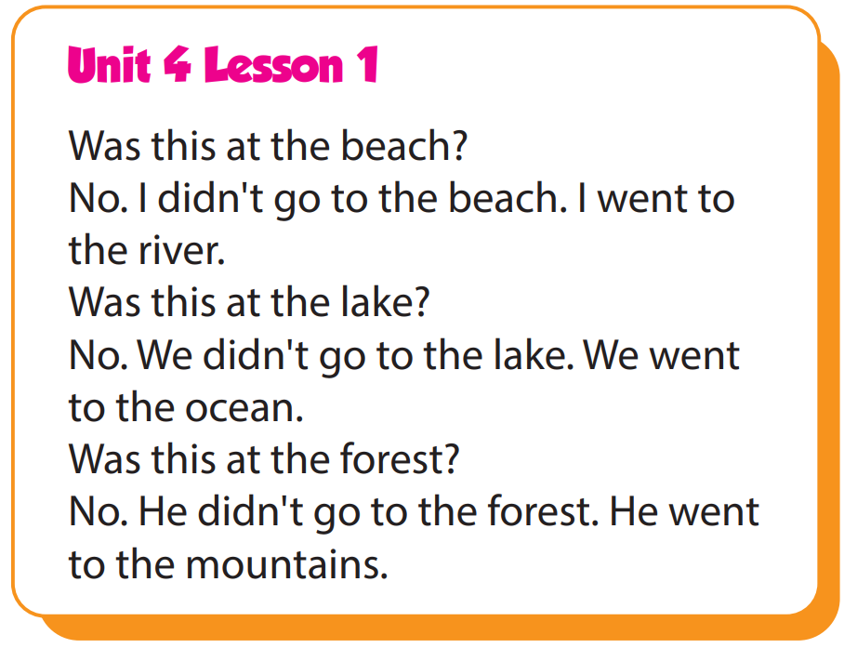

Slide 12
Was this at the beach?
No, I didn’t go to the beach. I went to the river.
Was this at the lake?
No, we didn’t go to the lake. We went to the ocean.
Was this at the forest?
No, he didn’t go to the forest. He went to the mountains.

Slide 14
Was this at the ………….?
No, I didn’t go to the ….. I went to the ……..
Was this at the ……….?
No, we didn’t go to the ………. We went to the ……...
Was this at the …….. ?
No, he didn’t go to the ……... He went to the ………….

Slide 15
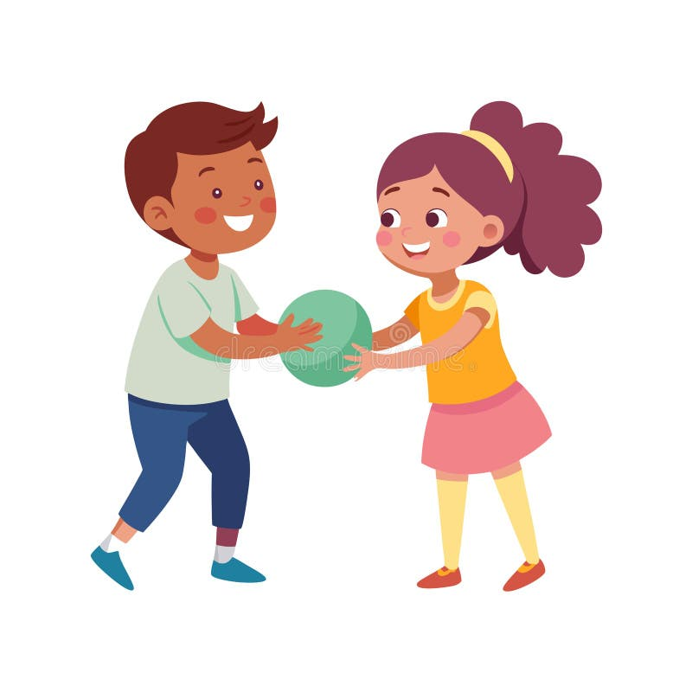
Let’s play ☺
Pass the ball

Slide 16
Student 1: I didn’t go to the …….
Student 2: I went to the …….
Student 3: I didn’t go to the …….
Student 4: I went to the …….

Slide 17
Let’s play ☺
Pass the ball

Slide 18
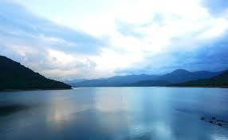
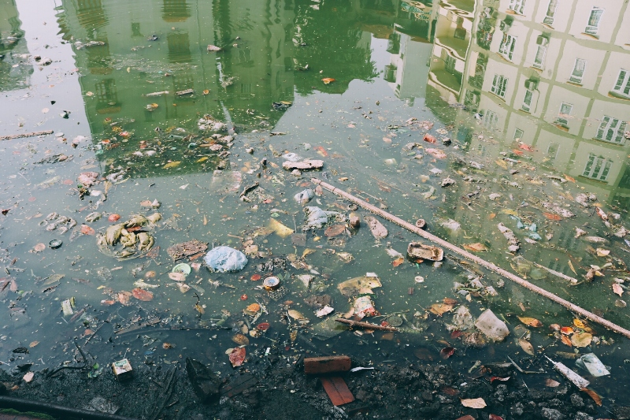

Slide 19
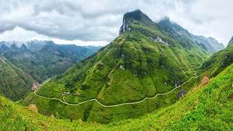
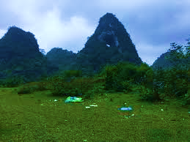

Slide 20
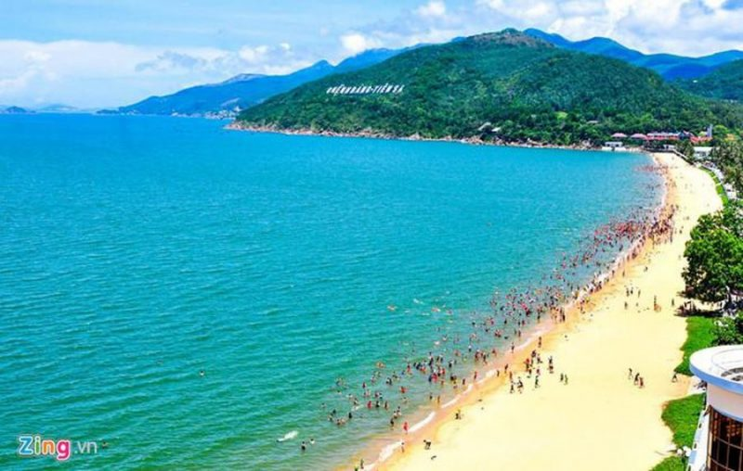
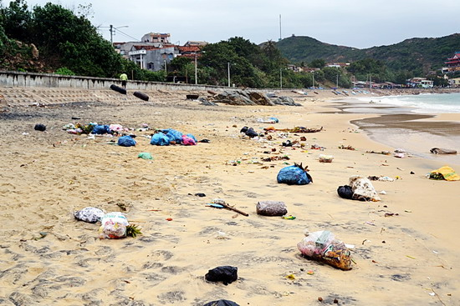

Slide 22
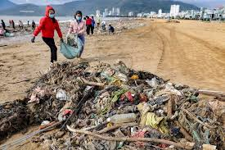
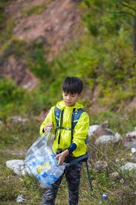
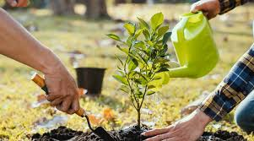

Slide 23
Friday, January 16th, 2026
Unit 4: Travel – Lesson 1 (C)
C1/ Intonation: Falling intonation
I went to the beach.
I went to the river.
C2/ Chant

Slide 24
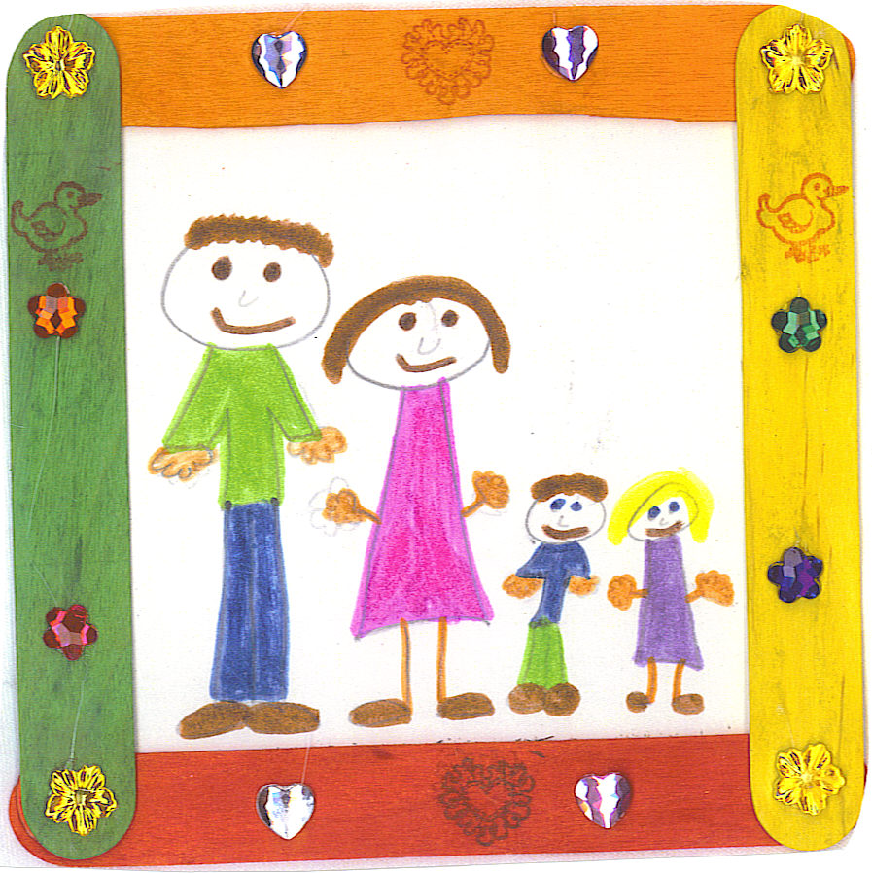


GOODBYE
SEE YOU LATER

Slide 25

Enjoy your day!

Slide 26

Lesson 3
Stay positive and have a nice day!

