Slide 1
WARM- UP
Notes:
Ms Dike

Slide 2
WORDSNAKE
Look and find 5 words about sports.
socvolleyballten
soccerbal
dfbasketball
badmintonvoll
hgtennisfr
Click on the number to check the answers.
◆
❖
⬥


Click on the animal to show the answers.
Notes:
Click vào dấu mũi tên sau khi thực hiện xong trò chơi

Slide 3
Period: 88
Unit 6: Clothes
Lesson 1-Part A,B
Page:82
Notes:
Ms Dike

Slide 4
Notes:
Ms Dike

Slide 5
Notes:
Ms Dike

Slide 8
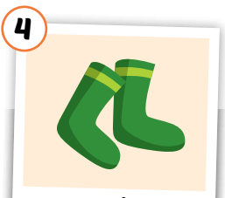
Click each English word to hear the sound.
socks
Notes:
GV giới thiệu từ vựng, CCQ

Slide 9
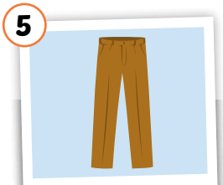
Click each English word to hear the sound.
pants
Notes:
GV giới thiệu từ vựng, CCQ

Slide 10
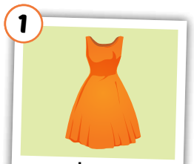
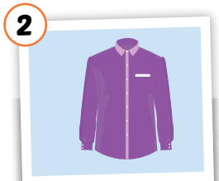
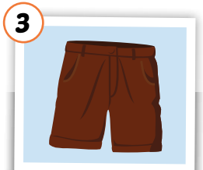
Click each English word to hear the sound.
dress
shirt
shorts
socks
pants
Notes:
GV giới thiệu từ vựng, CCQ

Slide 11
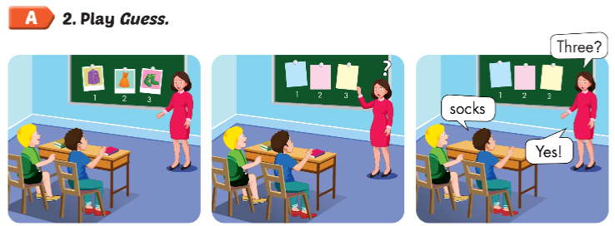

Slide 12
Structures

Slide 13
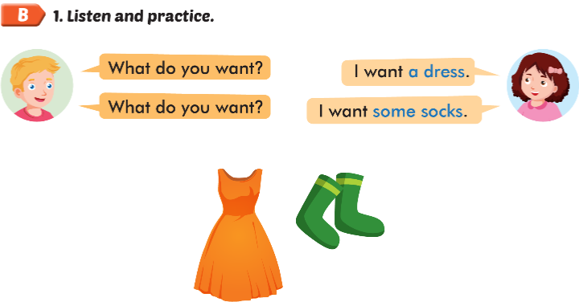

Slide 14
some pants
you want
you want
some socks
I want some shorts

Slide 15
Workbook
p. 58
Notes:
Ms Dike

Slide 16
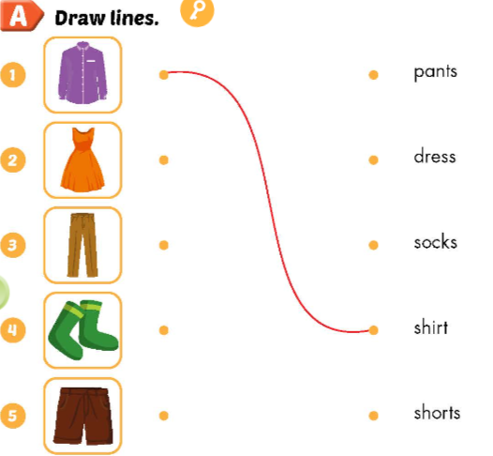

Slide 19
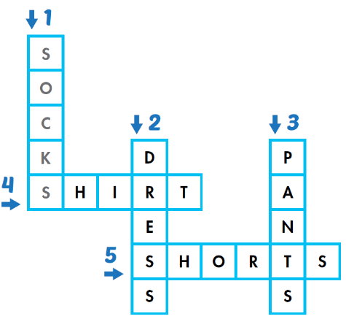

Slide 20
CONSOLIDATION
Notes:
Ms Dike

Slide 21
Draw clothes you want. Ask and answer with 3 friends.
Notes:
Ms Dike

Slide 22
Unit 6: Clothes – Lesson 1- Part A,B
1.
+ clothes : quần áo
+ dress : đầm, áo đầm
+ shirt : áo sơ mi
+ shorts : quần soóc, quần cộc
+ socks : đôi tất
+ pants : quần tây, quần dài
+ want : muốn
+ some : một vài
2.
- What do you want ?
→ I want a dress.
- What do you want ?
→I want some socks.
Notes:
Ms Dike

Slide 23
Notes:
Ms Dike

