Slide 1
Unit 8: MY FRIENDS AND I
Lesson 1 - Page 108

Slide 2
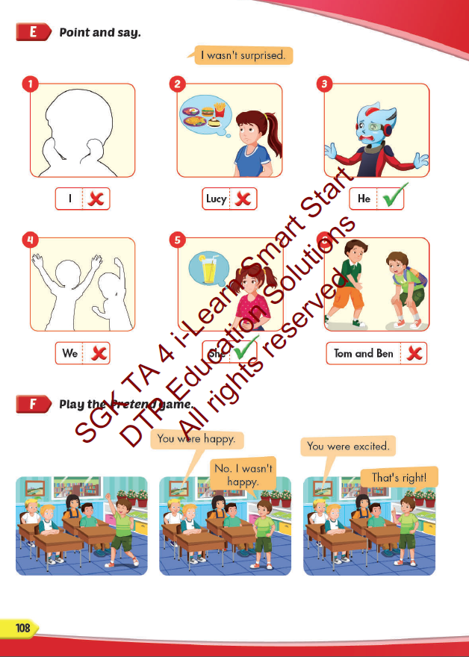
Lesson Outline
Warm-up
Practice
Speaking
Consolidation
Wrap-up

Slide 3
Objectives
By the end of this lesson, students will be able to answer how people felt.
Vocabulary: hungry, thirsty, scared, surprised, tired, excited.
Structure:
- I was tired.
- Alfie wasn't thirsty. He was hungry.
- Lucy and Ben weren't scared. They were excited.

Slide 4
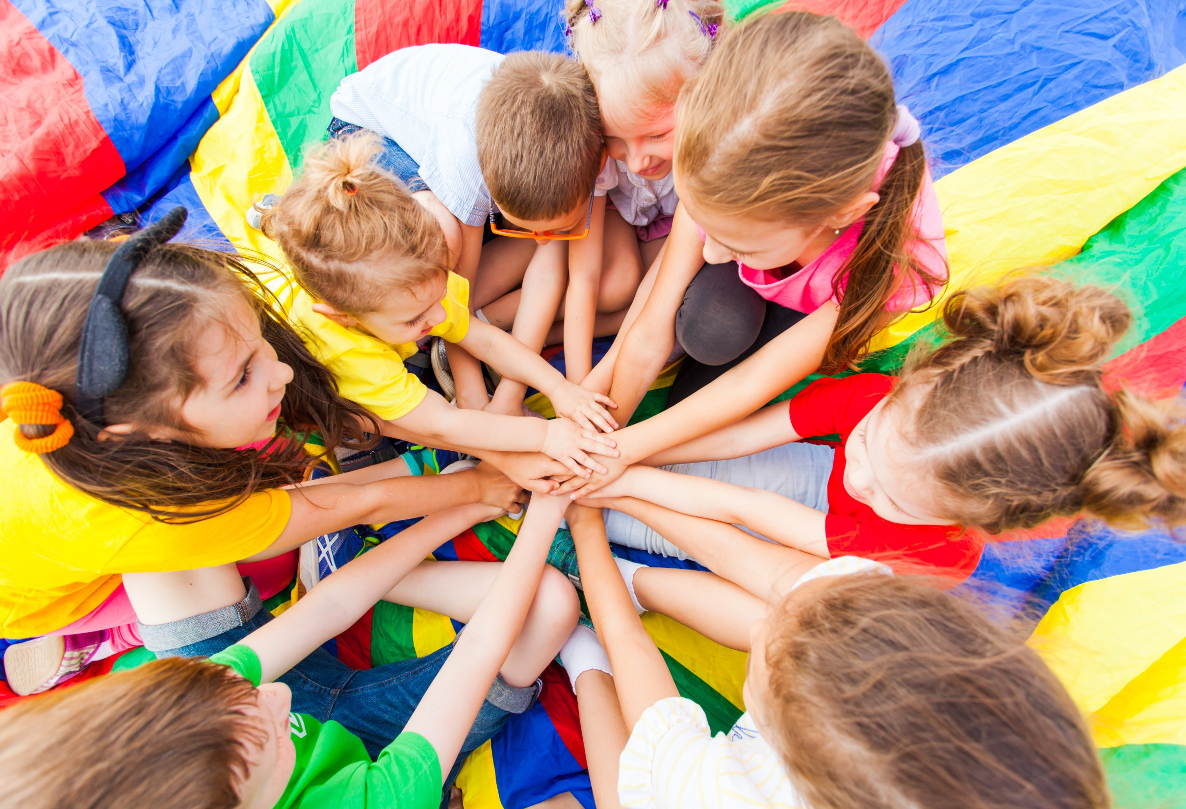
WARM UP

Slide 5
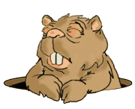
Game
Gold Miner
START

Slide 6
100$
150
50$
20$
100$
10$
150$
50$
20$

Slide 7
She was
Notes:
Click on the man to come back slide 6

Slide 8
He was
Notes:
Click on the man to come back slide 6

Slide 9
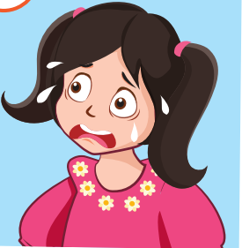
…. was
Notes:
Click on the man to come back slide 6

Slide 10
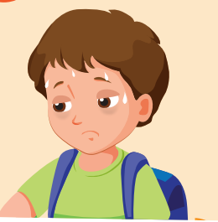
…. was
Notes:
Click on the man to come back slide 6

Slide 11
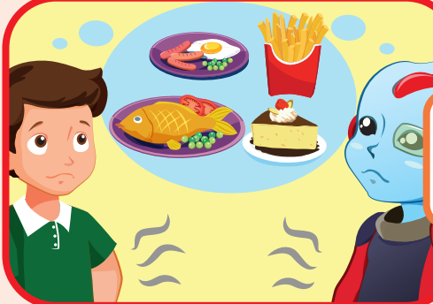
….. were
Notes:
Click on the man to come back slide 6

Slide 12
It’s time to learn …

Slide 13
Practice

Slide 14
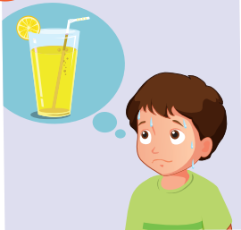
Choose the correct answer
Click on the picture to check the correct answer.
A. He was hungry.
B. He was thirsty.

Slide 15
Choose the correct answer
Click on the picture to check the correct answer.
A. She was scared.
B. She was tired.

Slide 16
Choose the correct answer
Click on the picture to check the correct answer.
A. He was excited.
B. He wasn’t excited.

Slide 17
Choose the correct answer
Click on the picture to check the correct answer.
A. He was surprised.
B. She was surprised.

Slide 18
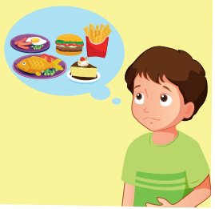
Choose the correct answer
Click on the picture to check the correct answer.
A. They were hungry.
B. He was hungry.

Slide 19
Listening

Slide 20
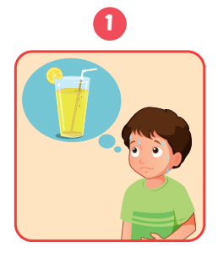
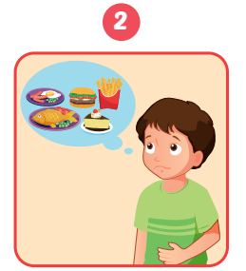
Click on the picture to check the correct answer.

Slide 21
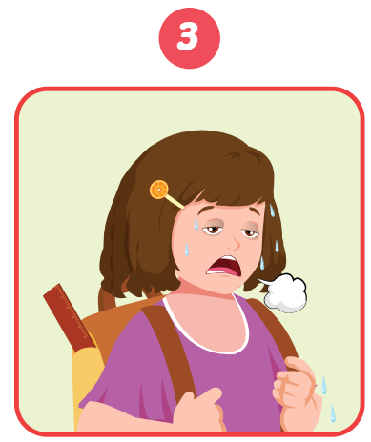
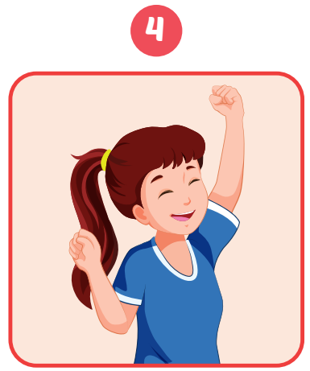
Click on the picture to check the correct answer.

Slide 22
Speaking

Slide 23
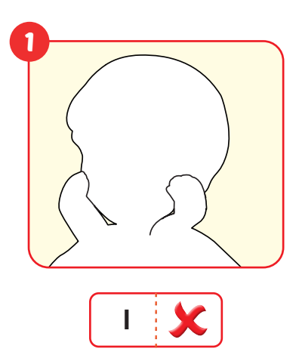
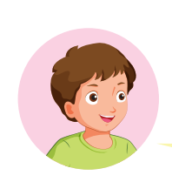

Slide 24
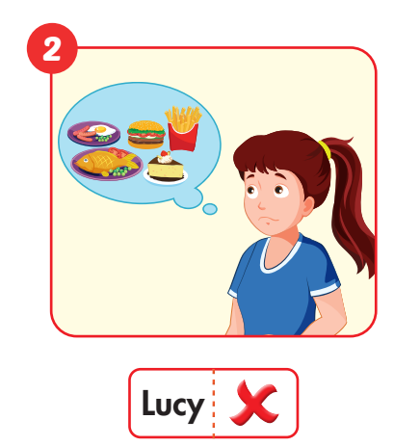
…………..

Slide 25
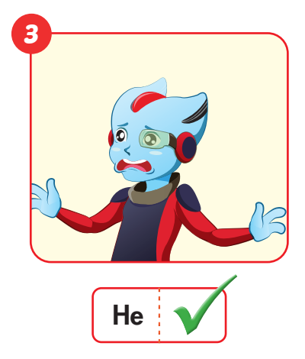
…………..

Slide 26
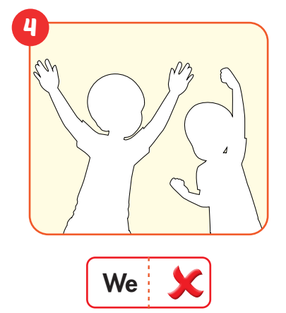
…………..

Slide 27
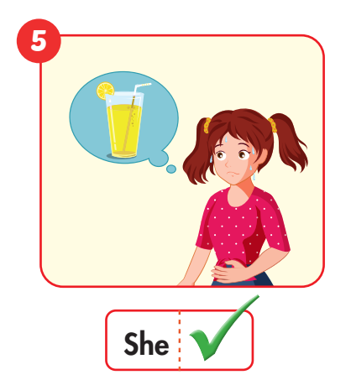
…………..

Slide 28
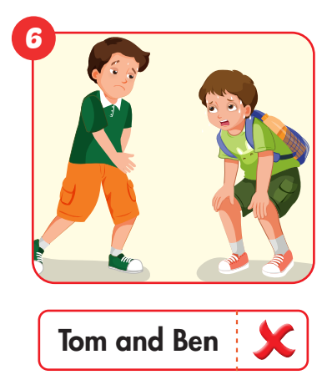
…………..

Slide 29
Production

Slide 30
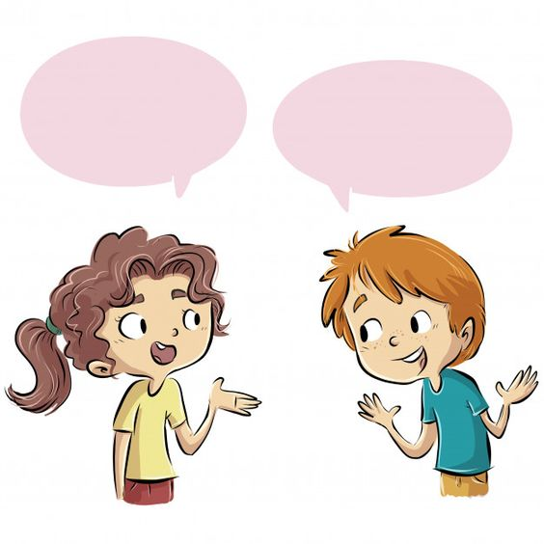

Slide 31
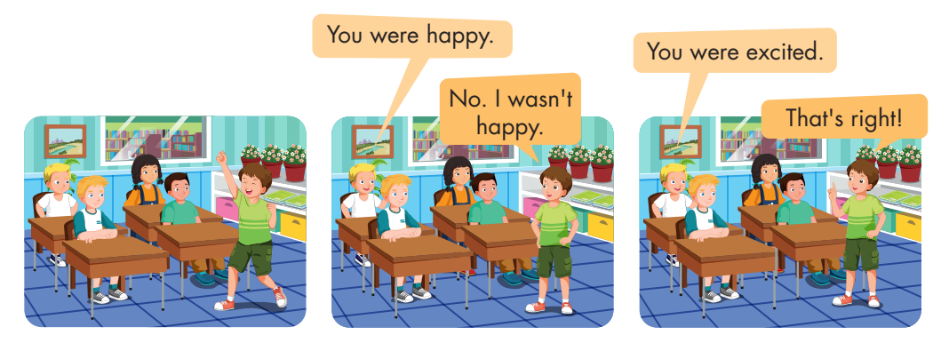

Slide 32
CONSOLIDATION

Slide 33
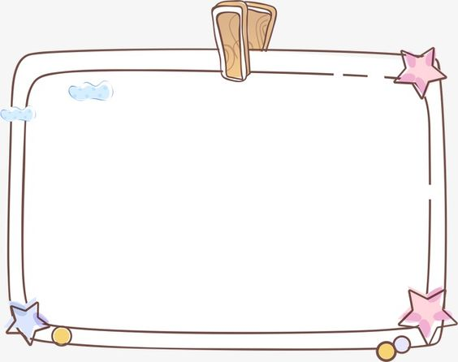
You were_________
That’s __________.
A
hungry/ right
B
surprised/ right
C
tired / right

Slide 34
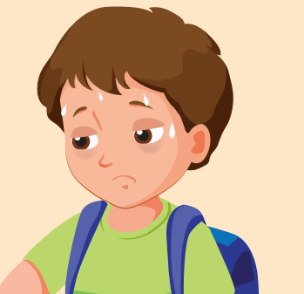
He was hungry.
No, _____. ______________.
A
he wasn’t/ He was tired.
B
he was/ He was tired.
C
He was/ He wasn’t tired.

Slide 35
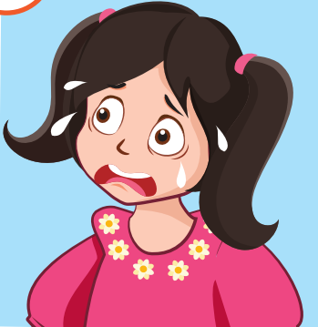
You were ______
____________.
A
thirsty/ That’s right.
B
scared/ No, I wasn’t.
C
scared/ That’s right.

Slide 36
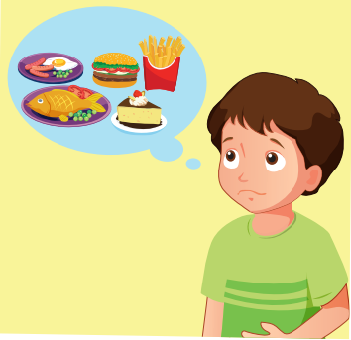
____________
Yes, ______.
A
You was hungry./ I was.
B
You were hungry./ I was.
C
You were hungry./ I were.

Slide 37
WRAP-UP

Slide 38
Today’s lesson
Vocabularies
hungry, thirsty, scared, surprised, tired, excited
Structures/ Sentence patterns
- I was tired.
- Alfie wasn't thirsty. He was hungry.
- Lucy and Ben weren't scared. They were excited.

Slide 39
Homework
Practice the vocabularies and structure, and make sentences using them.
Prepare the next lesson (page 109 SB)
Play the consolidation games in Tiếng Anh 4 i-Learn Smart Start DHA App on www.eduhome.com.vn

Slide 40
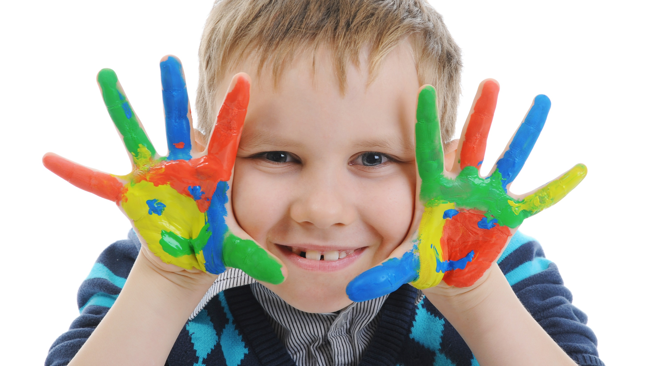
Enjoy your day!

