Slide 1








WELCOME
GRADE 5
Notes:
Ms Dike

Slide 2









WARMER
Notes:
Ms Dike

Slide 3

0. Do you want to play badminton?
→ No, thanks.

Slide 4
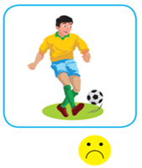
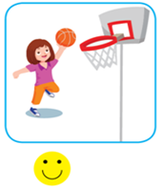


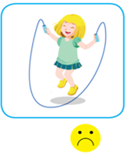
1
2
3
4
5

Slide 5











THEME 1
SCHOOL
Lesson 4

Slide 6
















LESSON 4
VOCABULARY
STORY & STRUCTURE
SING A SONG
PRACTICE STRUCTURE
PLAY GAME
Notes:
Ms Dike

Slide 7

VOCABULARY

Slide 8

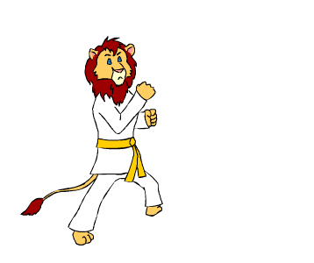
martial arts

Slide 9
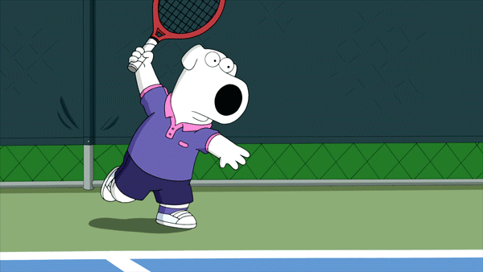
tennis

Slide 10
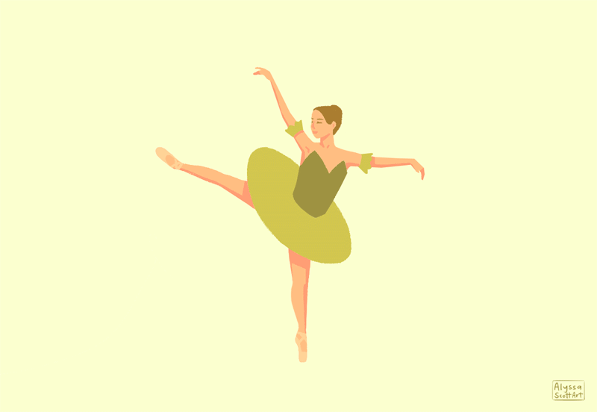
ballet

Slide 11
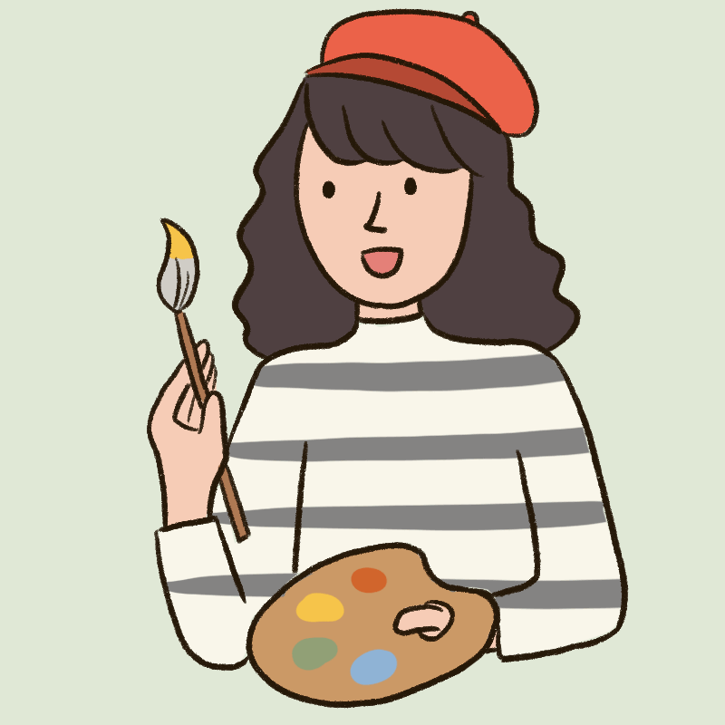
art

Slide 12
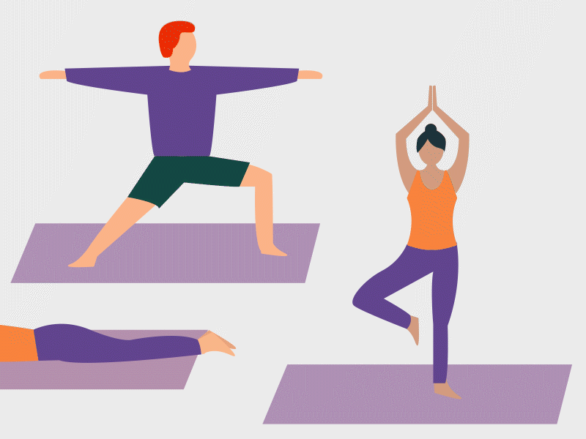
yoga

Slide 13

LOOK AND SAY

Slide 14
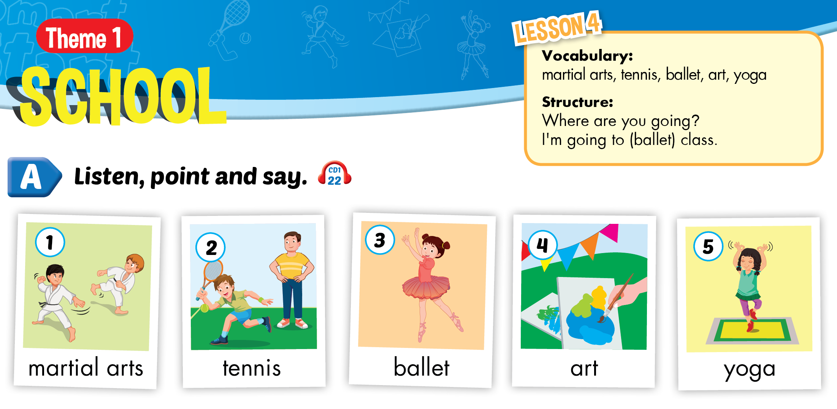


Slide 15
STRUCTURE

Slide 16

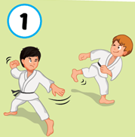
Where are you going?
→ I’m going to martial arts class.

Slide 17

D. PRACTICE.
POINT, ASK AND ANSWER.
Notes:
Ms Dike

Slide 18
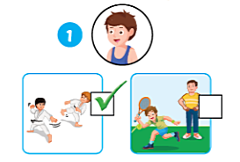
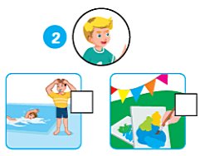

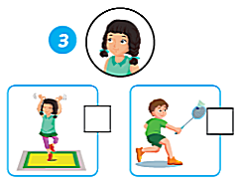
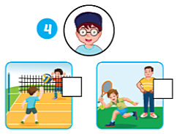
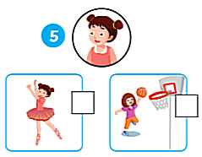
Where are you going?
I’m going to martial arts class.
2. Where are you going?
I’m going to art class.
✓
3. Where are you going?
4. Where are you going?
5. Where are you going?
Oh. I’m going to yoga class.
I’m going to tennis class.
I’m going to ballet class.
✓
✓
✓

Slide 19

B1. LISTEN AND READ

Slide 20

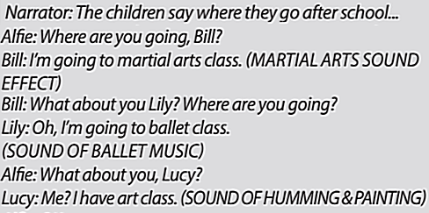
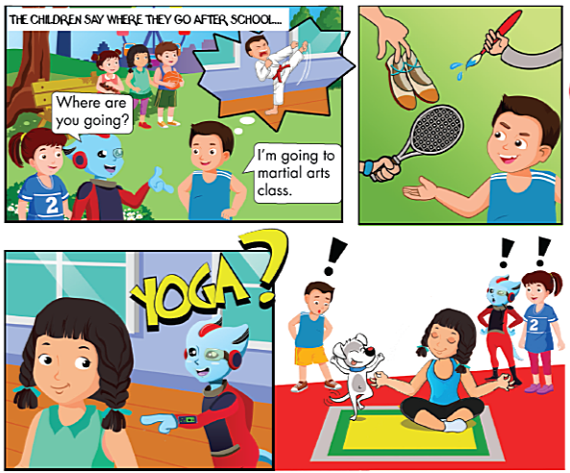


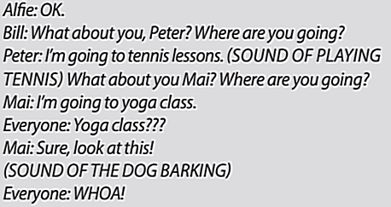
Who are they?
 What are they talking about?

Slide 21
B2.LISTEN AND CIRCLE

Slide 22
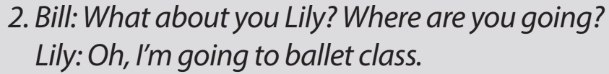
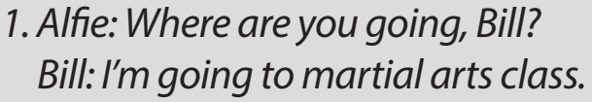


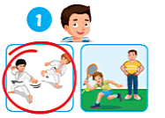
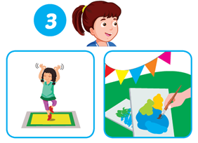
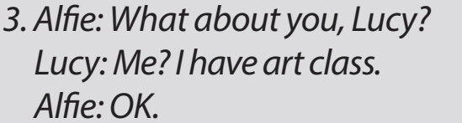
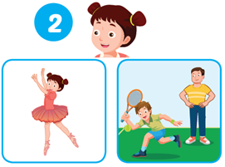
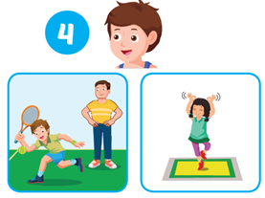

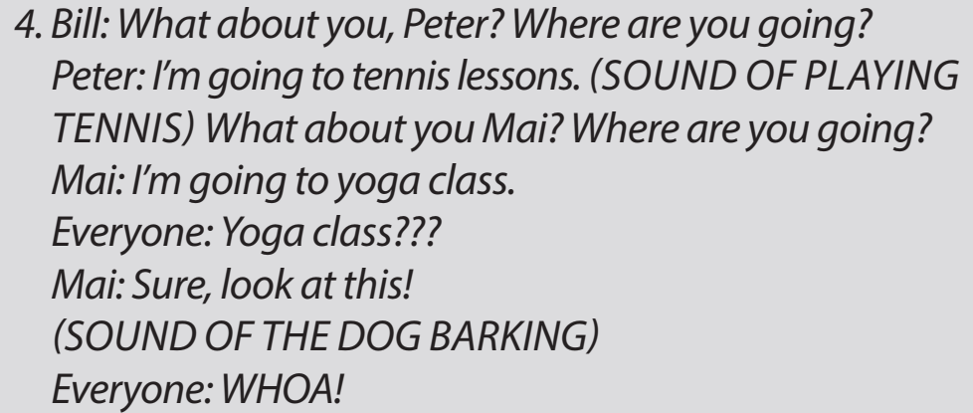

Slide 23
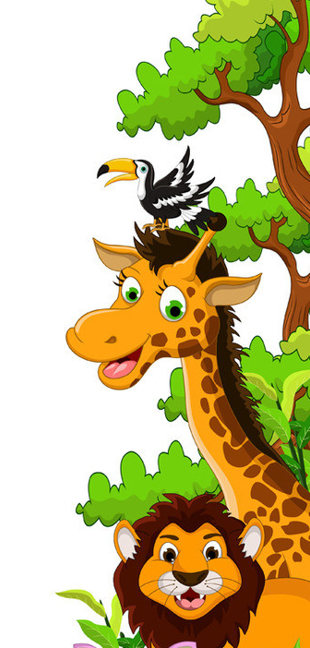
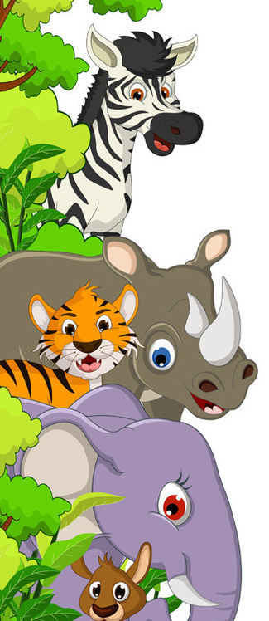


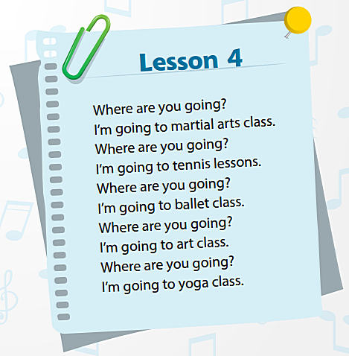
C.LISTEN. SING ALONG.

Slide 24
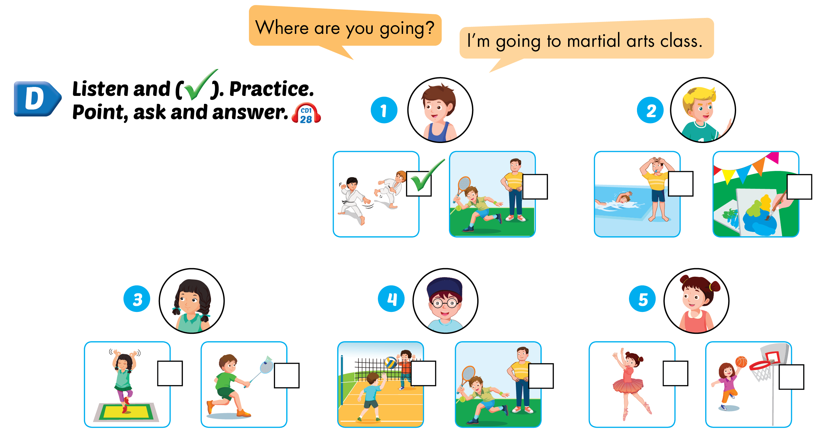
Lesson 4
D. LISTEN AND ( ✓)

Slide 25

Lesson 4
D. LISTEN AND ( ✓)

Slide 26
E. Play the “ Pretend” game

Slide 27
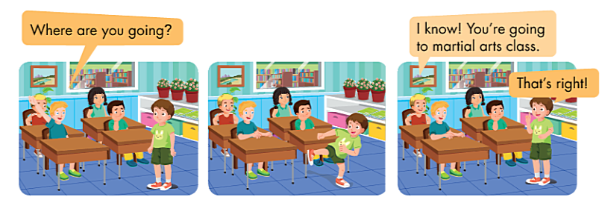
Notes:
Ms Dike

Slide 28

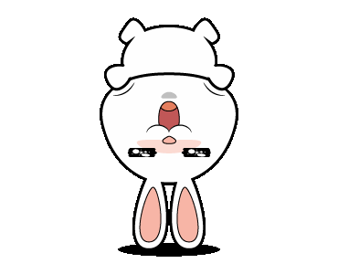
IT’S GAME TIME!

Slide 29


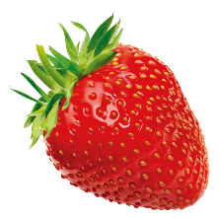


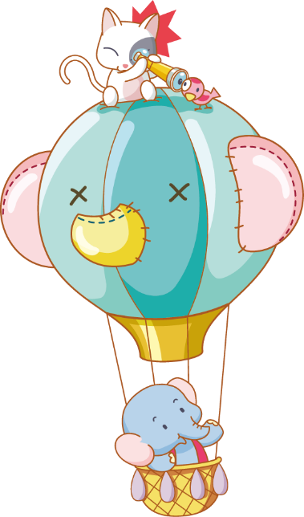

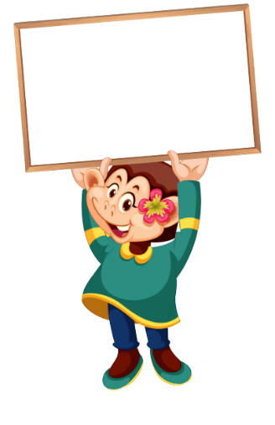

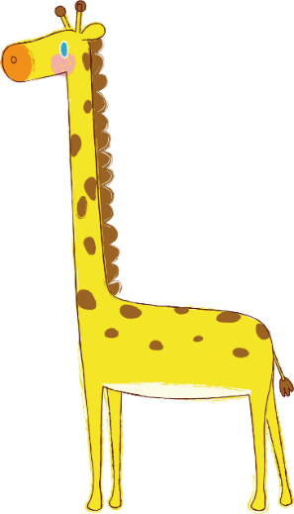

Luật chơi:
Chia lớp thành 2 đội
Bấm nút để quay, màu để dừng
Trả lời đúng được cộng điểm, trả lời sai nhường quyền trả lời cho đội bạn.
Kết thúc trò chơi đội nhiều điểm hơn sẽ chiến thắng.
PLAY

Slide 30

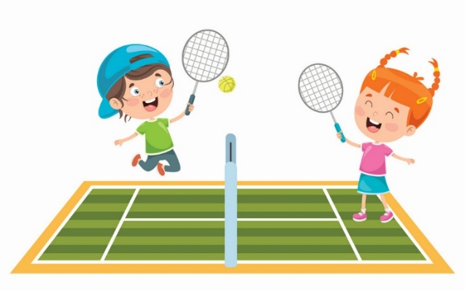



27
What do you do after school?
20
I play tennis.
I play table tennis.
A.
B.
QUESTION
I play badminton
I play football.
C.
D.

Slide 31
Where are you going?
10
I’m going to play basketball.
I’m going to martial art class.
A.
B.
QUESTION
I’m going to art class.
I’m going to martial class.
C.
D.

Slide 32
Whose nose grew longer every time he lied?
10
Tinkerbell
Peter Pan
A.
B.
QUESTION
Pinocchio
Frog prince
C.
D.

Slide 33
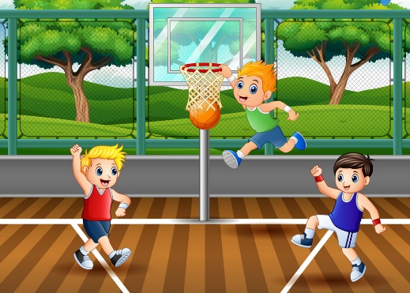
Do you want ______ play basketball?
10
in
at
A.
B.
QUESTION
on
to
C.
D.

Slide 34
What colors are the stars on American flag?
10
blue
white
A.
B.
QUESTION
yellow
red
C.
D.

Slide 35
What did you do in the summer?
10
I went to art class.
I played football.
A.
B.
QUESTION
I learned how to swim.
I’m going to art class.
C.
D.

Slide 36
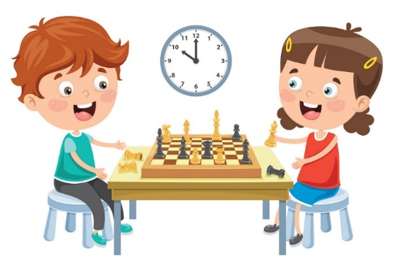
What are they doing?
20
They playing chess.
They’re playing chess.
A.
B.
QUESTION
They’re play chess.
They’re playing chees.
C.
D.

Slide 37
How many legs does a spider have?
20
eight
six
A.
B.
QUESTION
I’m American.
I’m American.
C.
D.

Slide 38
__________ after school?
I play football.
20
What do you do
What do you
A.
B.
QUESTION
What are you do
What’s do you do
C.
D.

Slide 39
Where are you going?
20
I’m going yoga class.
I’m going to ballet class.
A.
B.
QUESTION
I’m going to yoga class.
I’m going to balet class.
C.
D.

Slide 40


Slide 41

Theme 1: School (4)
1.
+ martial arts : võ thuật
+ tennis : quần vợt
  + ballet : múa ba-lê
+ art : môn mỹ thuật
+ yoga : yo-ga, ngồi thiền
  2.
- Where are you going?
→ I’m going to martial arts class.
Notes:
Ms Dike

Slide 42
Thanks
Notes:
Ms Dike

