Slide 1
GRADE 5 Theme 1 SCHOOL
Notes:
Ms Dike

Slide 2
2
VOCABULARY
Thanh Yến Trần 0967 255 149 zalo/ FB https://www.facebook.com/thanhyentrananhngutaymy/

Slide 3
Thanh Yến Trần 0967 255 149 zalo/ FB https://www.facebook.com/thanhyentrananhngutaymy/
study

Slide 4
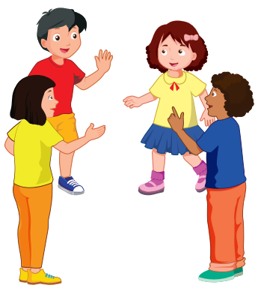
talk with friends
Thanh Yến Trần 0967 255 149 zalo/ FB https://www.facebook.com/thanhyentrananhngutaymy/

Slide 5
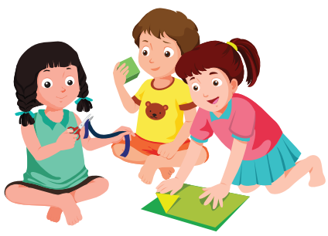
play with friends
Thanh Yến Trần 0967 255 149 zalo/ FB https://www.facebook.com/thanhyentrananhngutaymy/

Slide 6
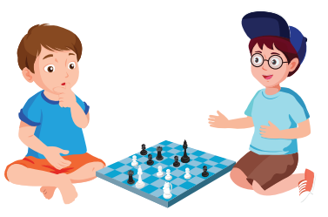
play chess
Thanh Yến Trần 0967 255 149 zalo/ FB https://www.facebook.com/thanhyentrananhngutaymy/

Slide 7
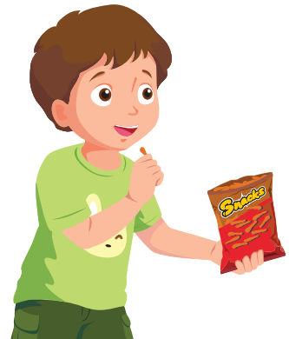
eat snacks
Thanh Yến Trần 0967 255 149 zalo/ FB https://www.facebook.com/thanhyentrananhngutaymy/

Slide 9
Look and say
Notes:
Ms Dike

Slide 11
3
STRUCTURE
Thanh Yến Trần 0967 255 149 zalo/ FB https://www.facebook.com/thanhyentrananhngutaymy/

Slide 12
What are they doing?
Thanh Yến Trần 0967 255 149 zalo/ FB https://www.facebook.com/thanhyentrananhngutaymy/
They’re studying.

Slide 13
What + be (am/is/are)+ S+ V_ing?
→ S + be (am/is/are) + V_ing.
- What is he / she doing?
→ He’s / She’ s swimming.

Slide 14
Lesson 2

Slide 15
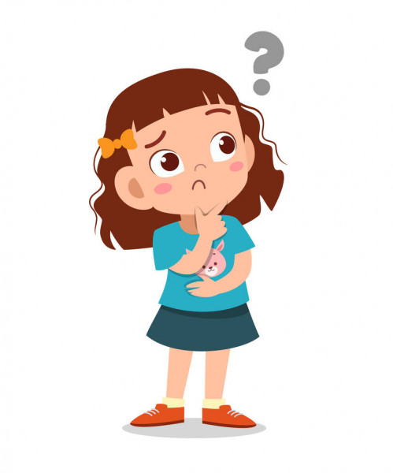
Speaking Practice
What are they doing?
They’re talking with friends.

Slide 16
Speaking Practice
What is he doing?
He’s eating snacks.

Slide 17
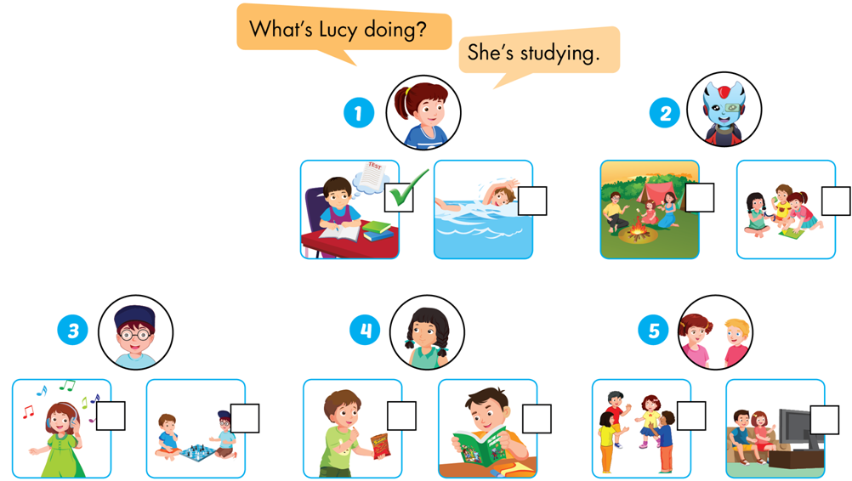
D. PRACTICE, POINT, ASK AND ANSWER

Slide 18
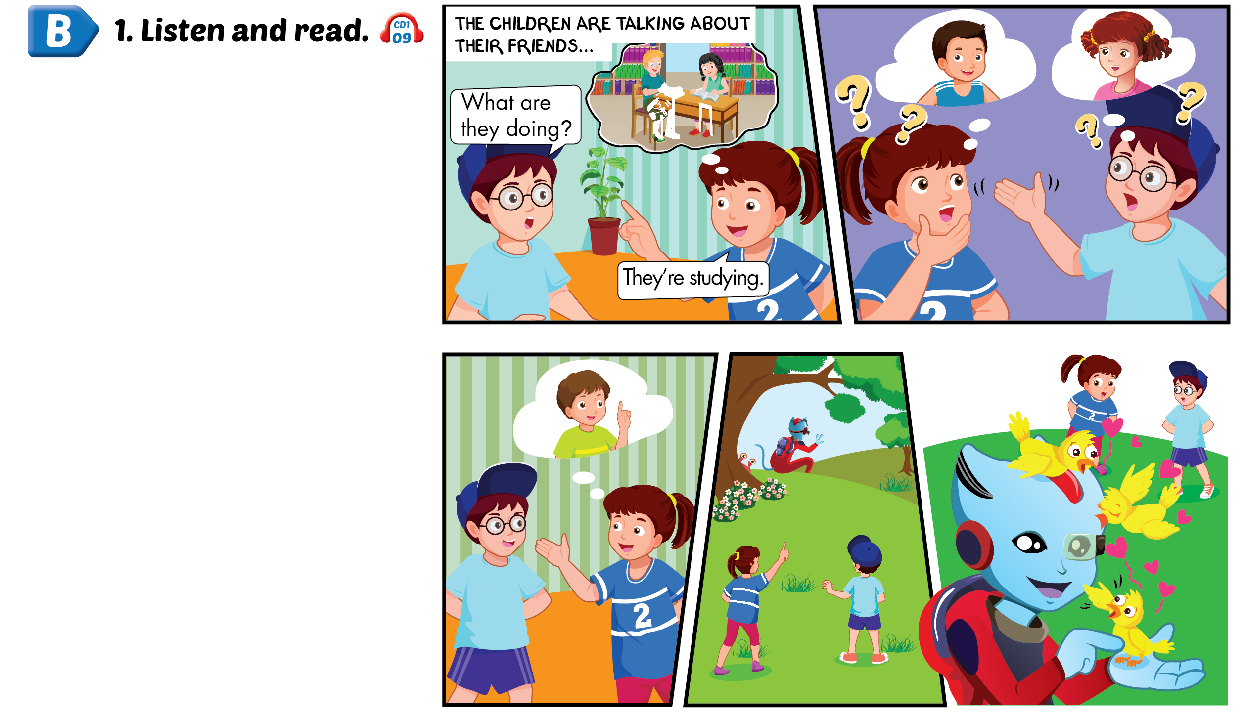
Lesson 2

Slide 19
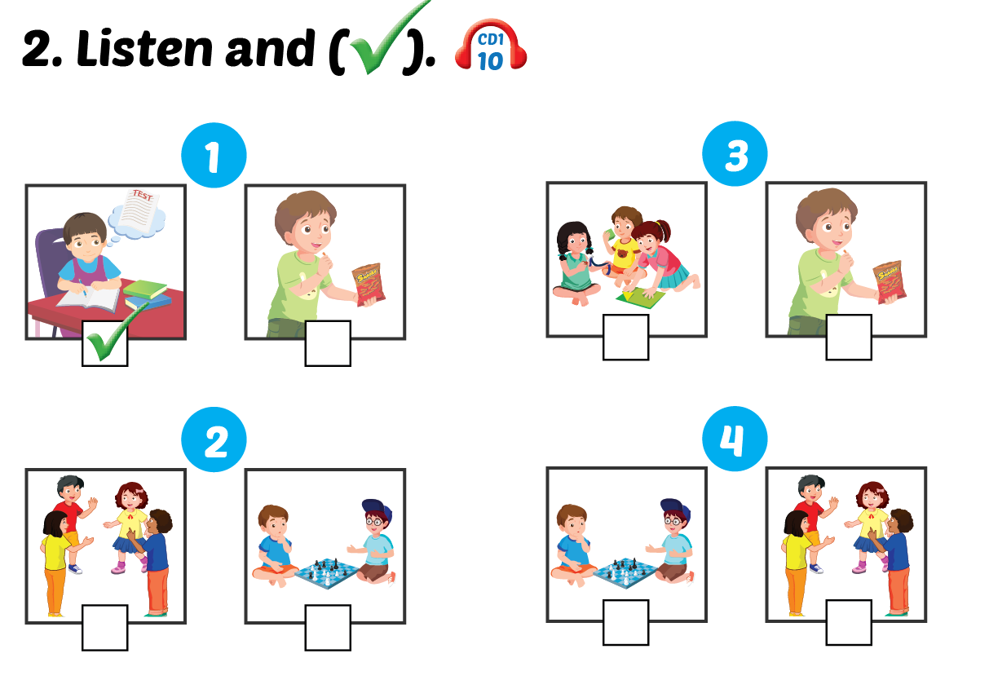
Lesson 2

Slide 20
Lesson 2
Notes:
Ms Dike

Slide 21
LISTEN. SING A LONG

Slide 22
Lesson 2

Slide 23
Lesson 2

Slide 24
Theme 1: School (2)
1.
+ study = + learn : học
+ talk with friends : trò chuyện với bạn
+ play with friends : chơi với bạn
+ play chess : chơi cờ
+ eat snacks : ăn nhẹ
2. Các động từ thêm «ing»trong Thì hiện tại tiếp diễn:
+ study – studying
+ talk – talking
+ play – playing
+ eat – eating
3. Hỏi – đáp họ đang làm gì:
- What are they doing?
→ They’re studying.

Slide 25
Bye Bye
Notes:
Ms Dike

