Slide 1
WELCOME TO NEW SCHOOL YEAR
GRADE 5

Slide 2
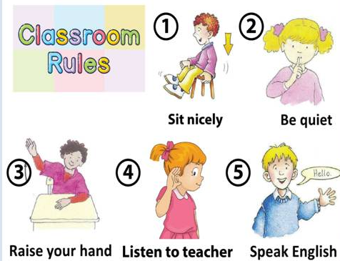

Slide 3
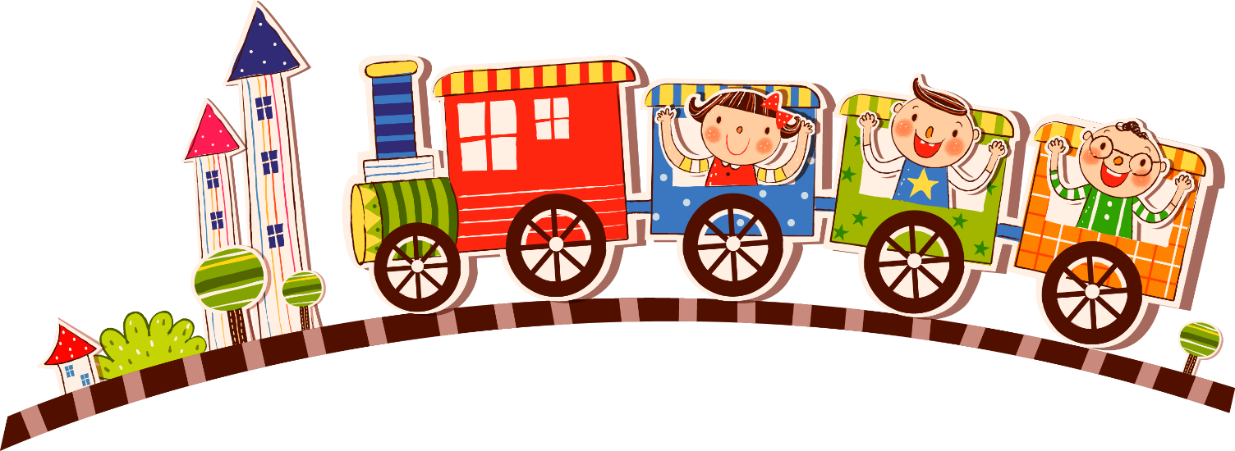
Warmer

Slide 4
THEME 1
SCHOOL
Lesson 1
Notes:
Ms Dike

Slide 5
VOCABULARY
Notes:
Ms Dike

Slide 6
LISTEN AND POINT

Slide 7
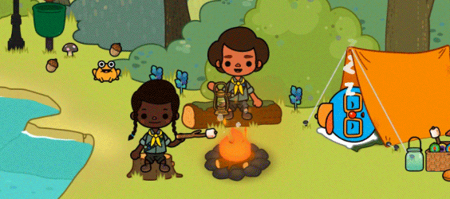
Vocabulary
go camping

Slide 8
Vocabulary
go to the beach

Slide 9
Vocabulary
go to the farm

Slide 10
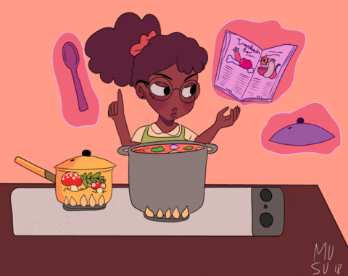
Vocabulary
learn how to cook

Slide 11
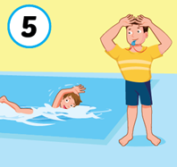
Vocabulary
learn how to swim

Slide 12
Lesson 1

Slide 13
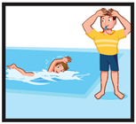
LOOK AND SAY:
go to the farm
learn how to swim
learn how to cook
go to the beach
go camping
Notes:
Ms Dike

Slide 14
GAMETIME

Slide 15
learn how to cook

Slide 16
go to the beach

Slide 17
go camping

Slide 18
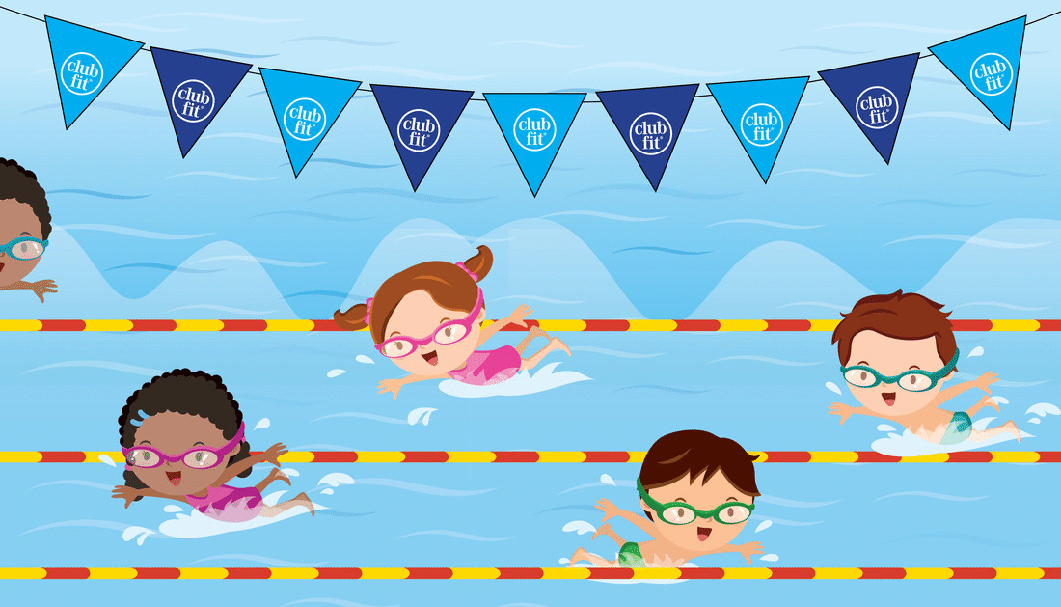
learn how to swim

Slide 19
go to the farm

Slide 20
STRUCTURE
Notes:
Ms Dike

Slide 21
What did you do in the summer?
- I went to the beach.

Slide 22
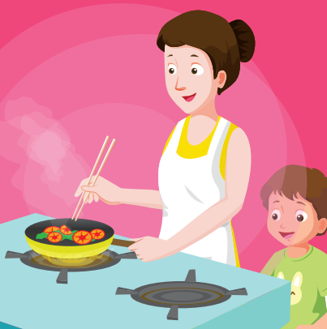
What did you do
in the summer?
I learned how to
cook.

Slide 23
Practice the structure
EX 1: What did you do in the summer?
→ I went to the beach.
SIMPLE PAST
QUESTION
go – went
learn – learnt/ learned

Slide 24
Tasks: Look at the picture and answer these questions

Slide 25
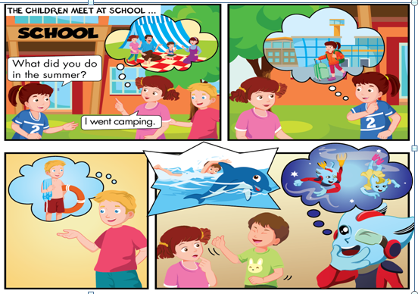
Who are they?
Where do they meet?

Slide 26
B1.Listen and read

Slide 27
Lesson 1

Slide 28
B2.LISTEN AND DRAW LINES

Slide 29
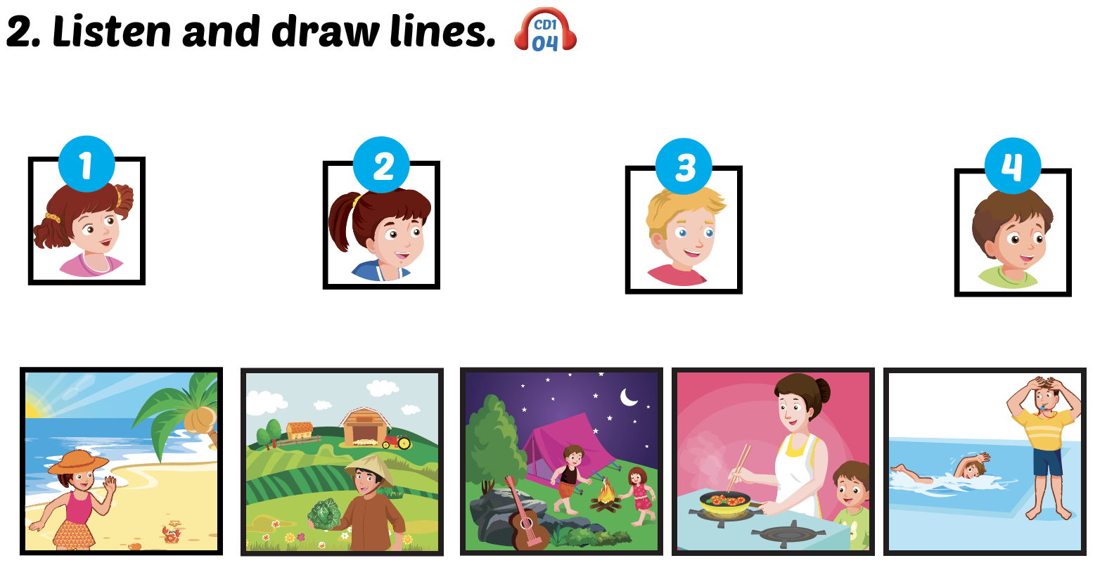
Lesson 1

Slide 30
Lesson 1

Slide 31
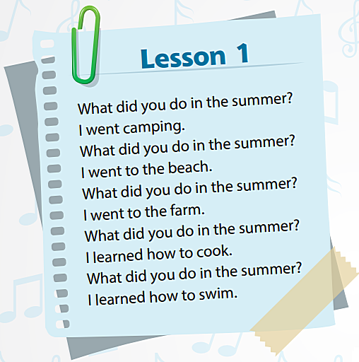
Click me to sing along.
Notes:
Ms Dike

Slide 32
Click me to listen pronunciation tip.
What did you do in the summer?

Slide 33
D. PRACTICE, POINT, ASK AND ANSWER
Lesson 1

Slide 34
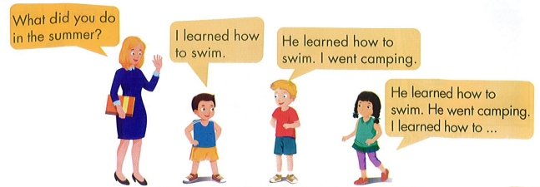
PLAY THE ‘MEMORY CHANT’ GAME

Slide 35
Theme 1: School (1)
1.
+ go camping : đi cắm trại
+ go to the beach : đến bãi biển
+ go to the farm : đến nông trại
+ learn how to cook : học nấu ăn
+ learn how to swim : học bơi
+ summer : mùa hè
2. Động từ quá khứ:
+ go – went
+ do – did
+ learn – learned/ learnt
3. Hỏi – đáp bạn đã làm gì vào mùa hè này:
- What did you do in the summer?
→I learned how to swim.

Slide 37
GOODBYE!!!
Notes:
Ms Dike

Slide 38
BYE BYE

