Slide 1

Unit 6: FOOD AND DRINKS
Lesson 3 (E,F) Page 86
& Part C,D (WB)page 57

Slide 2













Slide 3

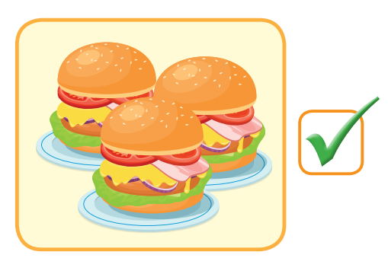

Y
Will you bring hamburgers?
Yes, I will.
CHECK
Notes:
3

Slide 4
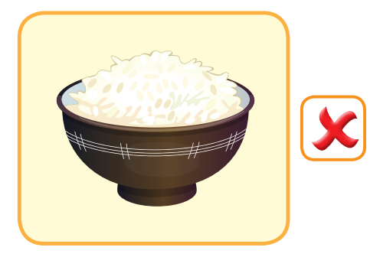
Will you bring rice?
No, I won’t.
CHECK
Notes:
4

Slide 5

Will she bring curry?
No, she won’t.
CHECK
Notes:
5

Slide 6
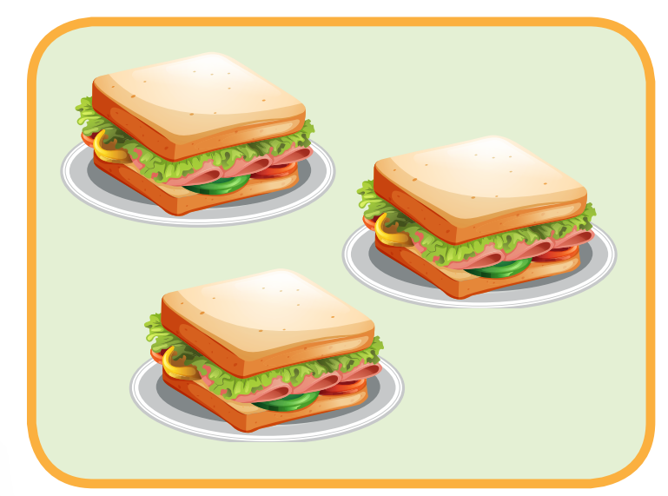

Y
Will he bring sandwiches?
Yes, he will.
CHECK
Notes:
6

Slide 7

Y
Will he bring pie?
Yes, he will.
CHECK
Notes:
7

Slide 8

It’s time to learn …

Slide 9

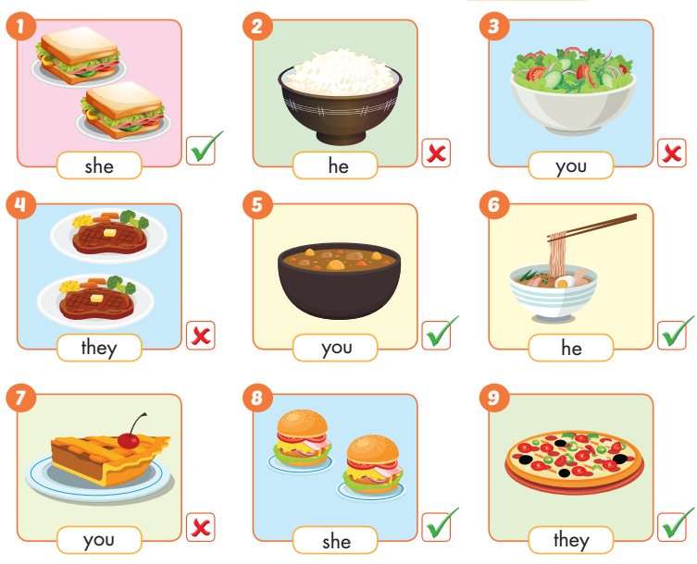

Slide 10

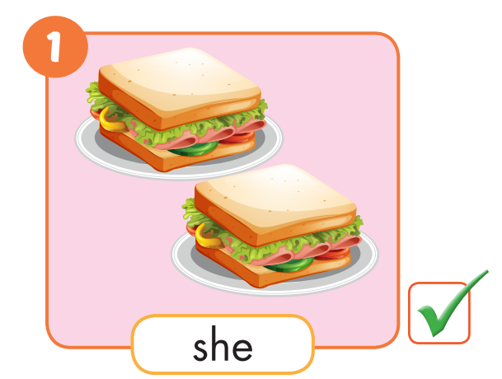

Slide 11
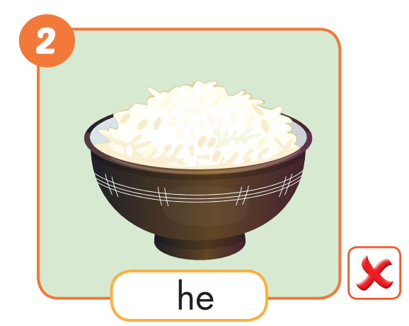
Will he bring _______?
rice
No,he won’t.

Slide 12
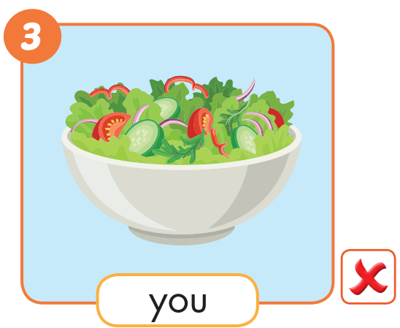
Will you bring ______?
salad
No, I won’t.

Slide 13
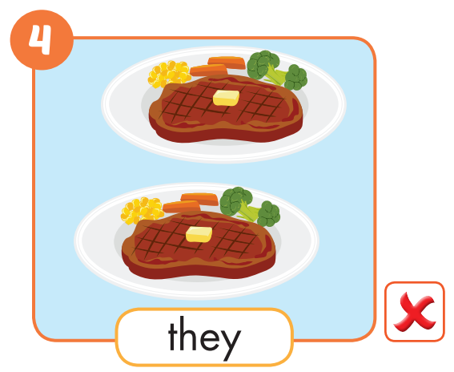
Will they bring ______?
steaks
No, they won’t.

Slide 14
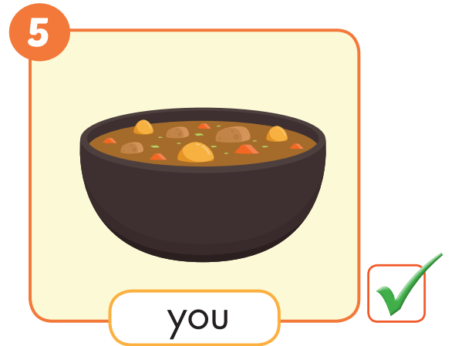
Will you bring ______?
curry
Yes, I will.

Slide 15
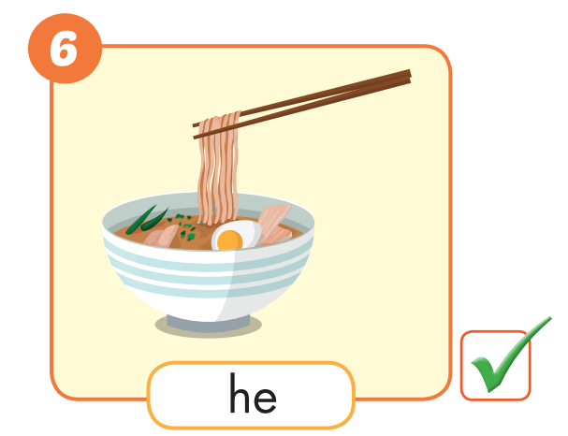
Will he bring _________?
noodles
Yes,he will.

Slide 16
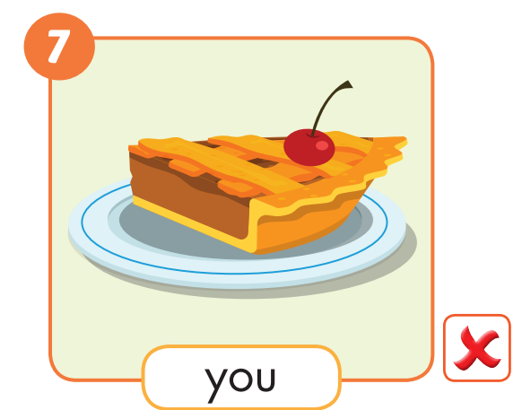
Will you bring _________?
pie
No, I won’t.

Slide 17
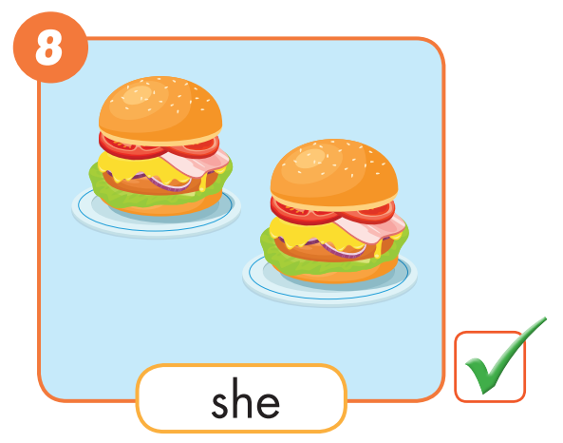
Will she bring ____________?
hamburgers
Yes, she will.

Slide 18
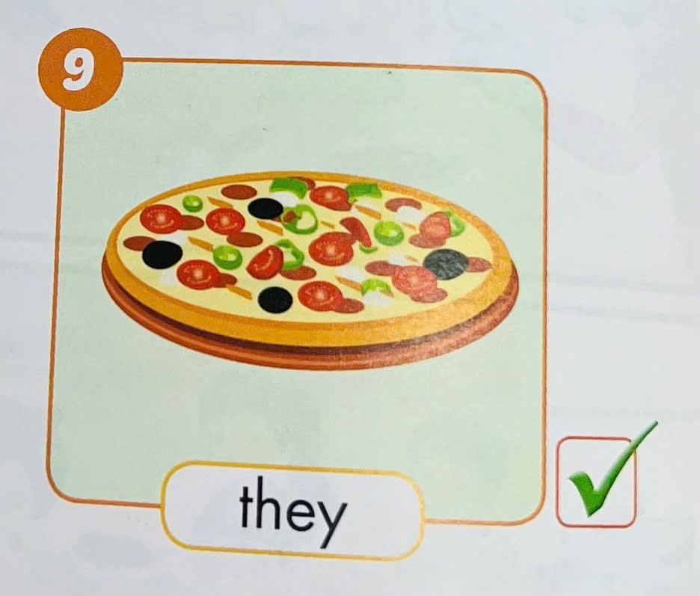
Will they bring ____________?
a pizza
Yes, they will.

Slide 19



Slide 20

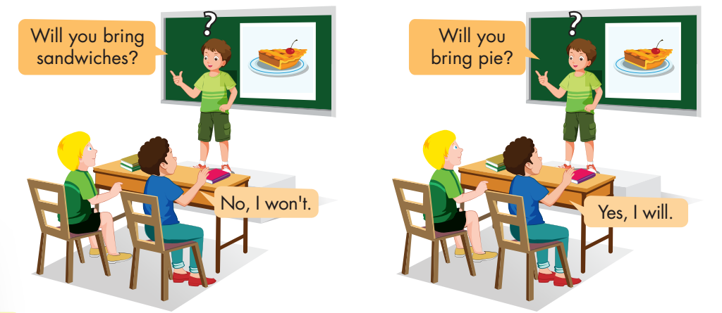

Slide 21


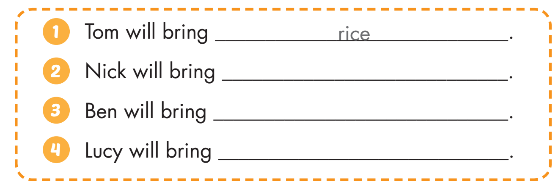
Practice
WB, page 57
steaks
curry
sandwiches

Slide 22

Enjoy your day!

