Slide 1











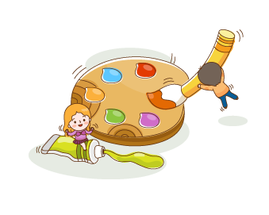
UNIT 1:
My Friends
Lesson 1
Notes:
Thanh Yến Trần 0967 255 149 zalo/ FB https://www.facebook.com/thanhyentrananhngutaymy/

Slide 2

Warm Up

Slide 3


Slide 4
Vocabulary

Slide 5


Slide 6



Notes:
Thanh Yến Trần 0967 255 149 zalo/ FB https://www.facebook.com/thanhyentrananhngutaymy/

Slide 7



Slide 8




Slide 9




Slide 10



Slide 11
Random
game
(open slides game)

Slide 12
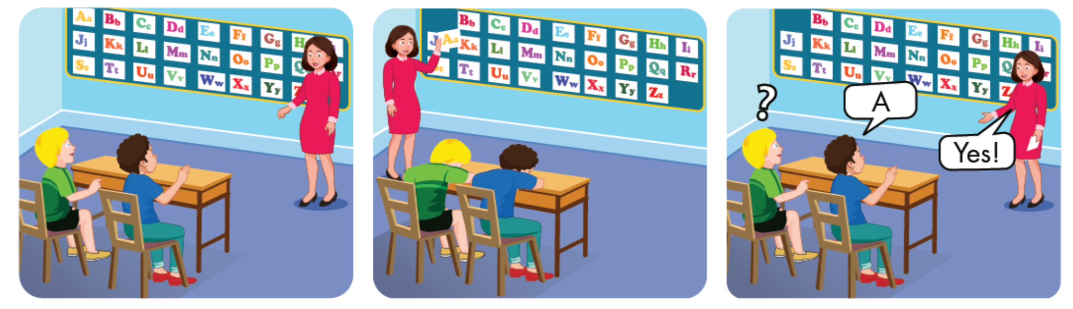

Slide 13
Sentence

Slide 14

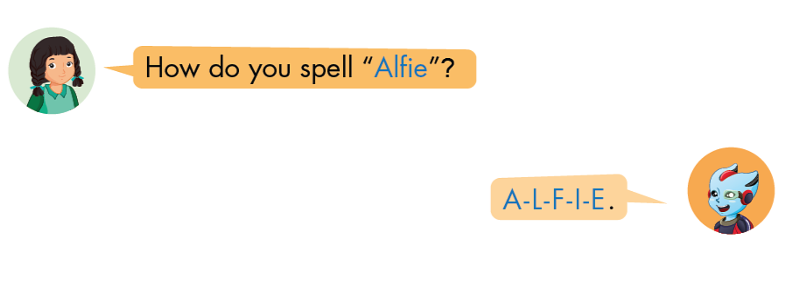

Slide 15


Structure
How do you spell “ Peter”?
P-E-T-E-R

Slide 16
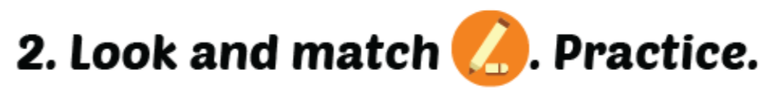

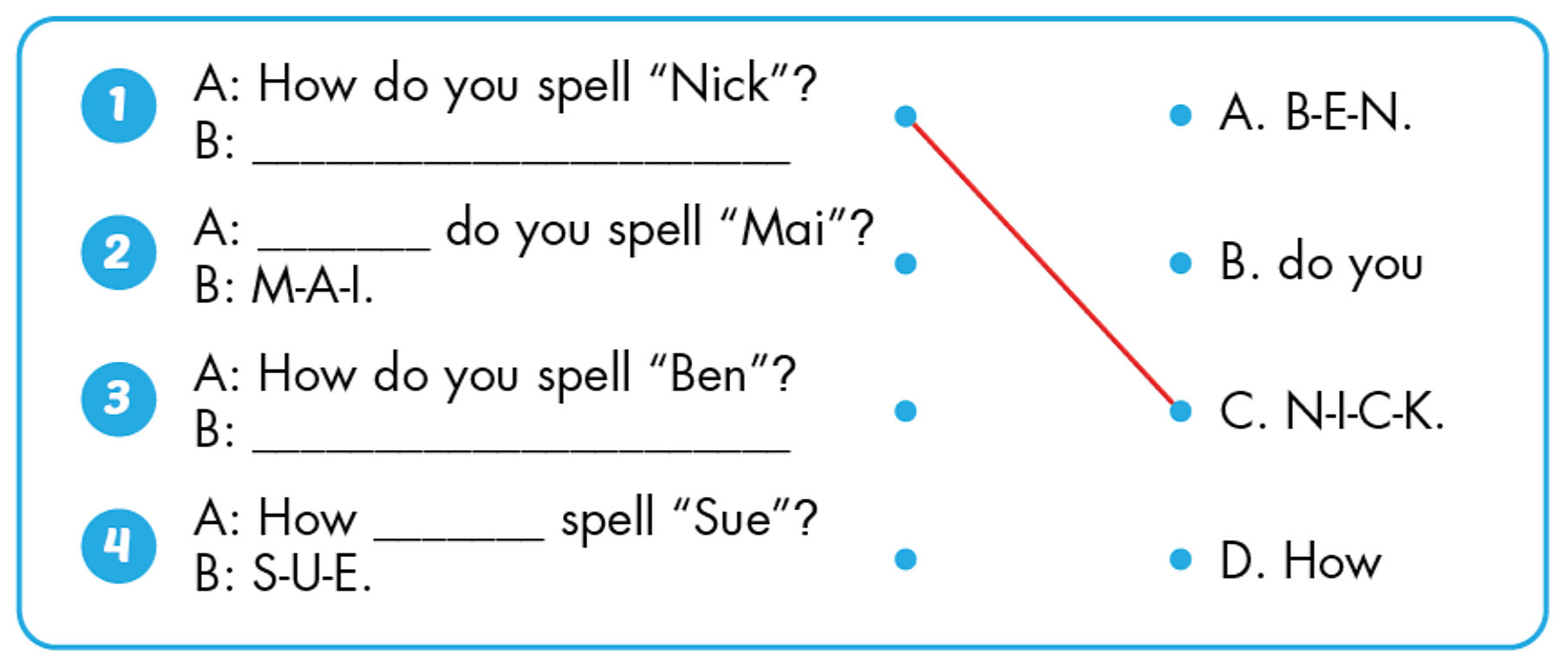

Slide 17



Slide 18

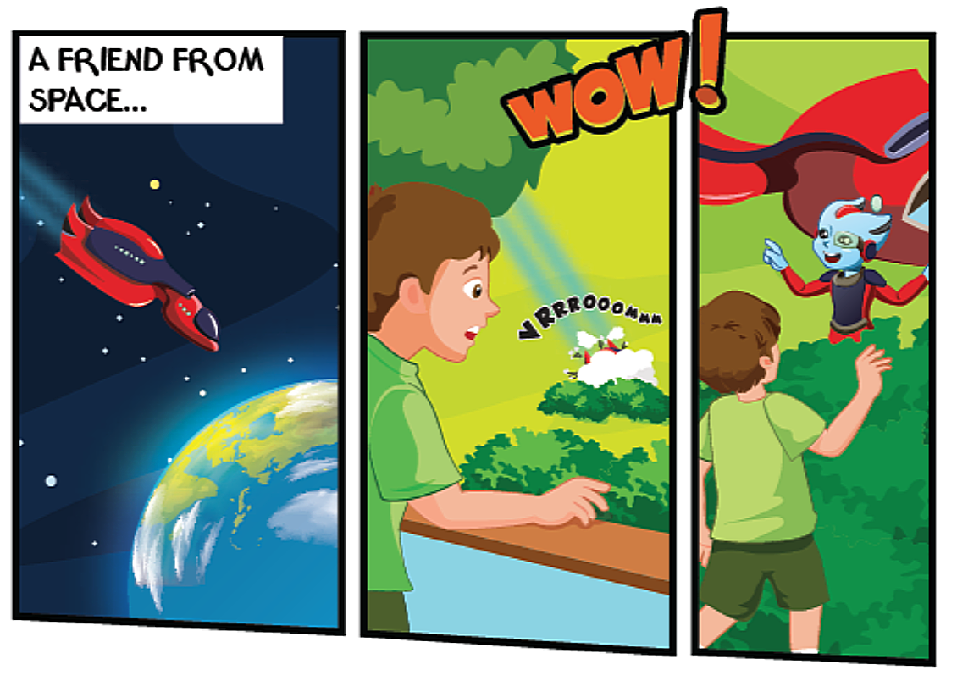
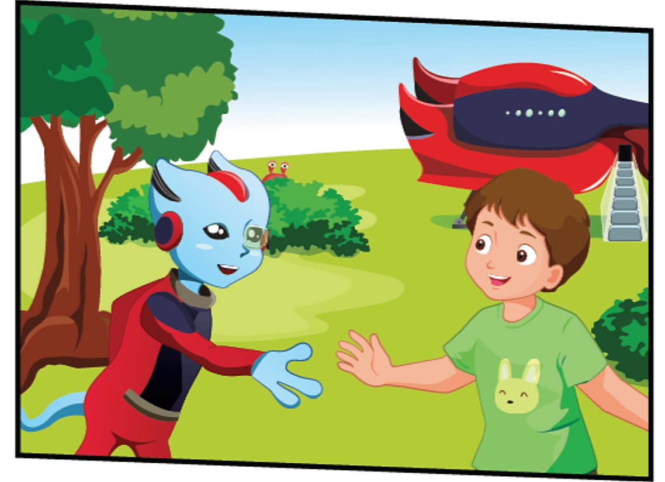
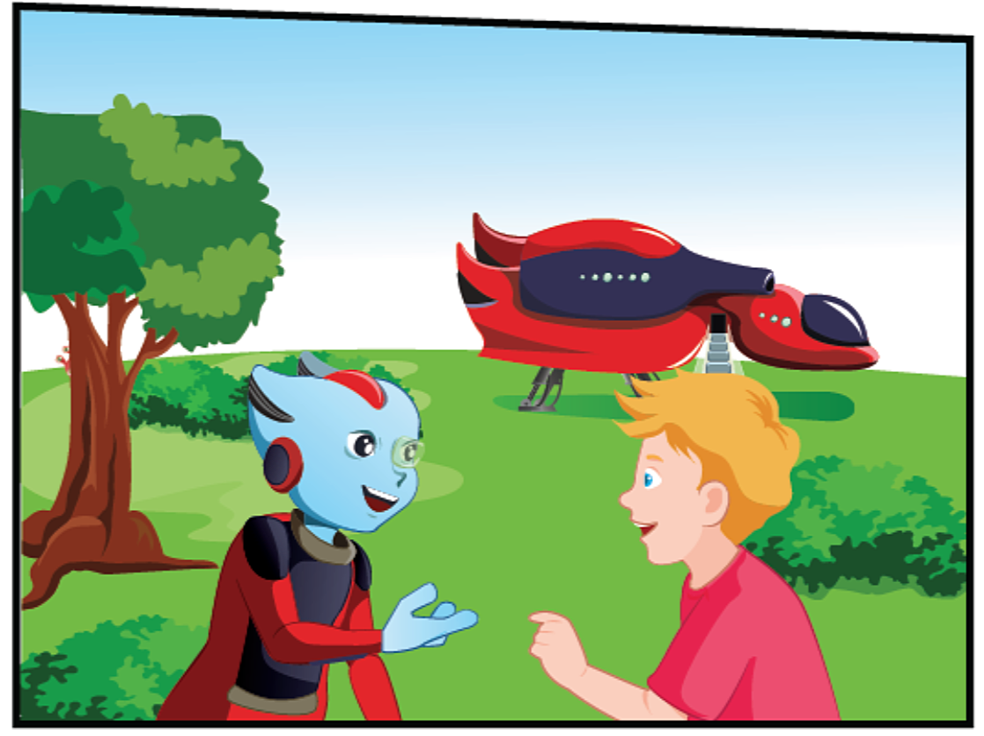

Slide 19
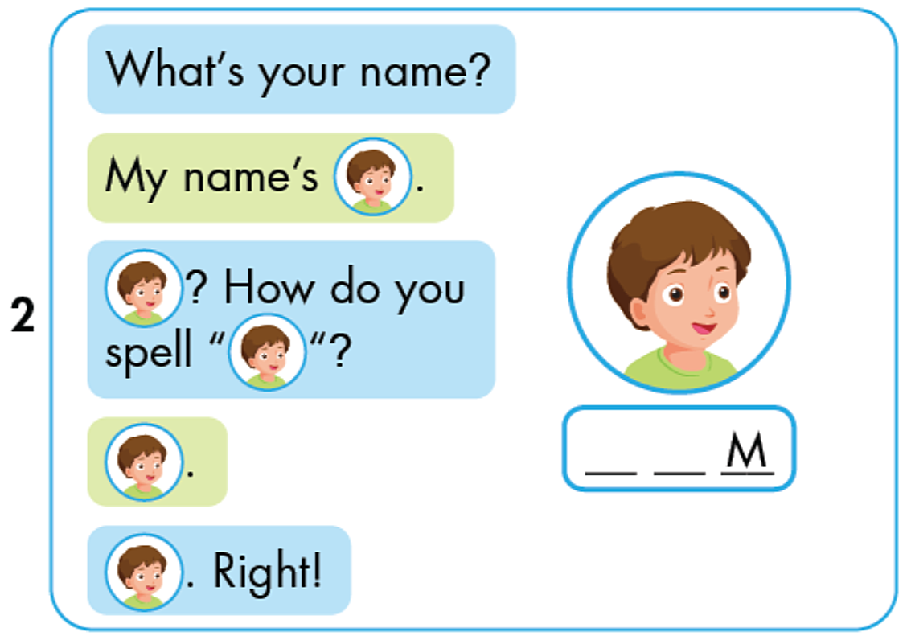

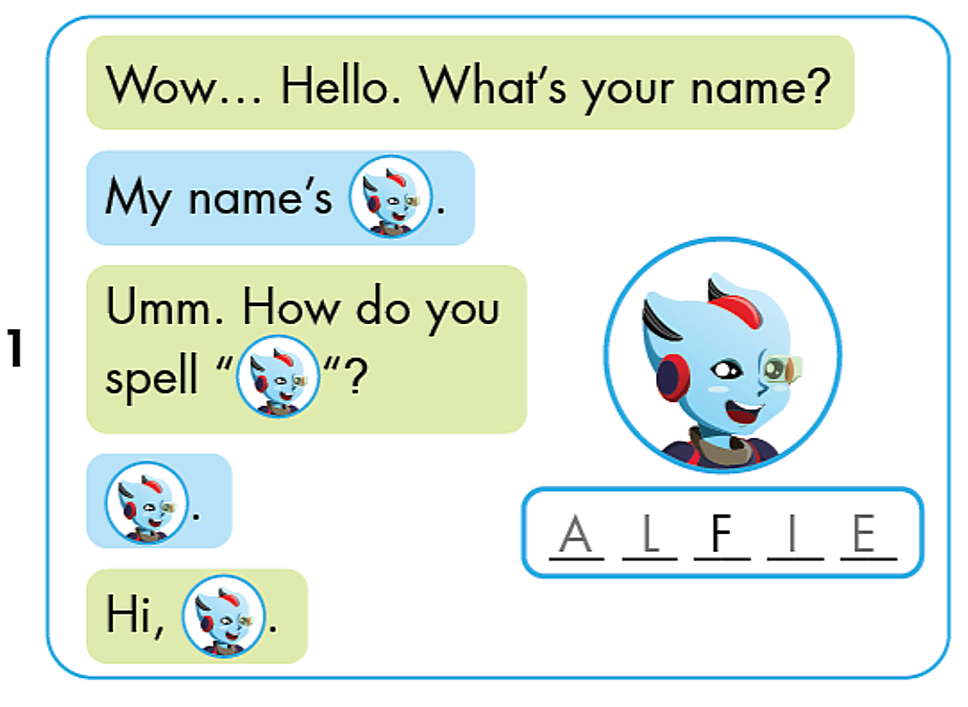
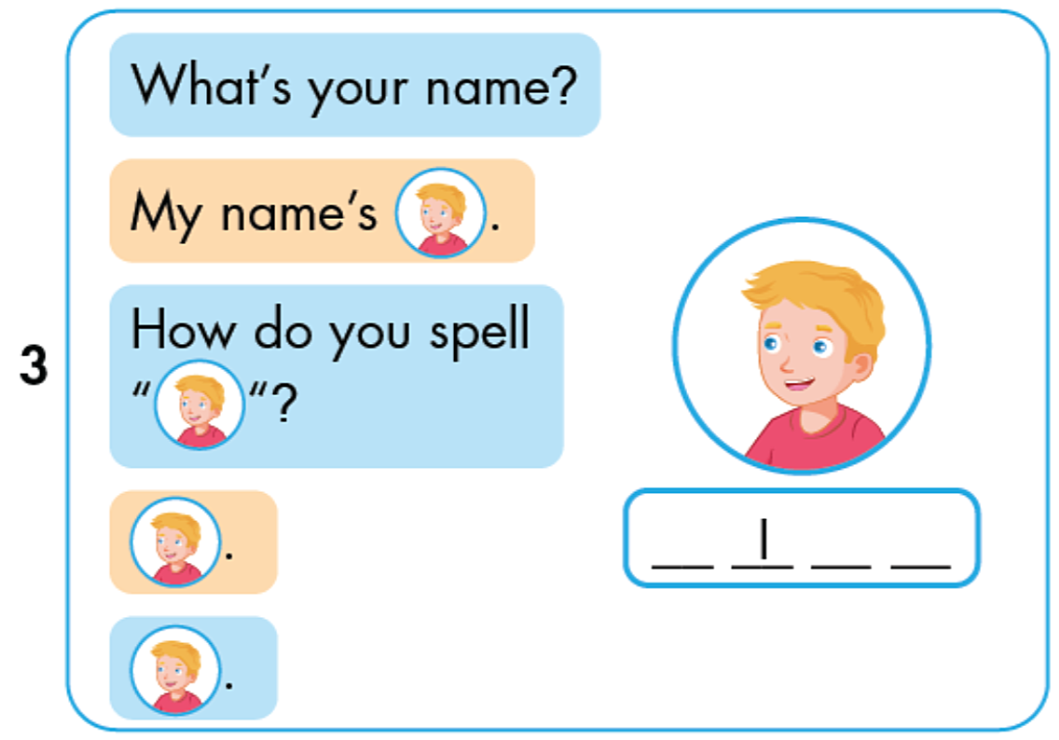
T O
N C K

Slide 20


Slide 21
GAME

Slide 22














Notes:
Thanh Yến Trần 0967 255 149 zalo/ FB https://www.facebook.com/thanhyentrananhngutaymy/

Slide 23




Listen and choose
What’s your name ?
My name is………….
Marry
Linda
Mandy
Notes:
Thanh Yến Trần 0967 255 149 zalo/ FB https://www.facebook.com/thanhyentrananhngutaymy/

Slide 24

Listen and choose
How do you spell your name ?
It’s………….
Billy
David
Peter
Notes:
Thanh Yến Trần 0967 255 149 zalo/ FB https://www.facebook.com/thanhyentrananhngutaymy/

Slide 25

Listen and choose
Hello, my name is…….
Anne
Anna
Andy
Notes:
Thanh Yến Trần 0967 255 149 zalo/ FB https://www.facebook.com/thanhyentrananhngutaymy/

Slide 26

Listen and choose
What’s your name ?
I’m………….
Jane
Jimmy
Jenny
Notes:
Thanh Yến Trần 0967 255 149 zalo/ FB https://www.facebook.com/thanhyentrananhngutaymy/

Slide 27

….. do you spell your name ?
It’s S-A-N-D-Y
Who
How
Why
Notes:
Thanh Yến Trần 0967 255 149 zalo/ FB https://www.facebook.com/thanhyentrananhngutaymy/

Slide 28

Listen and choose
Hello, my name is…….
J-I-M
J-E-M
J-A-M
Notes:
Thanh Yến Trần 0967 255 149 zalo/ FB https://www.facebook.com/thanhyentrananhngutaymy/

Slide 29
Listen and choose
What’s your name ?
I’m Mr………….
Jacks
Jones
Jonhs
Notes:
Thanh Yến Trần 0967 255 149 zalo/ FB https://www.facebook.com/thanhyentrananhngutaymy/

Slide 30

Listen and choose
How do you spell your name ?
It’s………….
Tommy
Thimes
Thomas
Notes:
Thanh Yến Trần 0967 255 149 zalo/ FB https://www.facebook.com/thanhyentrananhngutaymy/

Slide 31


WELLDONE!
Notes:
Thanh Yến Trần 0967 255 149 zalo/ FB https://www.facebook.com/thanhyentrananhngutaymy/

Slide 32
SPEAKING

Slide 33
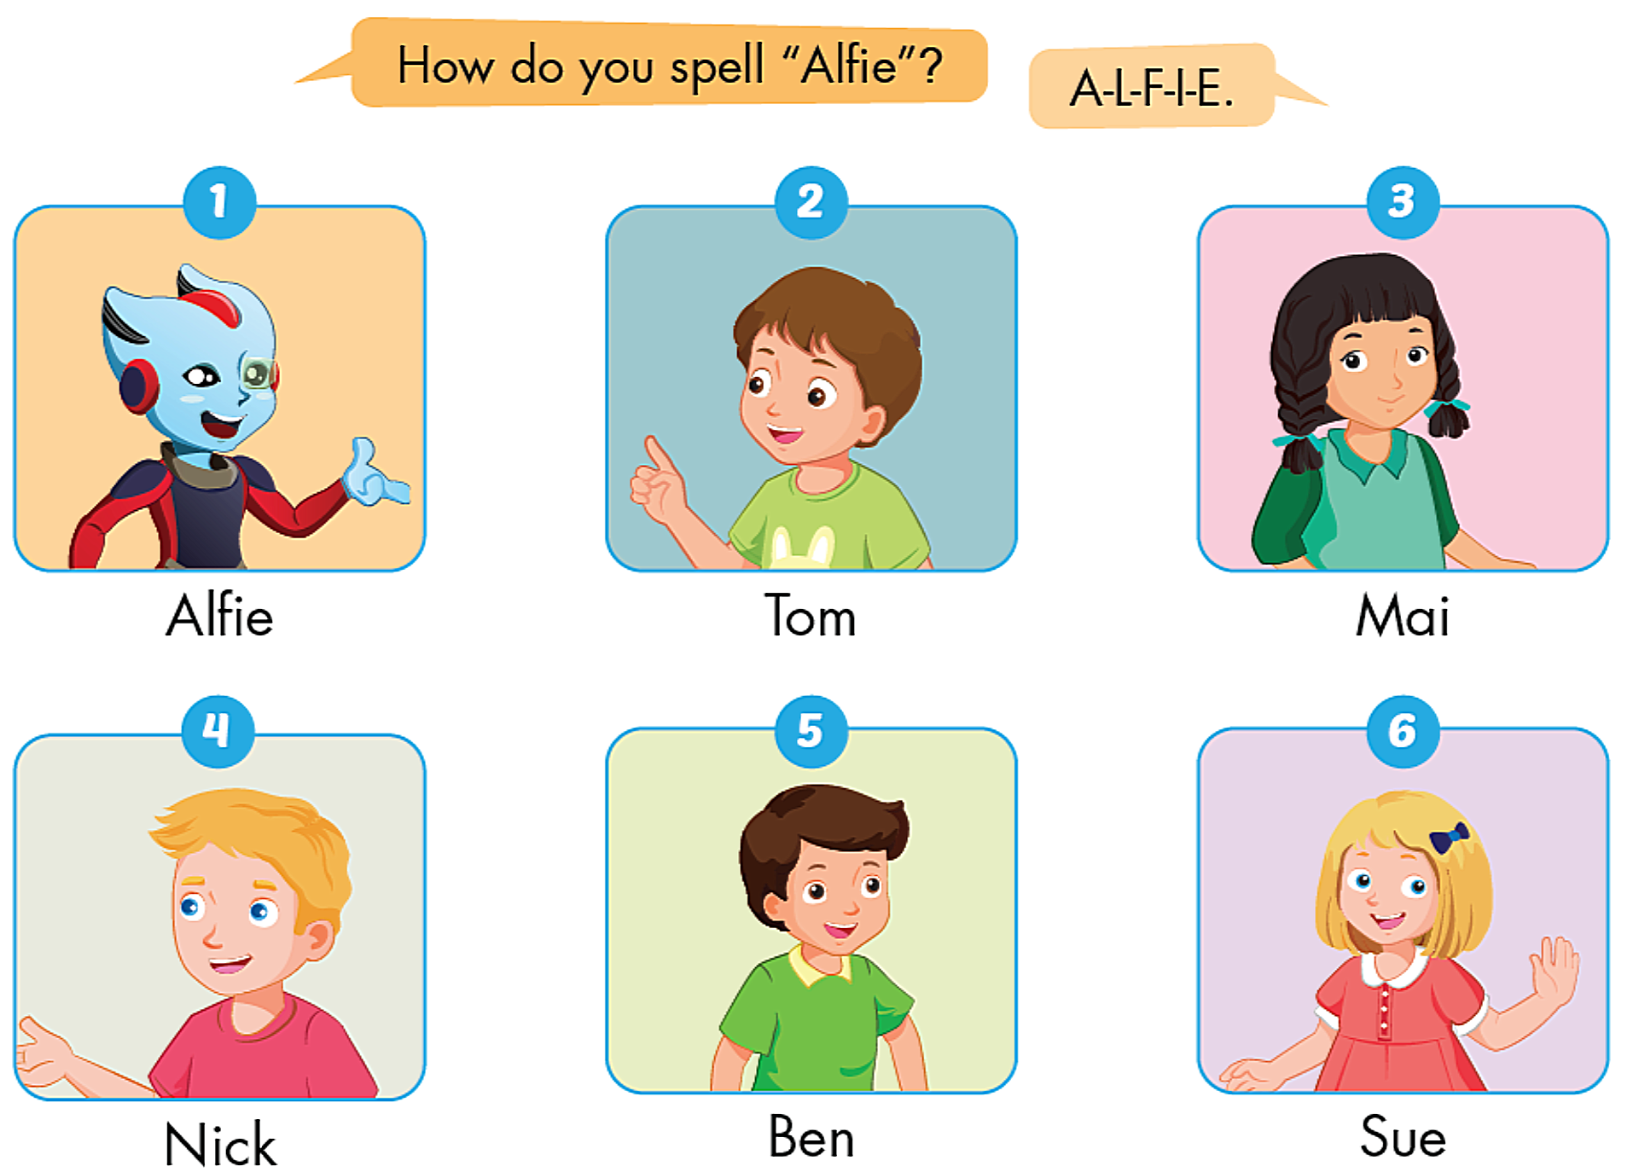


Slide 34
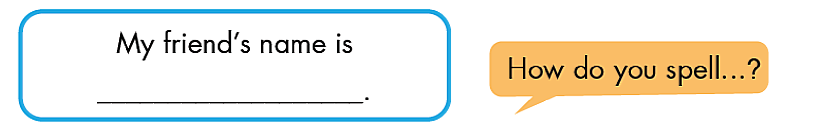

Slide 35
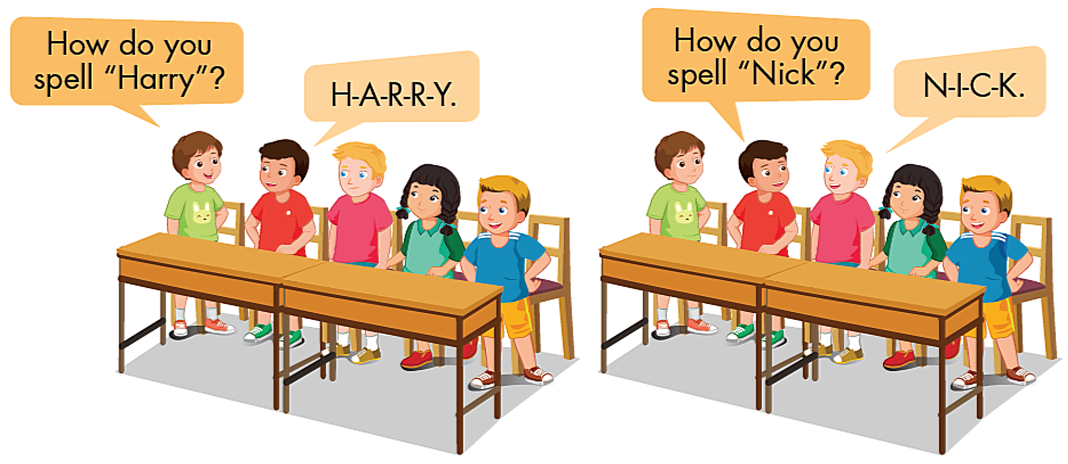

Slide 36
GOOD BYE !

