Slide 1
Quy Nhon Education and Training Department
Le Hong Phong Primary School
Welcome to our English class .
Teacher: DUONG THI KIEU VINH
English 3H

Slide 2
Warm –up (Hello song)

Slide 3
GAME: Matching
Sister

Slide 4
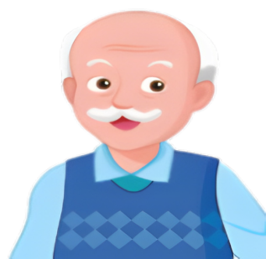
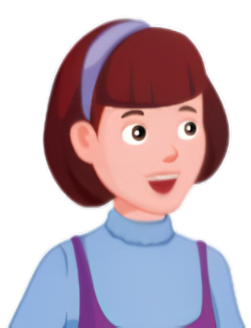
GAME: Matching
grandfather
brother
father
uncle
aunt
mother
cousin
grandmother

Slide 5
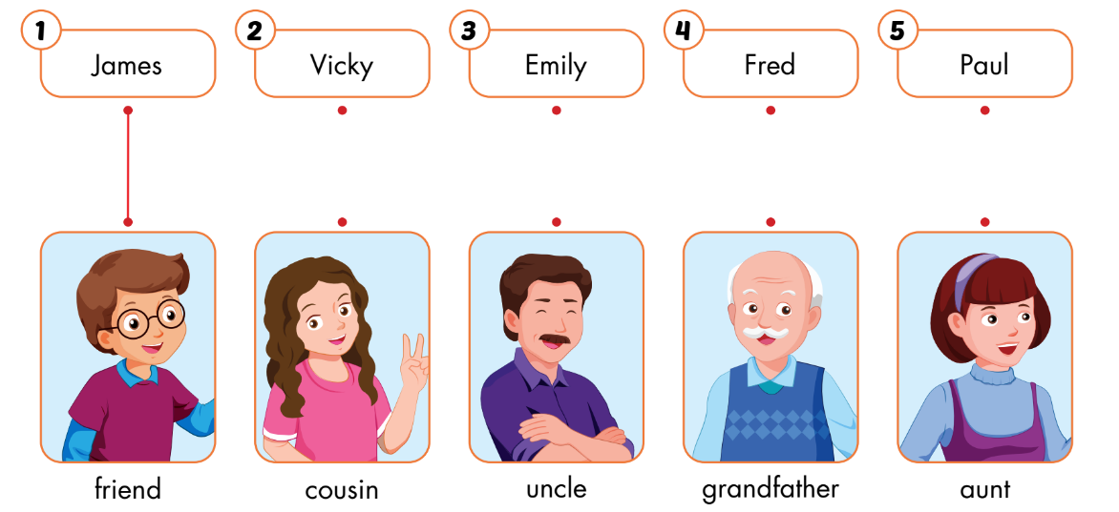
A
Listen and draw lines.

Slide 7
A
Listen and draw lines. (CD1 Track 57)
Keys

Slide 8
Reading

Slide 9
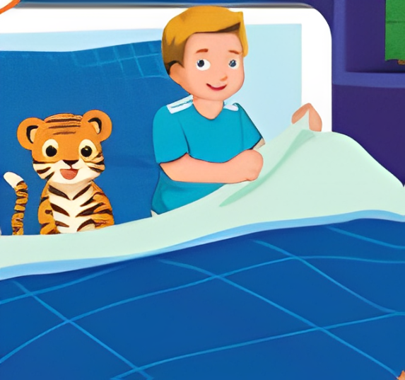
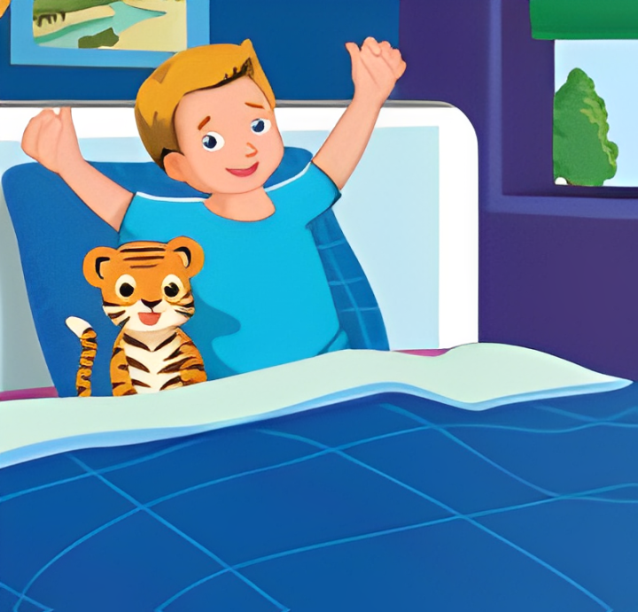
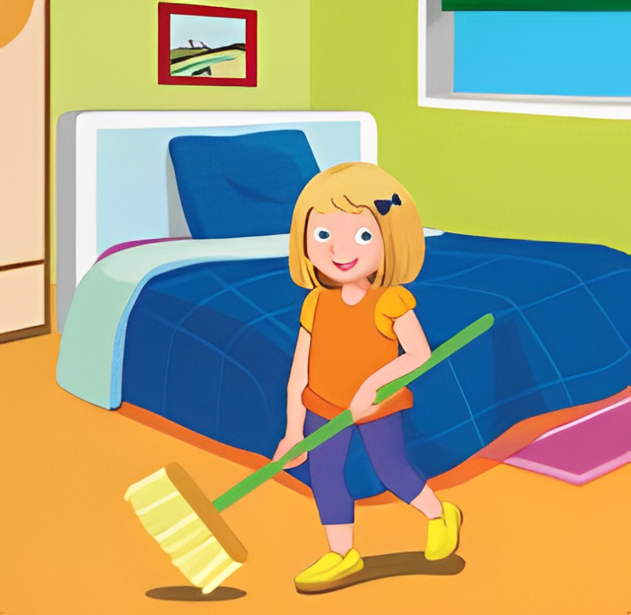
MIMING

Slide 10
B
Read the sentences. Choose a word from the box. Fill in the blanks.
up

Slide 11
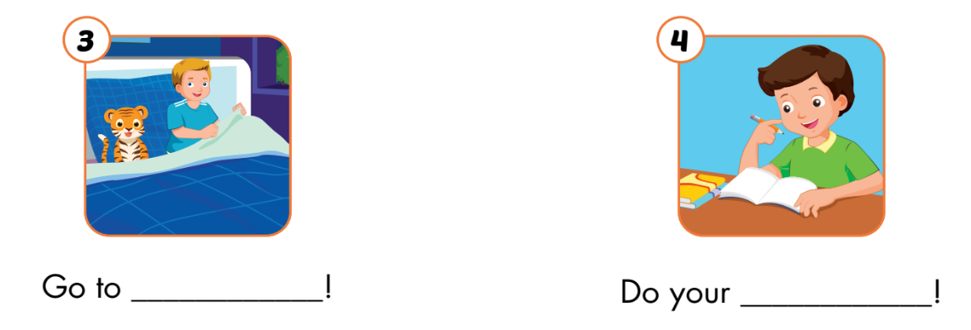
B
Read the sentences. Choose a word from the box. Fill in the blanks.
bed
homework

Slide 12
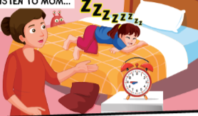
Role-play
Mom: Dan, ___________!
Dan: _____________
Mom: Linh, What are you doing?
Linh: ____________
Mom: Stop______________
Linh : _________________
Mom: Nhi, Your room is so messy!
________________
Nhi: ___________

Slide 13
UNIT 2 – WORKBOOK- A (Page 26)

Slide 14
A
Look at the table and pictures. Look at the numbers. Write the words and draw lines.

Slide 15
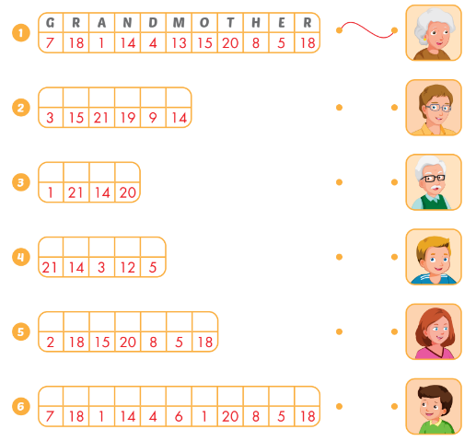
A
Look at the table and pictures. Look at the numbers. Write the words and draw lines.
c
o
u
s
i
n
a
u
n
t
u
n
c
l
e
b
r
o
t
h
e
r
g
r
a
n
d
f
a
t
h
e
r

Slide 16
PRODUCTION
CHOOSE THE CORRECT ANSWER
A, B OR C

Slide 17
REVIEW UNIT2
Who is he ?
A.He is great .
B.He is my brother .
C.He is nine.
HOME

Slide 18
REVIEW UNIT2
What is …..name ?
A.my
B. his
C. her
HOME

Slide 19
REVIEW UNIT2
Mom says:
A.“Go to bed ’’.
B.“Wake up.”
C.“Do your homework” .
HOME

Slide 20
REVIEW UNIT2
This is my …………..
A.grandmother
B. grandfather
C. father.
HOME

Slide 21
Thank you very much
Good bye! See you again!

