Slide 1
KIM DONG PRIMARY SCHOOL
WELCOME TO
CLASS 4A
TEACHER: NGUYEN THI HIEN LUONG

Slide 2
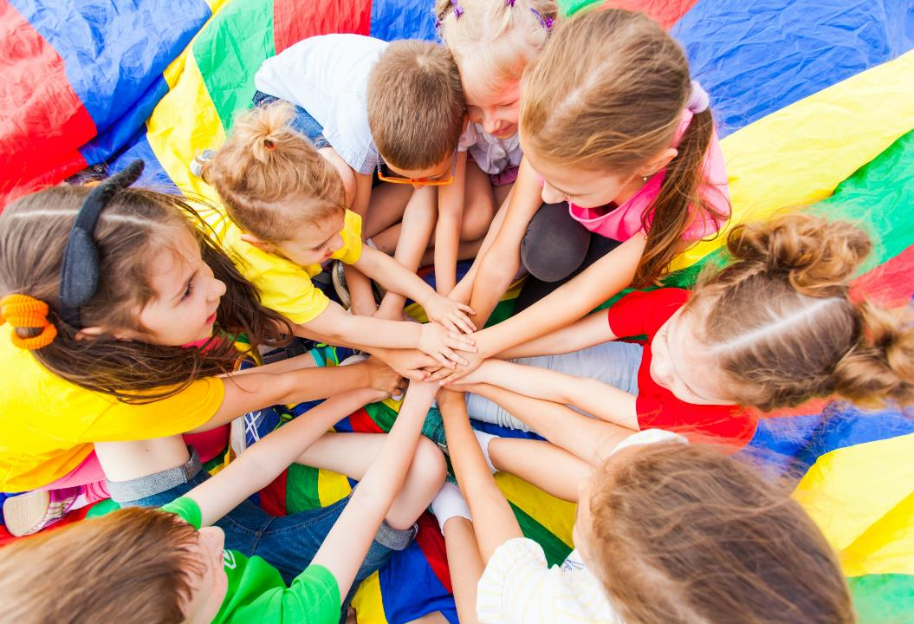
WARM UP

Slide 3
Play the Jump game
How to play
- Look at the picture and listen.
- Jump if the word is the same as the picture.
- Don’t jump if the word isn’t the same as the picture.

Slide 4
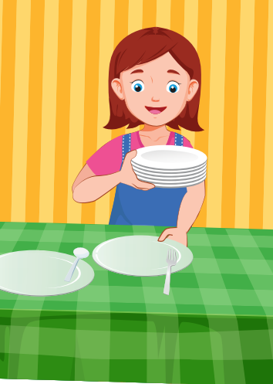

Slide 5
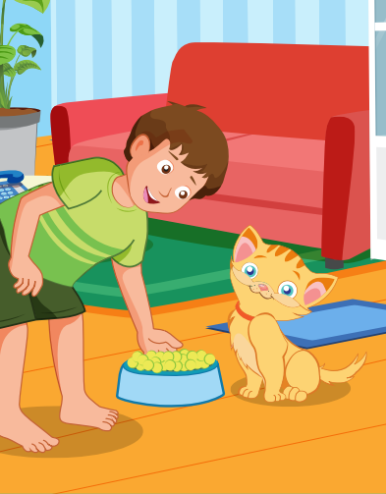

Slide 6
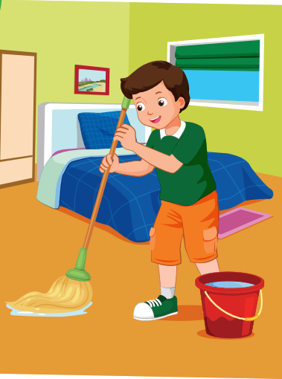

Slide 7
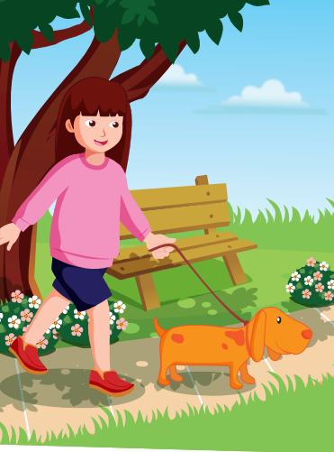

Slide 8
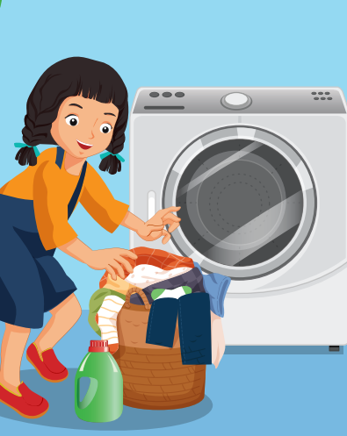

Slide 9
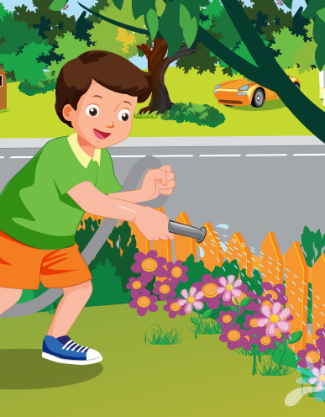

Slide 14
Saturday, March 30th, 2024
Unit 7 MY FAMILY Lesson 3. Part E, F(SB) + Part C, D(WB)
Presentation

Slide 15
LUCKY NUMBERS
CONGRATULATIONS
TEAM A
CONGRATULATIONS
TEAM B
1
2
3
4
5
6
7
8
1
2
3
4
5
6
7
8
9
1
10
2
3
4
5
6
7
8
9
10
TEAM A
TEAM B

Slide 16
Look and choose
sit
cut
set
_ | _ | _ |  | t | h | e |  | t | a | b | l | e

Slide 17
Look and choose
do
hi
go
_ | _ |  | t | h | e |  | l | a | u | n | d | r
y

Slide 18
Lucky number

Slide 19
Look and choose
walk
feed
need
_ | _ | _ | _ |  | t | h | e |  | c | a | t

Slide 20
Look and choose
see
put
mop
_ | _ | _ |  | t | h | e |  | f | l | o | o | r

Slide 21
Look and choose
sweep
close
water
_ | _ | _ | _ | _ |  | t | h | e |  | p | l | a
n | t | s

Slide 22
Lucky number

Slide 23
Look and choose
walk
feed
open
_ | _ | _ | _ |  | t | h | e |  | d | o | g

Slide 24
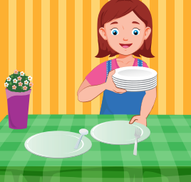
e - Look and answer
e - How do you help at home?
e - I set the table.

Slide 25
Ask and answer
How does your brother help at home?
He waters the plants.

Slide 26
Look and answer
How does your sister help at home?
She walks the dog.

Slide 27
Saturday, March 30th, 2024
Unit 7 MY FAMILY Lesson 3. Part E, F(SB) + Part C, D(WB)
Practice

Slide 28
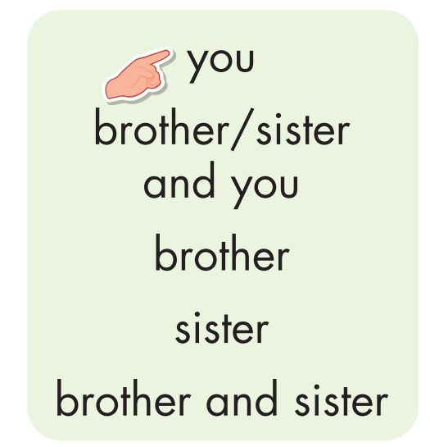
Saturday, March 30th, 2024
Unit 7 MY FAMILY Lesson 3. Part E, F(SB) + Part C, D(WB)
How do you help at home?
I set the table.
How do your brother and sister help at home?
They do the laundry.

Slide 29
Ask and answer
your sister

Slide 30
Ask and answer
brother and sister

Slide 31
Ask and answer
you

Slide 32
Ask and answer
brother

Slide 33
Saturday, March 30th, 2024
Unit 7 MY FAMILY Lesson 3. Part E, F(SB) + Part C, D(WB)

Slide 34
Saturday, March 30th, 2024
Unit 7 MY FAMILY Lesson 3. Part E, F(SB) + Part C, D(WB)
Production

Slide 35
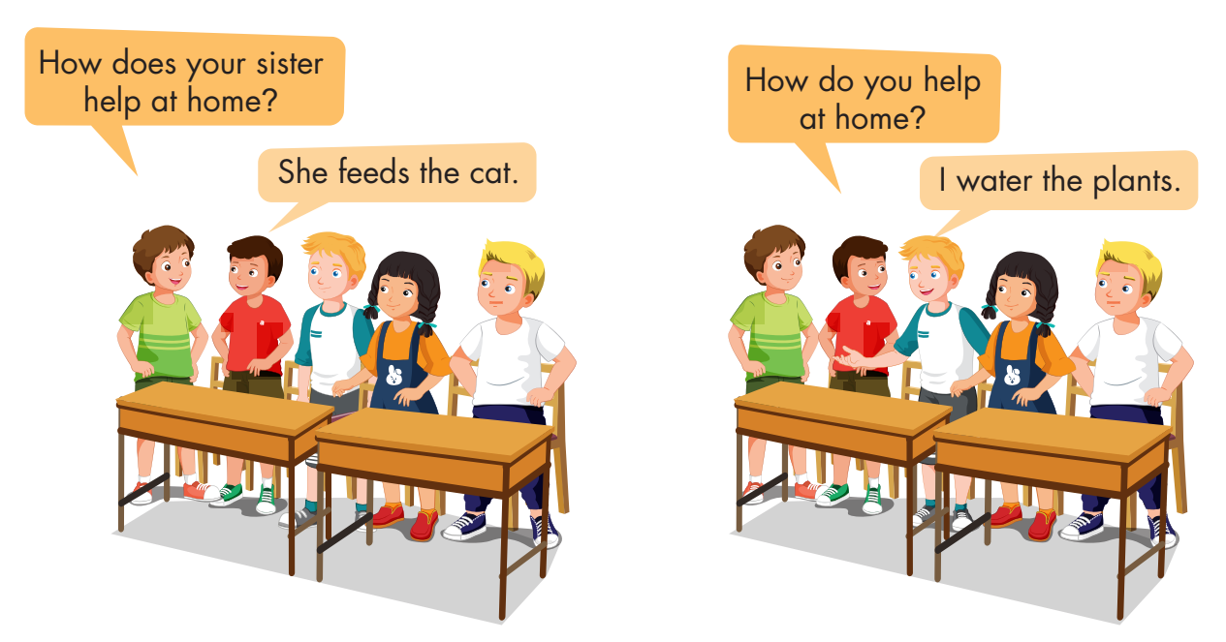
Saturday, March 30th, 2024
Unit 7 MY FAMILY Lesson 3. Part E, F(SB) + Part C, D(WB)

Slide 36
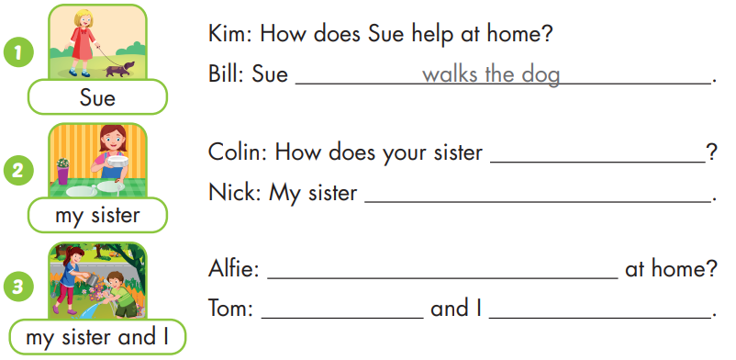
Saturday, March 30th, 2024
Unit 7 MY FAMILY Lesson 3. Part E, F(SB) + Part C, D(WB)
help at home
sets the table
How do your sister and you help
My sister
water the plants

Slide 37
Thanks for attention

