Slide 1

Unit 2: Family
Lesson 2 (A,B-SB) page 27 + (A,B-WB) page 20
Teacher: HUỲNH THỊ MỸ LINH
Class: 3

Slide 2

WARM UP

Slide 3

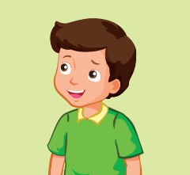

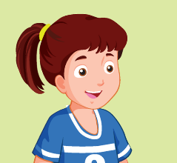
Look at the numbers and read the family members.
1
3
1
4
3
3
2
1
4
2
2
4
Notes:
Have students review the family members vocabulary.
Ask them to identify the words and numbers on the pictures.
Let them say the vocabulary first.
Correct their pronunciation if needed.
Ask the class to look at the number in each box and say a family member word.

Slide 4

Unit 2: FAMILY
Lesson 2 (A,B-SB) p.27 + (A,B-WB) p.20

Slide 5
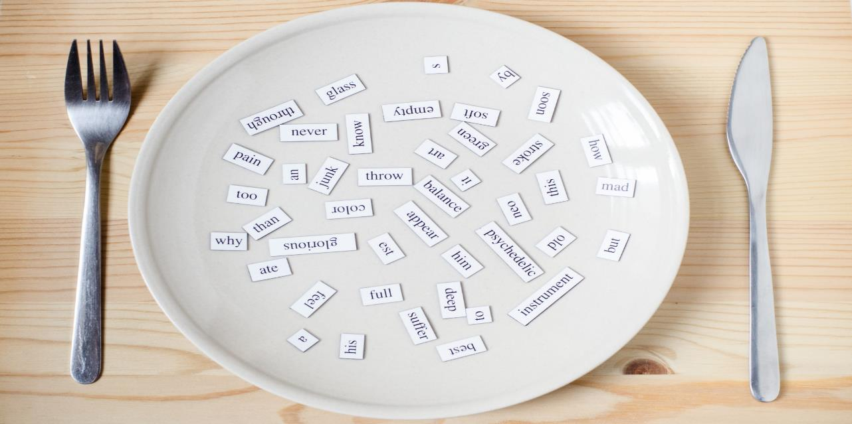
Vocabulary

Slide 6


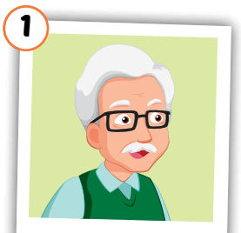
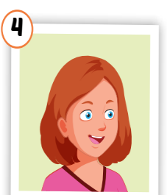
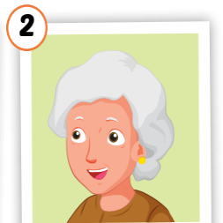
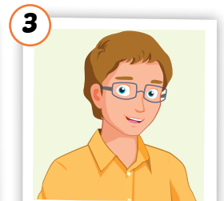
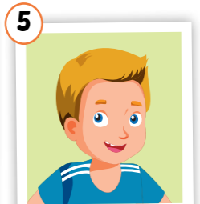
grandfather
grandmother
uncle
aunt
cousin

Slide 7
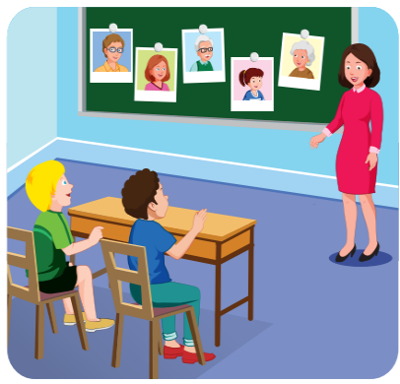
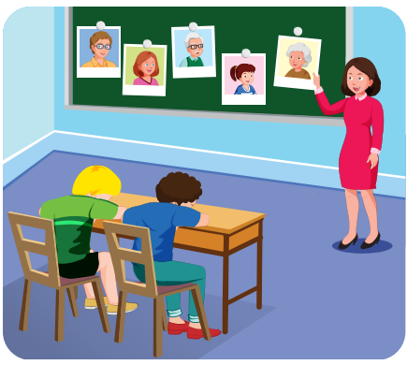
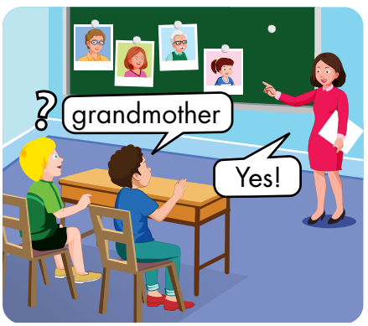

Slide 8
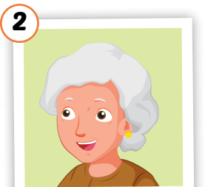





Slide 9
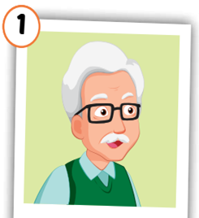
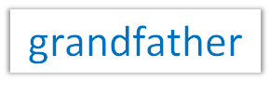

Slide 11

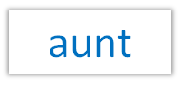

Slide 13


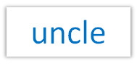
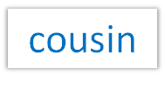

Slide 14

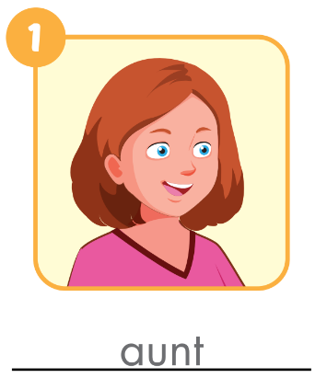
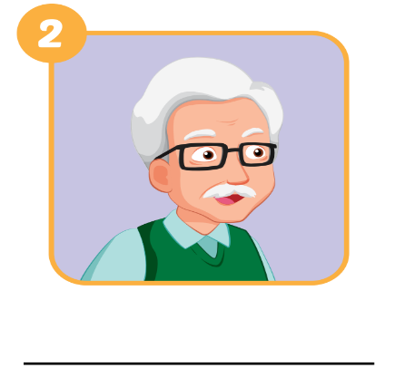
WB, page 20.
grandfather

Slide 15
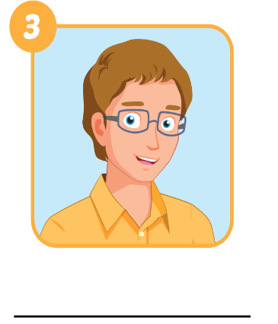
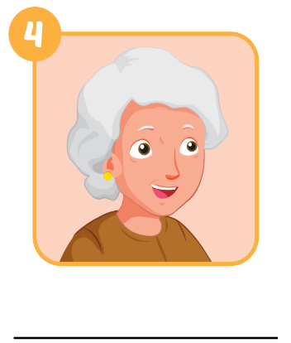
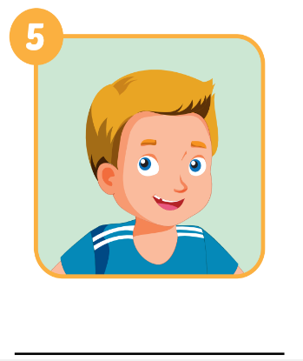
WB, page 20.
uncle
grandmother
cousin

Slide 16

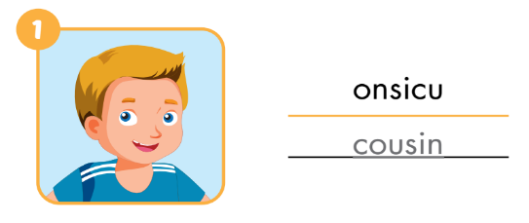
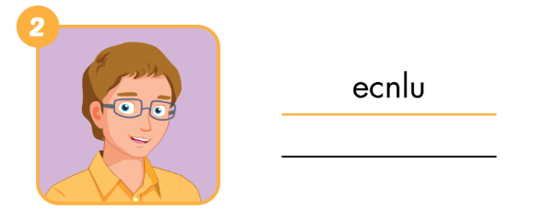
WB, page 20
uncle

Slide 17
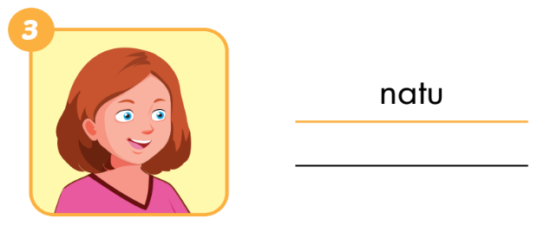
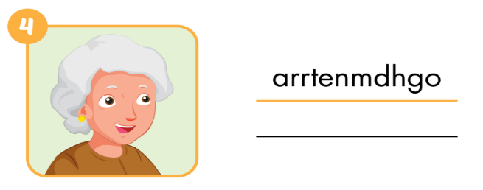
aunt
grandmother
WB, page 20

Slide 18
Structures

Slide 19









Slide 20

He’s my father
Who’s he?
His name’s Sam
What’s his name?

Slide 21

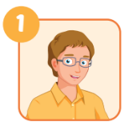
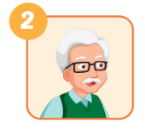
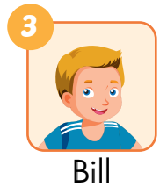
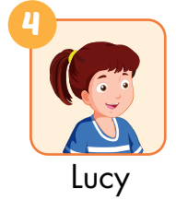
he
A: Who’s he?
B: He’s my________.
A: Who’s ___________?
B: He’s _____________.
uncle
my grandfather
A: What’s his name?
B: His name’s ______.
her name
A: What’s___________?
B: Her___________.
Bill
name’s Lucy

Slide 22
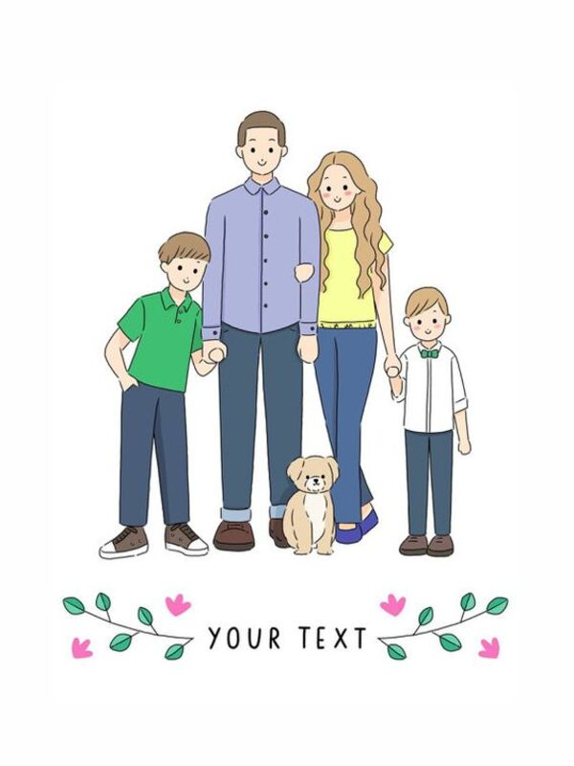
Ask and answer about your family

Slide 23
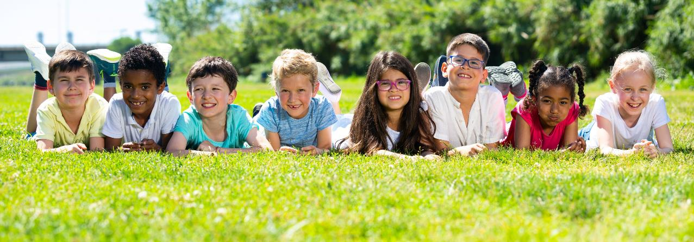
Have a nice day!

