Slide 1
Yen Phu 2 Primary School
Dong Da Primary School
Welcome to our class
Class: 5D
Teacher: Nguyen Nu Truc Ly

Slide 2
Sing a song
https://www.youtube.com/watch?v=leQlAifRD8U&t=125s

Slide 3
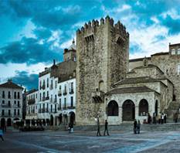
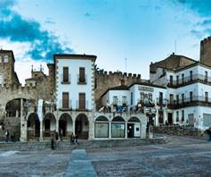
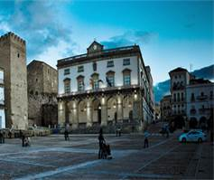
WHAT IS IT?

Slide 4
WHAT IS IT?
Turn around as many colored boxes as you can within the time limit (5 seconds) and say what it is in the picture.

Slide 5
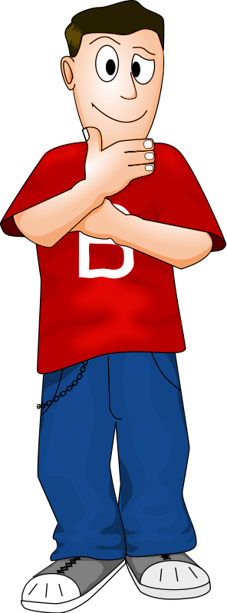
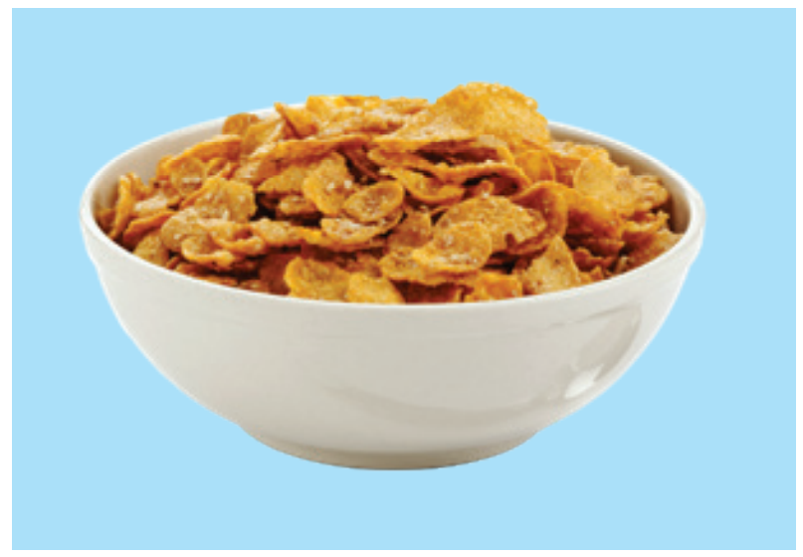
cereal
T
I
M
E
I
S
U
P
CHECK
NEXT
Click on the colored boxes to turn them around

Slide 6
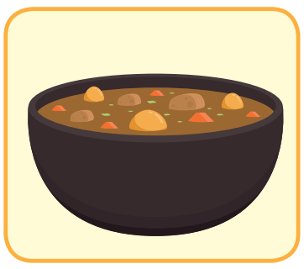
curry
T
I
M
E
I
S
U
P
CHECK
NEXT
Click on the colored boxes to turn them around

Slide 7
hot chocolate
T
I
M
E
I
S
U
P
CHECK
NEXT
Click on the colored boxes to turn them around

Slide 8
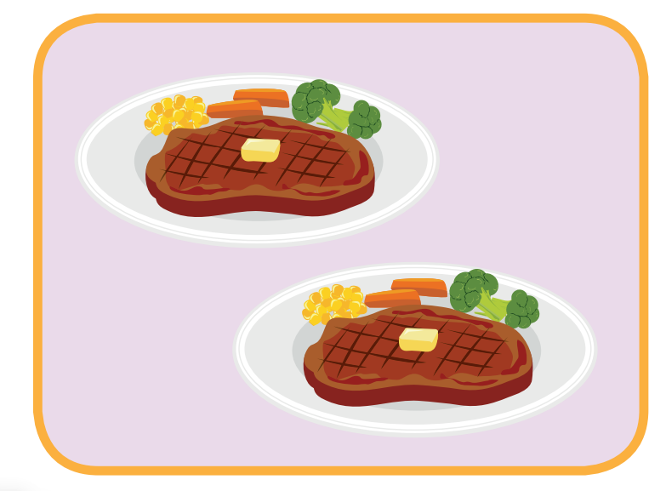
I will bring steak.
T
I
M
E
I
S
U
P
CHECK
NEXT
Click on the colored boxes to turn them around

Slide 9
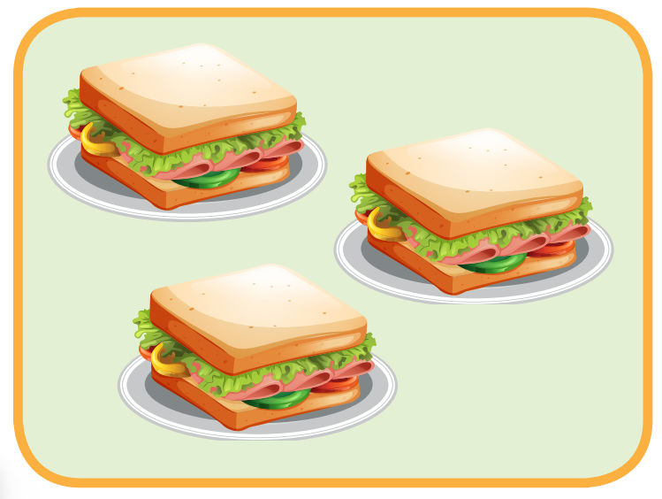
I will bring sandwiches.
T
I
M
E
I
S
U
P
CHECK
NEXT
Click on the coloured boxes to turn them around

Slide 10
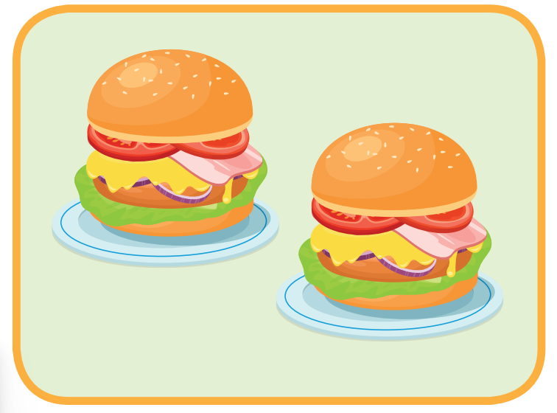
I will bring hamburgers.
T
I
M
E
I
S
U
P
CHECK
NEXT
Click on the colored boxes to turn them around

Slide 11
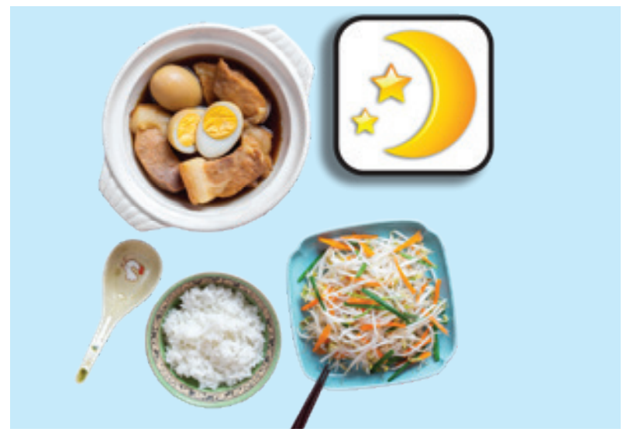
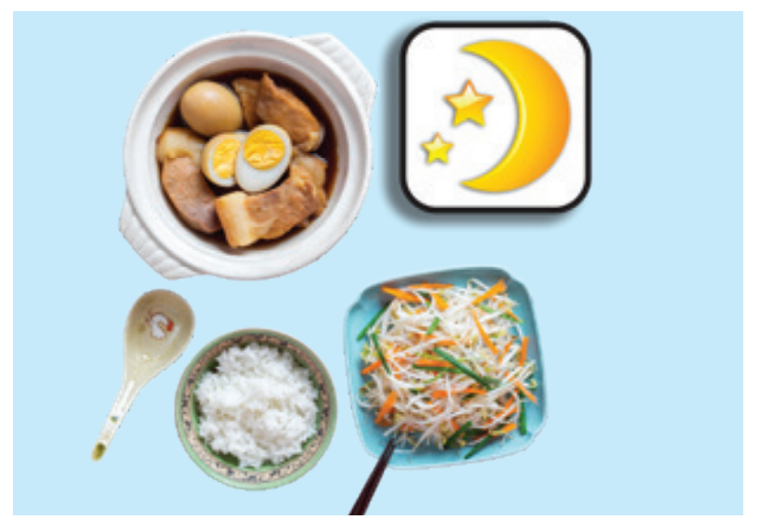
What is it?
They usually eat rice, egss, meat and vegetables for dinner.
T
I
M
E
I
S
U
P
CHECK
END

Slide 12
Friday, March 7th, 2025
Unit 6: Review and Practice (2)
D (SB, p.91) + BC (WB, p.61)

Slide 13
Ask and answer

Slide 15
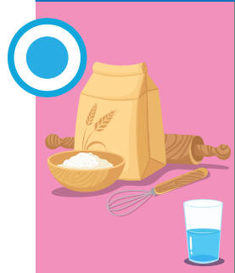
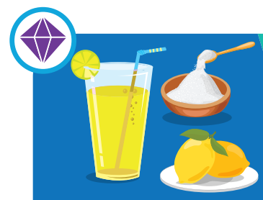

Slide 16
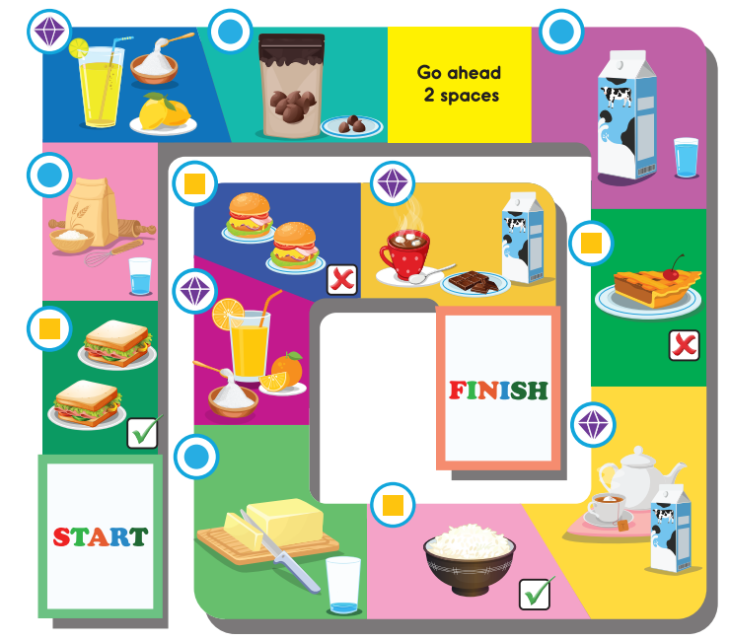

Slide 17
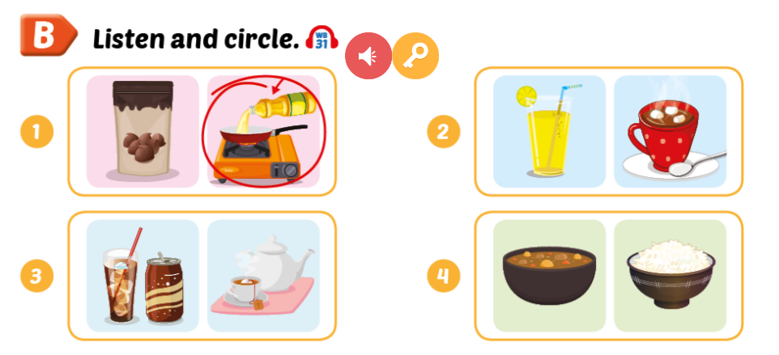
WB, page 61

Slide 18
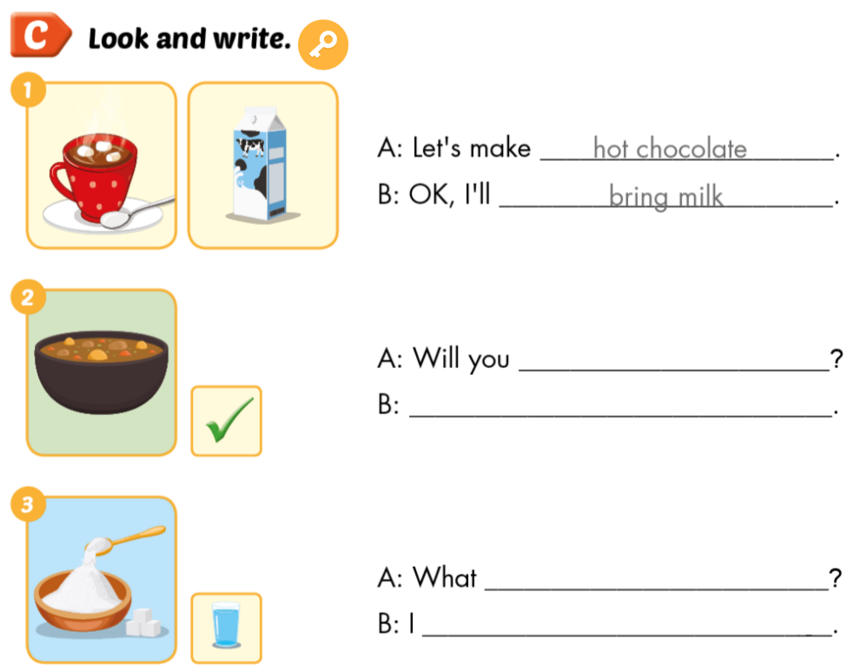

Slide 19
WB, page 61

Slide 20
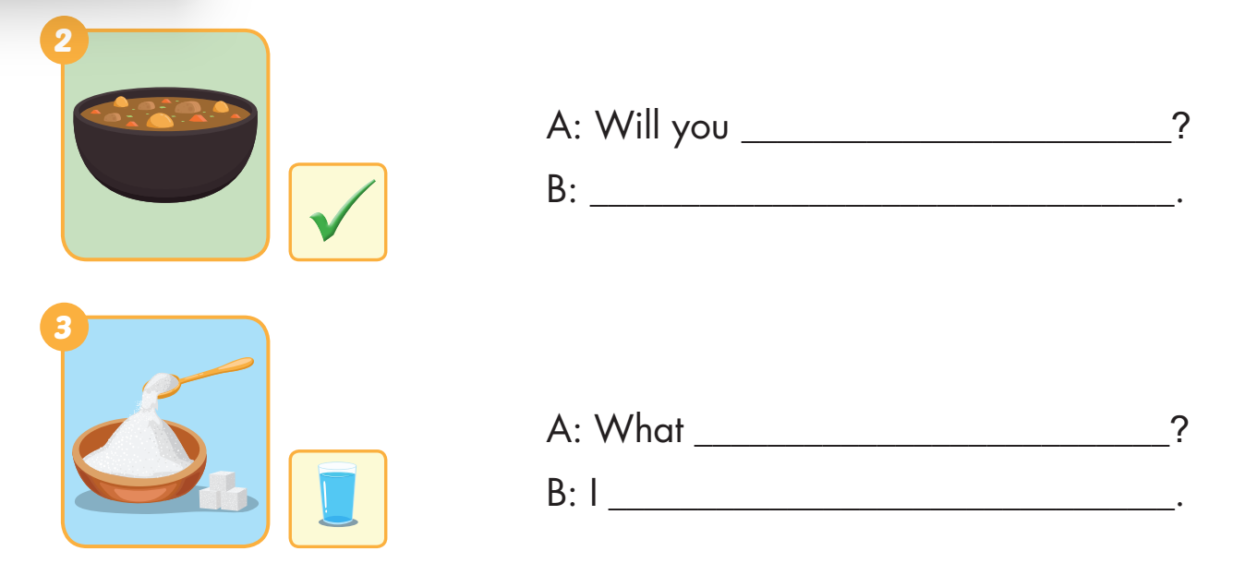
WB, page 61
bring curry
Yes. I will
do you need
need a lot of sugar

Slide 21
WB, page 61
bring sandwiches
No. I won’t

Slide 22
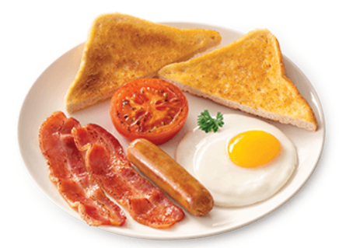
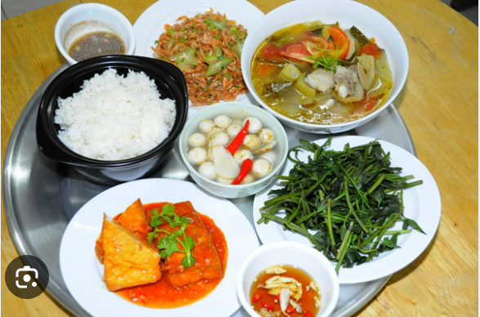
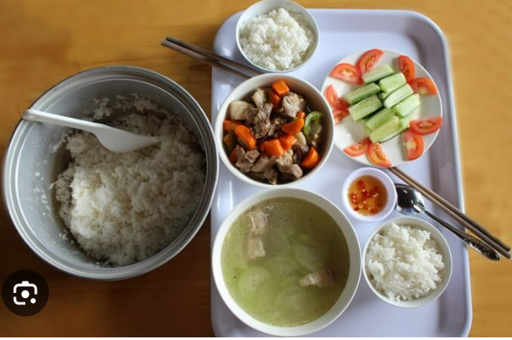

Slide 24
READ AND CHOOSE

Slide 25
I want to make a cake.
Ok. What do you need?
I need a lot of sugar.
I will bring curry.
I usually eat bread for breakfast.

Slide 26
What do you usually eat for dinner?
I will bring milk.
I need a little butter.
I usually eat rice for dinner.

Slide 27
Will you bring sandwiches, Nick?
I need a few apples.
Yes. I will.
She eats sandwiches for lunch.

Slide 28
Let’s make hot chocolate!
I usually eat cakes after dinner.
Ok. I will bring chocolate chips
Ok. I will bring bananas.

Slide 29
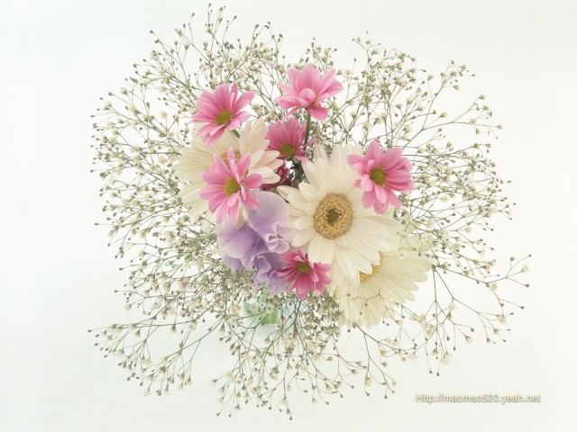
Thank for your attention
See you again!

Slide 30
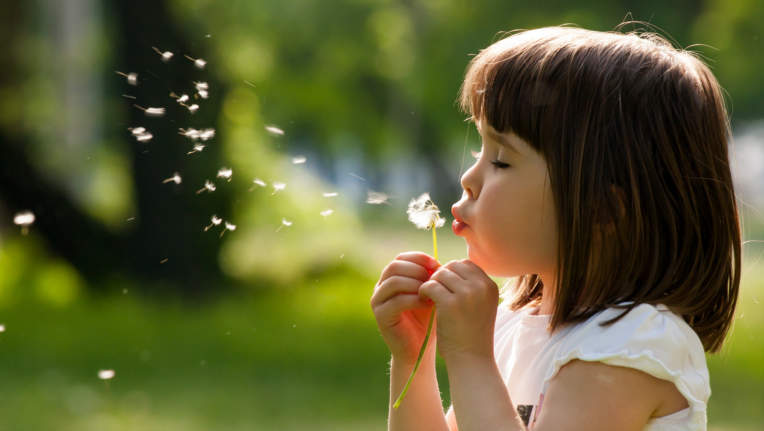
Enjoy your day!

Slide 31
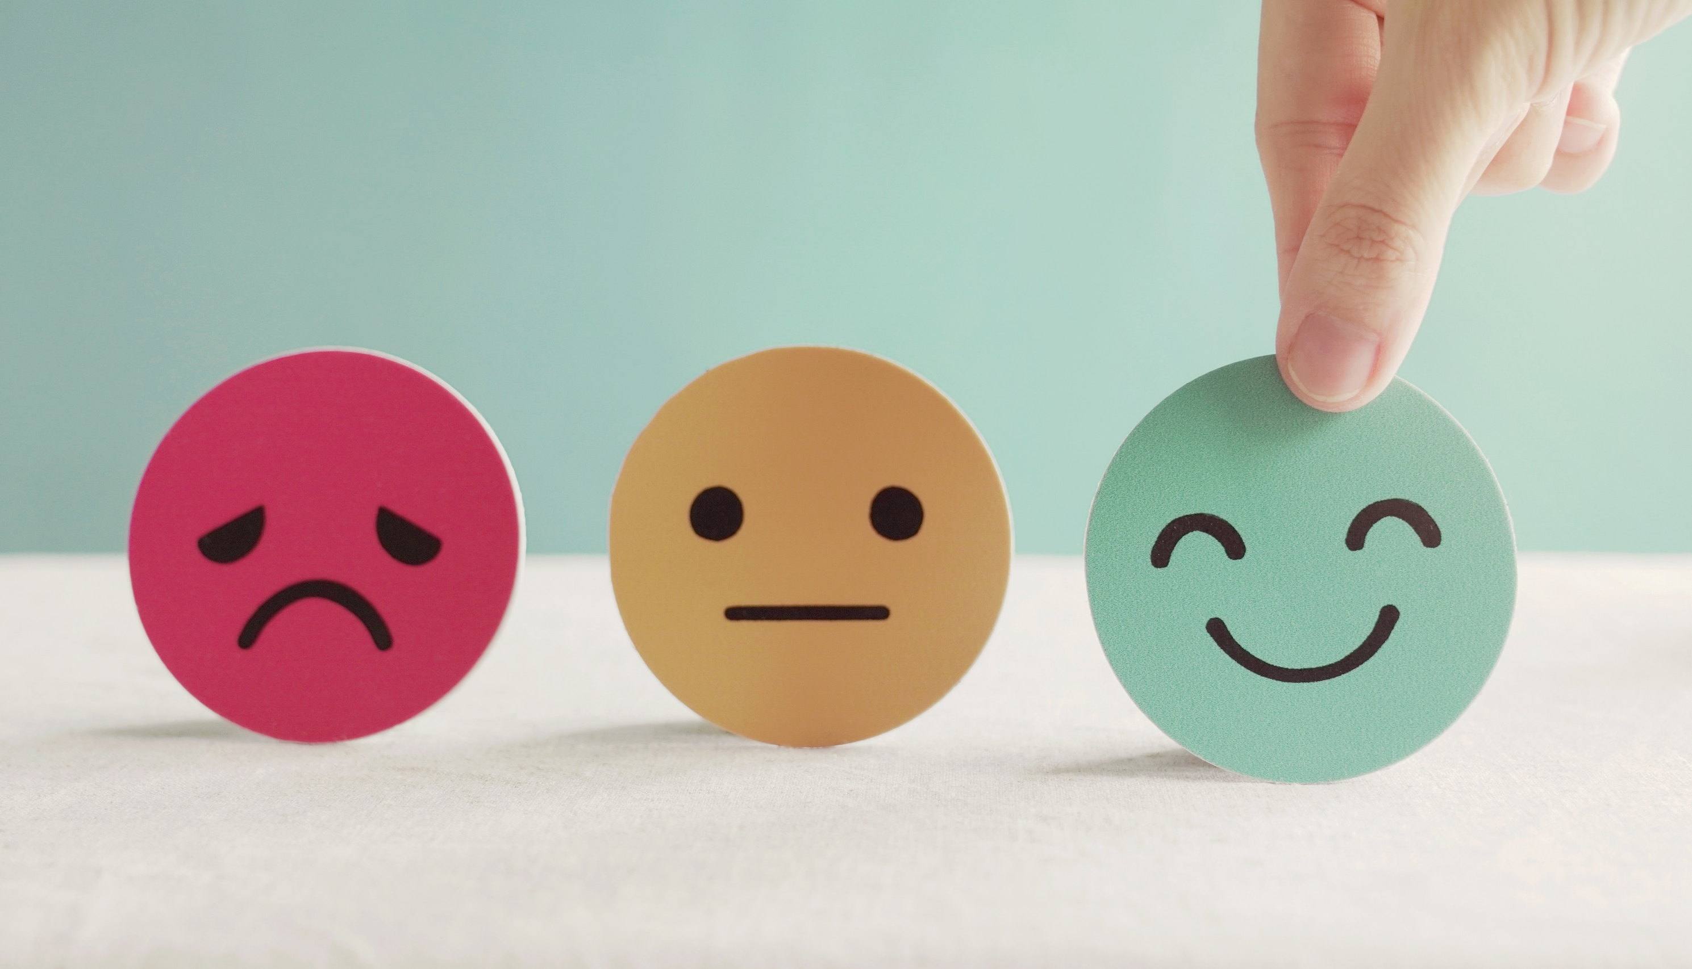
Lesson 3
Stay positive and have a nice day!

