Slide 1
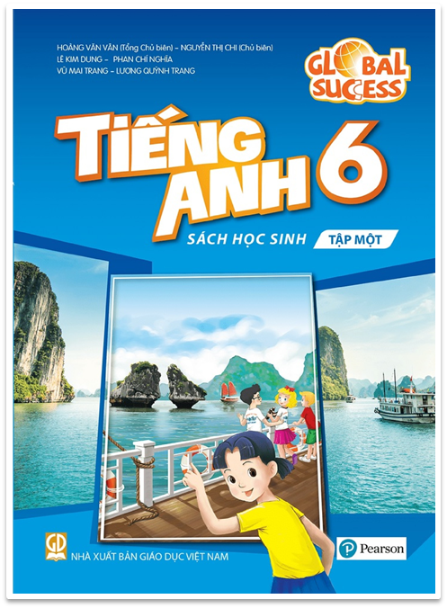
love

Slide 2
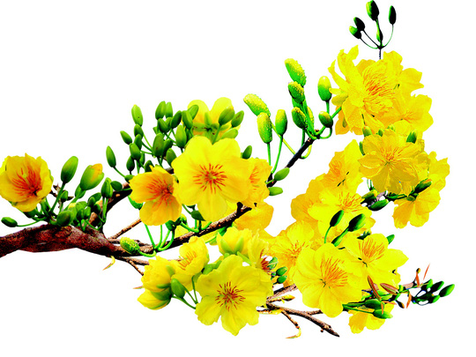
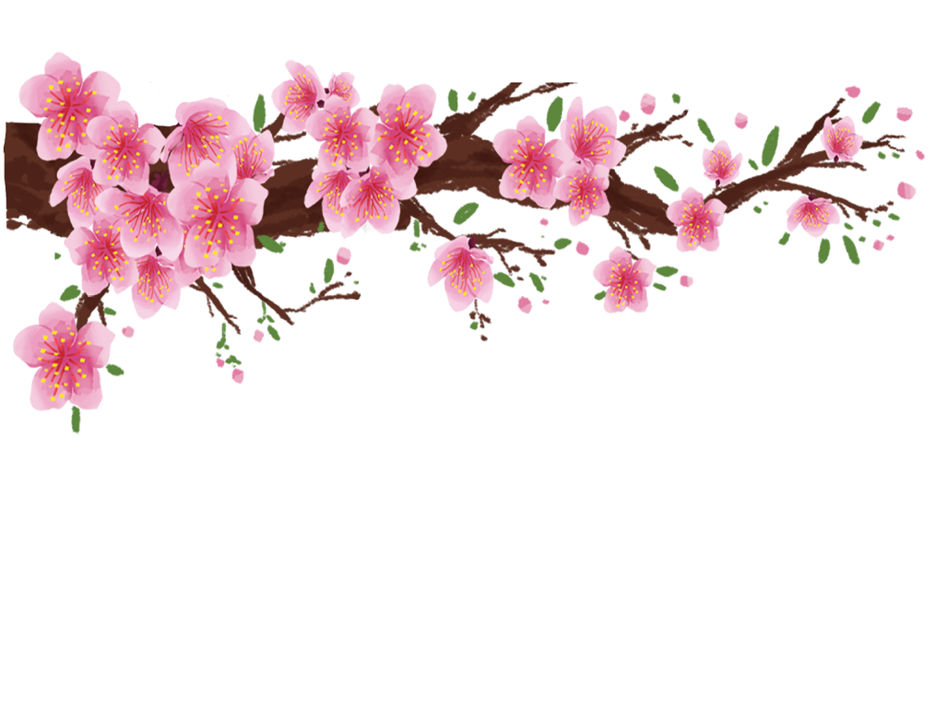
UNIT 6: OUR TET HOLIDAY
LESSON 6

Slide 3
Watch a clip
Write activities about Tet
- watching fireworks
- buying flowers
- going to the pagoda
- decorating houses
- gathering family
- buying new clothes
- getting lucky money
- making Chung cake
- eating special food

Slide 4
- How does your family prepare for Tet?
Suggested answers:
Buy new clothes
Clean the house
Decorate the house
- ……………………
Now we are going to listen to Nguyen’s letter to his pen-friend – Tom about how his family prepares for Tet.

Slide 5
I. Listening
Nguyen is writing to his penfriend Tom about how his family prepares for Tet. Listen and tick () the things you hear.
1.
old things

2.
peach flowers

3.
new clothes

4.
cakes
5.
wishes

6.
good luck
T

Slide 6
Listen again and answer the questions in one or two words.
GAME : WHO’S FASTER?
1.
What do they throw away before Tet?
2.
What do they clean and decorate?
3.
What colour are the envelopes?
4.
Who cooks banh chung?
5.
What shouldn’t they break?

Slide 7
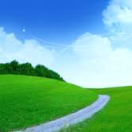
Who’s faster?
5
4
3
6
7
1
2

Slide 8
Who’s faster?
00
10
09
08
07
06
05
04
03
02
01
1. What do they throw away before Tet?
Old things
Who’s faster?

Slide 9
Who’s faster?
00
10
09
08
07
06
05
04
03
02
01
2. What do they clean and decorate?
(Their) houses.
Who’s faster?

Slide 10
Who’s faster?
00
10
09
08
07
06
05
04
03
02
01
3. What colour are the envelopes?
Red
Who’s faster?

Slide 11
Who’s faster?
00
10
09
08
07
06
05
04
03
02
01
4. Who cooks banh chung?
(His) father.
Who’s faster?

Slide 12
Who’s faster?
00
10
09
08
07
06
05
04
03
02
01
5. What shouldn’t they break?
Anything
Who’s faster?

Slide 13
LUCKy apple

Slide 14
LUCKy apple

Slide 15
Listen again and answer the questions in one or two words.
1.
What do they throw away before Tet?
Old things.
2.
What do they clean and decorate?
(Their) houses.
3.
What colour are the envelopes?
Red.
4.
Who cooks banh chung?
(His) father.
5.
What shouldn’t they break?
Anything.
T

Slide 16
AUDIO SCRIPT
Dear Tom,
Tet is coming and I’m very happy. We do a lot of things before Tet. We throw some old things away. We clean and decorate our homes. My mother goes shopping and buys food, red envelopes, and peach flowers. She also buys new clothes for us. My father makes banh chung and cooks them on an open fire. He says that I should make some wishes at Tet, and I shouldn’t break anything. It brings bad luck.
Yours Nguyen

Slide 17
II. Writing
Work in groups. Discuss and make a list of four things that you think children should and shouldn’t do at Tet.
Children should
1.
2.
Children shouldn’t
3.
4.

Slide 18
Work in groups. Discuss and make a list of four things that you think children should and shouldn’t do at Tet.
=> Answer:
1. Children should visit relatives with parents
2. Children should wear beautifful clothes
3. Children shouldn't break things
4. Children shouldn't play card all night
………………………………

Slide 19
Complete the email, using your ideas in 3.
To: tom@webmail.com
Subject: Tet in Viet Nam
Dear Tom,
Tet is coming. I will tell you more about our Tet.
At Tet, we should
We should
But we shouldn’t
We shouldn’t
Please write and tell me about your New Year celebration.
Yours,
Nguyen
.
, too.
.
, either.

Slide 20
Complete the email, using your ideas in 3.
To: tom@webmail.com
Subject: Tet in Viet Nam
Dear Tom,
Tet is coming. I will tell you more about our Tet.
At Tet, we should decorate our homes with flowers and plants.
We should visit our grandparents and relatives, too.
But we shouldn’t eat too much sweet food.
We shouldn’t keep lucky money, either. We should put into our piggy bank.
Please write and tell me about your New Year celebration.
Yours,
Nguyen

Slide 21
* Post - Writing
Share your writing with the class.

Slide 22
4. homework
Rewrite your writing.
Do the exercises in workbook.
Prepare LOOKING BACK AND PROJECT..

Slide 23
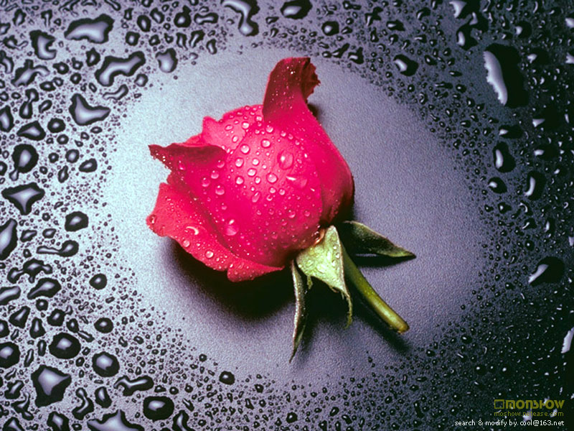
Thank you for your attention!

