Slide 1
UNIT 3: COMMUNITY SERVICE
Lesson 5: Skills 1

Slide 2
OBJECTIVES
01
02
After this lesson, students will be able to:
READING
- read for specific information about community activities at a school;
SPEAKING
- talk about the reasons why students join different community activities;

Slide 3
01
READING

Slide 4
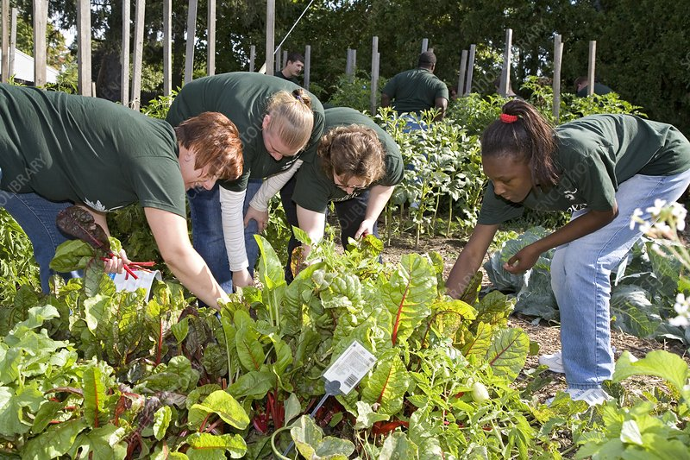
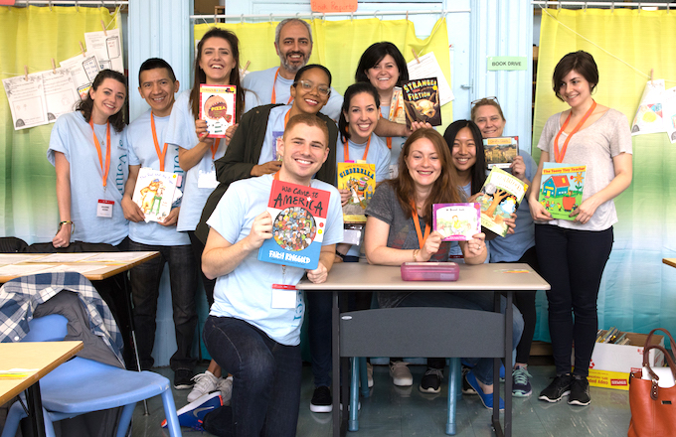
1. Work in pairs. Circle the activities you would like to do at your school.
A. growing vegetables in the school garden B. tutoring other students C. collecting books for the school library

Slide 5
2. Read the passage and match the highlighted words with their meanings.
1. give 2. give and receive 3. every month 4. pleased 5. teach
Bright Future School has many community activities for students. The school believes that a good way for students to develop themselves is through community service. All students can join any of these different projects:
– Tutoring: Upper grade students tutor lower grade students.
– Postcard-to-Help: Students make and sell postcards to raise money for local children.
– Visit-to-Read: Students visit a nursing home monthly and read books to the elderly.
– Garden-to-Give: Students grow vegetables and donate them to local schools.
– Paper-Plant-Exchange: Students collect paper and exchange it for plants. They then look after the plants in their school garden.
Students learn that they can help people and the world around them when they do community service. They feel useful and proud because they do good things.
5. teach
3. every month
1. give
2. give and receive
4. pleased

Slide 6
3. Read the passage again and tick True or False.
 | True | False
1. Community service allows students to develop themselves.
2. Each student can join only one project.
3. They tutor younger students.
4. Local children receive postcards from the Postcard-to-Help project.
5. Students receive plants when they give paper.

Slide 7
3. Read the passage again and tick True or False.
 | True | False
1. Community service allows students to develop themselves.
✓
Bright Future School has many community activities for students. The school believes that a good way for students to develop themselves is through community service.

Slide 8
3. Read the passage again and tick True or False.
 | True | False
2. Each student can join only one project.
✓
All students can join any of these different projects:
 | True | False
3. They tutor younger students.
✓
– Tutoring: Upper grade students tutor lower grade students.

Slide 9
3. Read the passage again and tick True or False.
 | True | False
4. Local children receive postcards from the Postcard-to-Help project.
✓
– Postcard-to-Help: Students make and sell postcards to raise money for local children.
 | True | False
5. Students receive plants when they give paper.
✓
– Tutoring: Upper grade students tutor lower grade students.

Slide 10
3. Read the passage again and tick True or False.
 | True | False
1. Community service allows students to develop themselves.
2. Each student can join only one project.
3. They tutor younger students.
4. Local children receive postcards from the Postcard-to-Help project.
5. Students receive plants when they give paper.
✓
✓
✓
✓
✓

Slide 11
02
SPEAKING

Slide 12
Match the projects with their description.
CHECK YOUR MEMORY
Tutoring
Students visit a nursing home monthly and read books to the elderly.
Postcard-to-Help
Students make and sell postcards to raise money for local children.
Visit-to-Read
Students collect paper and exchange it for plants. They then look after the plants in their school garden.
Garden-to-Give
Students grow vegetables and donate them to local schools.
Paper-Plant-Exchange
Upper grade students tutor lower grade students.
Notes:
– Tutoring:– Postcard-to-Help:
– Visit-to-Read:
– Garden-to-Give:
– Paper-Plant-Exchange:

Slide 13
4. Read about these students. Write the names of the projects you think they should join in the Projects column.
A. Tutoring B Postcard-to-Help C. Visit-to-Read
D. Garden-to-Give E. Paper-Plant-Exchange
 | Project
1. Nick likes reading books. He has a very nice voice, and he is also patient.
2. Ann is very good at maths and literature. She also loves children.
3. Minh loves collecting and making postcards.
4. Mark loves nature. He likes watching programmes about plants. He also likes being outdoors.
5. Tom likes collecting newspapers.

Slide 14
4. Read about these students. Write the names of the projects you think they should join in the Projects column.
A. Tutoring B Postcard-to-Help C. Visit-to-Read
D. Garden-to-Give E. Paper-Plant-Exchange
 | Project
1. Nick likes reading books. He has a very nice voice, and he is also patient.
2. Ann is very good at maths and literature. She also loves children.
3. Minh loves collecting and making postcards.
4. Mark loves nature. He likes watching programmes about plants. He also likes being outdoors.
5. Tom likes collecting newspapers.
1. Nick likes reading books. He has a very nice voice, and he is also patient.
C
2. Ann is very good at maths and literature. She also loves children.
A
B
3. Minh loves collecting and making postcards.
4. Mark loves nature. He likes watching programmes about plants. He also likes being outdoors.
D
E
5. Tom likes collecting newspapers.

Slide 15
5. Group of 6. 5 mins. Discuss.
Tutoring
Which project you would like to join? Why?
Postcard-to-Help
Visit-to-Read
Garden-to-Give
Paper-Plant-Exchange
Example: I will join the Tutoring project because I love teaching and I want to help others study better.

Slide 16
5. Report your group’s answers to the class.
Tutoring
Which project you would like to join? Why?
Postcard-to-Help
Visit-to-Read
Garden-to-Give
Paper-Plant-Exchange
Example: An will join the Tutoring project because she loves teaching and she wants to help others study better.

Slide 17
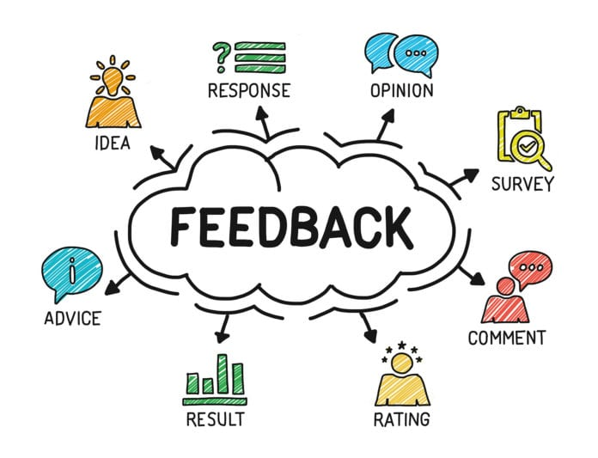
5. Others give comments for your friends and vote for the most interesting and informative presentation.

Slide 18
03
WRAP-UP

Slide 19
OBJECTIVES
01
02
After this lesson, students will be able to:
READING
- read for specific information about community activities at a school;
SPEAKING
- talk about the reasons why students join different community activities;

Slide 20
THANKS FOR YOUR ATTENTION!

