Slide 1
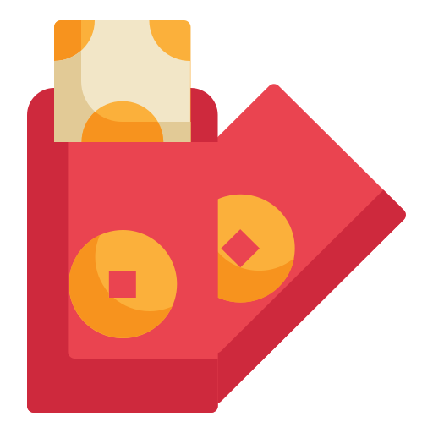

Slide 2
Unit
6
OUR TET HOLIDAY
LESSON 6: SKILLS 2

Slide 3
LESSON 6: SKILLS 2
LESSON 1: GETTING STARTED
Option 1: “Cultural Sharing Circle”
Option 2: “Decorate Your Own Red Envelope”
WARM-UP
Task 1: Listen and tick the things you hear. (p. 65)
Task 2: Listen again and answer the questions in one or two words. (p. 65)
* Listen again and tick (√) T (True) or F (False).
LISTENING
Task 3: Work in groups. Discuss and make a list of four things that you think children should and shouldn’t do at Tet. (p. 65)
Task 4: Complete the email, using your ideas in 3. (p. 65)
WRITING
Wrap-up
Homework
CONSOLIDATION

Slide 4
WARM-UP
OPTION 1
Cultural Sharing Circle

Slide 5
WARM-UP
OPTION 1
- Each participant to share a personal story or memory related to celebrating Tet within one minute

Slide 6
WARM-UP
LET’S START

Slide 7
WARM-UP
OPTION 2
Decorate Your Own Red Envelope

Slide 8
WARM-UP
OPTION 2
- Decorate your envelopes creatively while incorporating traditional symbols like flowers or zodiac animals. in 5 minutes

Slide 9
LISTENING
Nguyen is writing to his penfriend Tom about how his family prepares for Tet. Listen and tick () the things you hear.
1.
old things

4.
cakes
2.
peach flowers

5.
wishes

3.
new clothes

6.
good luck

Slide 10
LISTENING
1.
What do they throw away before Tet?
Old things.
2.
What do they clean and decorate?
(Their) houses.
Listen again and answer the questions in one or two words.
3.
What colour are the envelopes?
Red.
- Read the questions carefully and underline keywords in each question
4.
Who cooks banh chung?
(His) father.
5.
What shouldn’t they break?
Anything.

Slide 11
LISTENING
Tick (√) T (True) or F (False)
1.
They do many things before Tet.
T
2.
Nguyen’s mother goes shopping and buys food, red envelopes, and apricot blossom
F
3.
His father cooks banh chung in the oven.
F
4.
He shouldn’t break anything because it brings bad luck.
T

Slide 12
LESSON 6: SKILLS 2
LESSON 1: GETTING STARTED
Option 1: “Cultural Sharing Circle”
Option 2: “Decorate Your Own Red Envelope”
WARM-UP
Task 1: Listen and tick the things you hear. (p. 65)
Task 2: Listen again and answer the questions in one or two words. (p. 65)
* Listen again and tick (√) T (True) or F (False).
LISTENING
Task 3: Work in groups. Discuss and make a list of four things that you think children should and shouldn’t do at Tet. (p. 65)
Task 4: Complete the email, using your ideas in 3. (p. 65)
WRITING

Slide 13
WRITING
Work in groups. Discuss and make a list of four things that you think children should and shouldn’t do at Tet
Children should
1.
2.
Children shouldn’t
3.
4.

Slide 14
WRITING
Complete the email, using your ideas in 3.
To: tom@webmail.com
Subject: Tet in Viet Nam
Dear Tom,
Tet is coming. I will tell you more about our Tet.
At Tet, we should
We should
But we shouldn’t
We shouldn’t
Please write and tell me about your New Year celebration.
Yours,
Nguyen
decorate our houses with flowers and plants.
.
visit our grandparents and relatives
, too.
eat too much sweet food.
.
break dishes
, either.

Slide 15
LESSON 6: SKILLS 2
LESSON 1: GETTING STARTED
Option 1: “Cultural Sharing Circle”
Option 2: “Decorate Your Own Red Envelope”
WARM-UP
Task 1: Listen and tick the things you hear. (p. 65)
Task 2: Listen again and answer the questions in one or two words. (p. 65)
* Listen again and tick (√) T (True) or F (False).
LISTENING
Task 3: Work in groups. Discuss and make a list of four things that you think children should and shouldn’t do at Tet. (p. 65)
Task 4: Complete the email, using your ideas in 3. (p. 65)
WRITING
Wrap-up
Homework
CONSOLIDATION

Slide 16
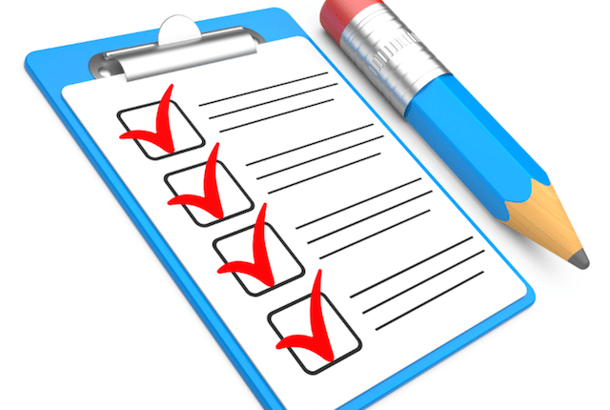
CONSOLIDATION
1
Wrap-up
What have we learnt in this lesson?
Listen for specific information about preparations for Tet
Write an email about what people should/ shouldn’t do at Tet

Slide 17
CONSOLIDATION
2
Homework
Imagine that you are Tom – Nguyen’s pen friend. Write a letter back to Nguyen to tell him about what people should and shouldn’t do in the New year in your country.

Slide 18
Website: hoclieu.vn
Fanpage: facebook.com/www.tienganhglobalsuccess.vn/

