Slide 2



Unit
6
OUR TET HOLIDAY
LESSON 5: SKILLS 1

Slide 3



LESSON 5: SKILLS 1
LESSON 1: GETTING STARTED
Option 1: "Resolution Race"
Option 2: “Word Association”
WARM-UP
Vocabulary
Task 1: Read the passages and decide who says sentences 1 – 5.
Task 2: Test your memory!
READING
Task 3: Work in groups. These are some activities from the reading passages in Task 1. Tell your group if you do them during Tet.
Task 4: Work in groups. Read the list and discuss what you should or shouldn’t do at Tet.
SPEAKING
Wrap-up
Homework
CONSOLIDATION

Slide 4
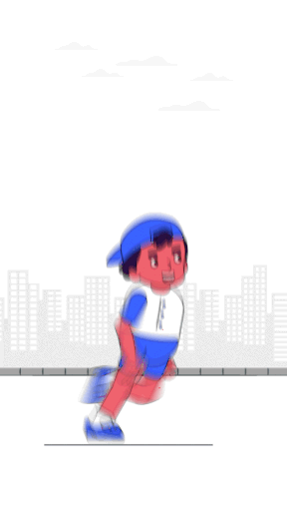
WARM-UP
OPTION 1
Resolution
Race

Slide 5
WARM-UP
OPTION 1
HOW TO PLAY

Slide 6
WARM-UP
OPTION 1
- There is a short list of common New Year's resolutions
- Work in groups
- Write as many resolutions as you can in miniboard (or A0 paper) in 5 minutes
- After the time is up, each group shares your resolutions with the rest of the class.
- The group with the most unique resolutions wins.

Slide 7
WARM-UP
OPTION 1
SOME RESOLUTIONS:
- Exercising more
- Reading more books
- Learning new skills

Slide 8
WARM-UP
LET’S START
5 MINUTES

Slide 9
WARM-UP
OPTION 2
Word Association
NEW YEAR’S DAY

Slide 10
WARM-UP
OPTION 2
- Brainstorm words or phrases that come to mind when you think of this holiday.
NEW YEAR’S DAY
- Share your ideas and create a word cloud together.

Slide 11
LESSON 5: SKILLS 1
LESSON 1: GETTING STARTED
Option 1: "Resolution Race"
Option 2: “Word Association”
WARM-UP
Vocabulary
Task 1: Read the passages and decide who says sentences 1 – 5.
Task 2: Test your memory!
READING

Slide 12



VOCABULARY
cheer (v)
give a loud shout of approval or encouragement
/tʃɪr/
cổ vũ

Slide 13
VOCABULARY
strike (v)
to hit something
/straɪk/
đánh/ điểm (đồng hồ)

Slide 14
VOCABULARY
custom (n)
a way of behaving or a belief that has been stablished for a long time
/ˈkʌstəm/
phong tục, tập quán

Slide 15
VOCABULARY
New words | Pronunciation | Meaning
1. cheer (v) | /tʃɪər/ | cổ vũ
2. strike (v) | /straɪk/ | đánh/ điểm (đồng hồ)
3. custom (n) | /ˈkʌstəm/ | phong tục, tập quán

Slide 16
VOCABULARY
QUICK QUIZ

Slide 17
VOCABULARY
HOW TO PLAY

Slide 18
VOCABULARY
- Look at the screen
- The quiz will appear and disappear so fast
- Remember the quiz so that they can choose correct answers.
- Which team has correct answers will get the points

Slide 19
VOCABULARY
LET’S PLAY

Slide 20
VOCABULARY
In some countries, it is a .................. to greet each other with a bow instead of a handshake
A. cheer
B. custom
C.strike

Slide 21
VOCABULARY
Everyone ........ as the winners received their medals.
A. cheered
B. custom
C. encouraged
D.fun

Slide 22
VOCABULARY
The clock was ........... ten as we went into the church
A. cheering
B. striking
C. encouraging
D.fun

Slide 23


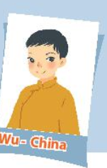

READING
Read the passages and decide who says sentences 1 – 5.
- Look at the pictures and tell me how these countries celebrate the New Year

Slide 24
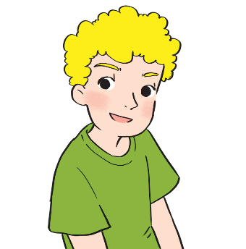
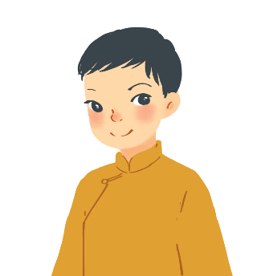
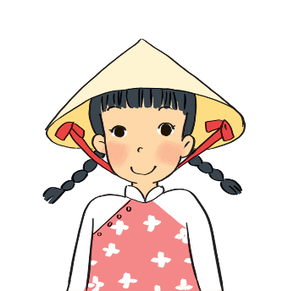
READING
A
I often go to Times Square with my parents to welcome the New Year. When the clock strikes midnight, colourful fireworks light up the sky. Everybody cheers and sings.
Russ – the USA
B
On New Year’s Day, we dress beautifully and go to our grandparents’ houses. We wish them Happy New Year and they give us lucky money. Then we go out and have a day full of fun.
Wu - China
c
I learn some customs about Tet from my parents. People give rice to wish for enough food and buy salt to wish for good luck. Dogs are lucky animals but cats are not. A cat’s cry sounds like "poor" in Vietnamese.
Mai – Viet Nam

Slide 25
READING
A. Russ
B. Wu
C. Mai
Statements | Who
1. Dogs are lucky animals. | C
2. We welcome the New Year at Times Square.
3. Children get lucky money.
4. We give rice to wish for enough food.
5. Children fress beautifully.
A
B
C
B

Slide 26
LESSON 5: SKILLS 1
LESSON 1: GETTING STARTED
Option 1: "Resolution Race"
Option 2: “Word Association”
WARM-UP
Vocabulary
Task 1: Read the passages and decide who says sentences 1 – 5.
Task 2: Test your memory!
READING
Task 3: Work in groups. These are some activities from the reading passages in Task 1. Tell your group if you do them during Tet.
Task 4: Work in groups. Read the list and discuss what you should or shouldn’t do at Tet.
SPEAKING

Slide 27

Speaking

Slide 28

SPEAKING
Work in groups. These are some activities from the reading passages in 1. Tell your group if you do them during Tet.
- Think of a family event and make notes about it in the form of a mind map. (you can use some activities in 1
FAMILY EVENTS

Slide 29
Example:
SPEAKING
Work in groups. These are some activities from the reading passages in 1. Tell your group if you do them during Tet.
I don’t go to Time Square to welcome the New Year.
- Look at your mind map think the questions that can be used.
- Work in groups. You take turns to ask and answer about the family event.

Slide 30
SPEAKING
Example:
Do you go to Times Square to welcome the New Year?
No,I don’t go to Time Square to welcome the New Year.

Slide 31

SPEAKING
Work in groups. Read the list and discuss what you should or shouldn’t do at Tet.
“Discussion Circle”

Slide 32
SPEAKING
- Work in groups in the circle
- Each student takes turns picking up a card and sharing your opinion about whether they think it’s should or shouldn’t, and explain your reason.
Discussion prompts:
- break things
-make a wish
- dress beautifully.
-
-
-
Discussion prompts:
- say”Have fun!” to your friends
- help decorate houses
- invite friends home
-
-
-
Discussion prompts:
- plays games all night
- invite friends home
- ask for lucky money
-
-
-
Notes:
they are cards. Print and cut it to do activities. You can add more activities
they are cards. Print and cut it to do activities. You can add more activities
There are some cards. Remember to print and cut it.

Slide 33
LESSON 5: SKILLS 1
LESSON 1: GETTING STARTED
Option 1: "Resolution Race"
Option 2: “Word Association”
WARM-UP
Vocabulary
Task 1: Read the passages and decide who says sentences 1 – 5.
Task 2: Test your memory!
READING
Task 3: Work in groups. These are some activities from the reading passages in Task 1. Tell your group if you do them during Tet.
Task 4: Work in groups. Read the list and discuss what you should or shouldn’t do at Tet.
SPEAKING
Wrap-up
Homework
CONSOLIDATION

Slide 34

CONSOLIDATION
1
Wrap-up
What have we learnt in this lesson?
Develop reading skill for general and specific information about the topic
Express judgement about the what children should/shouldn’t do at Tet

Slide 35

CONSOLIDATION
2
Homework
- Do exercise in workbook
- Search for information about whatchildren should/ shouldn’t do during New Year days in the China, Thailand, Japan or India.

Slide 36






Website: hoclieu.vn
Fanpage: facebook.com/www.tienganhglobalsuccess.vn/

