Slide 2
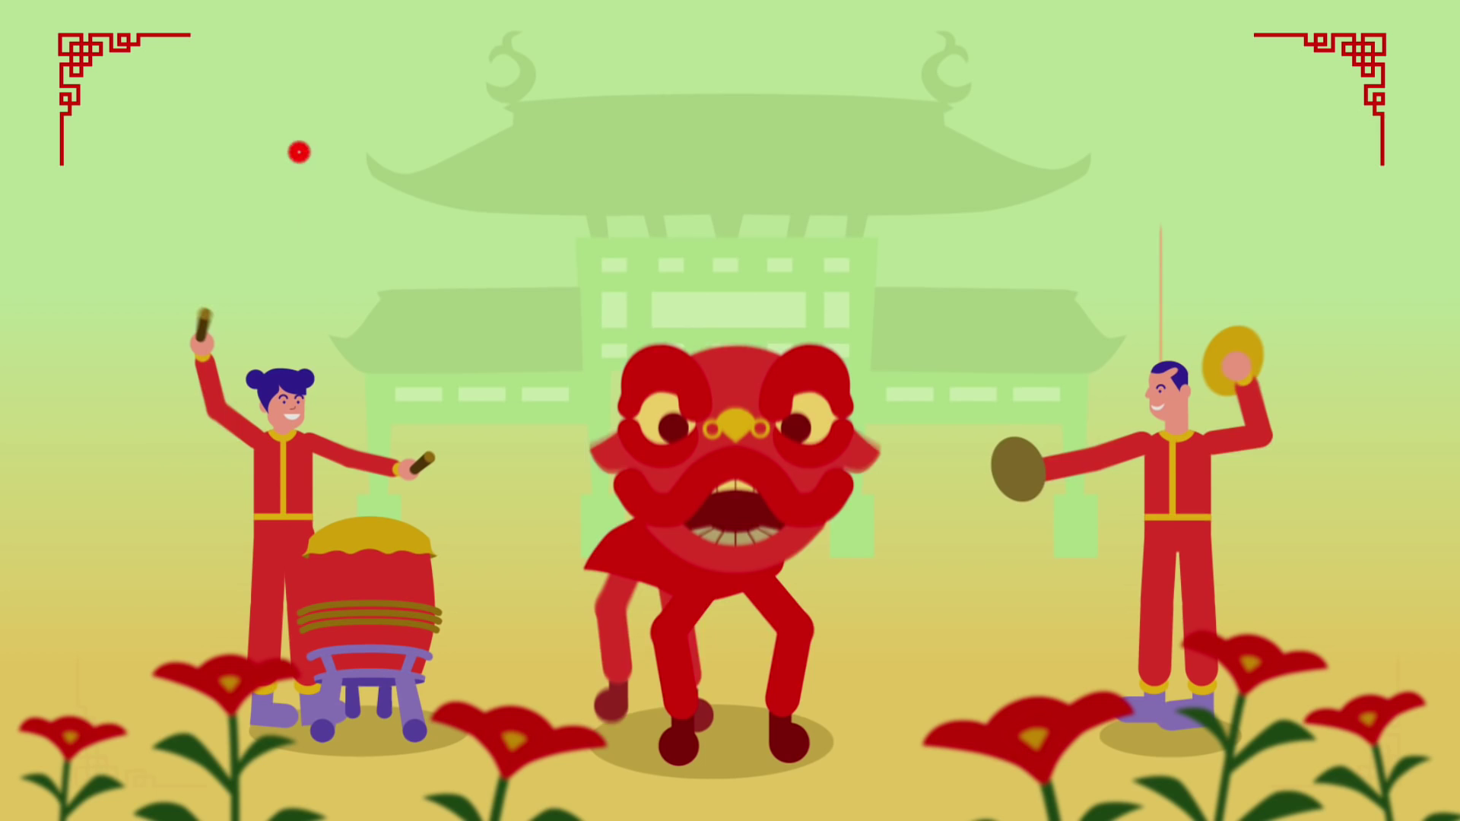
LESSON 4: COMMUNICATION

Slide 3




LESSON 4: COMMUNICATION
LESSON 1: GETTING STARTED
Option 1: "Wishing Cards"
Option 2: “Wish Wall”
WARM-UP
Saying New Year’s wishes
Task 1: Listen and read the New Year’s wish.
Task 2: Practice saying New Year’s wishes.
Student work in groups to complete the full sentence: “Wishing you joy and laughter …” to each other.
EVERYDAY ENGLISH
Task 3: Quiz: match the sentences with the pictures. Then match them with the countries.
Task 4: Read how people in different countries celebrate their New Year.
Then match the countries with the activities.
Task 5: Work in groups. Each student chooses one activity from Task 4.
Take turns to day them aloud. The group says which country he/ she is talking about.
NEW YEAR PRACTICES IN THE WORLD
CONSOLIDATION
Wrap-up
Homework

Slide 4

WARM-UP
OPTION 1
Wishing Cards

Slide 5
WARM-UP
OPTION 1
HOW TO PLAY

Slide 6
WARM-UP
OPTION 1
- Create personalized New Year wishing cards for someone special in your life in 6 minutes.
- They can include both written messages and drawings in your cards.

Slide 7
WARM-UP
LET’S DO IT

Slide 8


WARM-UP
OPTION 2

Slide 9
WARM-UP
OPTION 2
WISH WALL

Slide 10


WARM-UP
OPTION 2
- Work in groups
SHOULD
- Write down one meaningful New Year wish on sticky notes or small pieces of paper and stick them onto the wall (or A0 paper) anonymously.
SHOULDN’T
TET

Slide 11
LESSON 4: COMMUNICATION
LESSON 1: GETTING STARTED
Option 1: "Wishing Cards"
Option 2: “Wish Wall”
WARM-UP
Saying New Year’s wishes
Task 1: Listen and read the New Year’s wish.
Task 2: Practice saying New Year’s wishes.
Student work in groups to complete the full sentence: “Wishing you joy and laughter …” to each other.
EVERYDAY ENGLISH

Slide 12



Wishing you joy
& laughter … from January to December!
Everyday English
Saying New Year’s wishes

Slide 13


EVERYDAY ENGLISH
Listen and read the New Year’s wish.
Wishing you/I wish you + Noun/Noun phrase
Wishing you joy
& laughter … from January to December!

Slide 14

EVERYDAY ENGLISH
Practise saying New Year’s wishes to your friends, using the suggestions below or creating your own.
happy days from january to december
a year full of fun
happiness and cheers
a life full of happy moments
success in your studies
Wishing you/I wish you + ..............................

Slide 15
Wishing you joy
& laughter … from January to December!
New Year practices in the world

Slide 16

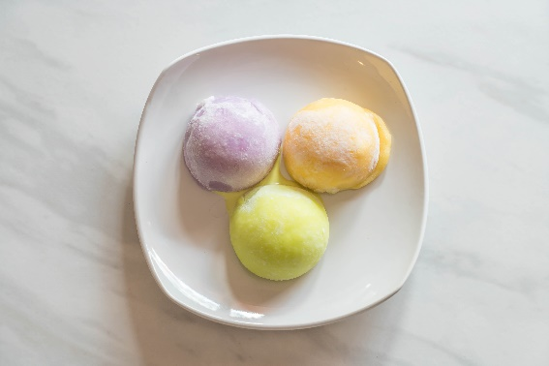

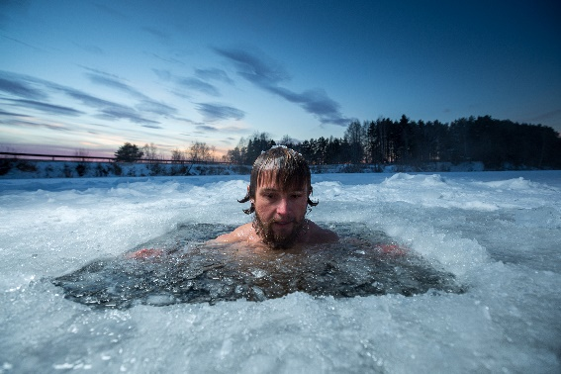
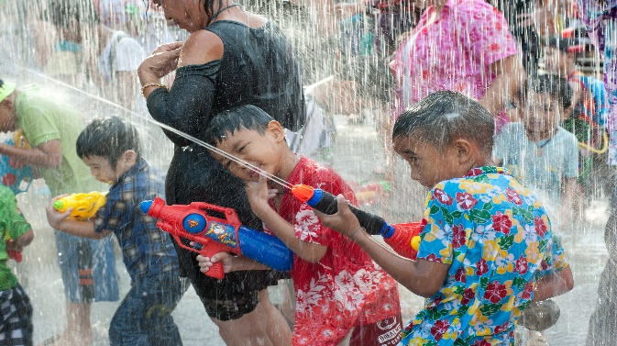
NEW YEAR PRACTICES IN THE WORLD
3
Match the sentences with the pictures. Then match them with the countries
1.
They go to Times Square to watch the New Year’s Eve Ball drop.
a
b
2.
They bathe in an ice hole.
3.
They eat mochi rice cakes.
c
d
4.
They throw water on other people.

Slide 17


b
a
1.
They go to Times Square to watch the New Year’s Eve Ball drop.
Thailand
The USA
b
c
2.
They bathe in an ice hole.
Japan
Russia
a
c
3.
They eat mochi rice cakes.
Japan
The USA
d
4.
They throw water on other people.
Thailand
Russia

Slide 18
NEW YEAR PRACTICES IN THE WORLD

Slide 19
NEW YEAR PRACTICES IN THE WORLD
Share with the class any interesting New Year’s practices from other countries/ parts of the world.

Slide 20
NEW YEAR PRACTICES IN THE WORLD
In Japan, temples ring their bells 108 times at midnight on December 31. By doing so, people believe the bad things of the past year will leave.
In Spain, people try to put 12 grapes in their mouth at midnight for good luck.
In Switzerland, they drop ice cream on the floor to celebrate the New Year.
In Romania, they throw coins into a river for good luck.
In Thailand, they throw water on other people to wash away bad luck.
Read how people in different countries celebrate their New Year. Then match the countries with the activities.
4

Slide 21
NEW YEAR PRACTICES IN THE WORLD
Countries
Activities
1. Japan
a. put 12 grapes in the mouth
b. ring bells 108 times
2. Spain
a. put 12 grapes in the mouth
b. ring bells 108 times
3. Switzerland
e. drop ice cream on the floor
c. throw coins into a river
c. throw coins into a river
5. Thailand
d. Throw water on other people
4. Romania
e. drop ice cream on the floor
d. throw water on other people

Slide 22
NEW YEAR PRACTICES IN THE WORLD
In Japan, temples ring their bells 108 times at midnight on December 31. By doing so, people believe the bad things of the past year will leave.
In Spain, people try to put 12 grapes in their mouth at midnight for good luck.
In Switzerland, they drop ice cream on the floor to celebrate the New Year.
In Romania, they throw coins into a river for good luck.
In Thailand, they throw water on other people to wash away bad luck.
5
Work in groups. Each student chooses one activity from 4. Take turns to say them aloud. The group says which country he / she is talking about.
Look at passages in Exercise 4.
Underline all the activities
Memorize the key words

Slide 23
NEW YEAR PRACTICES IN THE WORLD
One minute to pick the activity you are most interested from Exercise 4 and memorize it.
- Describe the activities you have chosen to the group.
The group/ The class gives the name of the country.
Example:
They throw water on other people.
It’s in Thailand.

Slide 24
NEW YEAR PRACTICES IN THE WORLD
Example:
They throw water on other people.
It’s in Thailand.

Slide 25
LESSON 4: COMMUNICATION
LESSON 1: GETTING STARTED
Option 1: "Wishing Cards"
Option 2: “Wish Wall”
WARM-UP
Saying New Year’s wishes
Task 1: Listen and read the New Year’s wish.
Task 2: Practice saying New Year’s wishes.
Student work in groups to complete the full sentence: “Wishing you joy and laughter …” to each other.
EVERYDAY ENGLISH
Task 3: Quiz: match the sentences with the pictures. Then match them with the countries.
Task 4: Read how people in different countries celebrate their New Year.
Then match the countries with the activities.
Task 5: Work in groups. Each student chooses one activity from Task 4.
Take turns to day them aloud. The group says which country he/ she is talking about.
NEW YEAR PRACTICES IN THE WORLD
CONSOLIDATION
Wrap-up
Homework

Slide 26

CONSOLIDATION
1
Wrap-up
What have we learnt in this lesson?
Introduce New Year’s wishes
Introduce students to some New Year’s practices in other countries

Slide 27

CONSOLIDATION
2
Homework
- Do exercise in workbook
- Choose a New Year celebration in the world and find out the information about it.

Slide 28






Website: hoclieu.vn
Fanpage: facebook.com/www.tienganhglobalsuccess.vn/

