Slide 2
Unit
6
OUR TET HOLIDAY
LESSON 2: A CLOSER LOOK 1

Slide 3
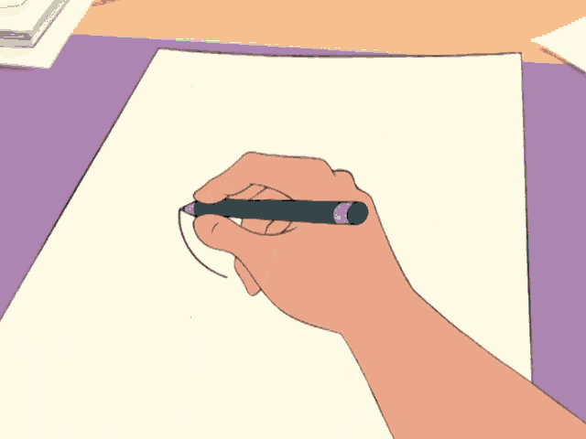
LESSON 2: A CLOSER LOOK 1
LESSON 2: A CLOSER LOOK 1
WARM-UP
Task 1: Hidden pictures
Vocabulary
Task 2: Match the verbs with the nouns.
Task 3: Complete the sentences with the words in the box.
VOCABULARY
Task 4: Listen and repeat the words. (p. 60)
Task 5: Listen and repeat the poem. Pay attention to the sounds /s/ and /ʃ/ in the underlined words. (p. 60)
PRONUNCIATION
PRODUCTION
Tongue Twisters
CONSOLIDATION
Wrap-up
Homework

Slide 4
WARM-UP
HIDDEN PICTURES

Slide 5
WARM-UP
HOW TO PLAY

Slide 6
WARM-UP
- Work in groups
- The teacher slowly removes the squares while you take turns guessing what picture is hidden behind them.
- If you have right answer, your team will have points.

Slide 7
WARM-UP
LET’S PLAY

Slide 8
Firework
/ˈfaɪr.wɝːk/
SHOW

Slide 9
Furniture
/ˈfɝː.nɪ.tʃɚ/
SHOW

Slide 10
wish
/wɪʃ/
SHOW

Slide 11
fun
/fʌn/
SHOW

Slide 12
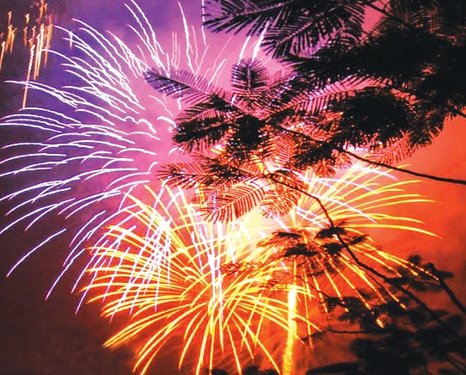
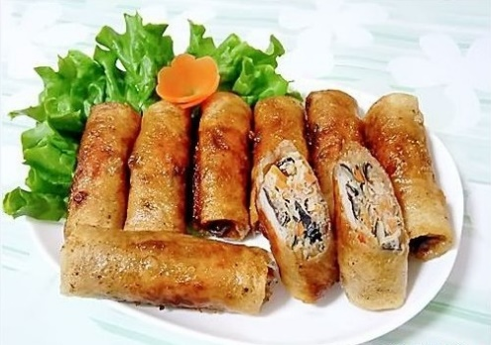
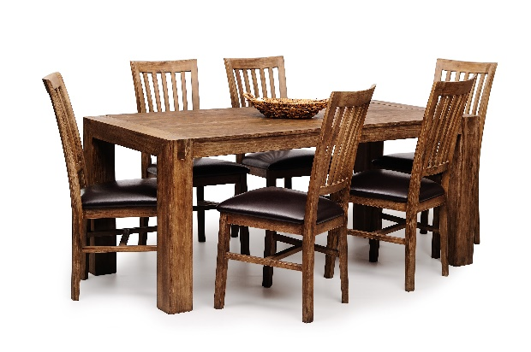
WARM-UP
Now we do exercise...

Slide 13
WARM-UP
Write the words / phrases in the box under the pictures.
wish
fun
fireworks
special food
furniture
1. fireworks
2. special food
3. fun
1.
2.
3.

Slide 14
WARM-UP
Write the words / phrases in the box under the pictures.
wish
fun
fireworks
special food
furniture
4. wish
5. furniture
4.
5.

Slide 15
LESSON 2: A CLOSER LOOK 1
LESSON 2: A CLOSER LOOK 1
WARM-UP
Task 1: Hidden pictures
Vocabulary
Task 2: Match the verbs with the nouns.
Task 3: Complete the sentences with the words in the box.
VOCABULARY

Slide 16
VOCABULARY
Match the verbs with the nouns.
VERBS | Nouns
1. have | a. a wish
2. visit | b. fireworks
3. give | c. the furniture
4. make | d. lucky money
5. clean | e. relatives
6. watch | f. fun
1.
2.
3.
4.
5.
6.
f
e
d
a
c
b

Slide 17
VOCABULARY
3
Complete the sentences with the words in the box.
shopping
celebrate
clean
food
peach
celebrate
1. In Viet Nam, we................................Tet in January of February
peach
2. At Tet, we decorate our houses with ........................... flowers
clean
3. Children should help their parents to....................... their house.

Slide 18
VOCABULARY
3
Complete the sentences with the words in the box.
shopping
celebrate
clean
food
peach
shopping
4. People do a lot of.................................... before Tet.
food
5. My mother usually cooks special ........................... duing Tet.

Slide 19
LESSON 2: A CLOSER LOOK 1
LESSON 2: A CLOSER LOOK 1
WARM-UP
Task 1: Hidden pictures
Vocabulary
Task 2: Match the verbs with the nouns.
Task 3: Complete the sentences with the words in the box.
VOCABULARY
Task 4: Listen and repeat the words. (p. 60)
Task 5: Listen and repeat the poem. Pay attention to the sounds /s/ and /ʃ/ in the underlined words. (p. 60)
PRONUNCIATION

Slide 20
PRONUNCIATION
/s/ and /ʃ/

Slide 21
/s/
PRONUNCIATION
First, listen and repeat the sound:
/ʃ/

Slide 22
PRONUNCIATION
/s/
/ʃ/

Slide 23
4
Listen and repeat the words.
NOW, Listen and repeat the words

Slide 24
4
Listen and repeat the words.
shopping
special
rice
spring
wish
celebrate

Slide 25
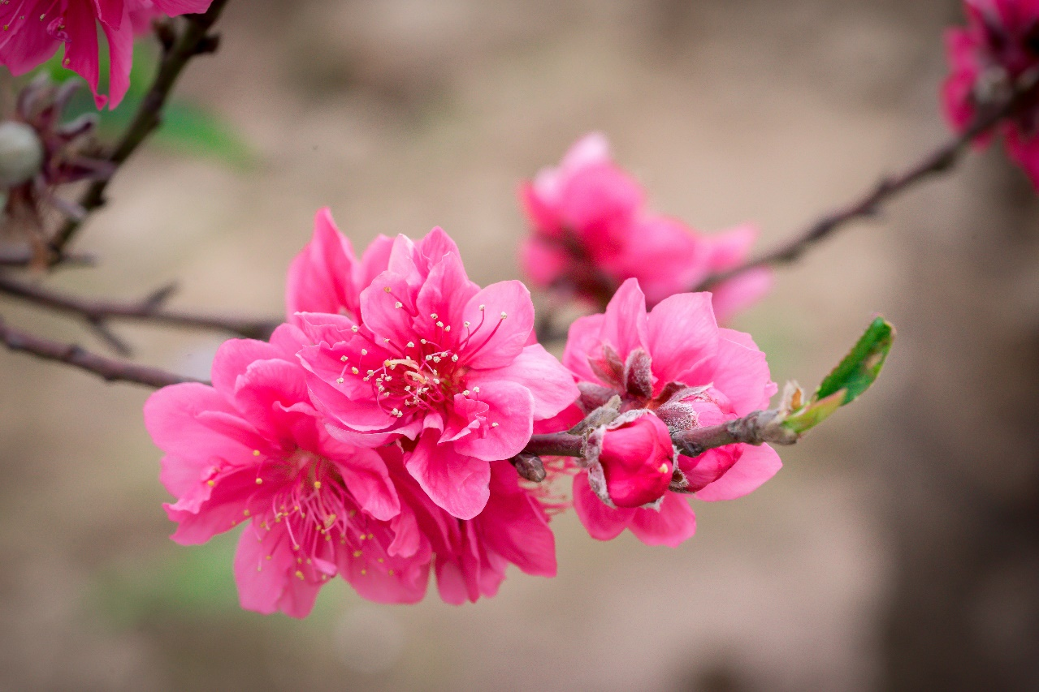
PRONUNCIATION
5
Listen and repeat the poem. Pay attention to the sounds /s/ and /ʃ/ in the underlined words.
Spring is coming!
Tet is coming!
She sells peach flowers.
Her cheeks shine.
Her eyes smile.
Her smile is shy.
She sells peach flowers.

Slide 26
LESSON 2: A CLOSER LOOK 1
LESSON 2: A CLOSER LOOK 1
WARM-UP
Task 1: Hidden pictures
Vocabulary
Task 2: Match the verbs with the nouns.
Task 3: Complete the sentences with the words in the box.
VOCABULARY
Task 4: Listen and repeat the words. (p. 60)
Task 5: Listen and repeat the poem. Pay attention to the sounds /s/ and /ʃ/ in the underlined words. (p. 60)
PRONUNCIATION
PRODUCTION
Tongue Twisters

Slide 27
PRODUCTION
Tounge Twisters

Slide 28
PRODUCTION
- Work in pairs/groups
- Create tongue twisters that include words with the /s/ and /∫/ sounds related to Tet holiday in 5 miutes
Example:
“Sally sent sweet spring wishes during Tet”

Slide 29
PRODUCTION
5 MINUTES

Slide 30
LESSON 2: A CLOSER LOOK 1
LESSON 2: A CLOSER LOOK 1
WARM-UP
Task 1: Hidden pictures
Vocabulary
Task 2: Match the verbs with the nouns.
Task 3: Complete the sentences with the words in the box.
VOCABULARY
Task 4: Listen and repeat the words. (p. 60)
Task 5: Listen and repeat the poem. Pay attention to the sounds /s/ and /ʃ/ in the underlined words. (p. 60)
PRONUNCIATION
PRODUCTION
Tongue Twisters
CONSOLIDATION
Wrap-up
Homework

Slide 31
CONSOLIDATION
1
Wrap-up
What have we learnt in this lesson?
Extend and practice vocabulary related to "Tet": things, activities and practices
Pronounce the sounds /s/ and /∫/ correctly

Slide 32
CONSOLIDATION
2
Homework
- Learn new words by heart.
- Practice pronouncing the sound /s/ and /∫/.

Slide 33
Website: hoclieu.vn
Fanpage: facebook.com/www.tienganhglobalsuccess.vn/

