Slide 2
Unit
6
OUR TET HOLIDAY
LESSON 1: GETTING STARTED
Happy New Year

Slide 3
Unit
6
OUR TET HOLIDAY
LESSON 1: GETTING STARTED
Happy New Year

Slide 4
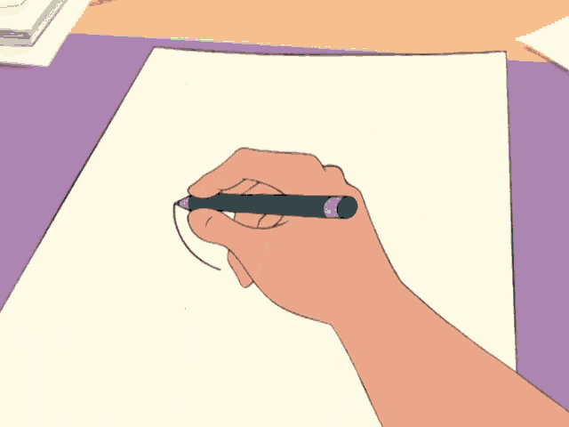
LESSON 1: GETTING STARTED
LESSON 1: GETTING STARTED
WARM-UP
Quick draw
Vocabulary
PRESENTATION
Task 1: Listen and read. (p. 58)
Task 2: What are Linda and Phong talking about? (p. 59)
Task 3: Complete the sentences about Tet with the information from the conversation in 1. (p. 59)
Task 4: Match the words/ phrases in the box with the pictures. (p. 59)
PRACTICE
PRODUCTION
Task 5: Game – Is it about Tet? (p. 59)
CONSOLIDATION
Wrap-up
Homework

Slide 5
WARM-UP
Quick draw:

Slide 6
WARM-UP
HOW TO PLAY

Slide 7
WARM-UP
- Work in groups
- Each round, one student from each team stands up and faces away from the screen
- There are the words/sentences on the screen. Members in each group will describe the words/sentences so that the students can draw the picture.
- If you draw right picture, your team will have points.

Slide 8
WARM-UP
LET’S PLAY

Slide 9
WARM-UP
1.
Flowers

Slide 10
WARM-UP
2.
Fireworks

Slide 11
WARM-UP
3.
sticky rice cake

Slide 12
WARM-UP
4.
Children visit their grandparents

Slide 13
WARM-UP
5.
People exchange gifts.

Slide 14
LESSON 1: GETTING STARTED
LESSON 1: GETTING STARTED
WARM-UP
Quick draw
Vocabulary
PRESENTATION

Slide 15
PRESENTATION
celebrate (v)
to show that a day or an event is important by doing something special on it
/ˈselɪbreɪt/
ăn mừng, tán dương

Slide 16
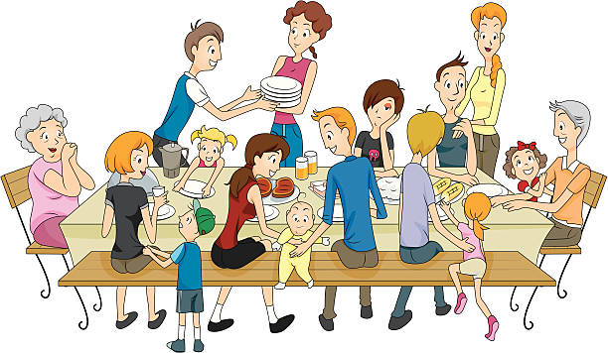
PRESENTATION
decorate (v)
to make something look more attractive by putting things on it
/ˈdekəreɪt/
trang trí

Slide 17
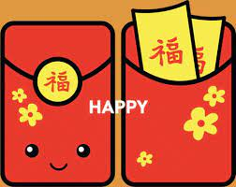
PRESENTATION
all members of a family meeting together for a social event
family gathering
/ˈfæməli ˈɡæðərɪŋ/
sum họp gia đình

Slide 18
PRESENTATION
money placed in a red envelope and given as a gift, usually for Lunar New Year
lucky money
/ˈlʌki ˈmʌni/
tiền lì xì

Slide 19
PRESENTATION
New words | Pronunciation | Meaning
1. celebrate (v) | /ˈselɪbreɪt/ | ăn mừng, tán dương
2. decorate (v) | /ˈdekəreɪt/ | trang trí
3. family gathering | /ˈfæməli ˈɡæðərɪŋ/ | sum họp gia đình
4. lucky money | /ˈlʌki ˈmʌni/ | tiền lì xì

Slide 20
LESSON 1: GETTING STARTED
LESSON 1: GETTING STARTED
WARM-UP
Quick draw
Vocabulary
PRESENTATION
Task 1: Listen and read. (p. 58)
Task 2: What are Linda and Phong talking about? (p. 59)
Task 3: Complete the sentences about Tet with the information from the conversation in 1. (p. 59)
Task 4: Match the words/ phrases in the box with the pictures. (p. 59)
PRACTICE

Slide 21
PRACTICE
1
Listen and read.
- Look at picture on page 58.
Questions:
1. What do you think they are talking about?
2. When is Tet?
3. Is it a holiday?
4. What do we do at Tet?

Slide 22
PRACTICE
Now, listen and read.

Slide 23
PRACTICE
Linda: Phong, does Viet Nam celebrate New Years?
Phong: Yes, we do. We have Tet.
Linda: When is Tet?
Phong: At different times. This year, it’s in January.
Linda: What do you do at Tet?
Phong: We clean our homes and decorate them with ﬂowers.
Linda: Is Tet a time for family gatherings?
Phong: Yes. It’s a happy time for everybody.
Linda: Great.
Phong: Yes, and another good thing about Tet is that children get lucky money.
Linda: That sounds interesting. Is there anything special people should do?
Phong: We should say “Happy New Year” when we meet people, and we shouldn’t break anything.
C. What to eat and wear during tet
B. Tet in Viet Nam
A. New Years in the world

Slide 24
PRACTICE
2
What are Linda and Phong talking about
A. New Years in the world
B. Tet in Viet Nam
C. What to eat and wear during tet

Slide 25
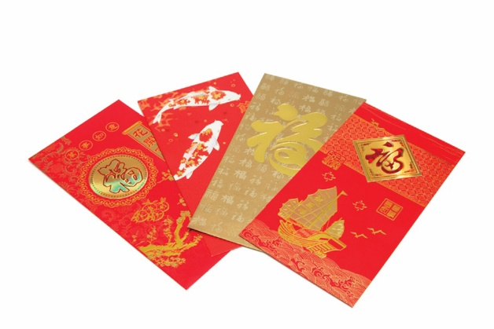
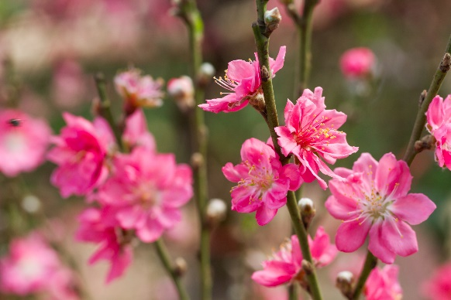
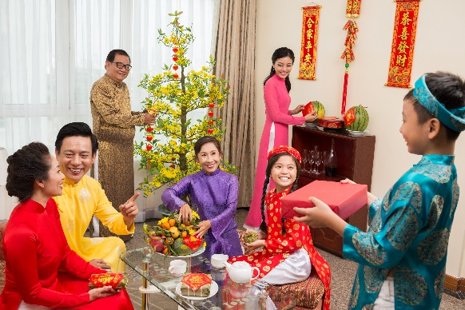
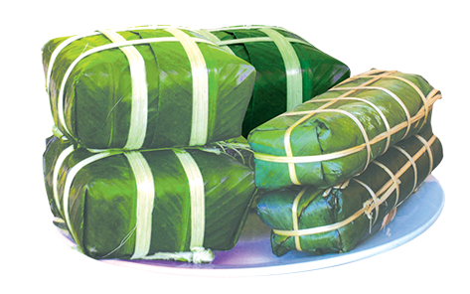
PRACTICE
3
Complete the sentences about Tet with the informatio n from the conversation in 1.
1.
January
This year Tet is in
.
2.
homes
We decorate our
.
3.
Tet is a time for family
gatherings
.
lucky money
4.
Children get
.
People shouldn’t
break
anything.
5.

Slide 26
PRACTICE
4
Match the words / phrases in the box with the pictures.
a. lucky money
a. lucky money
c. banh chung and banh tet
c. banh chung and banh tet
b. peach flowers
b. peach flowers
d. family gathering
d. family gathering
1
2
b. peach flowers
a. lucky money

Slide 27
PRACTICE
4
Match the words / phrases in the box with the pictures.
a. lucky money
a. lucky money
c. banh chung and banh tet
c. banh chung and banh tet
b. peach flowers
b. peach flowers
d. family gathering
d. family gathering
3
4
c. banh chung and banh tet
d. family gathering

Slide 28
LESSON 1: GETTING STARTED
LESSON 1: GETTING STARTED
WARM-UP
Quick draw
Vocabulary
PRESENTATION
Task 1: Listen and read. (p. 58)
Task 2: What are Linda and Phong talking about? (p. 59)
Task 3: Complete the sentences about Tet with the information from the conversation in 1. (p. 59)
Task 4: Match the words/ phrases in the box with the pictures. (p. 59)
PRACTICE
PRODUCTION
Task 5: Game – Is it about Tet? (p. 59)

Slide 29
PRODUCTION
5
Is it about Tet?
Write two things or activities and share them with the class. The class listen and decide whether they are about or not about Tet.
Example:
Student: banh chung
Class: It’s about Tet.
Student: flying a kite.
Class: It’s not about Tet.

Slide 30
LESSON 1: GETTING STARTED
LESSON 1: GETTING STARTED
WARM-UP
Quick draw
Vocabulary
PRESENTATION
Task 1: Listen and read. (p. 58)
Task 2: What are Linda and Phong talking about? (p. 59)
Task 3: Complete the sentences about Tet with the information from the conversation in 1. (p. 59)
Task 4: Match the words/ phrases in the box with the pictures. (p. 59)
PRACTICE
PRODUCTION
Task 5: Game – Is it about Tet? (p. 59)
CONSOLIDATION
Wrap-up
Homework

Slide 31
CONSOLIDATION
1
Wrap-up
- Tell me some words you remember from the lesson.
- Make some sentences with vocabulary which they learned from the lesson.

Slide 32
CONSOLIDATION
Linda: Phong, does Viet Nam celebrate New Years?
Phong: Yes, we do. We have Tet.
Linda: When is Tet?
Phong: At different times. This year, it’s in January.
Linda: What do you do at Tet?
Phong: We clean our homes and decorate them with ﬂowers.
Linda: Is Tet a time for family gatherings?
Phong: Yes. It’s a happy time for everybody.
Linda: Great.
Phong: Yes, and another good thing about Tet is that children get lucky money.
Linda: That sounds interesting. Is there anything special people should do?
Phong: We should say “Happy New Year” when we meet people, and we shouldn’t break anything.

Slide 33
CONSOLIDATION
1
Wrap-up
What have we learnt in this lesson?
identify the topic of the unit
use lexical items related to ”Tet:
Use the vocabulary and structures to describe things and activities at Tet

Slide 34
CONSOLIDATION
2
Homework
- Learn new words by heart.
- Practice using phrases they have learnt.

Slide 35
Website: hoclieu.vn
Fanpage: facebook.com/www.tienganhglobalsuccess.vn/

