Slide 1

WELCOME TO OUR CLASS!

Slide 2
KIM’S GAME

Slide 3

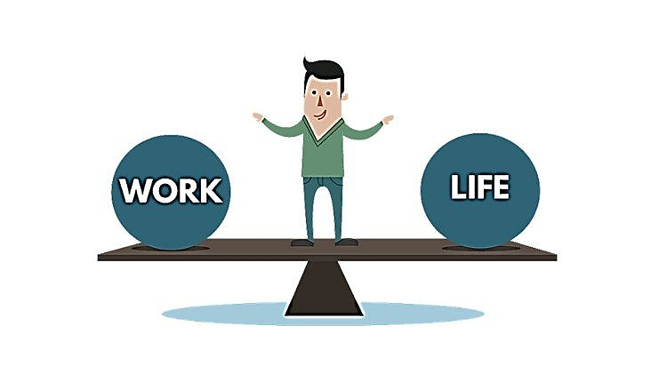
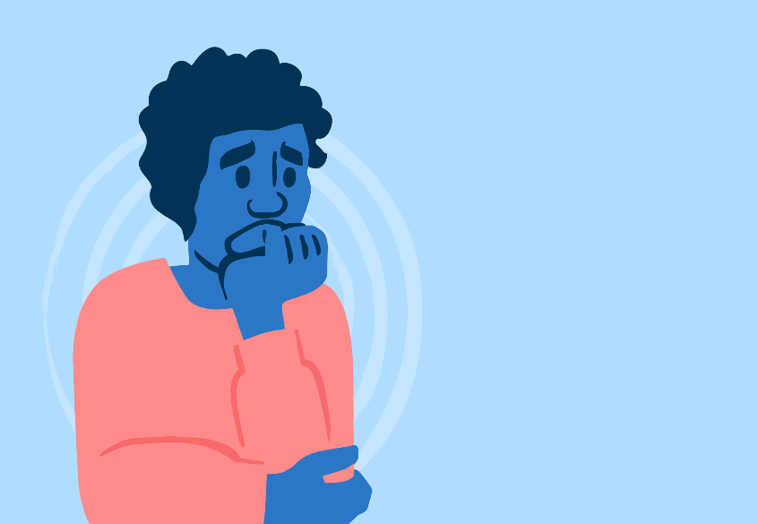
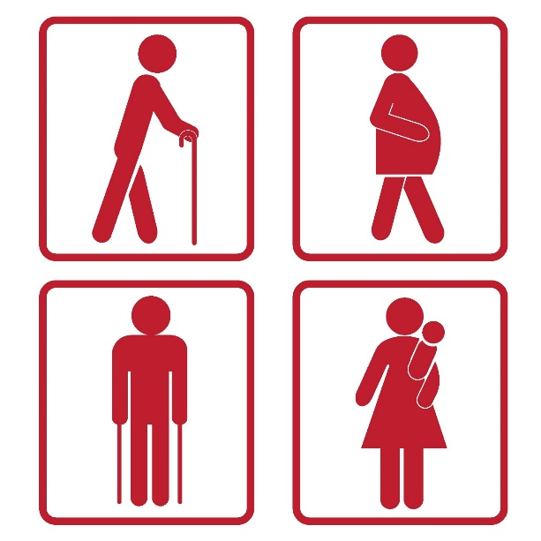
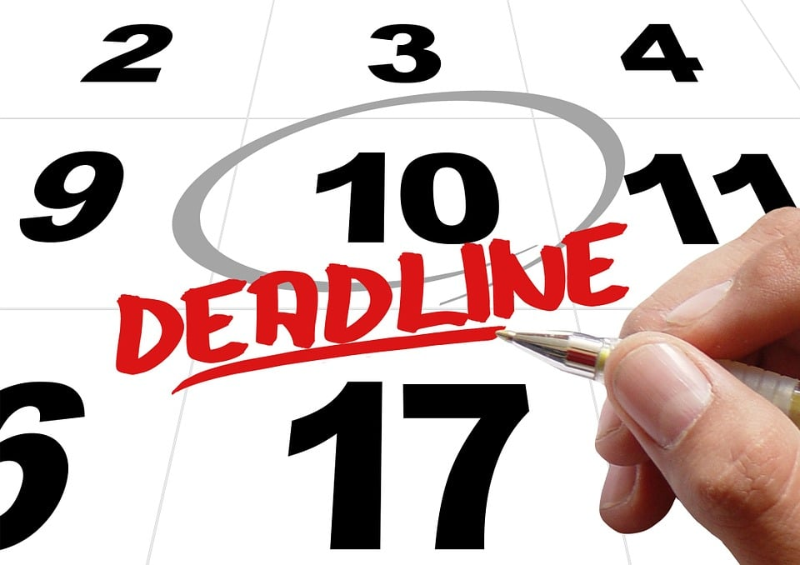


REMEMBER AND WRITE DOWN THE WORDS

Slide 4



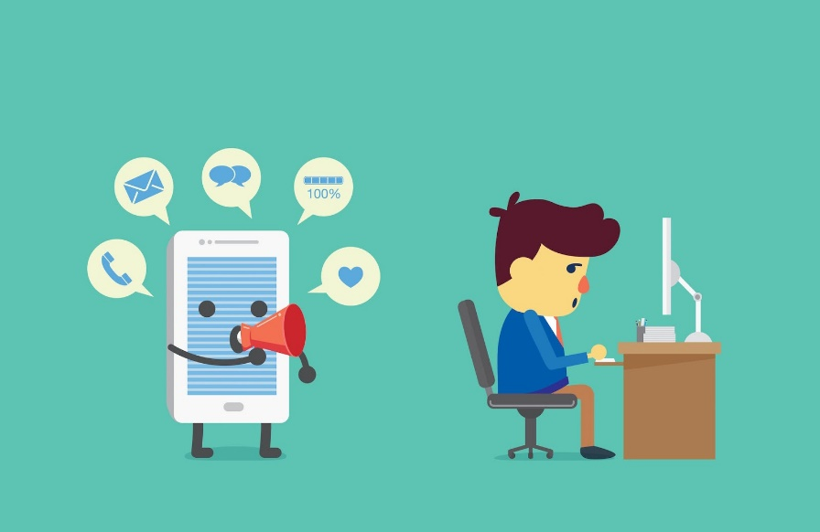
CHECK YOUR ANSWER
well-balanced / balance
anxiety
priority
distraction
advice
deadline / due date

Slide 5
Unit 3:
HEALTHY LIVING FOR TEENS
Lesson 7: Looking back

Slide 6
VOCABULARY

Slide 7
1. Complete the sentences with the correct words and phrases in the box.
stressed out priority delay well-balanced due date
1. A ________________meal or diet contains all the different things you need to keep you healthy.
2. The ________________ for the project is next Friday.
3. I’ve got too much to do, and I’m completely ________________.
4. Nick gave ________________ to tasks at his job because he couldn’t do everything he wanted today.
5. You may not feel better if you ________________ going to the doctor.
well-balanced
due date
stressed out
priority
delay
Notes:
1. well-balanced 2. due date 3. stressed out 4. priority 5. delay

Slide 8
2. Choose the correct answer A, B, C, or D.
1. To most people, ______ living means both physical and mental health are functioning well together.
A. healthy B. unhealthy C. health D. healthily
2. When we ______ our task, we headed home.
A. succeeded B. won C. accomplished D. managed
3. She’s in poor health, but she’s ______ about her future.
A. optimistic B. negative C. pleased D. unhappy
4. There are too many ____ in this classroom – it’s hard for me to pay attention to the lesson.
A. difficulties B. distractions C. obstacles D. omissions
5. He was in a good ______ when he got home from school.
A. mind B. feeling C. attitude D. mood
Notes:
1. A 2. C 3. A 4. B 5. D

Slide 9
2. Choose the correct answer A, B, C, or D.
1. To most people, ______ living means both physical and mental health are functioning well together.
A. healthy B. unhealthy C. health D. healthily
2. When we ______ our task, we headed home.
A. succeeded B. won C. accomplished D. managed
3. She’s in poor health, but she’s ______ about her future.
A. optimistic B. negative C. pleased D. unhappy
4. There are too many ____ in this classroom – it’s hard for me to pay attention to the lesson.
A. difficulties B. distractions C. obstacles D. omissions
5. He was in a good ______ when he got home from school.
A. mind B. feeling C. attitude D. mood
Notes:
1. A 2. C 3. A 4. B 5. D

Slide 10
GRAMMAR

Slide 11

Conditional sentence type 1
If + S + present simple tense, S + will + bare inf.
Instead of will, we can use modal verbs: can, must, may, might, should…

Slide 12
3. Complete the sentences with the correct modal verbs in the box. A modal verb can be used twice.
can must should might
1. If you don’t want to get in an accident, you _________ follow these safety
instructions.
2. If you take these pills, you _________ feel better soon.
3. You _________ come and join us if you like.
4. If you feel unwell, you _________ consult a doctor.
5. If she tries hard, she _________ speak English better than you.
must
might
can
should
can
Notes:
1. must 2. might 3. can 4. should 5. Can

Slide 13
4. Circle the most suitable modal verbs to complete the sentences.
1. He shouldn’t / may not / cannot stay up late tonight if he wants to feel awake and alert tomorrow morning.
2. Nick should / can’t / might be very excited if we invite him to our home.
3. Mai can / must / should be good at time management if she takes a training course at school.
4. If you want to save on your electricity bills, you must / can / might turn off all the electric equipment before going out.
5. If you help me tidy our flat this morning, you must / can / can’t go out this afternoon.
Notes:
1. shouldn’t 2. might 3. can 4. must 5. can

Slide 14

















1. He _____stay up late tonight if he wants to feel awake and alert tomorrow morning.
shouldn’t
may not
can not

Slide 15





2. Nick ______ be very excited if we invite him to our home.
should
can’t
might

Slide 16
3. Mai ____be good at time management if she takes a training course at school.
can
must
should

Slide 17
4. If you want to save on your electricity bills, you _____turn off all the electric equipment before going out.
must
can
might

Slide 18
5. If you help me tidy our flat this morning, you _____go out this afternoon.
must
can
can’t

Slide 19
Look at the answers again.
1. He shouldn’t stay up late tonight if he wants to feel awake and alert tomorrow morning.
2. Nick might be very excited if we invite him to our home.
3. Mai can be good at time management if she takes a training course at school.
4. If you want to save on your electricity bills, you must turn off all the electric equipment before going out.
5. If you help me tidy our flat this morning, you can go out this afternoon.
Notes:
1. shouldn’t 2. might 3. can 4. must 5. can

Slide 20

Do the quiz
Notes:
1. shouldn’t 2. might 3. can 4. must 5. can

Slide 21
WRAP-UP
What have we learnt in this lesson?
Revise the vocabulary items learnt in the unit.
Revise the forms and uses of comparative adverbs.
Develop research and collaboration skills and practise giving an oral presentation.

Slide 22
HOMEWORK
Review the vocabulary and grammar points in Unit 3
Do exercises in the workbook
Prepare: Unit 4: Getting Started

Slide 23
THANK YOU!

