Slide 1




WELCOME TO OUR CLASS!
Teacher: ……………..

Slide 2

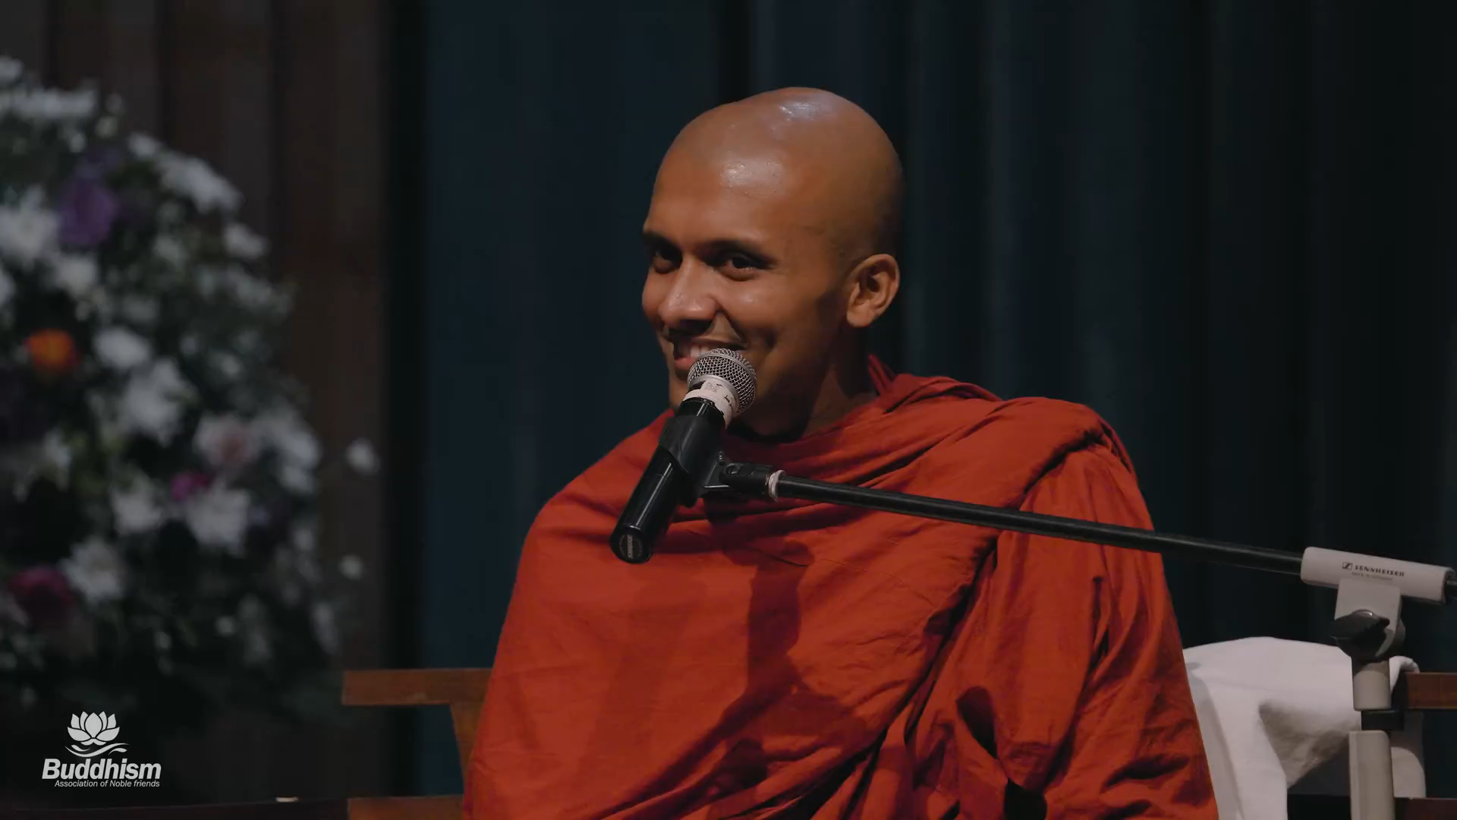



How to live a balanced life

Slide 3
1. Work in pairs. Discuss the following question.
How do you make time for study and other activities?

Slide 4



Unit 3:
HEALTHY LIVING FOR TEENS
Lesson 6: Skills 2

Slide 5



VOCABULARY

Slide 6




VOCABULARY
schoolwork (n)
.
/ˈskuːl.wɝːk/
việc học tập
Notes:
studying done by a child at school or at home

Slide 7
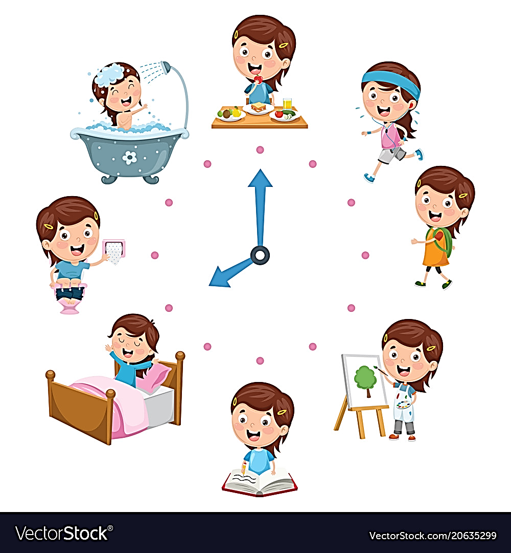
VOCABULARY
routine (n)
.
/ruːˈtiːn/
việc thường làm (hàng ngày)
Notes:
a usual or fixed way of doing things:

Slide 8

VOCABULARY
submit (v)
.
/səbˈmɪt/
nộp, đệ trình
Notes:
to give or offer something for a decision to be made by others

Slide 9

VOCABULARY
minimize (v)
.
/ˈmɪn.ɪ.maɪz/
giảm đến mức tối thiểu
Notes:
to reduce something to the least possible level or amount:

Slide 10
VOCABULARY
New words | Pronunciation | Meaning
1. schoolwork (n) | /ˈskuːl.wɝːk/ | việc học tập
2. routine (n) | /ruːˈtiːn/ | việc thường làm (hàng ngày)
3. submit (v) | /səbˈmɪt/ | nộp, đệ trình
4. minimize (v) | /ˈmɪn.ɪ.maɪz/ | giảm đến mức tối thiểu

Slide 11
LISTENING
How to manage the time effectively

Slide 12


Tom
Phong
Trang

Slide 13
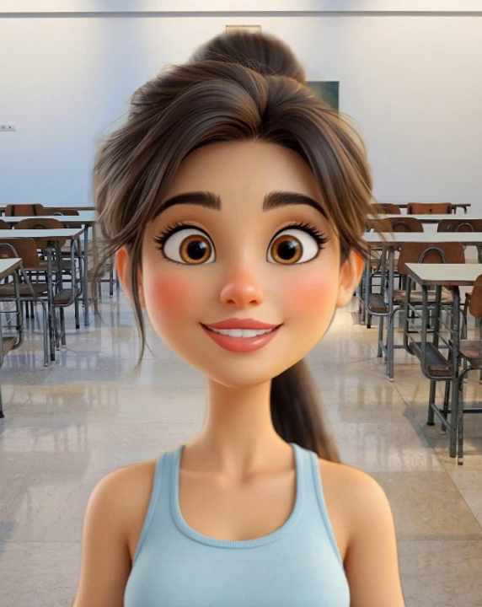

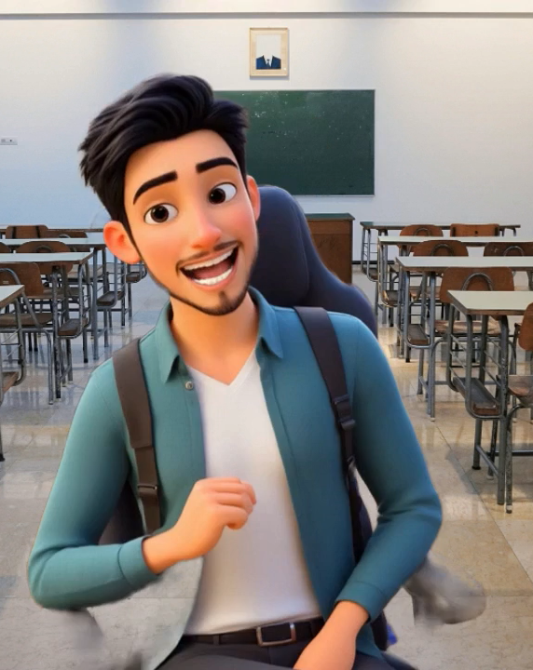
2. For each student (1 – 3), choose the opinion (A – C) each of them expresses.
1. Trang
2. Phong
3. Tom
A. I don’t let things distract me from the schoolwork that I have to do.
B. Using a calendar to plan my work ahead helps me manage my time effectively.
C. I try not to delay doing my homework and working on my projects and coming tests.
Notes:
Trang: B, Phong: A, Tom: C.

Slide 14
2. For each student (1 – 3), choose the opinion (A – C) each of them expresses.
B
A
C
1. Trang
2. Phong
3. Tom
A. I don’t let things distract me from the schoolwork that I have to do.
B. Using a calendar to plan my work ahead helps me manage my time effectively.
C. I try not to delay doing my homework and working on my projects and coming tests.
Notes:
Trang: B, Phong: A, Tom: C.

Slide 15

3. Listen again and choose the correct answer A, B, or C.
1. Trang enters what she has to do into a ______ at the beginning of each term.
A. poster B. routine C. calendar
2. Trang often uses ______ colours to mark project due dates and exam times on her calendar.
A. different B. the same C. similar
3. Phong turns off his cell phone and signs out of social media ______ when he starts his work.
A. accounts B. networks C. websites
4. Tom tries not to ______ homework until just before the due date.
A. leave B. complete C. submit
5. Tom ______ his projects and coming tests and adds them to his schedule.
A. prepares B. reviews C. revises
Notes:
1. C 2. A 3. A 4. A 5. B

Slide 16






TIME MANAGEMENT HABITS
Daily routines | How you give priority to your tasks | Challenges

Slide 17




WRITING

Slide 18
4. Match the time management tips in column A with the explanations and / or reasons in column B.
A | B
1. Making a plan or schedule for things you need to do, including appointments, projects, homework and tests | a. You should decide which is the most urgent and important task so that you can concentrate on it first. By doing this, you may not be at a loss to deal with too much work at the same time.
2. Giving priority to the most important task | b. An effective routine can help you accomplish the things you need to do. The more you follow a daily routine, the less you will worry or get stressed.
3. Building an effective daily routine | c. You can plan your work ahead by using a calendar, a diary, or a mobile app. It helps you remember what you need to accomplish and when you should do it.
Notes:
Key: 1. c 2. a 3. b

Slide 19
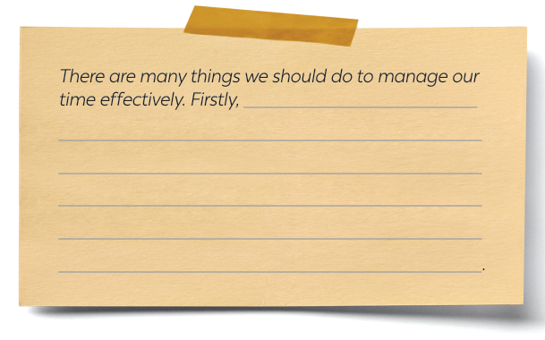
5. Write a paragraph (about 100 words) about how to manage your time effectively. Use the tips in 4 or your own ideas.
Notes:
Key: 1. c 2. a 3. b

Slide 20
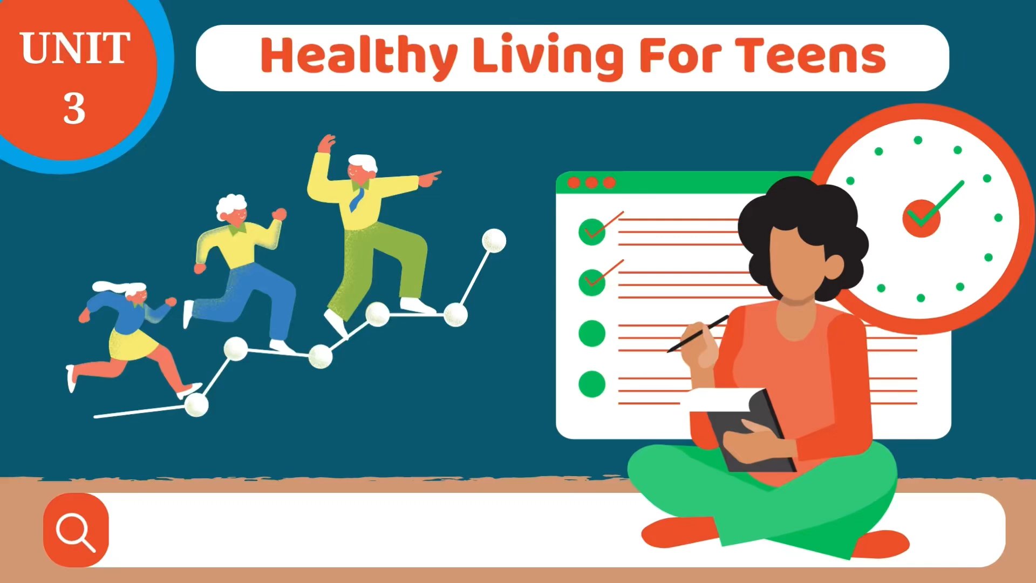
5. Write a paragraph (about 100 words) about how to manage your time effectively. Use the tips in 4 or your own ideas.
Notes:
Key: 1. c 2. a 3. b

Slide 21

5. Write a paragraph (about 100 words) about how to manage your time effectively. Use the tips in 4 or your own ideas.
Suggested answer:
There are many things we should do to manage our time effectively. Firstly, we should set specific goals and prioritise them according to their importance level. This will help us keep focused on our most important tasks and avoid wasting time on tasks that do not contribute to our goals. Secondly, creating a schedule or to-do list can help us manage our time efficiently by breaking down our day into manageable chunks. We should also be realistic about how long each task will take and build in extra time for unexpected interruptions or delays. Thirdly, it is essential to eliminate distractions and time-wasting activities, such as social media or unnecessary meetings, which can reduce our productivity. By following these tips, you we can effectively manage your time and achieve success in all aspects of your life.
Notes:
Key: 1. c 2. a 3. b

Slide 22
WRAP-UP
What have we learnt in this lesson?
Listening skill for specific information.
Writing a paragraph about how to manage their time effectively, using the given tips or their own ideas.

Slide 23






HOMEWORK
Learn by heart vocabulary
Complete the writing task by yourself
Do exercises in the workbook
Prepare: Looking back and Project

Slide 24














THANK YOU!

