Slide 1
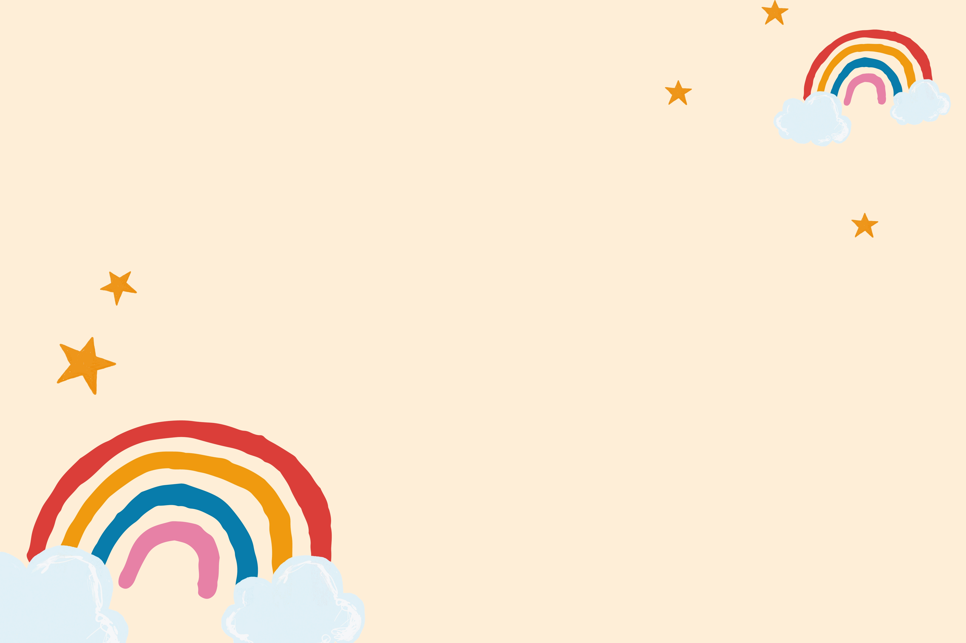
……………. Secondary School
WELCOME TO OUR CLASS!
Presented by:…

Slide 2


Slide 3

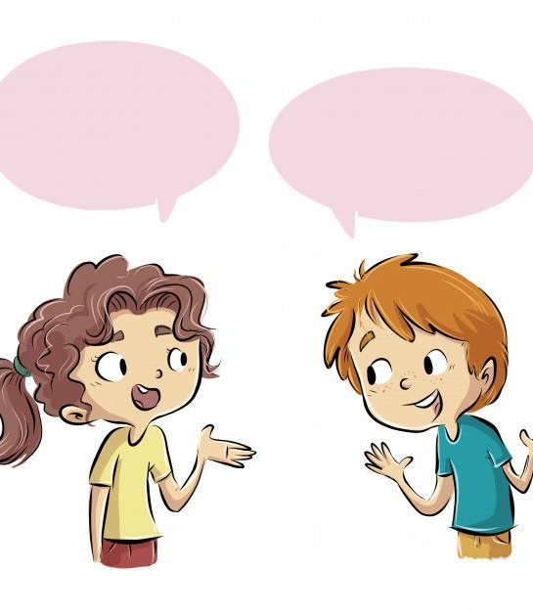
ANSWER:
+ Do you have a well-balanced life?
+ Can you make any adjustments to achieve a more well-balanced life?

Slide 4
Unit 3:
HEALTHY LIVING FOR TEENS
Lesson 5: Skills 1

Slide 5
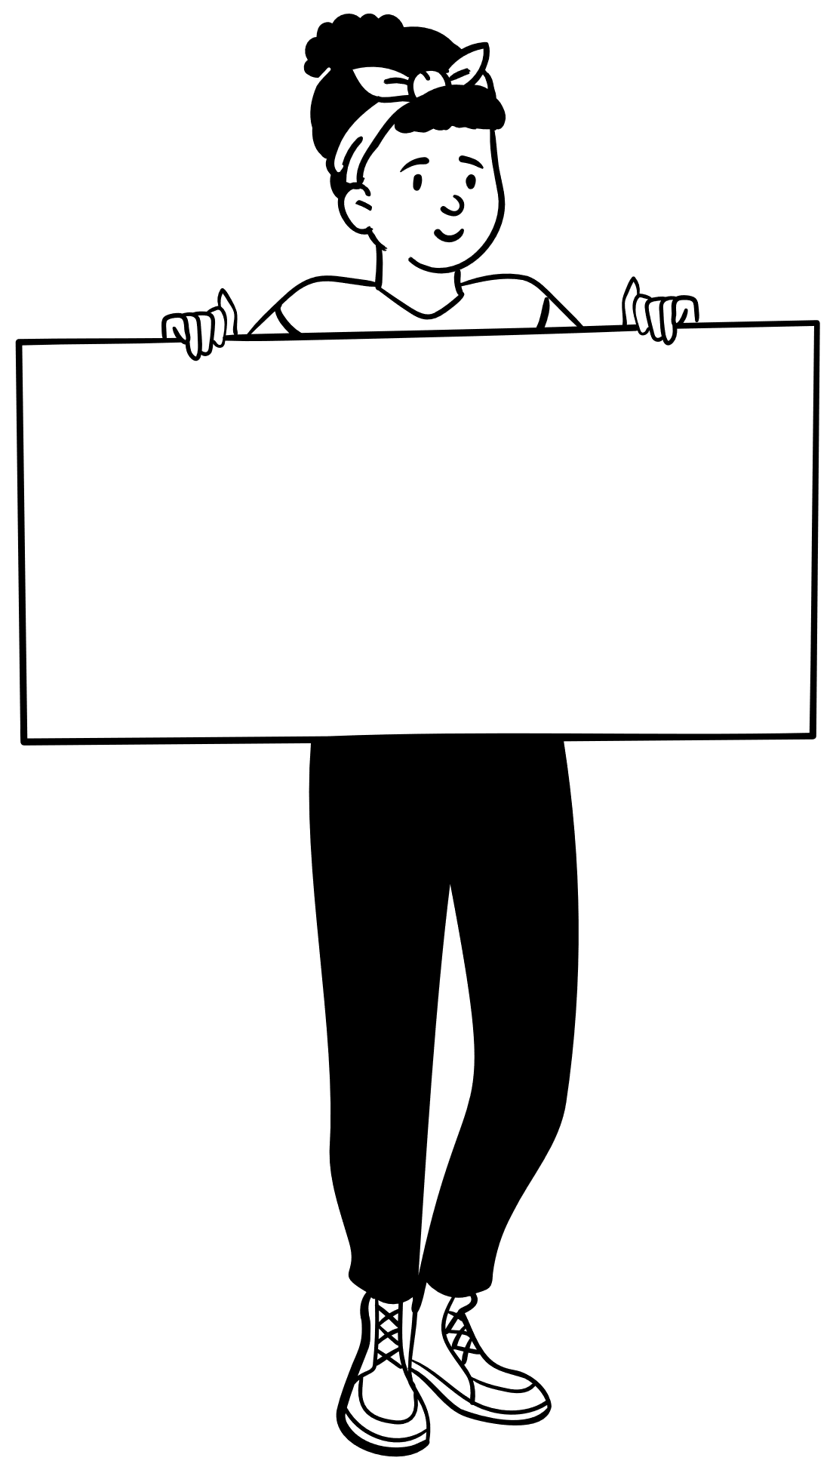
1. DISCUSSION
How is a well-balanced life important for students?

Slide 6
2. The following text is about how a successful teen celebrity kept a well-balanced life when he was at school
When I was at school, I had to learn how to have a well-balanced life in order to reduce stress and anxiety. Below are some of the typical things I did.
Firstly, I managed my time properly. I started to plan my schedule, made a weekly work list and gave priority to some of my work. This helped me concentrate my efforts on my most important tasks.
In addition, I communicated with my family, friends, and teachers about my busy schedule and problems, so they would offer me additional support.
I also took breaks appropriately because they helped me keep away from stress and anxiety, and gave my brain a rest and improved my mood.
Finally, I looked after my physical health. I got at least eight hours of sleep a day. I played football with my classmates twice a week and went for a walk with my grandparents early every morning. Besides, I also tried to follow a healthy diet. I ate a lot of fruit and vegetables. I ate little fattening foods and avoided junk foods like chips, cookies, pizza, etc.

Slide 7
2. Read the text and match each highlighted word with its meaning.
a. more than the amount you expected or agreed to
b. likely to make you fat
c. the state of feeling nervous or worried that something bad is going to happen
d. in a way that is suitable or right for a particular situation
1. anxiety
1. c
2. a
3. d
4. b
2. additional
3. appropriately
4. fattening

Slide 8

Check your answers
anxiety (n)
a. more than the amount you expected or agreed to
b. likely to make you fat
d. in a way that is suitable or right for a particular situation
.
/æŋˈzaɪ.ə.ti/
c. the state of feeling nervous or worried that something bad is going to happen
sự lo lắng
Notes:
anxiety (n) an uncomfortable feeling of nervousness or worry about something that is happening or might happen in the future

Slide 9
Check your answers
b. likely to make you fat
c. the state of feeling nervous or worried that something bad is going to happen
d. in a way that is suitable or right for a particular situation
additional (adj)
a. more than the amount you expected or agreed to
/əˈdɪʃ.ən.əl/
thêm, bổ sung
Notes:
additional (a) extra

Slide 10
Check your answers
a. more than the amount you expected or agreed to
b. likely to make you fat
c. the state of feeling nervous or worried that something bad is going to happen
appropriately (adv)
/əˈprəʊ.pri.ət.li/
một cách thích hợp
d. in a way that is suitable or right for a particular situation
Notes:
appropriately (adv) close to a particular number or time although not exactly that number or time:

Slide 11
Check your answers
a. more than the amount you expected or agreed to
c. the state of feeling nervous or worried that something bad is going to happen
d. in a way that is suitable or right for a particular situation
fattening (adj)
b. likely to make you fat
/ˈfæt.ən.ɪŋ/
gây béo
Notes:
fattening (a) Fattening food contains a lot of fat, sugar, etc. that would quickly make you fatter if you ate a lot of it:

Slide 12
Look at the answers again
c. the state of feeling nervous or worried that something bad is going to happen a. more than the amount you expected or agreed to
d. in a way that is suitable or right for a particular situation b. likely to make you fat
sự lo lắng
1. anxiety
1. c
2. a
3. d
4. b
2. additional
thêm, bổ sung
3. appropriately
một cách thích hợp
4. fattening
gây béo

Slide 13
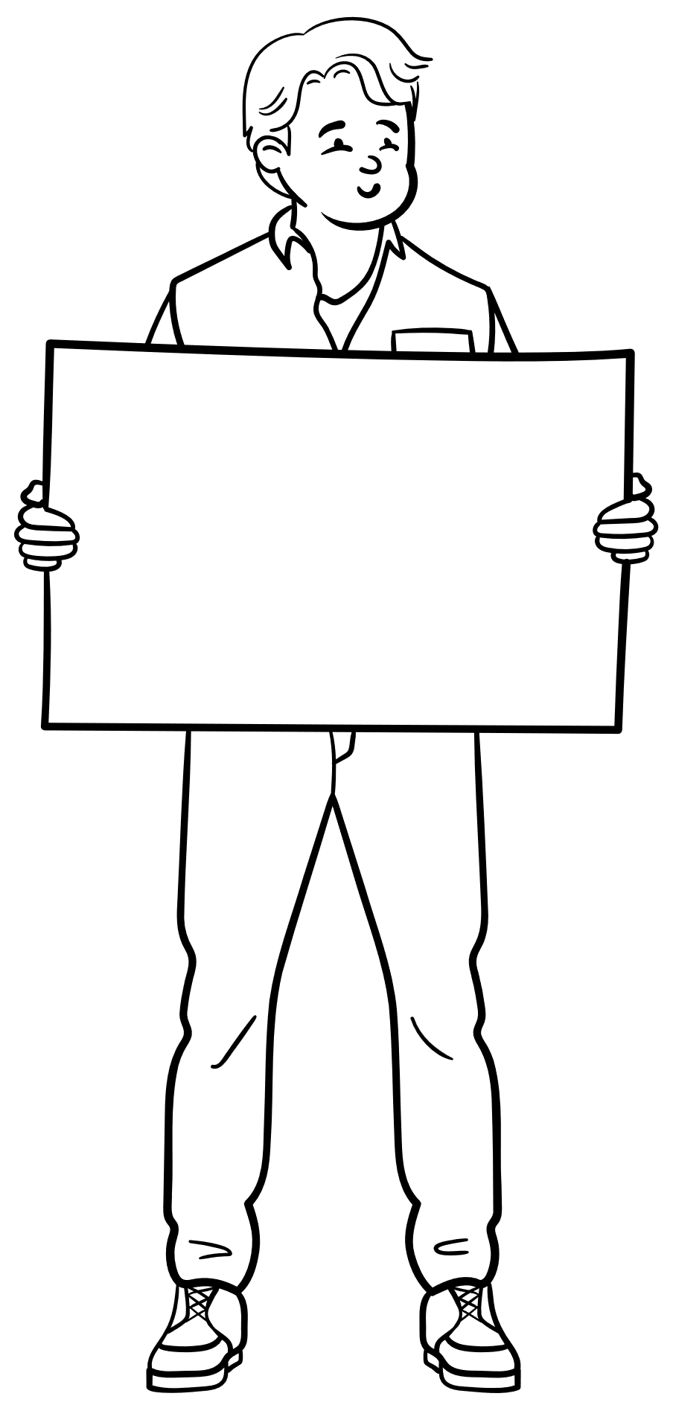
Why did he have to learn how to have a well-balanced life when he was a student?

Slide 14
3. Read the text again and answer the following questions.
1. Why did the teen celebrity have to learn how to have a well-balanced life when he was a student?
2. What did he do to manage his time properly?
3. Why did he communicate with his family, friends, and teachers about his schedules and problems?
4. Why did he take breaks?
5. How did he follow a healthy diet?

Slide 15



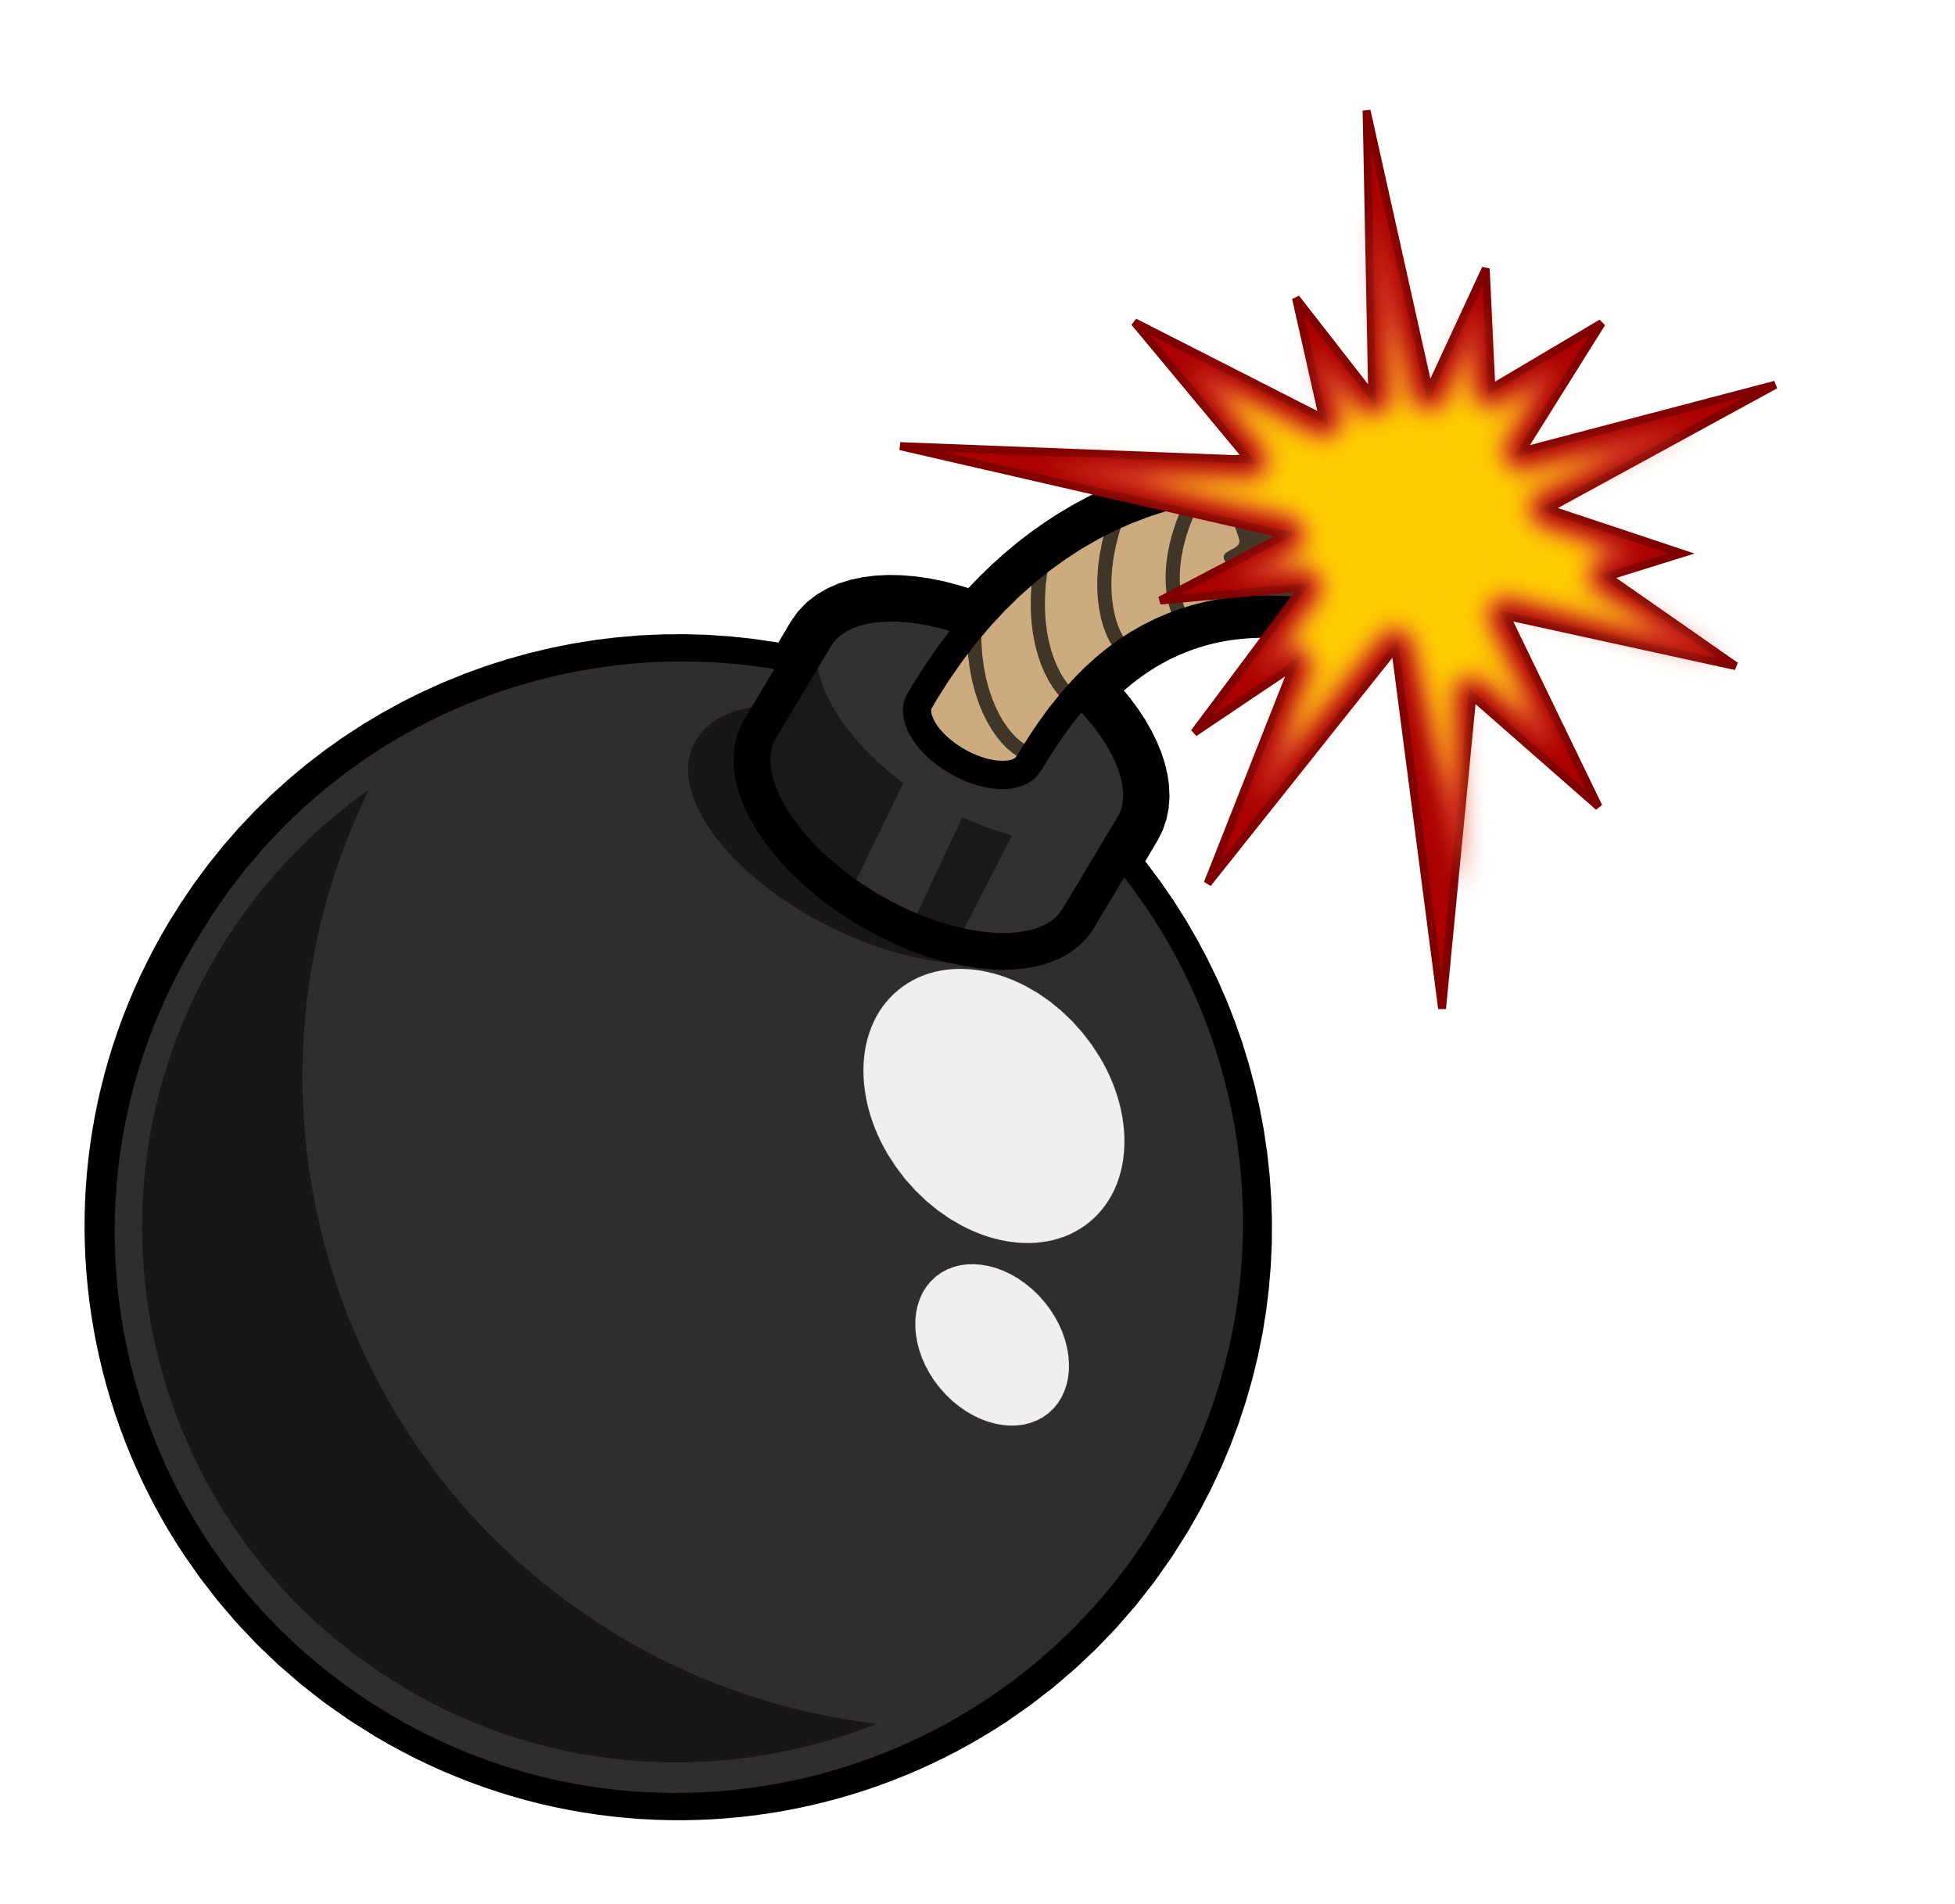


BOMB GAME
START!

Slide 16

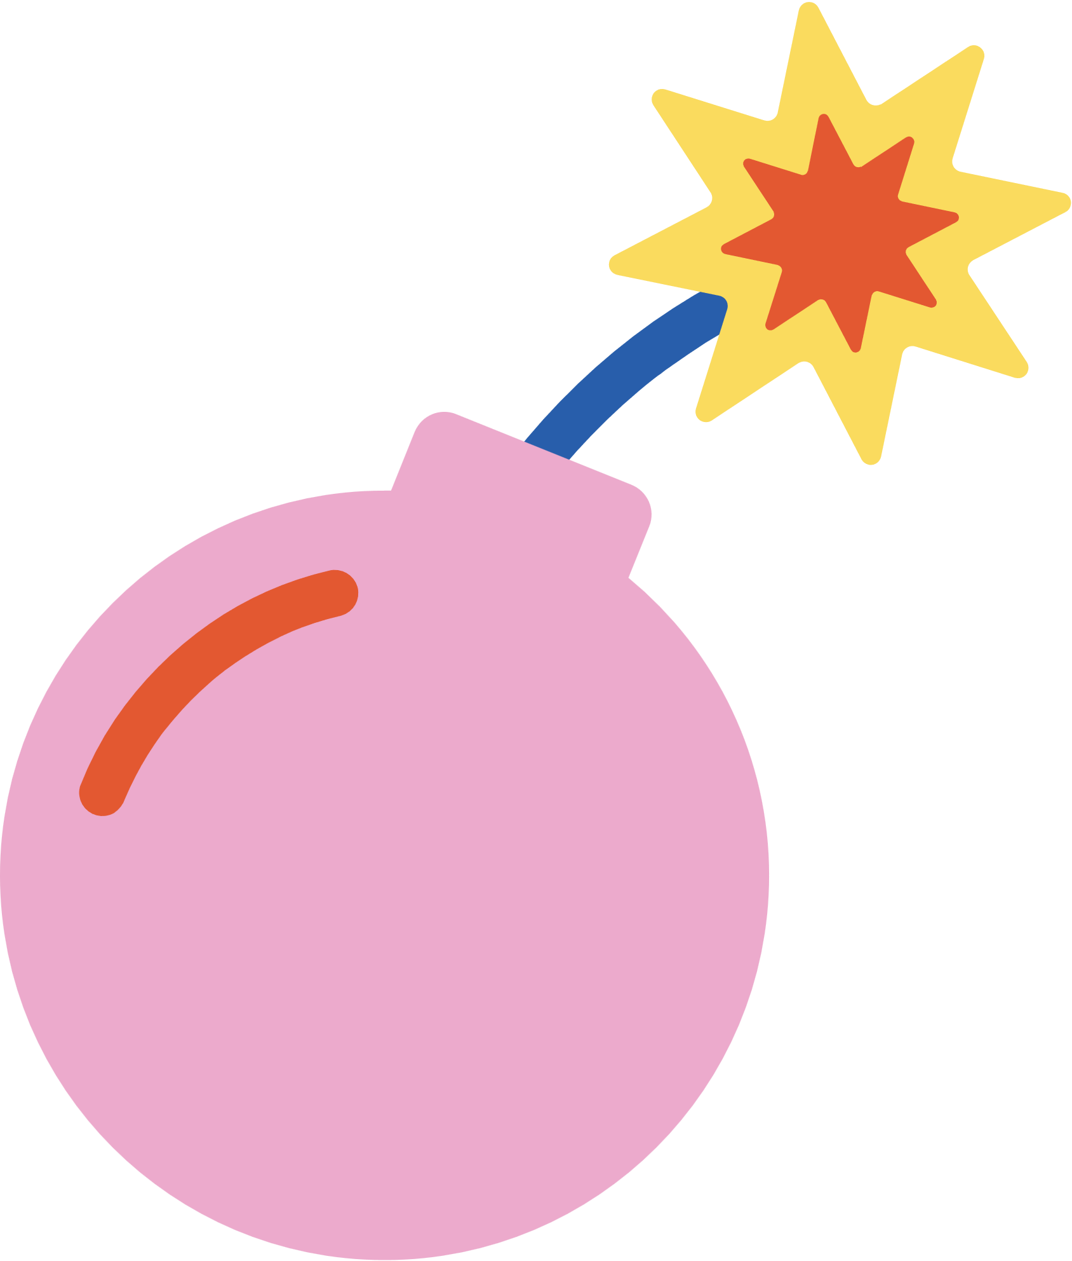
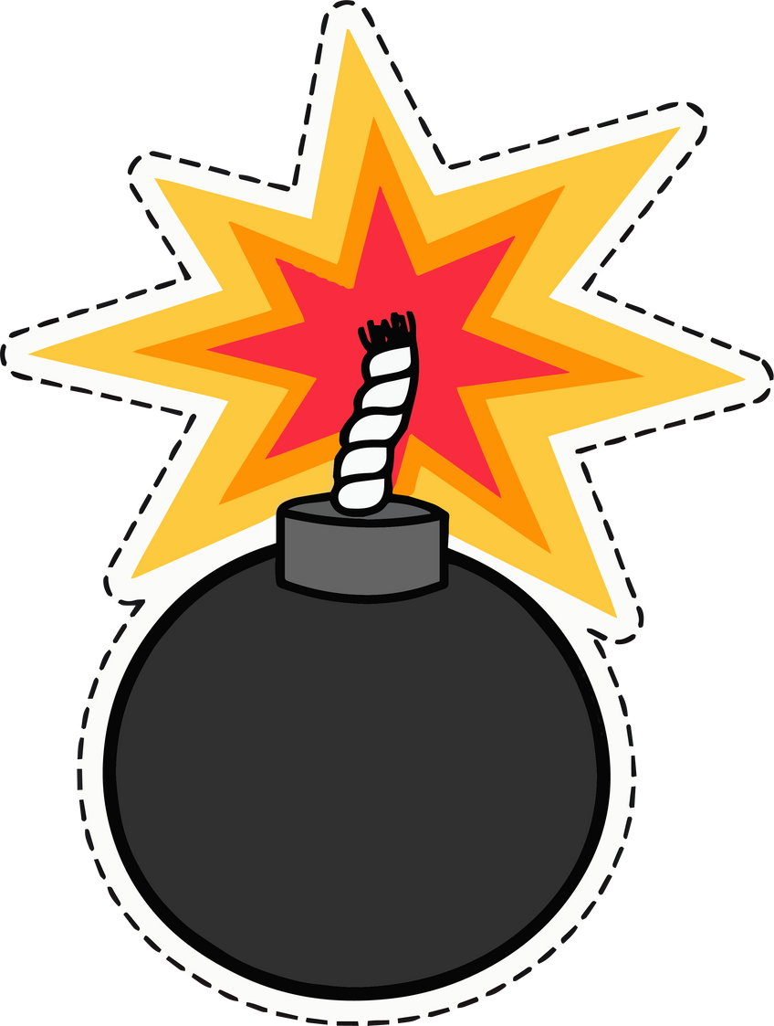
BOMB GAME
1
2
3
4
5
6
7
8

Slide 17


Check your answer
1. Why did the teen celebrity have to learn how to have a well-balanced life when he was a student?
Because he wanted to reduce stress and anxiety.
1
+ 10 points
Notes:
Ấn vào số đề quay về trang chủ

Slide 18
Check your answer
2. What did he do to manage his time properly?
He planned his schedule, made a weekly work list and gave priority to his work, which helped him concentrate his efforts on his most important tasks.
2
+ 20 points
Notes:
Ấn vào số đề quay về trang chủ

Slide 19
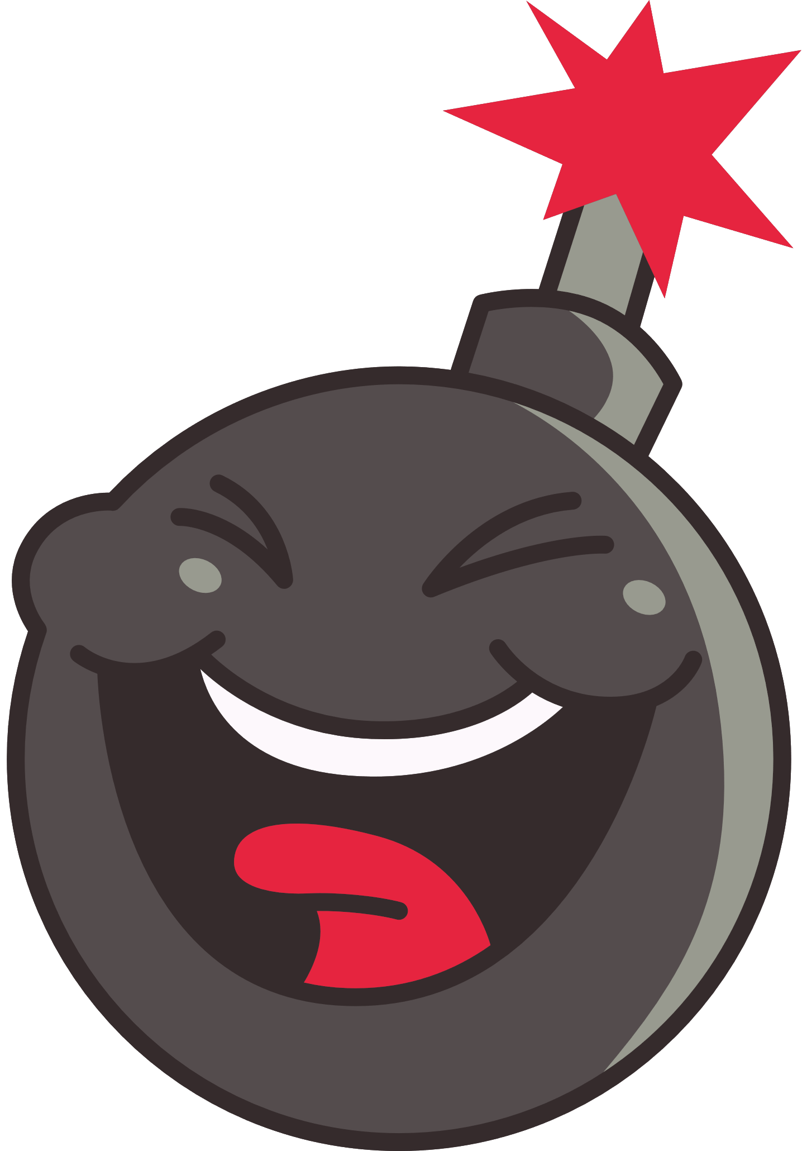

3
LUCKY NUMBER: + 50 points
Notes:
Ấn vào số đề quay về trang chủ

Slide 20
Check your answer
3. Why did he communicate with his family, friends, and teachers about his schedules and problems?
Because they would offer him additional support.
4
+ 20 points
Notes:
Ấn vào số đề quay về trang chủ

Slide 21
5
LOSE ½ POINTS
Notes:
Ấn vào số đề quay về trang chủ

Slide 22
Check your answer
4. Why did he take breaks?
Because they helped him keep away from stress and anxiety, and gave his brain a rest and improved his mood.
6
+ 20 points
Notes:
Ấn vào số đề quay về trang chủ

Slide 23


7
LOSE ALL YOUR POINTS
Notes:
Ấn vào số đề quay về trang chủ

Slide 24
Check your answer
5. How did he follow a healthy diet?
He ate a lot of fruit and vegetables. He ate little fattening foods and avoided junk foods like chips, cookies, pizza, etc.
8
+ 30 points
Notes:
Ấn vào số đề quay về trang chủ

Slide 25
Look at the answers again.
1. Because he wanted to reduce stress and anxiety.
2. He planned his schedule, made a weekly work list and gave priority to his work, which helped him concentrate his efforts on his most important tasks.
3. Because they would offer him additional support.
4. Because they helped him keep away from stress and anxiety, and gave his brain a rest and improved his mood.
5. He ate a lot of fruit and vegetables. He ate little fattening foods and avoided junk foods like chips, cookies, pizza, etc.

Slide 26
4. Work in pairs. Ask and answer the following questions about how to have a well-balanced life. Make notes of your partner’s answers.
1. How can we manage our time properly?
2. How can we spend time with our friends, teachers, and parents?
3. How can we avoid stress and anxiety?
4. How can we take care of our physical
health?

Slide 27
5. Work in groups. Take turns to talk about your partner’s ideas about how to have a well-balanced life.
Suggested answers:
I talked with An about how she manages a well-balanced life. First, she manages her time properly by creating a to-do list and give priority to her tasks based on their importance and deadlines. Second, she plans regular times to connect with friends, through study groups or social outings. She also maintains open communication with her teachers by asking questions and seeking help when needed. Next, she practises mindfulness techniques such as deep breathing, meditation, or yoga to manage stress and maintain a clear mind. Finally, she engages in regular physical activities that she enjoys like jogging, dancing, swimming, etc to help boost her energy.

Slide 28
WRAP-UP
What have we learnt in this lesson?
Vocabulary related to related to students’ life and schoolwork.
Reading for specific information.
Talking about partner’s ideas about how to have a well-balanced life.

Slide 29
HOMEWORK
Learn by heart vocabulary
Do exercises in the workbook
Prepare: Skills 2

Slide 30
THANK YOU!

