Slide 1

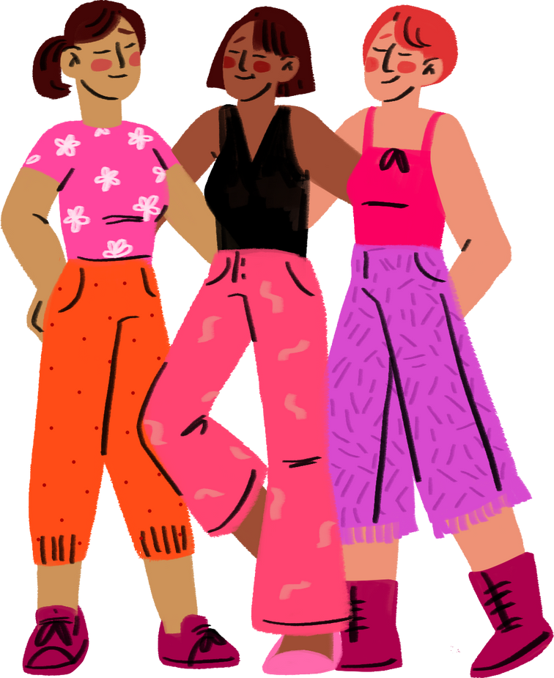
WELCOME TO OUR CLASS!

Slide 2
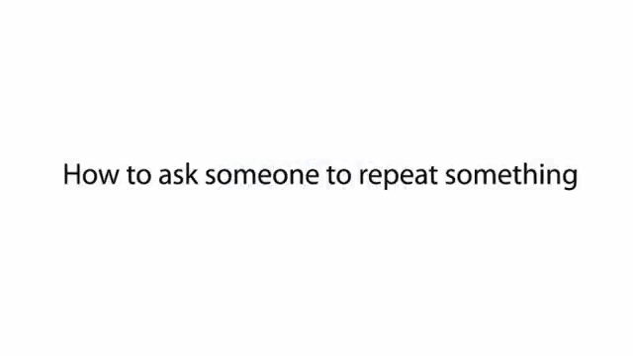
Watch a video and fill in each blank with ONE word.
1. I'm sorry, I didn't quite _____ that.
2. Could you ____ that again?
3. I'm sorry. I still didn’t ___ that.
4. _____ more time?
5. Look! I can't hear a ____ you're saying.

Slide 3
Watch a video and fill in each blank with ONE word.
1. I'm sorry, I didn't quite _____________ that.
2. Could you _____________ that again?
3. I'm sorry. I still didn’t _____________ that.
4. _____________ more time?
5. Look! I can't hear a _____________ you're saying.
catch
say
get
One
word

Slide 4


Unit 3:
HEALTHY LIVING FOR TEENS
Lesson 4: Communication

Slide 5
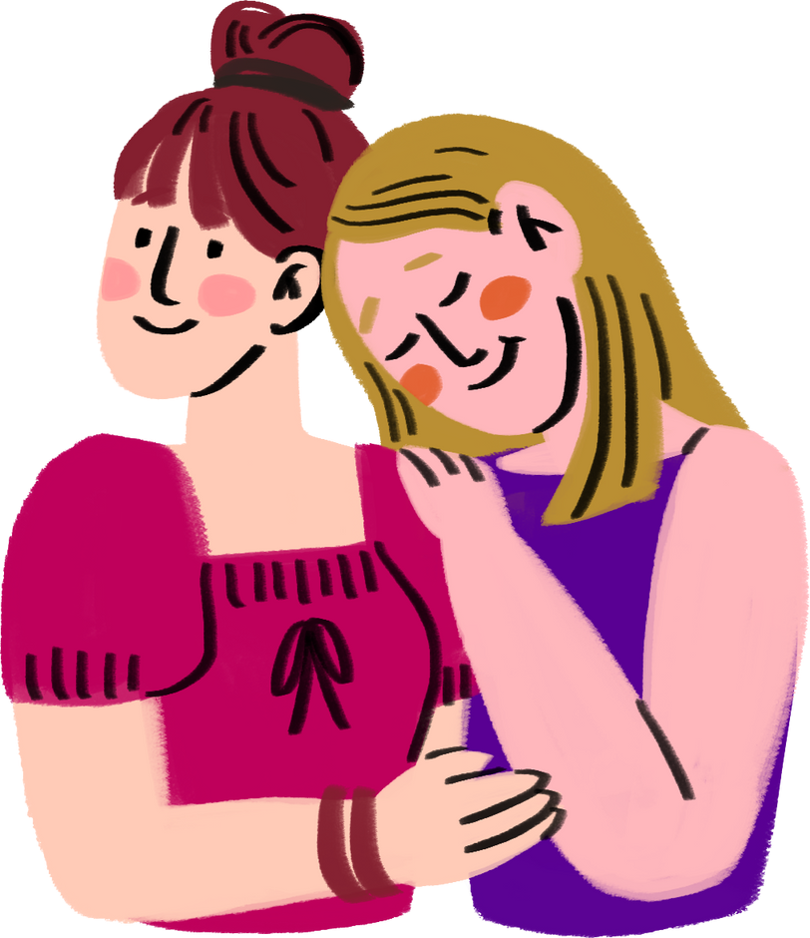
ASKING FOR REPETITION AND RESPONDING

Slide 6

1. Listen and read the dialogues below. Pay attention to the highlighted sentences.
Mai: Can you open the door, Tom?
Tom: Sorry?
Mai: Can you open the door, please?
01.
Nick: Excuse me. Would you mind showing me the way to the post office?
Woman: I beg your pardon.
Nick: Would you mind showing me the way to the post office?
02.

Slide 7

ASKING FOR REPETITION | RESPONDING
Sorry? | Repeat/Simplify what you have said
I beg your pardon.
I'm sorry, I didn't quite catch that.
Could you say that again?
One more time?
Look! I can't hear a word you're saying.

Slide 8
2. Work in pairs. Make similar conversations for the following situations.
Situation 1: You ask your friend to pass the book, but he / she can’t hear what you say.
Situation 2: A stranger asks you the way to the nearest bus station, but you can’t hear what he / she says.

Slide 9

2. Work in pairs. Make similar conversations for the following situations.
Situation 1: You ask your friend to pass the book, but he / she can’t hear what you say.
Can you pass me the book?
Sorry?
Can you pass me the book, please?

Slide 10
2. Work in pairs. Make similar conversations for the following situations.
Situation 2: A stranger asks you the way to the nearest bus station, but you can’t hear what he / she says.
Excuse me. Could you tell me the way to the nearest bus station, please?
I beg your pardon.
Could you tell me the way to the nearest bus station, please?

Slide 11
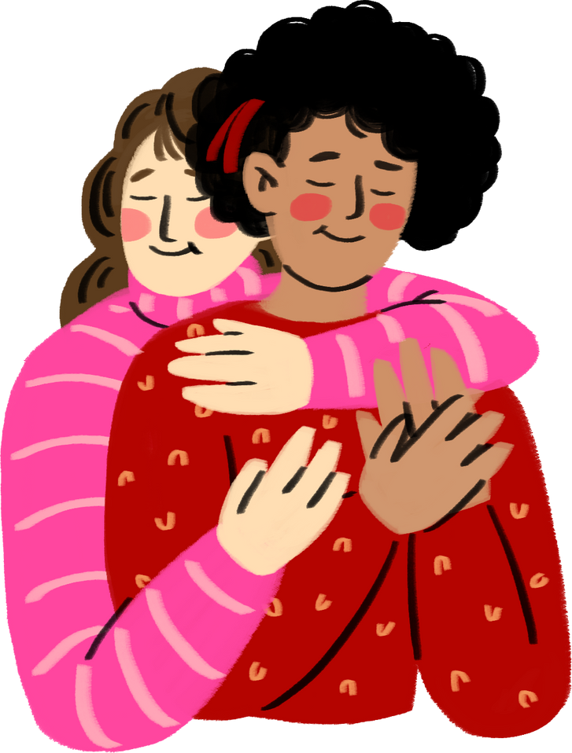
TIPS FOR BEING HAPPY ON SCHOOL DAYS

Slide 12
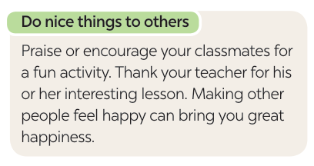
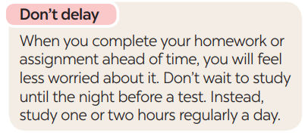
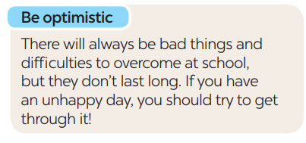
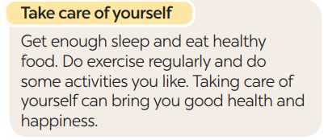
3. Read the text and complete each sentence that follows with a suitable word.

Slide 13
3. Read the text and complete each sentence that follows with a suitable word.
1. You should make others feel ______ by giving them encouragement or being thankful to them.
2. You shouldn’t ______ doing your homework or assignment or preparing for a test. This will reduce your stress.
3. Getting enough sleep, eating healthy food, and doing what you like can bring you good health and ___________.
4. You should always be expecting good things to happen and try to ____________ difficulties.
Notes:
1. happy 2. delay 3. happiness 4. overcome

Slide 14

3. Read the text and complete each sentence that follows with a suitable word.
happy
1. You should make others feel ______ by giving them encouragement or being thankful to them.
Notes:
1. happy 2. delay 3. happiness 4. overcome

Slide 15
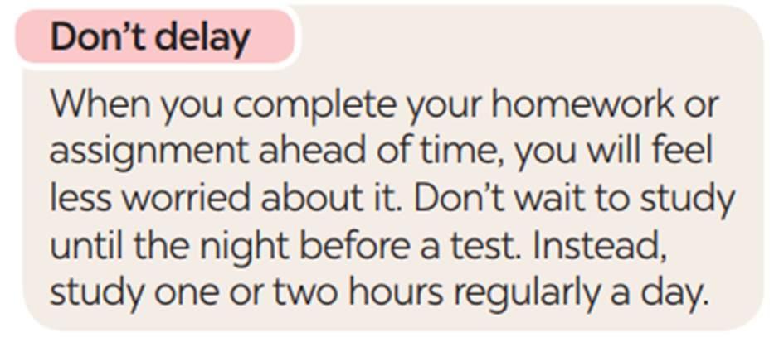
3. Read the text and complete each sentence that follows with a suitable word.
delay
2. You shouldn’t ______ doing your homework or assignment or preparing for a test. This will reduce your stress.
Notes:
1. happy 2. delay 3. happiness 4. overcome

Slide 16

3. Read the text and complete each sentence that follows with a suitable word.
3. Getting enough sleep, eating healthy food, and doing what you like can bring you good health and ___________.
happiness
Notes:
1. happy 2. delay 3. happiness 4. overcome

Slide 17
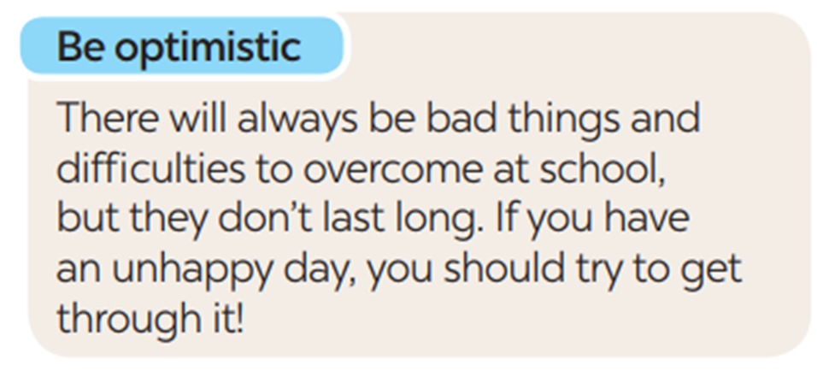
3. Read the text and complete each sentence that follows with a suitable word.
4. You should always be expecting good things to happen and try to ____________ difficulties.
overcome
Notes:
1. happy 2. delay 3. happiness 4. overcome

Slide 18
Look at the answers again
happy
1. You should make others feel ______ by giving them encouragement or being thankful to them.
2. You shouldn’t ______ doing your homework or assignment or preparing for a test. This will reduce your stress.
3. Getting enough sleep, eating healthy food, and doing what you like can bring you good health and ___________.
4. You should always be expecting good things to happen and try to ____________ difficulties.
delay
happiness
overcome
Notes:
1. happy 2. delay 3. happiness 4. overcome

Slide 19
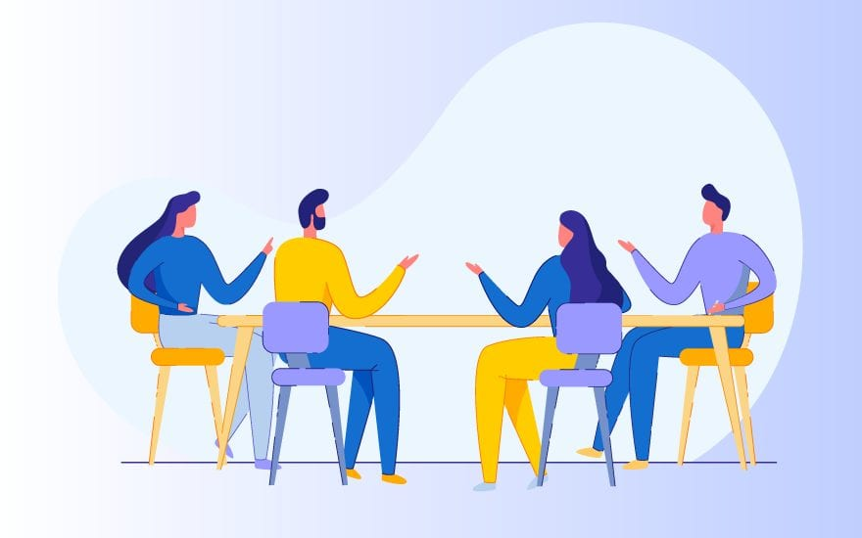
4. Work in groups. Write tips for one of the following situations.
Situation 1: A friend of yours cannot get a good night’s sleep.
Situation 2: A friend of yours does not feel very well.
Situation 3: A friend of yours cannot remember the words he / she learnt.
Notes:
1. happy 2. delay 3. happiness 4. overcome

Slide 20
5. Present your tips to the class.
Situation 1:
Situation 2:
Situation 3:
You should try to go to bed and wake up at the same time every day, even on weekends.
You should pay attention to your symptoms. If they become severe, you should see a doctor.
You should try using the words you’ve learnt in sentences or conversations.

Slide 21
WRAP-UP
What have we learnt in this lesson?
Ask for repetition and respond.
Learn about tips to make students feel happy on school days.
Further develop their reading skill for specific information (scanning).
Give presentation of the tips.

Slide 22
HOMEWORK
Practice asking for repetition and responding
Do exercises in the workbook
Prepare: Skills 1

Slide 23
THANK YOU VERY MUCH

