Slide 1


WELCOME TO OUR CLASS!
Presented by ……………………..

Slide 2
Unit 3:
HEALTHY LIVING FOR TEENS
Lesson 1: Getting Started (P. 28-29)

Slide 3

OBJECTIVES
1
Gain an overview of the topic of Healthy living for teens
2
Gain vocabulary to talk about how to have a well-balanced life as a secondary student

Slide 4

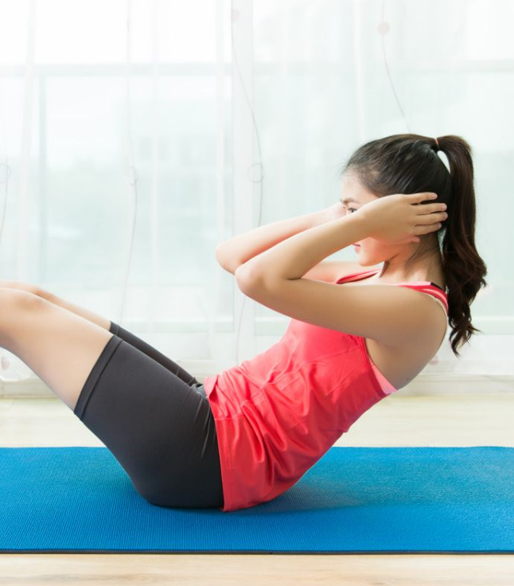

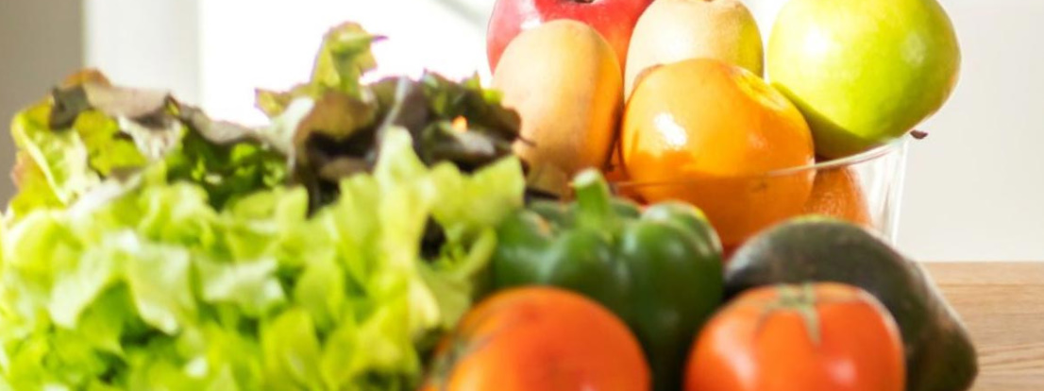
Look and answer
What do you think about each picture?

Slide 5



LOOK AND ANSWER
1
Who are they?
A school counsellor, Nick, Mai, and Phong.
2
What are they talking about?
A. The importance of sleeping well before exams.
B. Tips for maintaining good physical and mental health.
C. The benefits of physical exercise

Slide 6

What are they talking about?
A. The importance of sleeping well before exams.
B. Tips for maintaining good physical and mental health.
C. The benefits of physical exercise

Slide 7
AN ADVICE FROM A SCHOOL COUNSELLOR
School Counsellor: Good morning, class. Welcome to our “Tips for Good Physical and Mental Health”. In this session, feel free to ask any questions.
Nick: How can we maintain good physical health?
School Counsellor: You should get enough sleep, eat a healthy diet, and do physical exercise regularly.
Mai: My parents say students of our age need to sleep at least eight hours a day. Is that right?
School Counsellor: Yes, it is.
Phong: But we often find it difficult to get a good night’s sleep, especially before exams. Could you offer us any advice?
School Counsellor: I understand that exams bring about lots of stress. You can reduce this stress by studying long before the exam, not waiting until the night before it.
Phong: Thank you. Do you have any tips about looking after our mental health?
School Counsellor: If you want to have good mental health, you should have a well-balanced life. I mean you should balance your study and life.
Nick: But how can we balance them?
School Counsellor: Well, you have to manage your time by planning your schedule and giving priority to your work. And you should keep a balance between study and play.

Slide 8

2. READ THE CONVERSATION AGAIN AND WRITE T (TRUE) OR F (FALSE)
TRUE
FALSE
1. The counsellor is giving advice on how to maintain good physical and mental health.
2. According to Mai’s parents, students shouldn’t sleep more than eight hours a day.
3. Many students find it easy to get a good night’s sleep before exams.
4. Nick doesn’t know how to have a well-balanced life.
5. The school counsellor advises the students to balance their study and play time.

Slide 9
CHECK YOUR ANSWER
1. The counsellor is giving advice on how to maintain good physical and mental health.
Nick: How can we maintain good physical health?
School Counsellor: You should…
Phong: Thank you. Do you have any tips about looking after our mental health?
School Counsellor: If you want….
T

Slide 10
CHECK YOUR ANSWER
2. According to Mai’s parents, students shouldn’t sleep more than eight hours a day.
Mai: My parents say students of our age need to sleep at least eight hours a day. Is that right?
F

Slide 11
CHECK YOUR ANSWER
3. Many students find it easy to get a good night’s sleep before exams.
Phong: But we often find it difficult to get a good night’s sleep, especially before exams. Could you offer us any advice?
F

Slide 12
CHECK YOUR ANSWER
4. Nick doesn’t know how to have a well-balanced life.
Nick: But how can we balance them?
T

Slide 13
CHECK YOUR ANSWER
5. The school counsellor advises the students to balance their study and play time.
School Counsellor: Well, you have to manage your time by planning your schedule and giving priority to your work. And you should keep a balance between study and play.
T

Slide 14

LOOK AT THE ANSWERS AGAIN
TRUE
FALSE
1. The counsellor is giving advice on how to maintain good physical and mental health.
2. According to Mai’s parents, students shouldn’t sleep more than eight hours a day.
3. Many students find it easy to get a good night’s sleep before exams.
4. Nick doesn’t know how to have a well-balanced life.
5. The school counsellor advises the students to balance their study and play time.

Slide 15


3. MATCH THE WORDS WITH THEIR DEFINITIONS
1. physical
a. a person whose job is to help and support people with problems
b. connected with a person’s body rather than their mind
c. something that you think is more important than other things and should be dealt with first
d. connected with the state of health of the mind
e. having the right amounts of all the different parts that make up something
2. mental
3. well-balanced
4. priority
5. counsellor

Slide 16
CHECK YOUR ANSWER
1. physical
b. connected with a person’s body rather than their mind
(thuộc) thể chất

Slide 17

CHECK YOUR ANSWER
2. mental
d. connected with the state of health of the mind
(thuộc) tinh thần

Slide 18
CHECK YOUR ANSWER
3. well-balanced
e. having the right amounts of all the different parts that make up something
cân bằng

Slide 19
CHECK YOUR ANSWER
4. priority
c. something that you think is more important than other things and should be dealt with first
sự ưu tiên

Slide 20
CHECK YOUR ANSWER
5. counsellor
a. a person whose job is to help and support people with problems
cố vấn, người tư vấn

Slide 21

LOOK AT THE ANSWERS AGAIN
b. connected with a person’s body rather than their mind
1. physical
d. connected with the state of health of the mind
2. mental
e. having the right amounts of all the different parts that make up something
3. well-balanced
c. something that you think is more important than other things and should be dealt with first
4. priority
a. a person whose job is to help and support people with problems
5. counsellor

Slide 22
4. COMPLETE THE SENTENCES WITH THE WORDS IN THE BOX.
physical | counsellor | well-balanced | priority | mental
1. You should make a list of all the jobs you have to do and give _______ to them.
2. Maintaining a ________ life often means making time for the things you have to do, as well as the things you want to do in a suitable way.
3. The police asked them to describe his _________ appearance.
4. You need to maintain your physical and _______ health.
5. The ______ is willing to listen to the students to help them solve their problems.

Slide 23
LOOK AT THE ANSWERS AGAIN
1. You should make a list of all the jobs you have to do and give priority to them.
2. Maintaining a well-balanced life often means making time for the things you have to do, as well as the things you want to do in a suitable way.
3. The police asked them to describe his physical appearance.
4. You need to maintain your physical and mental health.
5. The counsellor is willing to listen to the students to help them solve their problems.

Slide 24

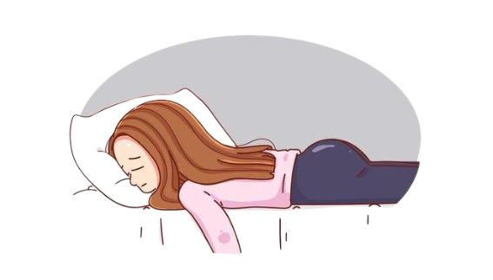
LOOK AND ANSWER
1.
How does she feel?
She is tired.
2.
What should she do?
She should take a break and do more physical exercise.

Slide 25

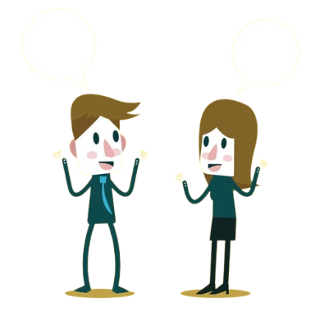
5. WORK IN PAIRS. INTERVIEW EACH OTHER ABOUT HOW HEALTHY YOU ARE. GIVE EACH OTHER ADVICE.
Example:
A: How healthy are you? B: I’m tired.
A: You should take a break and do some physical exercise

Slide 26
5. WORK IN PAIRS. INTERVIEW EACH OTHER ABOUT HOW HEALTHY YOU ARE. GIVE EACH OTHER ADVICE.
Clues:
a bit stressed/ do exercise (walking, jogging…)
pretty good/ maintain
a bit sad/ talk to friend or do something fun

Slide 27

WRAP UP
1
Identify the topic of the unit
2
Learn some vocabulary related to Healthy living for teens

Slide 28
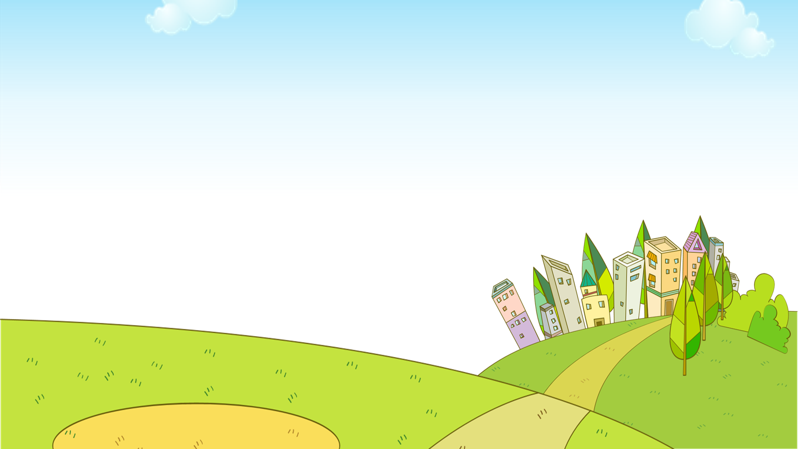


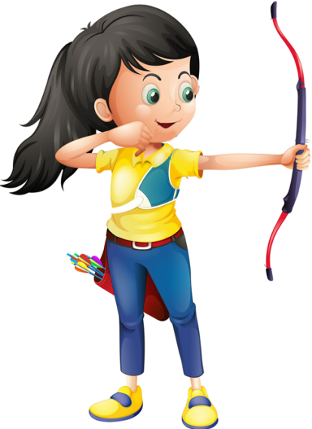

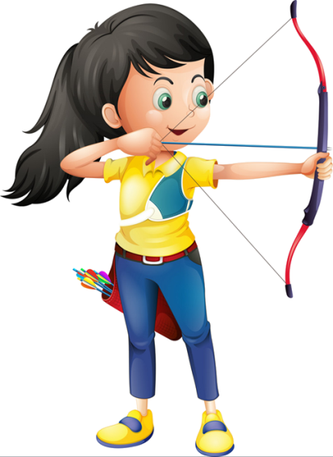


1. This book has helped me in leading a more ________ life.
A. well-balanced
B. counsellor
Ms Huyền Phạm
0936.082.789

Slide 29
2. The hospital always gives _____ to emergency cases.
A. priority
B. phycical
Ms Huyền Phạm
0936.082.789

Slide 30
3. The sports teachers are trying to help develop the _____ well-being of their students.
A. mental
B. physical
Ms Huyền Phạm
0936.082.789

Slide 31
4. It takes a lot of ____ effort to understand these ideas.
A. emotional
B. mental
Ms Huyền Phạm
0936.082.789

Slide 32
HOMEWORK
1
Learn by heart vocabulary
2
Prepare: A Closer Look 1
3
Start preparing for the project

Slide 33


HOW GOOD ARE YOUR CLASSMATES AT TIME MANAGEMENT?
Ask your classmates about how good they are at time management.
Count the answers you have got for each student (page 37)
Present your group’s findings on how good your classmates are at time management.

Slide 34
Thank You

