Slide 1

Unit 2: School
Lesson 2.3: Pronunciation and Speaking.
Student’s book - Page 19.

Slide 2
Speaking. Interview a partner.
What’s your name?
How many clubs are there in your school? What are they?
Which one is your favorite?
What do you like doing in your free time?
Notes:
https://www.shutterstock.com/image-vector/men-work-computer-workplace-talk-illustration-1256154682

Slide 3
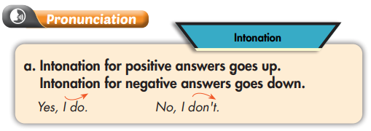

Slide 4



Click here to play the audio
Listen to the sentences and focus on how the intonation goes up then down.
Practice.
Do you like playing basketball?
Yes, I do
No, I don’t

Slide 5

Click here to play the audio
Listen and cross out the one with the wrong intonation.
Do you like reading?
Yes, I do
No, I don’t

Slide 6
Read the sentences with the correct intonation to a partner.
Do you like reading?
Yes, I do
No, I don’t

Slide 7

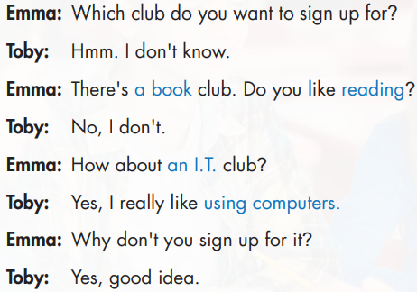
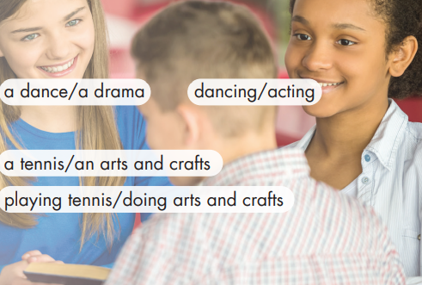
Practice the conversation. Swap the roles and repeat.

Slide 8
Work in pairs. Practice with your own ideas.
Which club do you want to sign up for?
Hmm, don’t know.
Notes:
https://www.shutterstock.com/image-vector/cute-girl-kid-boy-talking-each-1905081079

Slide 9

Let’s join the club.
You want to sign up for some clubs next year.
Ask your partner what activities your partner likes doing.
Note down the same activities you and your partner like doing.
Notes:
https://www.shutterstock.com/image-vector/speaking-people-chat-icon-stock-vector-1172839960

Slide 10
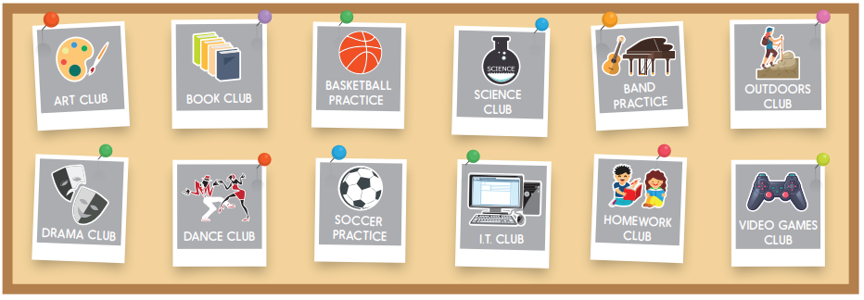
Base on the same activities you and your partner like doing, decide on one club to join.

Slide 11
Join another pair. Which club do most people want to join?
Our group wants to join…
Notes:
https://www.shutterstock.com/image-vector/woman-headhunter-icon-cartoon-vector-web-1853283415

Slide 12

CONSOLIDATION

Slide 13
Pronunciation. Intonation
Intonation for positive answers and negative answers.
Do you like playing basketball?
Yes, I do
No, I don’t

Slide 14
Pronunciation.
Work in pairs. Ask a partner and check your partner’s pronunciation.
Do you like playing basketball?
Do you like learning science?
Do you like going out with your friends?
Do you like acting?

Slide 15
Homework
Review the vocabulary and grammar notes in Tiếng Anh 6 i-Learn Smart World Notebook (pages 10 & 11).
Play the consolation games in Tiếng Anh 6 i-Learn Smart World DHA App on www.eduhome.com.vn
Prepare the next lesson (page 20- SB).

