Slide 1


Slide 2





The flags of the world
Russia
Canada
India
Singapore
Australia

Slide 3

UNIT 8: ENGLISH SPEAKING COUNTRIES
Period 62: GETTING STARTED
How’s your summer camp?

Slide 4

I. Vocabulary:
1. Awesome /ˈɔːsəm/ (adj): Tuyệt
2. Absolutely /'æbsəlu:tli/ (adv): Tuyệt đối, chắc chắn
3. Official / əˈfɪʃl / (adj): Chính thức
4. Difficulty /'difikəlti/ (n): Sự khó khăn
5. Have difficulty in ... = Gặp khó khăn trong ...
6. Difficult /'difikəlt/ (adj): Khó
7. Accent /ˈæksent/ (n): Giọng điệu
8. Native /'neitiv/ (adj): Thuộc bản xứ
9. Native speakers: Người bản xứ

Slide 5
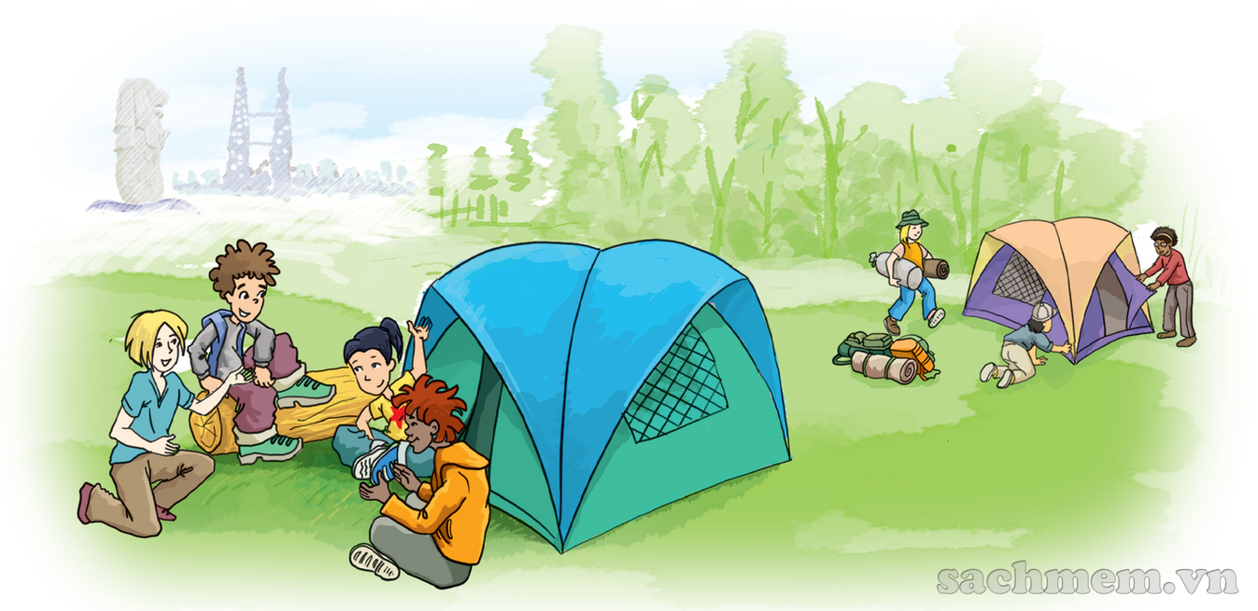
II. Practice
How's your summer camp?

Slide 6

How's your summer camp?
Nick: How's your international summer camp going, Phong?
Phong: Awesome, just awesome.
Nick: You sound so happy. What do you like about it?
Phong: It's hard to say. Everything's wonderful: the friends I've made, the places I've visited, the activities…
Nick: Oh… Your English has improved a lot!
Phong: Absolutely. I use English every day, with people from different countries.
Nick: Where are they from?
Phong: Everywhere! Places like India, Canada… English is also an official language here in Singapore.
Nick: Right. Have you made any friends from English speaking countries?
Phong: I'm in a team with two boys from Australia and a girl from the USA.
Nick: Do you have difficulty understanding them?
Phong: I found it difficult to understand them at first. Perhaps it's because of their accent, but it's OK now.
Nick: It's great that you can practise English with native speakers. When are you back?
Phong: Our camp closes on July 15th and I take the night flight home the same day.
Nick: Looking forward to seeing you then. Enjoy!
Phong: I will. Thanks. Bye.

Slide 7
1a, Find a word or an expression from the conversation which you use when you ...
1. think something is wonderful | →
2. agree with somebody | →
3. cannot decide | →
4. are not sure about something | →
Awesome, just awesome.
Absolutely / Right
It's hard to say.
Perhaps
Do you know any other expressions which have the same meaning

Slide 8
1b, Read the conversation again and answer the questions
Where is Phong now?.
2. Where do the campers come from?.
3. What has Phong done so far?.
4. Why has he been able to improve his English?.
5. Who are in the same team with Phong?.
6. When can Nick see Phong?.

Slide 9
1. Listen and read
b. Read the conversation again and answer the questions.
1. Where is Phong now?
2. Where do the campers come from?
3. What has Phong done so far?
He’s at an international summer camp (in Singapore).
They come from different countries.
He has made new friends, visited places, and taken part in different activities.

Slide 10
1. Listen and read
b. Read the conversation again and answer the questions.
4. Why has he been able to improve his English?
5. Who are in the same team with Phong?
6. When can Nick see Phong?
Because he uses English every day with people from different countries.
Two boys from Australia and a girl from the USA.
After July 15th.

Slide 11
2. Complete the sentences with words/ phrases from the box.
native speakers
English speaking countries
summer camp
official language
the USA
accents
summer camp
1. Last year I had a wonderful time at a in Britain.
2. The USA, the United Kingdom and New Zealand are all .
3. Australians are of English because they use it as their mother tongue.
4. is in the mid-north of America.
5. Usually, people from different parts of a country speak their language with different .
6. English is an in countries like India, Malaysia and Singapore.
English speaking countries
native speakers
The USA
accents
official language

Slide 12






3. Put the names of the countries under their flags.
New Zealand
Singapore
Australia
The USA
Canada
The United Kingdom
The USA
1.
The United Kingdom
Singapore
2.
3.
Canada
New Zealand
Australia
5.
6.
4.

Slide 13
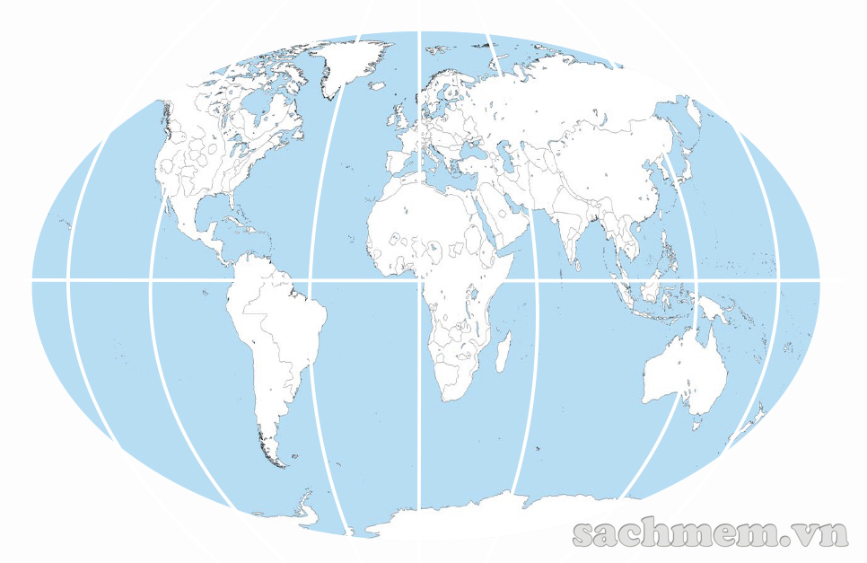
4. Game: Where are they ?
Work in groups of five or six. Locate the six countries in 3 on the map below. The first group to find all the countries wins.
Canada
USA
UK
Mexico
Singapore
New Zealand
Australia

Slide 14
• HOMEWORK •
‣ Learn by heart the new words.
‣ Prepare for: Unit 8 – A Closer Look 1
‣ Do exercises in workbook.

Slide 15


