Slide 1


English 8
UNIT 7 . POLLUTION
LESSON 3: A CLOSER LOOK 2
Welcome to our class

Slide 2
A Closer look 2
1. Conditional sentences type 1
I. Grammar
2. CONDITIONAL SENTENCES TYPE 2
EX 1, 2 (PAGE 09)
II. EXERCISES
EX 3, 4 (PAGE 10)

Slide 3



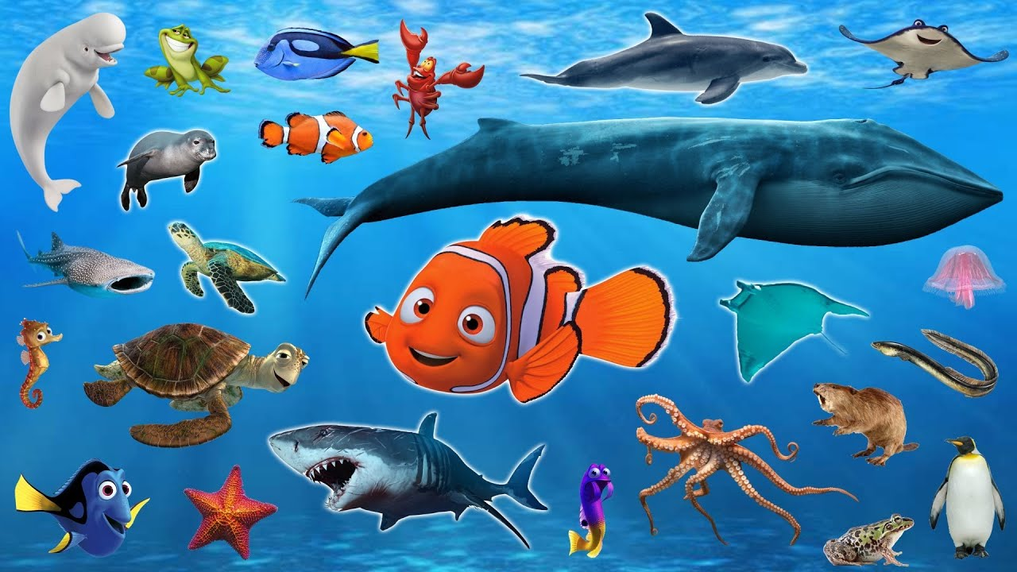
I. VOCABULARY
- increase (v) :
tăng lên
# decrease (v):
giảm xuống
- aquatic creatures (n):
sinh vật dưới nước
- reproduce (v):
sản xuất lại
- resident (n):
dân cư

Slide 4
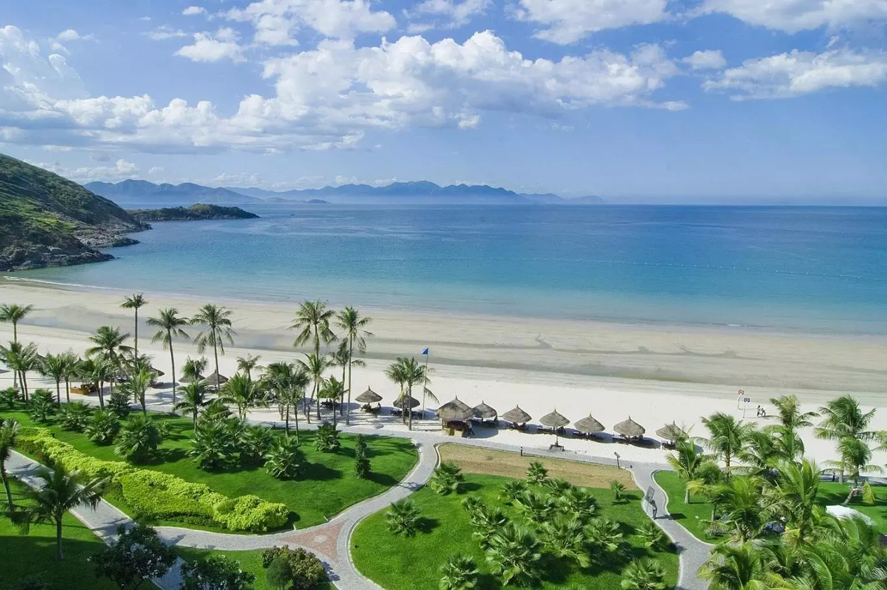
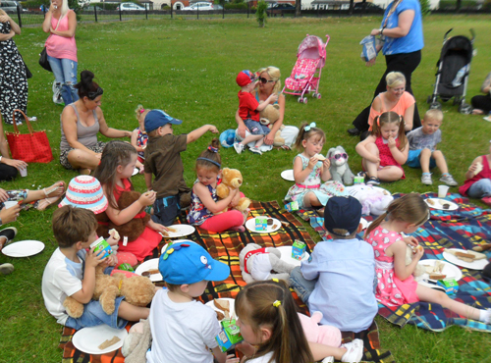
Is the weather beautiful or bad?
It’s beautiful
Where do they go ?
They go on a picnic
The weather is beautiful. They go on a picnic
If the weather is beautiful, they will go on a picnic.

Slide 5
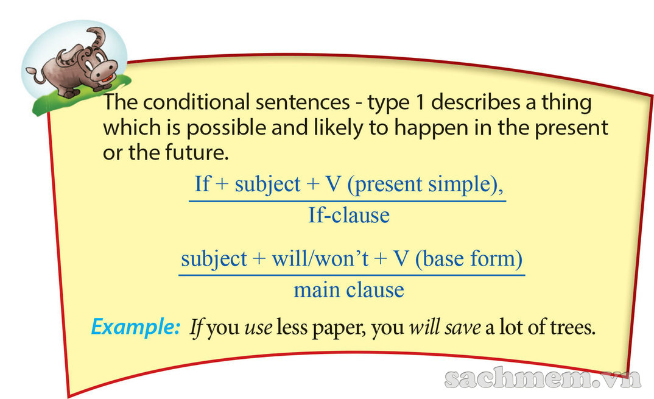
* Conditional sentences type 1: review

Slide 6

II. Conditional sentence type 1
If the weather is beautiful, they will go on a picnic
If-clause
Main clause
1. Form:
If + S + V-s/-es (am/is/are)
(don’t/doesn’t + V),
S + will/won’t + V…
Câu điều kiện loại 1 dùng để chỉ hành động hay sự việc có thể xảy ra ở hiện tại hoặc tương lai
2. Using:
EX : If it rains, I will stay at home
I will stay at home if it rains.

Slide 7


1. Put the verbs in brackets into the correct form.
recycle
1. If we (recycle)…………………….. more, we (help) …………………….. the Earth.
2. Factories (not dump) …………………….. waste into rivers if the government (fine)……………... ..them heavily.
3. If people (travel) ………………….. to work by bus, there (be) ……………………. fewer car fumes.
4. We (save) ……………….…. thousands of trees if we
(not waste) …………………… paper.
5. If we (use)…………………… water carefully, more people (have) ……………………. fresh water.
will help
will not/won’t dump
fines
travel
will be
will save
don’t waste
use
will have

Slide 8
2. Combine each pair of sentences to make a conditional sentences type 1.
Students are more aware of protecting the environment. Teachers teach environmental issues at school.
2. Light pollution happens. Animals change their behaviour patterns.
3. The levels of radioactive pollution decrease. We switch from nuclear power to renewable energy sources.
4. The water temperature increases. Some aquatic creatures are unable to reproduce.
5. People get more diseases. The water is contaminated.

Slide 9
2. Combine each pair of sentences to make a conditional sentences type 1.
Students are more aware of protecting the environment. Teachers teach environmental issues at school.
→ Students will be more aware of protecting the environment if teachers teach environmental issues at school.
2. Light pollution happens. Animals change their behaviour patterns.
→ If light pollution happens, animals will change their behaviour patterns.
3. The levels of radioactive pollution decrease. We switch from nuclear power to renewable energy sources.
→ The levels of radioactive pollution will decrease if we switch from nuclear power to renewable energy sources.

Slide 10
2. Combine each pair of sentences to make a conditional sentences type 1.
4. The water temperature increases. Some aquatic creatures are unable to reproduce.
→ If the water temperature increases, some aquatic creatures will be unable to reproduce.
5. People get more diseases. The water is contaminated.
→ People will get more diseases if the water is contaminated.

Slide 11

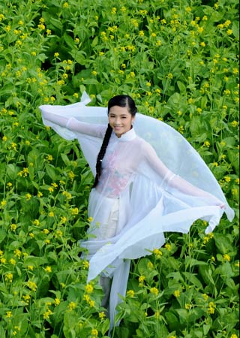
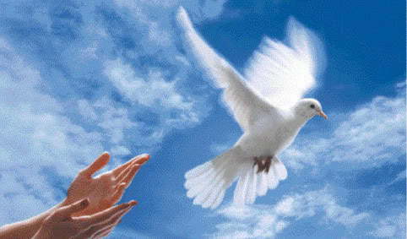


If she were a bird, she would fly in the sky.

Slide 12
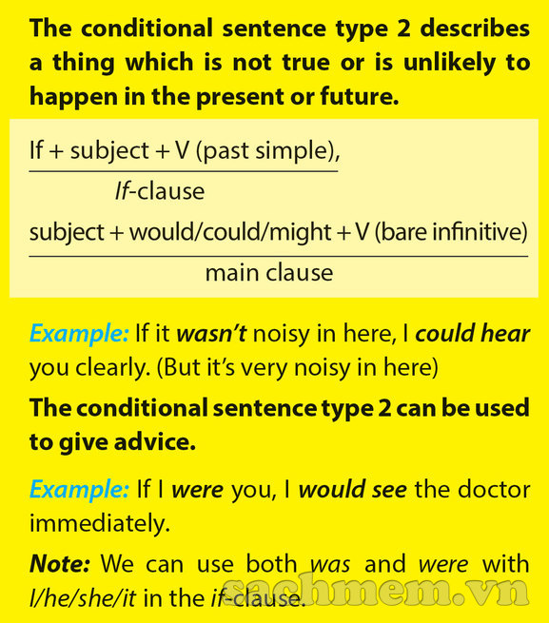
Conditional sentences type 2:

Slide 13
III. Conditional sentence type 2
If she were a bird, she would be a dove.
If clause
Main clause
* Form:
If + S + V2/V-ed/Was/Were…,
S + would/should/ could/ might + V…
* Note: I/He/She/It + Was/were
* Using:
- Câu điều kiện loại 2 dùng để chỉ hành động hay sự việc không thể xảy ra ở hiện tại hoặc tương lai.
- Có thể dùng để chỉ lời khuyên
Ex: If I were you, I would see the doctor immediately.
I would see the doctor immediately If I were you

Slide 14

3. Match an If-clause in A with a suitable main clause in B.
A | B
1. If I were you, | a. What would happen?
2. If Lan wasn’t ill, | b. I’d look for a new place to live.
3. If there were fewer cars on the road, | c. She would join our tree planting activity.
4. If people really cared about the environment, | d. There would be less pollution.
5. If there was no fresh water in the world, | e. They wouldn’t dump waste into the lake.

Slide 15
4. Put the verbs in brackets into the correct form.
were
If you (be) …………… the president, what you (do) …………………… to help the environment?
2. They get sick so often. If they (exercise) ……………. more, they (be) ……………….. healthier.
3. If I (have) …………… one million US dollars, I (build) ……………….. more parks in our city.
4. Ngoc’s mother is unhappy. If Ngoc (tidy) …………….. her room every day, her mother (not be) ……………… so upset.
5. There isn’t a garden at our house. If there (be) …………, we (grow) ………………… vegetables.
would you do
exercised
would be
had
would build
tidied
wouldn’t be
was / were
would grow

Slide 16

GAME: PELMANISM
1
1. If there were
fewer people ill,
3. If she has time ,
4. If we feel hungry
after that,
2
3
4
He would come
to see you
The world would
be happier
I would learn
very hard
6
5
8
We will eat some
hamburgers
2. If I were you,
She will help you
7
9

Slide 17

Homework:
Learn by heart the vocabulary and the conditional sentences
Do all the exercises
Prepare: Unit 7:Communication

Slide 18

Thanks for your atendance!
Goodbye. See you again

