Slide 2
- Semester II School year: 2022 - 2023
Welcome to our class

Slide 3
Unit 7: Pollution - A Closer look 1

Slide 4
Unit 7: Pollution - A Closer look 1
I. Vocabulary
II. Pronunciation.

Slide 5
I. Vocabulary

Slide 6
* Vocabulary
To poison ( v ): Đầu độc
Poison ( n ): Thuốc độc
Poisonous ( adj ): Dộc
Contaminate ( v ): Làm bẩn
Contamination ( n ): Sự ô nhiễm
Contaminant ( n ): Chất ô nhiễm
Contaminated ( adj ): Bị ô nhiễm
To pollute ( v ): Gây ô nhiễm
Pollution ( n ): Sự ô nhiễm
Pollutant ( n ): Chất gây ô nhiễm
Polluted ( adj ): Bị ô nhiễm
To die ( v ): Chết
Death ( n ): Cái chết
Dead ( adj ): Bị chết/ Đã chết
To damage ( v ): Thiệt hại
Damage ( n ): Làm thiệt hại
Damaged ( adj ): Bị thiệt hại
Verb ( v ): Động từ
Preposition ( pre ): Giới từ
Noun ( n ): Danh từ
Conjunction ( con ): Liên từ
Adjective ( adj ): Tính từ
Adverb ( adv ): Trạng từ

Slide 7
1. Complete the table with appropriate verbs, nouns, and adjectives.
Verb ( v ) | Noun ( n ) | Adjective ( adj )
Poison | ( 1 ): | Poisonous
( 2 ): | Contamination Contaminant | Contaminated
To pollute | Pollution ( 3 ): | ( 4 ):
To die | ( 5 ): | Dead
To damage | Damage | ( 6 ):
Poison
Contaminate
Polluted
Pollutant
Death
Damaged

Slide 8
2. Complete the sentences with the words from the table in 1. You don’t need to use all the words. The first letter of each word has been provided.
oisonous
1. The p chemical waste is dumped into the river.
2. Do you know what p ` cause air pollution?
3. The d fish are floating in the water.
4. Don't drink that water. It's c .
5. The acid rain has caused d to the trees in this area.
6. If we p the air, more people will have breathing problems.
ollutants
ead
ontaminated
amage
ollute

Slide 9
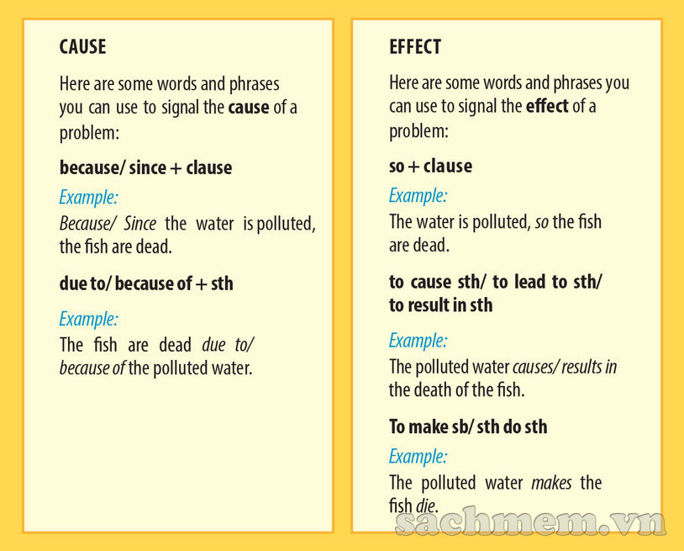

Slide 10
3a. Decide with sentences in each pair of sentences is cause and which is an effect. Write C (for cause) or E (for effect) next to each sentences. Note that the words in brackets relate to Activity
1. People throw litter on the ground. Many animals eat the litter and become sick. (because)
2. Ships spill oil in oceans and rivers. Many aquatic animals and plants die. (lead to)
3. Households dump waste into the river. It is polluted. (so)
4. Their children have birth defects. The parents were exposed to radiation. (since)
5. We can't see the stars at night. There is too much light pollution. (due to)
C
E
C
E
C
E
E
C
E
C

Slide 11
3b. Combine the sentences in each pair into a new sentences that shows a cause/ effect relationship. Use the cause or effect signal word or phrase given in brackets. You will have to add, delete, or change words in most sentences.
Example:1. Because people throw litter on the ground, many animals eat it and become sick./ Many animals eat the litter and become sick because people throw it on the ground.
2.
3.
4.
5.
Oil spills from ships in the oceans and rivers lead to the death of many aquatic animals and plants
Households dump waste into the river so it is polluted
Since the parents were exposed to radiation, their children have birth defects
We can't see the stars at night due to the light pollution.

Slide 12
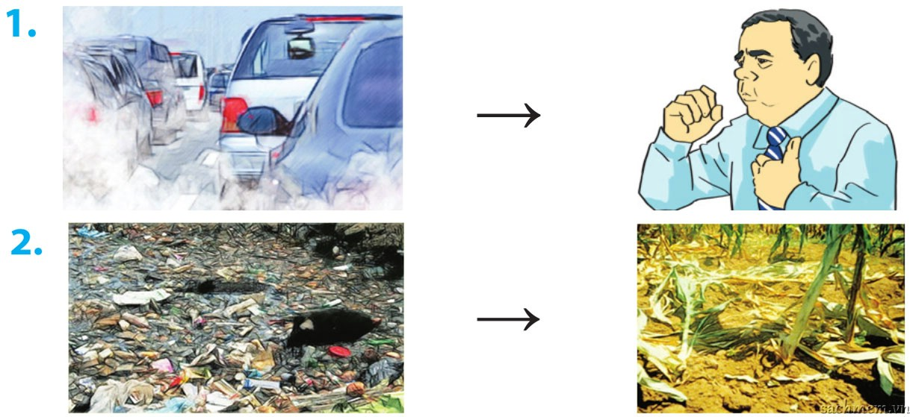
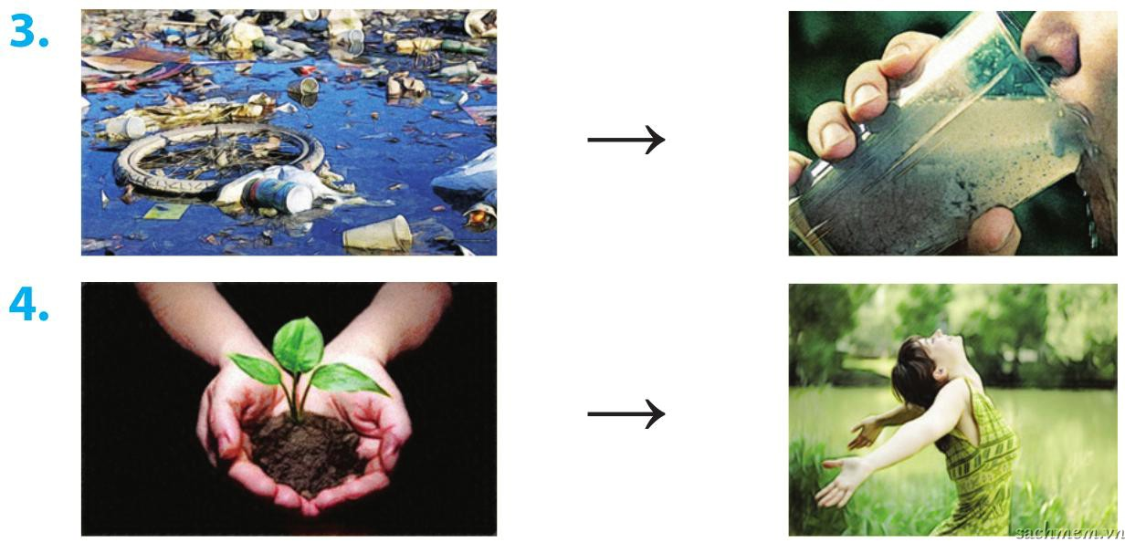
4. Work in groups. Look at the pairs of pictures. Give as many sentences as possible to show cause/ effect relationships
Example:
People cough because they breathe in the fumes from cars.
The fumes from cars make people cough.
2.
3.
4.
We won't have fresh water to drink because of water pollution.
The soil is polluted, so plants can't grow.
We plant trees, so we can have fresh air.

Slide 13
II. Pronunciation.

Slide 14
II. Pronunciation.
Stress in words ending in –ic and –al

Slide 16
5. Listen and mark stress in each word, then repeat it.
‘
‘
1. artistic
2. athletic
3. historic
4. historical
5. logical
6. physical
7. heroic
8. poetic
9. botanic
10. botanical
‘
‘
‘
‘
‘
‘
‘
‘

Slide 17
6. Underline the words ending in –ic and circle the words ending in –al in the following sentences. Mark the stress in each word. Listen and check your answer, then repeat the sentences
1. According to scientific research, tiny species may help clean radioactive pollution.
2. Water quality has become a national problem.
3. Many people have received medical treatment because of the disease.
4. Chemical waste can cause water pollution.
5. The reduction in air pollution was dramatic last year.
‘
‘
‘
‘
‘

Slide 18
Advice
- Students go home to supplement the missing and completed exercises in their textbooks or notebooks.
- Students memorize the words in the * VOCABULARY . section
- Students prepare the new lesson in advance, do all the exercises of the new part.

Slide 19
Goodbye.See you again.
Thank you for watching

