Slide 1
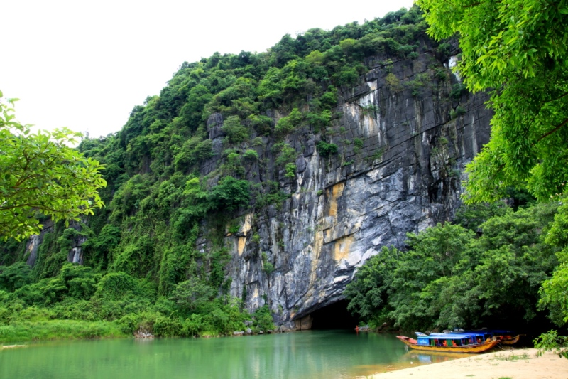
Phong Nha Ke Bang National park

