Slide 1
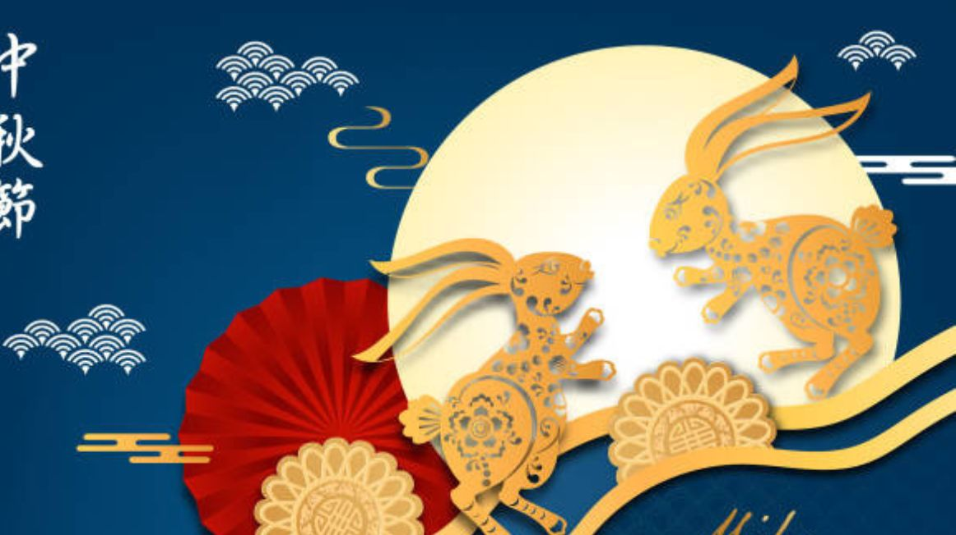
Mid-Autumn Festival

Slide 2
When does Mid-Autumn take place?

Slide 3
What is an indispensable cake during the Mid-Autumn Festival ?

Slide 4
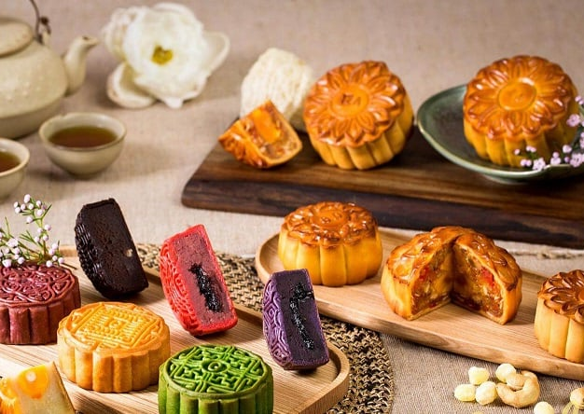
Mooncakes are two main types : baked mooncake and sticky rice mooncake. It has a circular shape typical of the moon.
Mooncakes have many typles of fillings such as green beans, durian, lotus seeds, milk coconut, taro, etc.

Slide 5
What do children like do on Mid-Autumn Festival ?

Slide 6
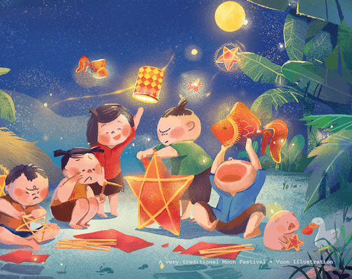
On Mid-Autumn Festival, lantern parade is one of the indispensable customs and is loved by children
Lanterns come in many shapes such as star lanterns, carp lanterns, relvoving lantern, etc.

Slide 7
What is the indispensable dance during on Mid-Autumn Festival ?

Slide 8
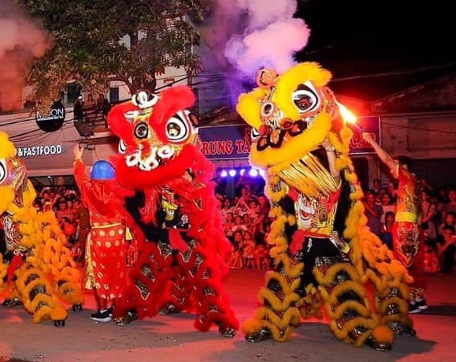
Unicorn dance is not only a folk art but also a wish for happiness and prosperity for the remaining month of the year.
The Unicorns appear on the night of Mid-Autumn Festival as a wish of good luck, dispelling bad omens brings good luck for good harvest, budding fruit trees and prosperity for the wholeyear.

Slide 9
That brings us to the end of my presentation Thank you for watching

