Slide 1
SPEAKING
HELLO EVERYONE
WE ARE GROUP 1
THE FOLLOWING IS OUR PRESENTATION

Slide 2
TET LUNAR NEW YEAR ( TẾT NGUYÊN ĐÁN )

Slide 3
START

Slide 4
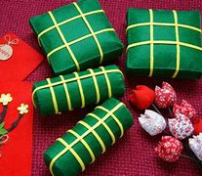
BANH CHUNG AND BANH TET

Slide 5
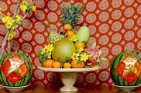
FIVE – FRUIT TRAY

Slide 6
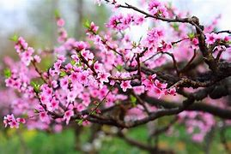
PEACH TREE

Slide 7
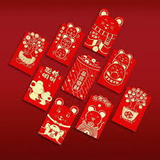
LUCKY MONEY ENVELOPE

Slide 9
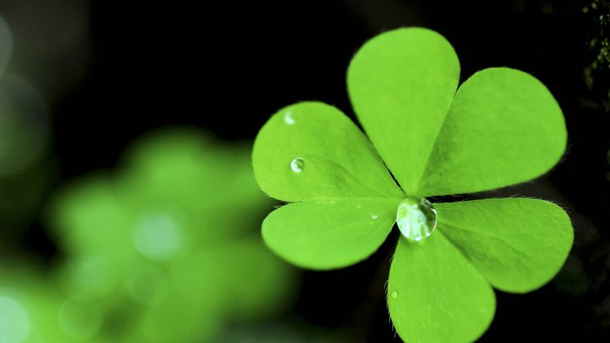
THANK YOU AND EVERYONE FOR LISTENING TO OUR GROUP"S PRESENTATION GOOD LUCK

Slide 10
GROUP MEMBER 1
Ngô Đoàn Thảo Nguyêt
Nguyễn Tiến Phát
Trần Katin
Hà Cẩm Nhiên
Lê Tôn Thanh Hoàng
Huỳnh Lâm Ngọc Chi

