Slide 1
WELCOME TO OUR CLASS!

Slide 2
What can you see in the video?
How do you feel when you see it?

Slide 3
Unit 9:
NATURAL DISASTERS
Lesson 4: Communication

Slide 4
OBJECTIVES
1
2
Use the lexical items related to natural disasters.
Practice giving and responding to bad news.

Slide 5
VOCABULARY

Slide 6
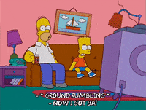
VOCABULARY
shake (v)
/ʃeɪk/
rung, lắc
1
2
3

Slide 7
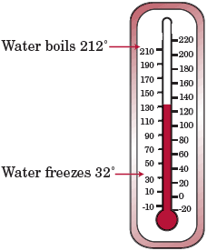
VOCABULARY
Fahrenheit (n)
/ˈfærənhaɪt/
Độ F (đo nhiệt độ)
1
2
3

Slide 8
VOCABULARY
Richter scale (n)
/ˈrɪktə skeɪl/
Độ rích te (đo độ mạnh của động đất)
1
2
3

Slide 9
VOCABULARY
- Shake (v) | /ʃeɪk/ | Rung, lắc
- Fahrenheit (n) | /ˈfærənhaɪt/ | Độ F (đo nhiệt độ)
- Richter scale (n) | /ˈrɪktə skeɪl/ | Độ rích te (đo độ mạnh của động đất)
1
2
3

Slide 10
Everyday English
Giving and responding to bad news.

Slide 11
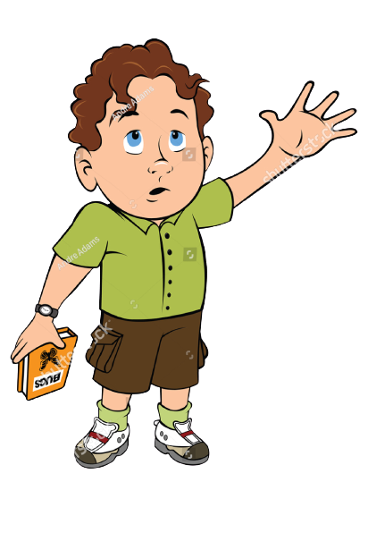
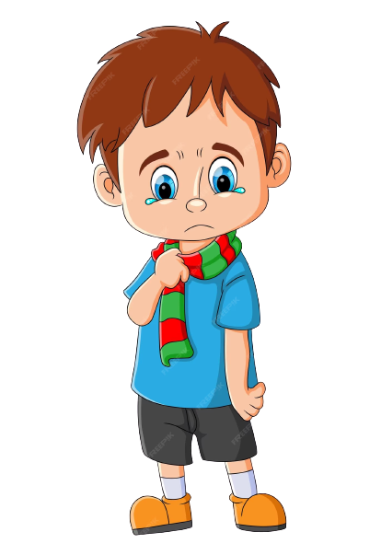
Look and answer
Who are they?
How is Phong feeling now?
Do you know the reason why?
Mark
Phong

Slide 12
1. Listen and read the dialogue below. Pay attention to the highlighted sentences.
Phong, why are you so sad?
My grandparents called this morning. A flood destroyed their house.
I’m sorry to hear that.
It also damaged all of their crops.
That’s awful! I hope your grandparents are safe.

Slide 13
Responding to bad news:
- I’m sorry to hear that.
- That’s awful!

Slide 14
2. Work in pairs. Practise giving and responding to bad news in the following situations.
- You have a friend in a mountainous area. A landslide destroyed his family’s garden yesterday. You share this news with your classmate.
A
- You hear that a big earthquake hit a city. You share this news with your classmate.
B

Slide 15
Knowledge of natural disasters

Slide 16
3. Read the short passages below. Decide which natural disaster each person below is talking about.
=> Nam: landslide
=> Ann: tornado
=> Tom: earthquake

Slide 17
Types of Severe Weather
Choose the correct answer to each question to see how much you know about natural disasters.
Question 1: Which of these may cause landslides?
A. Heavy rain. B. Wind. C. Lightning.
Question 2: Which of these activities may cause landslides?
A. Littering. B. Cutting down trees. C. Polluting the air.
Question 3: What scale is used for measuring earthquakes?
A. Fahrenheit scale. B. Celsius scale. C. Richter scale.
Question 4: What natural disaster can an earthquake cause?
A. A flood. B. A landslide. C. A tornado.
Question 5: What do tornadoes form from?
A. An earthquake. B. A flood. C. A thunderstorm.
Question 6: Where do tornadoes mostly happen?
A. In the USA. B. In the UK. C. In Viet Nam
Tornado
Cyclone
a giant tube of air spinning violently
a circular storm containing
strong winds and rains

Slide 18
Types of Severe Weather
Choose the correct answer to each question to see how much you know about natural disasters.
Question 1: Which of these may cause landslides?
A. Heavy rain. B. Wind. C. Lightning.
Question 2: Which of these activities may cause landslides?
A. Littering. B. Cutting down trees. C. Polluting the air.
Question 3: What scale is used for measuring earthquakes?
A. Fahrenheit scale. B. Celsius scale. C. Richter scale.
Question 4: What natural disaster can an earthquake cause?
A. A flood. B. A landslide. C. A tornado.
Question 5: What do tornadoes form from?
A. An earthquake. B. A flood. C. A thunderstorm.
Question 6: Where do tornadoes mostly happen?
A. In the USA. B. In the UK. C. In Viet Nam
Tornado
Cyclone
a giant tube of air spinning violently
a circular storm containing
strong winds and rains

Slide 19
In this lesson, you have:
learnt new words related to natural disasters.
learnt how to give and respond to bad news.
WRAP-UP
Let's Try This!
Match the images below with the correct severe weather name.
Then, give one to two "weather-words" to describe each photo.
Thunderstorm
Blizzard
1
2
3
Flash flood
__________
__________
__________

Slide 20
ANSWER KEY
Let's Try This!
Match the images below with the correct severe weather name.
Then, give one to two "weather-words" to describe each photo.
1
2
3
Blizzard
Thunderstorm
Flash flood
snow, cold
lightning, thunder
water, rain

Slide 21
Types of Severe Weather
Blizzard
Thunderstorm
a snowstorm with strong winds
a storm with lightning and thunder

Slide 22
Types of Severe Weather
Flash Flood
Heat Wave
a quick flooding of low-lying land
a period of extremely hot weather

Slide 23
Let's Keep in Mind!
Weather
Severe Weather
Types of Severe Weather
Outside conditions that you experience every day
Extreme and dangerous weather that can damage properties and result in the loss of human lives
Include tornadoes, cyclones, blizzards, thunderstorms, flash floods, and heat waves
REFERENCE
National Geographic Society. "Extreme Weather on Our Planet." National Geographic Society, 16 Mar. 2020, www.nationalgeographic.org/activity/extreme-weather-on-our-planet.
Facts Just for Parents, Teachers and Students. "Severe Weather Facts for Kids." Facts Just for Parents, Teachers and Students, Mar. 2023, www.factsjustforkids.com/weather-facts/severe-weather-facts-for-kids

Slide 24
Resource Page
Use these illustrations in your Canva Presentation. To find even more elements about the weather, use these collection codes in the elements search bar:
canvaeducationscienceobjectsinthesky
canvaeducationscienceweather
canvaeducationweather
Don't forget to delete this page before presenting. Happy designing!

Slide 25
Press these keys
while on Present mode!
B
for blur
C
for confetti
D
for a drumroll
M
for mic drop
O
for bubbles
Q
for quiet
U
0-9
for unveil
Any number from 0-9 for a timer

