Slide 1
SONG VE SECONDARY SCHOOL
Hello every one !!!
love
TRẦN THỊ THÙY NGA

Slide 2
Game:
Sentence puzzling
1. is | city | My | beautiful. | very
2. His | big. | is | very | house
3. school | Our | a big | has | garden.
4. Your | than | is smaller | school | mine.
5. Hers | shoes | than | are bigger | My.
* Suggested answers:
My city is very beautiful.
His house is very big.
Our school has a big garden.
Your school is smaller than mine
My shoes are bigger than Hers.

Slide 3
LESSON 1
Grammar
Possessive adjectives
Possessive pronouns

Slide 4
* Grammar :
1. Possessive adjectives : ( Tính từ sở hữu)
A possessive adjective is used only when there is a noun following it.
( Tính từ sở hữu chỉ được sử dụng khi có một danh từ theo sau nó).
EX: I have a pen. →This is my pen.
2. Possessive pronouns : (Đại từ sở hữu)
A possessive pronoun is used alone, without a noun following it.
(Một đại từ sở hữu được sử dụng một mình, không có danh từ theo sau nó.)
EX: - This book is my book , not your book .
- This book is mine, not yours.

Slide 5
* Grammar :
Pronouns | Possessive adjectives | Possessive pronouns
I | my | mine
you he | your his | yours his
she | her | hers
it we | its our | its ours
you | your | yours
they | their | theirs

Slide 6
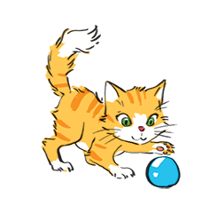
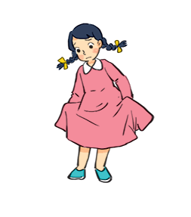
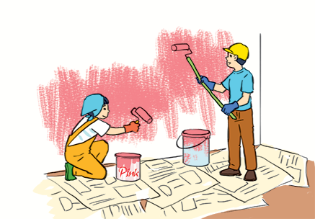
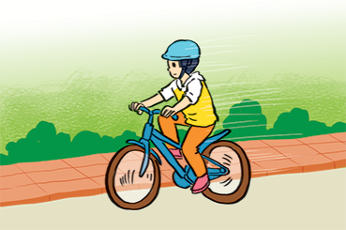
Match the sentences with the pictures, paying attention to the underlined part in each sentence.
1.
Sue doesn’t like her new dress.
1 - d
a
b
2.
Billy is riding his bicycle.
2 - f
3.
I’ll write my name in red. Could you write
your name in blue?
d
3 - e
c
4.
The cat is playing with its ball.
4 - b
5.
We love our school.
5 - a
e
f
6.
They are painting their room pink.
6 - c

Slide 7
Complete the sentences with the correct possessive adjectives.
1. I love cartoons. ............favourite cartoon is Dragon Balls.
2. This book has your name on it. Is it .................. book?
3. The lion has three cubs. .............. cubs are playing under a big tree.
4. Do you know my friend Anna? .................. house is close to the park.
5. We are from Switzerland. ................. country is famous for chocolate.
6. This is my younger brother. ……………..name is Tuan.

Slide 8
THE BIG WHEEL GAME
QUESTIONS
10
40
1
4
30
50
SPIN
2
5
20
10
-15
-20
3
6
05
60

Slide 9
Complete the sentences with the correct possessive adjectives.
My
1. I love cartoons. ...............favourite cartoon is Dragon Balls.

Slide 10
Complete the sentences with the correct possessive adjectives.
your
2. This book has your name on it. Is it .............book?

Slide 11
Complete the sentences with the correct possessive adjectives.
Its
3. The lion has three cubs. ............. cubs are playing under a big tree.

Slide 12
Complete the sentences with the correct possessive adjectives.
4. Do you know my friend Anna? .................. house is close to the park.
Her

Slide 13
Complete the sentences with the correct possessive adjectives.
Our
5. We are from Switzerland. ................. country is famous for chocolate.

Slide 14
Complete the sentences with the correct possessive adjectives.
His
6. This is my younger brother. …………….name is Tuan.

Slide 15
Complete the sentences with the correct possessive adjectives.
My
1. I love cartoons. ............favourite cartoon is Dragon Balls.
2. This book has your name on it. Is it .................. book?
3. The lion has three cubs. .............. cubs are playing under a big tree.
4. Do you know my friend Anna? .................. house is close to the park.
5. We are from Switzerland. ................. country is famous for chocolate.
6. This is my younger brother. ……………..name is Tuan.
your
Its
Her
Our
His

Slide 16
Complete the sentences with the correct possessive pronouns.
1.
I have a new bike. The bike is .
mine
These are Mai’s and Lan’s maps. These maps are .
2.
theirs
3.
This is a present for you. It’s .
yours
4.
My father has new shoes. They’re .
his
5.
This is our new house. The house is .
ours

Slide 17
Underline the correct word in brackets to complete each sentence.
1.
Australia is a strange country. All of (it’s / its) big cities are along the coast.
2.
Our city is very crowded. How about (your / yours)?
3.
I love my football club. Does phong like (his / him)?
4.
(Our / Ours) street is short and narrow.
5.
They cannot f ind (their / theirs) city map anywhere.

Slide 18
Choose the correct word to complete the sentences.
1.
The book is (my / mine / yours), but you are welcome to read it.
2.
( Your / Yours / You) bike is dirty, and I can’t tell what colour it is.
3.
Your country is much bigger than (our / ours / their).
4.
(They / Their / Theirs) dog is so friendly. It never barks.
5.
(It / It’s / Its) not easy to find your way in a strange city.

Slide 19
homework
Revise the grammar.
Redo all the exercises.
Prepare Skills1.

