Slide 1
NGUYEN HUE SECONDARY SCHOOL
WELCOME TO OUR CLASS !
ENGLISH 8
Teacher: Tran Thi Anh Thu
School - year: 2024 - 2025
Notes:
1

Slide 2
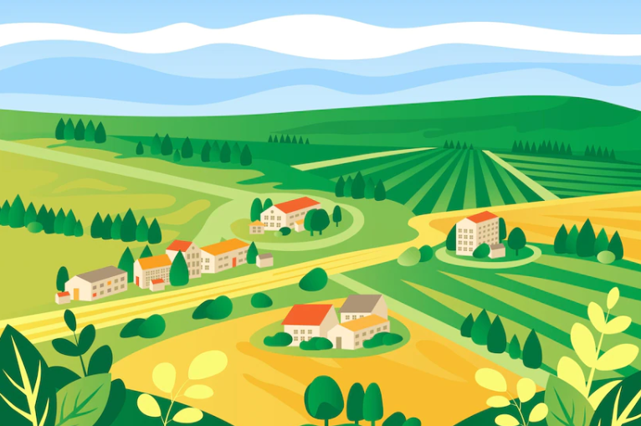
WARM-UP
MAKING
COMPARISON

Slide 3
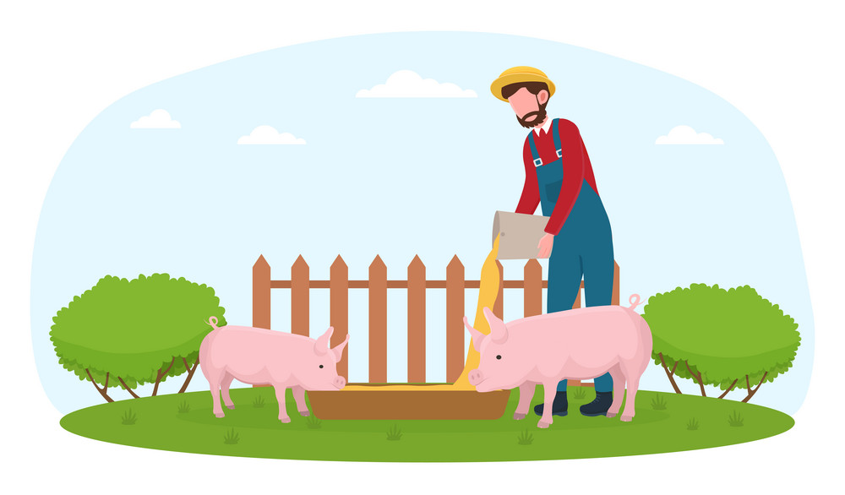
Unit
2
LIFE IN THE COUNTRYSIDE
Period 11 LESSON 3: A CLOSER LOOK 2

Slide 4
I. GRAMMAR
* Comparative adverbs
a. Comparative forms of short adverbs
S1 + V + short adv – er + than + S2 + auxiliary V (trợ động từ)
N / O / Pronoun
Ex: I get up later than she does
Lan / her / she
b. Comparative forms of long adverbs
S1 + V + more + long adv + than + S2 + auxiliary V (trợ động từ)
N / O / Pronoun
Ex: I drive more carefully than Lan
c. Some irregular adverbs:
well → better badly → worse little -> less much -> more
d. Adverbs have the same forms as adjectives : fast , late, hard, soon, long, high,….
fast -> faster

Slide 5
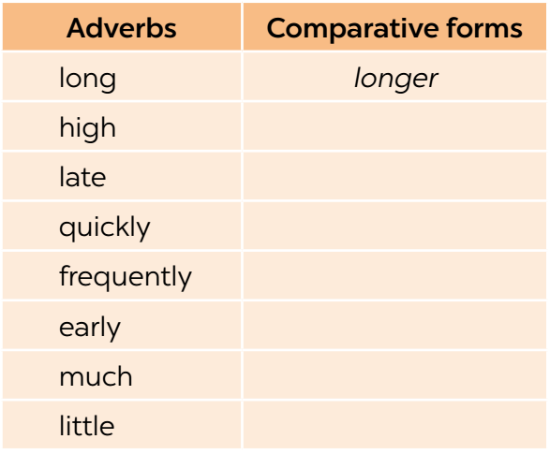
II.PRACTICE
1
Write the comparative forms of the adverbs in the table below.
higher
later
more quickly
more frequently
earlier
more
less

Slide 6
II. PRACTICE
2
Complete the sentences with the comparative forms of the adverbs in brackets.
1. Mai dances (beautifully) _______________ than Hoa does.
2. Please write (clearly) _____________. I can’t read it.
3. Life in the city seems to move (fast) _____ than that in the countryside.
4. If you want to get better marks, you must work much (hard) ______.
5. Today it’s raining (heavily) ____________ than it was yesterday.
more beautifully
more clearly
faster
harder
more heavily

Slide 7
II. PRACTICE
3
Complete the sentences with suitable comparative forms of the adverbs from the box.
early soundly fast carefully quietly
1. After his accident last month, he is driving _____________ now.
2. A horse can run ______ than a buffalo.
3. You’re too loud. Can you speak a bit ____________?
4. After working hard all day on the farm, we slept ____________ than ever before.
5. The farmers started harvesting their crops ______ than expected.
more carefully
faster
more quietly
more soundly
earlier

Slide 8
II. PRACTICE
4
Read the situations and complete the sentences using the comparative forms of the adverbs in brackets.
1. The red car can run 200 km/h while the black car can run 160 km/h.
 The red car can run _______________________. (fast)
2. Nick can jump 1.5 m high while Tom can jump only 1.3 m.
 Nick can jump ___________________. (high)
faster than the black car
higher than Tom (can)

Slide 9
II. PRACTICE
3. Mai and hoa both did well on the exam. Hoa got 80% of the answers correct and Mai got 90%.
Mai did ___________________________. (well)
4. My dad expected the workers to arrive at 7 a.m., but they arrived at 6:30 a.m.
The workers arrived __________________________. (early)
5. The buses run every 15 minutes. The trains run every 30 minutes.
 The buses run ____________________________. (frequently)
better on the exam than Hoa
earlier than my dad expected
more frequently than the trains

Slide 10
PRODUCTION
5
Work in pairs. Ask and answer to find out who:
– can run faster
– can jump higher
– stays up later at night
– gets up earlier in the morning
Example: A: How fast can you run? B: I can run 15 kilometres an hour. A: OK, you can run faster than me.
Report your results to the class.

Slide 11
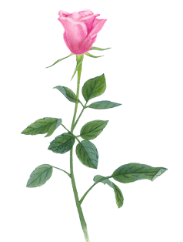
THANKS FOR YOUR LISTENING!

Slide 12
I. GRAMMAR
– For most adverbs (often with two or more syllables), we make comparative forms by adding more.
Example:
slowly → more slowly
carefully → more carefully
– For adverbs that have the same forms as adjectives like fast, hard, soon, etc., we make comparative forms by adding -er.
Example:
fast → faster
hard → harder
– Some irregular adverbs:
well → better
badly → worse

