Slide 1
NGUYEN HUE SECONDARY SCHOOL
WELCOME TO OUR CLASS !
ENGLISH 8
Teacher: Tran Thi Anh Thu
School - year: 2024 - 2025
Notes:
1

Slide 2
HIDDEN PICTURES
LET’S PLAY!

Slide 3
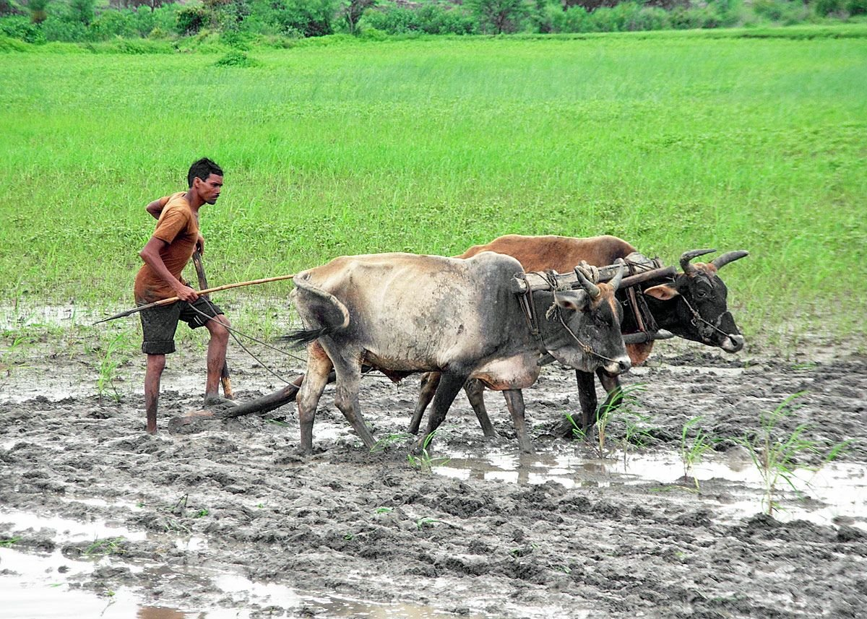
ploughing fields
SHOW
KEY

Slide 4
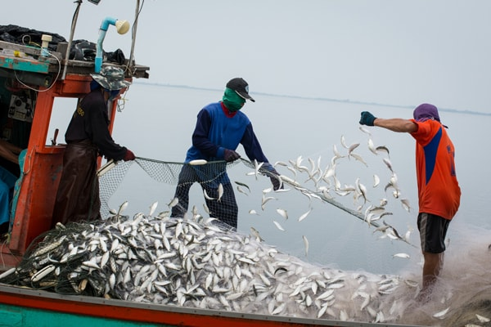
catching fish
SHOW
KEY

Slide 5
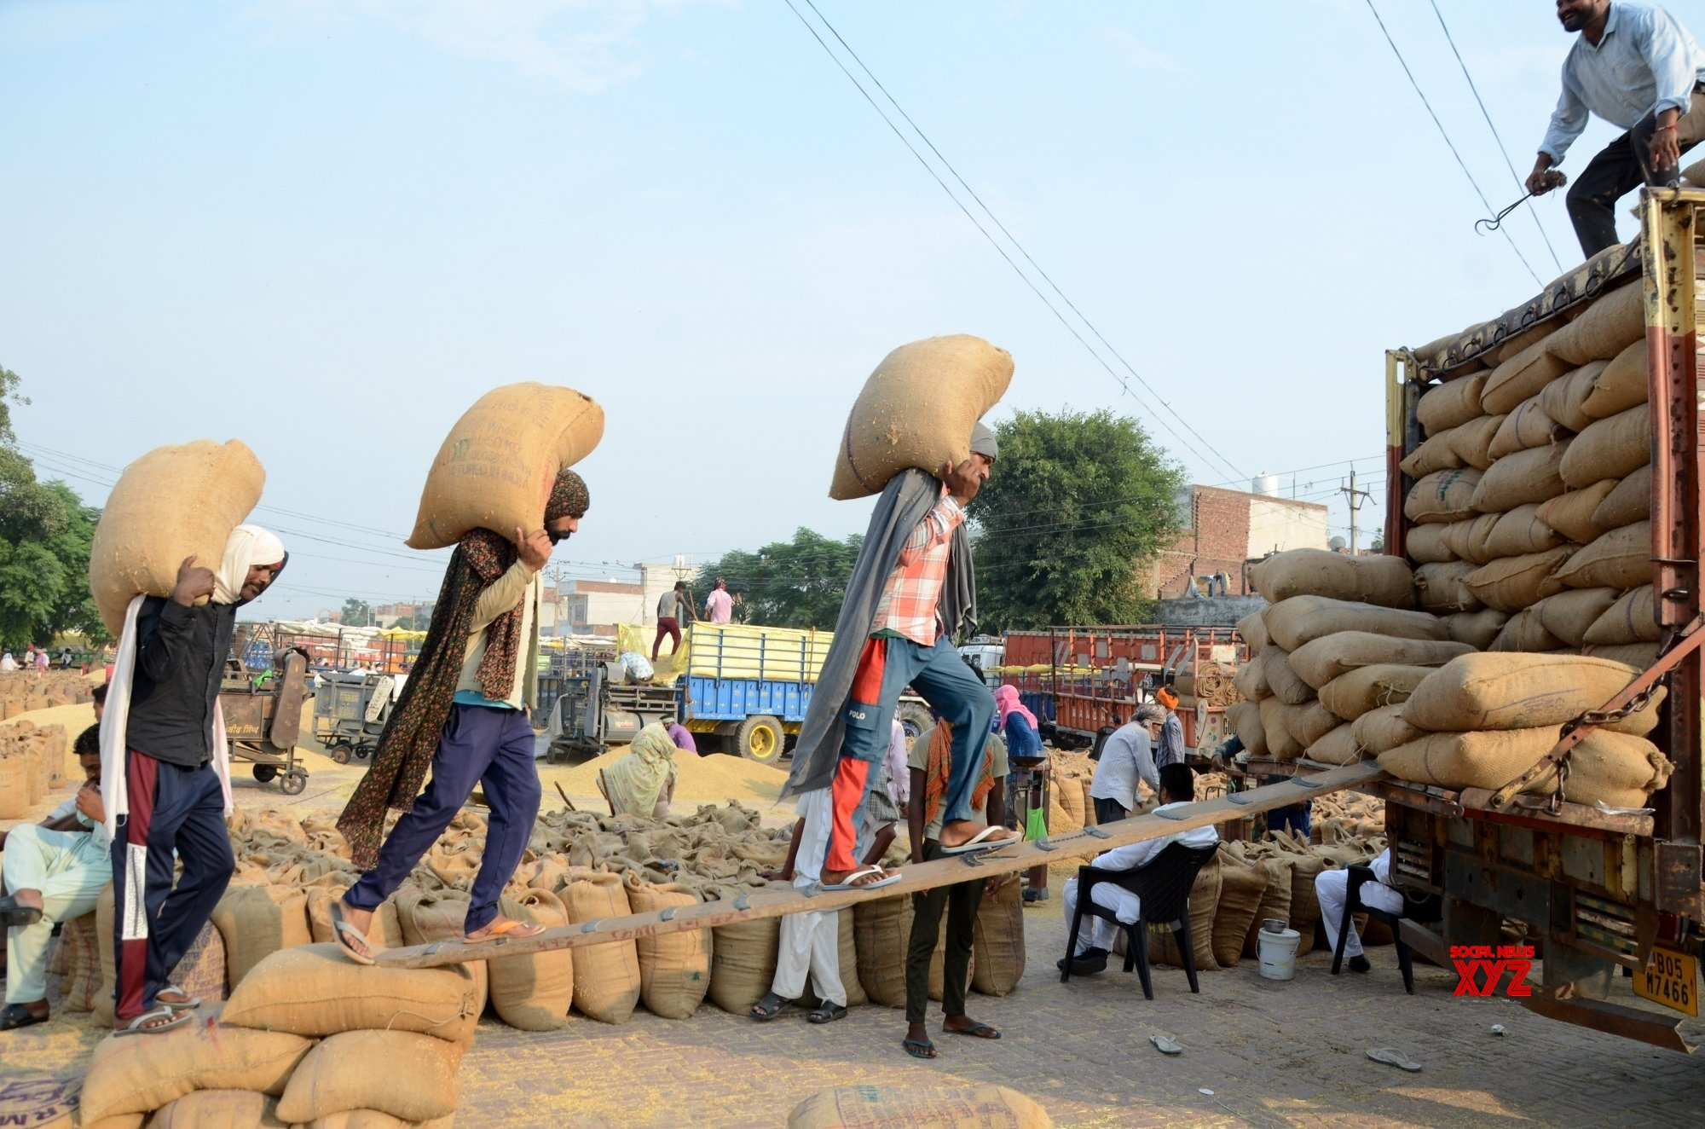
loading rice
SHOW
KEY

Slide 6
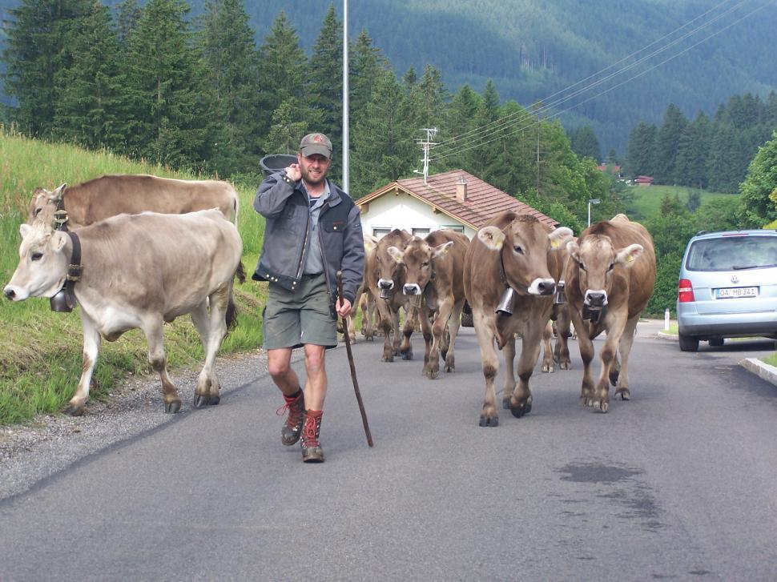
herding cows
SHOW
KEY

Slide 7
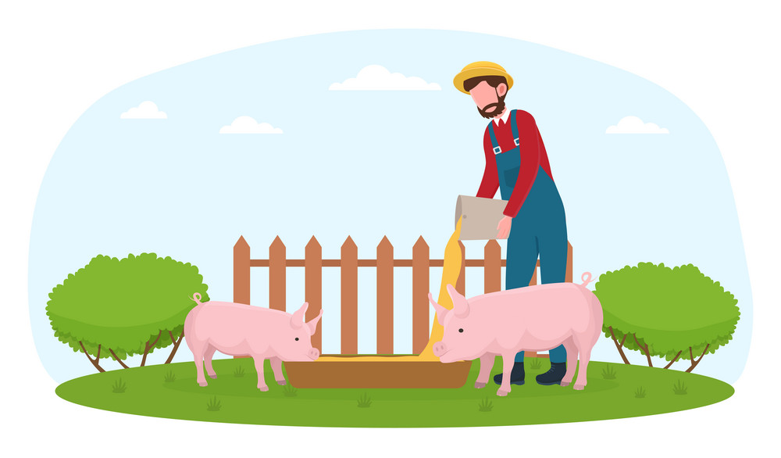
Unit
2
LIFE IN THE COUNTRYSIDE
Period 10 LESSON 2: A CLOSER LOOK 1

Slide 8
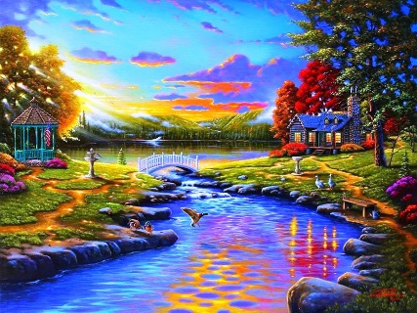
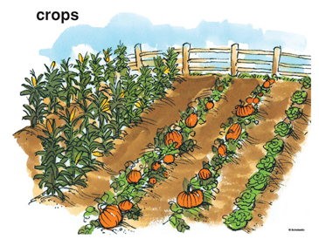
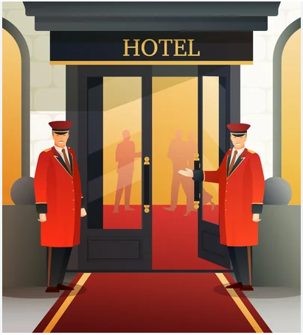
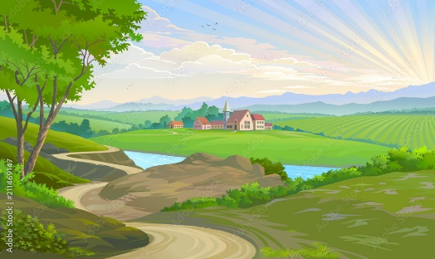
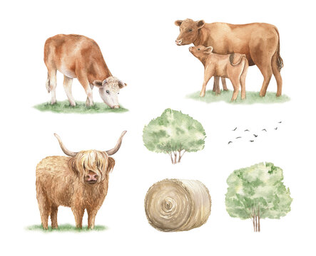
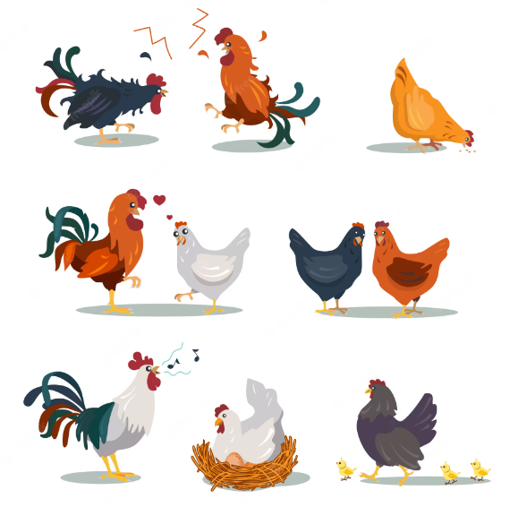
Wednesday, September 25th, 2024
UNIT 2 : LIFE IN THE COUNTRYSIDE
Period 10 LESSON 2: A CLOSER LOOK 1
I. Vocabulary:
- cattle (n)
- poultry (n)
- crop (n)
- vast (adj)
- hospitable (adj)
- well-trained (adj)
- picturesque (adj)
- cottage (n)
- pick fruit
- orchard (n)
- be busy doing s.th
-nvy
: gia súc
: gia cầm
: vụ, mùa
: rộng lớn, mênh mông, bao la
: mến khách, hiếu khách
: lành nghề, có tay nghề
: đẹp, hấp dẫn, đẹp như tranh vẽ
: nhà tranh
: hái trái cây
: vườn cây ăn quả
: bận làm cái gì đó
A .
2

Slide 9
* PRACTICE
1
Circle the correct words to complete the sentences.
1. We helped the farmers herd cattle / poultry.
2. They are helping their parents pick plants / fruit in the orchard.
3. At harvest time farmers are busy cutting and collecting food / crops.
4. The driver loaded / unloaded the rice from the back of the truck.
5. People here live by catching / holding fish from nearby lakes
and ponds.

Slide 10
* PRACTICE
2
Match the following adjectives with their definitions.
a. pretty, especially in a way that looks old-fashioned
b. having something near or around
c. extremely large in area, size, amount, etc.
d. pleased to welcome guests; generous and friendly to visitors
e. having received good or thorough training

Slide 11
* PRACTICE
3
Complete the sentences with the words from 2.
1. The local people are kind and __________ to visitors.
2. Our factory needs a lot of ____________ workers.
3. While travelling up the mountain, people always stop and take photos of the ___________ scenery.
4. The Sahara is a ______ desert that covers parts of eleven countries in Northern Africa.
5. The lake is _____________ by a lot of trees.
hospitable
well-trained
picturesque
vast
surrounded

Slide 12
II.PRONUNCIATION
/ə/ and /ɪ/

Slide 13
Watch a video and pay attention to the sounds /ə/ and /ɪ/.

Slide 14
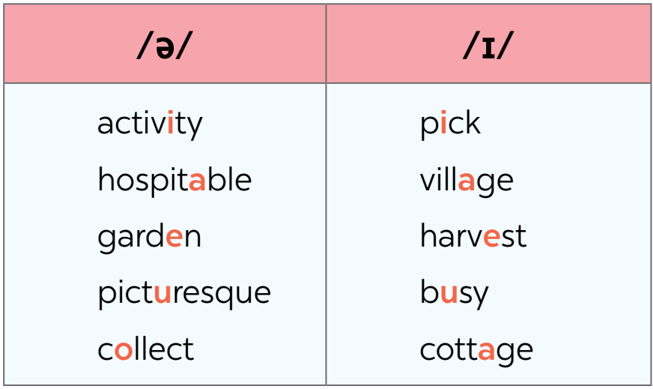
II.PRONUNCIATION
4
Listen and repeat the words. Pay attention to the sounds /ə/ and /ɪ/.

Slide 15
II.PRONUNCIATION
5
Listen and practise the sentences. Underline the bold words with /ə/, and circle the bold words with /ɪ/.
1. There is a lot of water in the bottle.
2. The farmers here are hard-working.
3. They are picking fruits in the orchard.
4. People in my village usually gather at weekends.
5. Please buy some milk and pasta at the supermarket.

Slide 16
THANKS FOR YOUR LISTENING!

