Slide 1
NGUYEN HUE SECONDARY SCHOOL
WELCOME TO OUR CLASS !
ENGLISH 8
Teacher: Tran Thi Anh Thu
School - year: 2024 - 2025
Notes:
1

Slide 2
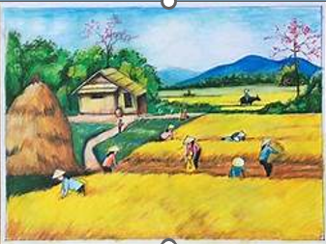
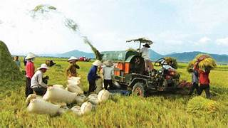
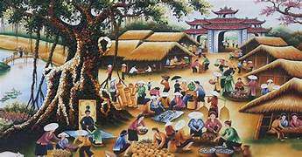
LIFE IN THE COUNTRYSIDE

Slide 3
Unit
2
LIFE IN THE COUNTRYSIDE
PERIOD 9 LESSON 1: GETTING STARTED
Last summer holiday

Slide 4
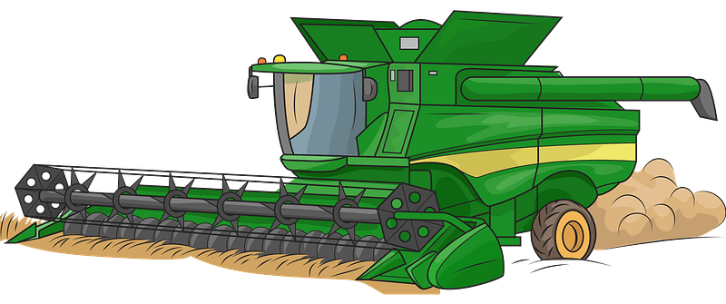
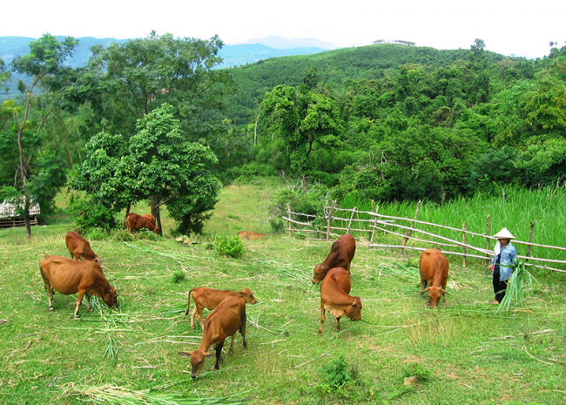
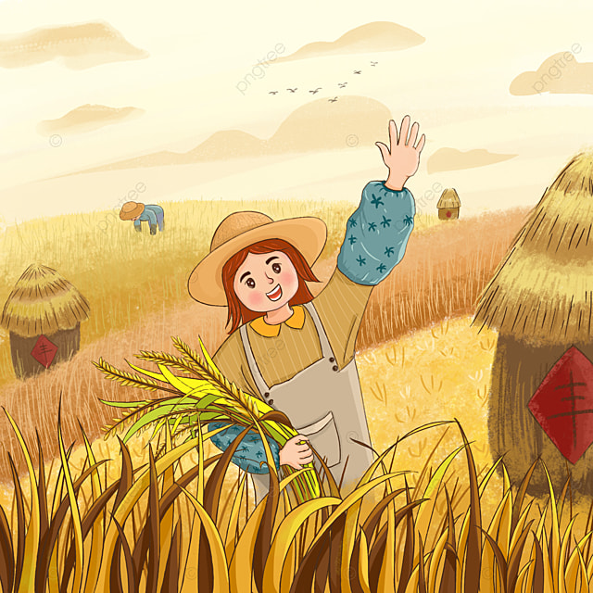
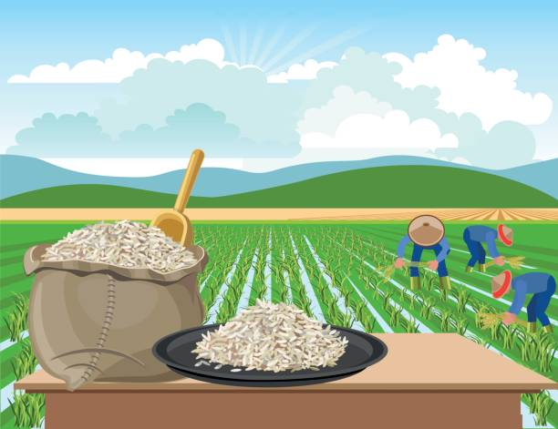
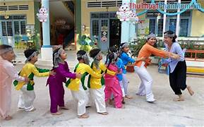
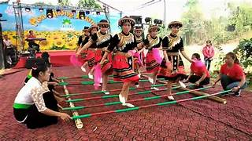
Wednesday, September 25th, 2024
UNIT 2 : LIFE IN THE COUNTRYSIDE
Period 9 LESSON 1: GETTING STARTED
I. Vocabulary:
- harvest (n, v)
- combine harvester (n)
- herd cows
- paddy field (n)
- bamboo dancing (n)
- dragon - snake (n)
- load(v)
- unload (v)
- seem + adj / to-inf
- envy (s.o)
- tan (v,n)
-nvy
: vụ gặt, vụ thu hoạch /gặt hái, thu hoạch
: máy gặt đập liên hợp
: chăn bò
: cánh đồng lúa
: múa sạp
: rồng rắn lên mây
: chất, chở
: dỡ hàng
: dường như
: ghen tị (với ai đó)
:làm rám nắng/ làn da rám nắng
A .
2

Slide 5
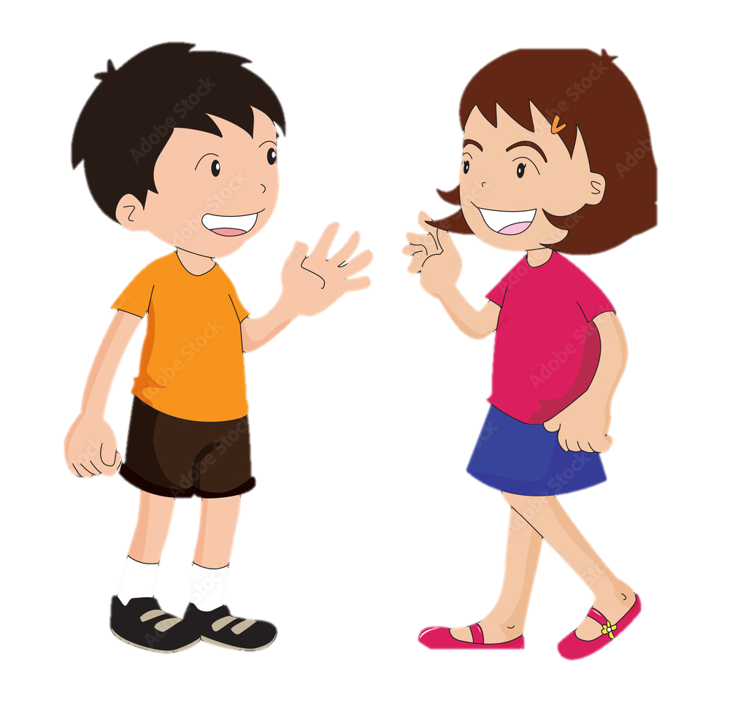
Nick
LAST SUMMER HOLIDAY
Who has just come back from a very enjoyable summer holiday?
Mai

Slide 6
II. PRACTICE
1
Listen and read.
Nick: You look great with a tan, Mai!
Mai: Thank you. I’ve just come back from a very enjoyable summer holiday.
Nick: Really? Where did you stay?
Mai: I stayed at my uncle’s house in a small village in Bac Giang Province.
Nick: What did you do there?
Mai: A lot of things. It was harvest time. The villagers were harvesting rice with a combine harvester. I helped them load the rice onto a truck. Then we unloaded the rice and dried it.
Nick: Sounds great!
Mai: And sometimes I went with the village children to herd the buffaloes and cows. I made friends with them on my first day.
Nick: Were they friendly?
Mai: Yes, they were. They took me to the paddy fields to fly kites. And in the evening, we played traditional games like bamboo dancing and dragon-snake.
Nick: Oh, I envy you!
Mai: Things move more slowly there than in our city, but people seem to have a healthier life.

Slide 7
II. PRACTICE
2. Read the conversation again and choose the correct answer to each question.
1. How does Mai feel about her summer holiday?
A. She likes it. B. She doesn’t like it. C. She thought it was fine.
2. Where did she stay during her summer holiday?
A. At her friend’s house.
B. At her uncle’s house.
C. At her grandparents’ house.
3. During harvest time, people harvest rice by ______.
A. themselves B. using a truck C. using a combine harvester
4. Mai thinks people in the countryside lead ______.
A. a healthy life B. an exciting life C. an interesting life

Slide 8
II. PRACTICE
2
Read the conversation again and choose the correct answer to each question.
1. How does Mai feel about her summer holiday?
A. She likes it.
B. She doesn’t like it.
C. She thought it was fine.
2. Where did she stay during her summer holiday?
A. At her friend’s house.
B. At her uncle’s house.
C. At her grandparents’ house.

Slide 9
II. PRACTICE
2
Read the conversation again and choose the correct answer to each question.
3. During harvest time, people harvest rice by ______.
A. themselves
B. using a truck
C. using a combine harvester
4. Mai thinks people in the countryside lead ______.
A. a healthy life
B. an exciting life
C. an interesting life

Slide 10
II. PRACTICE
3
Complete the sentences with the words and phrases from the box.
paddy field
herd
harvest time
load
combine harvester
1. It took them an hour to ___________ all the goods onto the truck.
2. Nowadays, people in my village use a __________________ to harvest their rice and separate the grains from the rest of the plant.
3. Today it is my turn to __________ the cows.
4. A place in which people grow rice is called a _______________.
5. A busy time when people cut and gather their crops is called _____________.

Slide 11
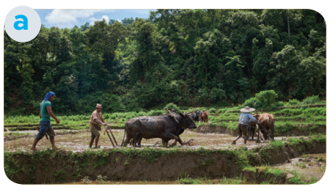
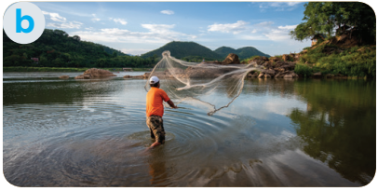
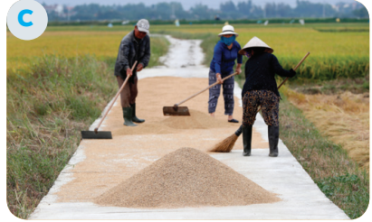
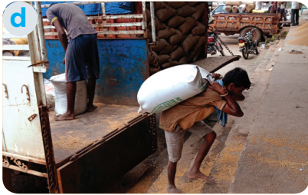
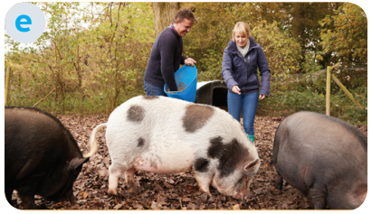
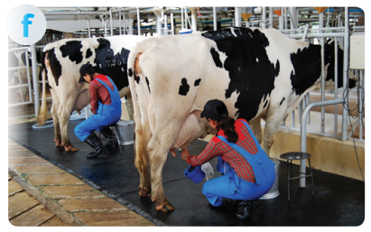
II. PRACTICE
4
Match the activities that people living in the countryside often do with the pictures.
1. unloading rice
2. ploughing fields
3. milking cows
4. feeding pigs
5. catching fish
6. drying rice

Slide 12
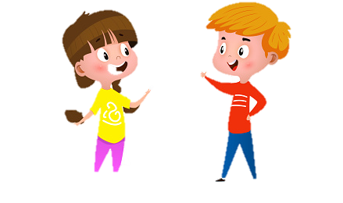
5. Ask and answer about the pictures
What are they doing in picture a?
They are ploughing fields.

Slide 13
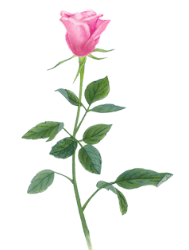
THANKS FOR YOUR LISTENING!

