Slide 2
WARM-UP
KIM’S GAME
RULE:
Work in groups
Look at the pictures on the screen.
They will disappear after 2 seconds, so try to remember all the pictures without writing them down.
After all the pictures disappear, you have 1 minute to write down the word / phrase in each picture on your poster.
2 points for each correct answer

Slide 3
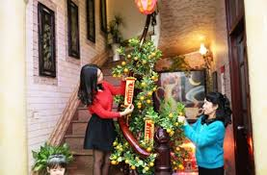
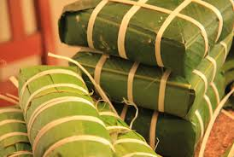
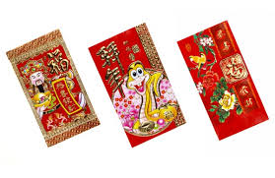
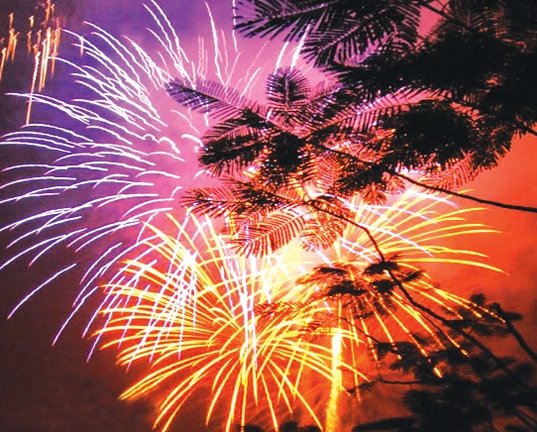
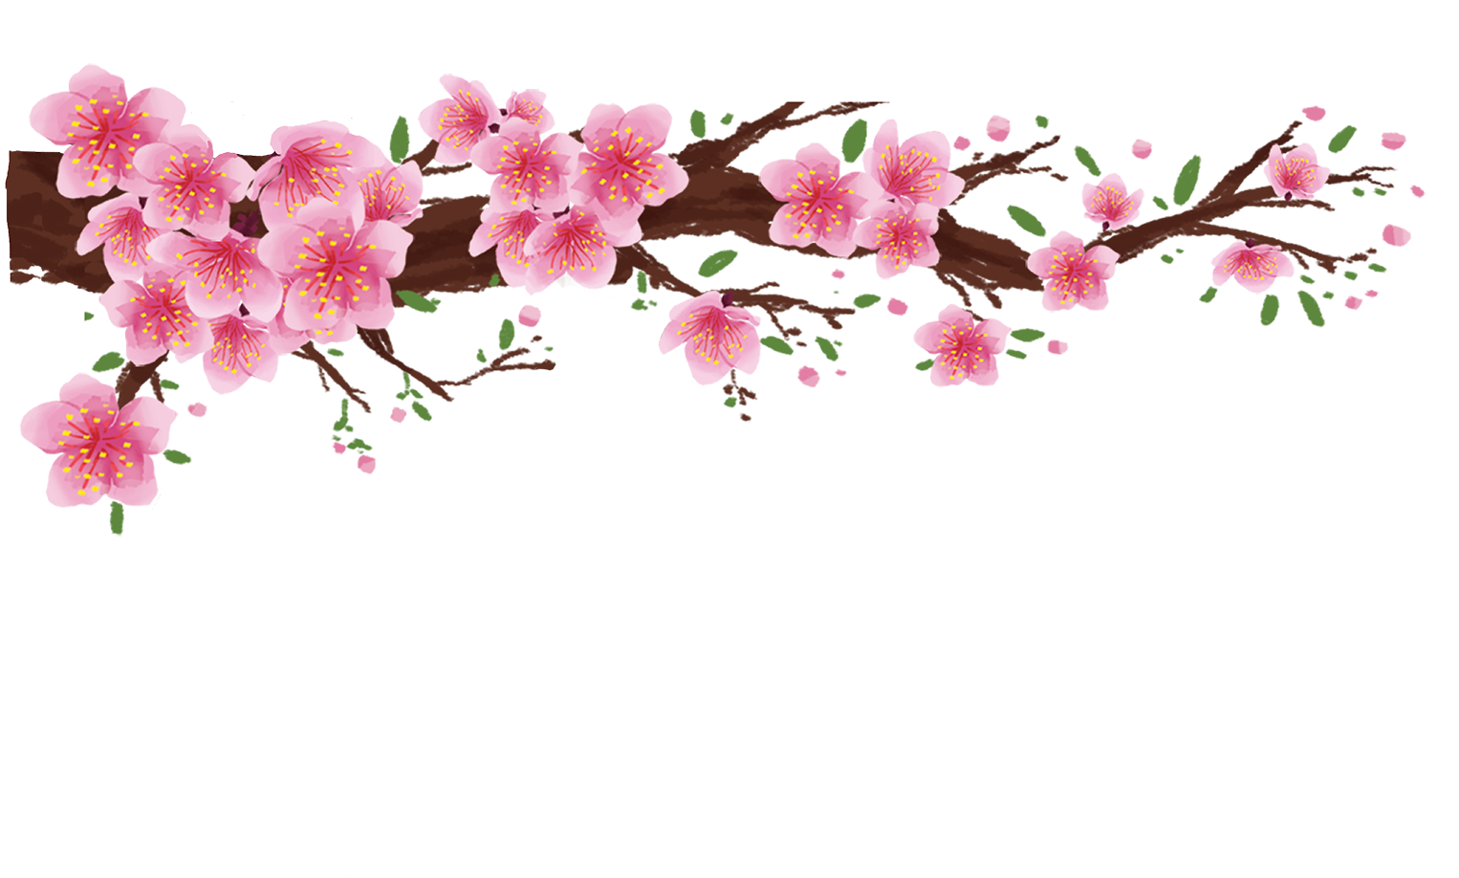
WARM-UP
KIM’S GAME

Slide 4
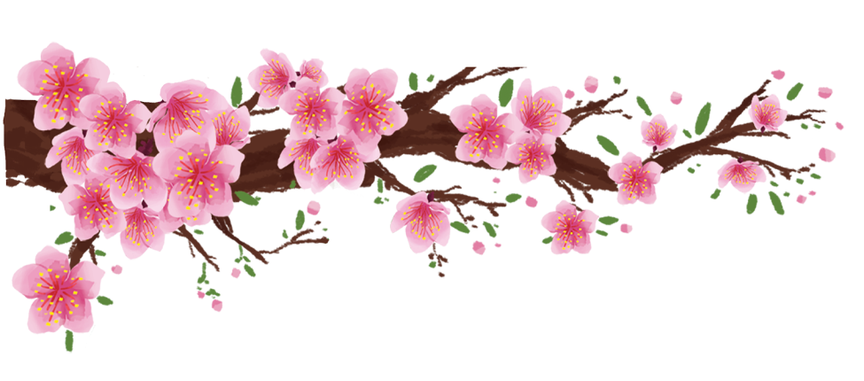
WARM-UP
KIM’S GAME
peach flower
banh chung and banh tet
fireworks
lucky money
house decoration

Slide 5
Unit
5
OUR CUSTOMS AND TRADITIONS
LESSON 1: GETTING STARTED
LESSON 1: GETTING STARTED
Tet is coming

Slide 6
PRESENTATION
admire (v)
/ədˈmaɪr/
khâm phục , chiêm ngưỡng

Slide 7
PRESENTATION
chase away
/tʃeɪs əˈweɪ/
xua đuổi

Slide 8
PRESENTATION
pray (v)
/preɪ/
cầu nguyện

Slide 9
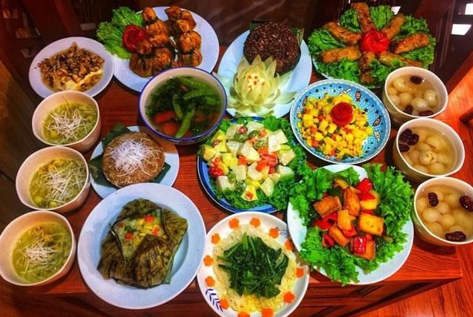
PRESENTATION
offering (n)
/ˈɒfərɪŋ/
đồ thờ cúng

Slide 10
PRESENTATION
ornamental tree
/ɔːnəˈmentl triː/
cây cảnh

Slide 11
PRESENTATION
Vocabulary | Pronunciation | Meaning
1. admire (v) | /ədˈmaɪr/ | khâm phục
2. chase away | /tʃeɪs ə’wei / | xua đuổi
3. pray (v) | /preɪ/ | cầu nguyện
4. offering (n) | /ˈɒfərɪŋ/ | đồ thờ cúng
5. ornamental tree | /ɔːnəˈmentl triː/ | cây cảnh

Slide 12
VOCABULARY
Vocabulary |  | Meaning
1. admire (v)
2. chase away
3. pray (v)
4. offering (n)
5. ornamental tree
cầu nguyện
đồ thờ cúng
cây cảnh
khâm phục
xua đuổi

Slide 13
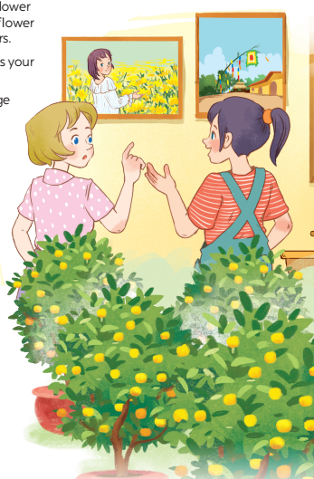
PRACTICE
1
Listen and read.
- What can you see in each picture?
- Can you guess the places that the picture show?

Slide 14
PRACTICE
1
Listen and read.
Elena: Wow, this girl looks so cute.
Trang: Yeah ... She’s my cousin. She’s at Sa Dec flower Village. Tet is coming soon, so many people visit flower villages to take pictures with the blooming flowers.
Elena: Oh, I’m fond of admiring the flowers. Does your family visit places like this too?
Trang: Yes, we do. We usually visit nhat Tan Village to buy kumquat trees and peach blossoms.
Elena: I see flowers and ornamental trees everywhere these days. What are they for?
Trang: We, Vietnamese, use plants and flowers for decorations and for oﬀerings. They are an important part of our Tet tradition.
Elena: And what’s that tall tree in the photo?
Trang: Well, it’s actually a bamboo pole. People place it in the yard of the communal house. They hang decorative items like small bells and lanterns on it. They want to chase away bad luck and pray for a lucky new year.
Elena: Interesting! I didn’t know that.

Slide 15
PRACTICE
2
Read the conversation again and tick T (True) or F (False).
Sentences | T | F
1. Elena and Trang are at Sa Dec Flower Village.
2. Many people visit ﬂower villages to take photos.
3. Trang’s family usually buys kumquat trees and peach blossoms at Nhat Tan Village.
4. Flowers are not part of any Vietnamese traditions.
5. People decorate bamboo poles with small bells and lanterns for New Years.
Trang’s cousin is at Sa Dec Flower Village
Plants and flowers are an important part of Tet

Slide 16
PRACTICE
3
Match the phrase with the correct pictures.

Slide 17
PRACTICE
4
Complete the sentences with the verbs from the box.
1. The British decorate their Christmas trees and ______ presents under them.
2. Tom likes to ______ the view from the hill.
3. In many cultures, knocking on wood is a way to ______ away bad spirits.
4. Many Asians go to Buddhist temples to ______ for good luck.
place
admire
chase
pray

Slide 18
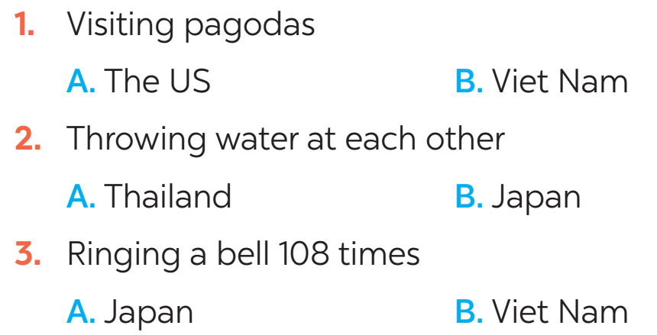
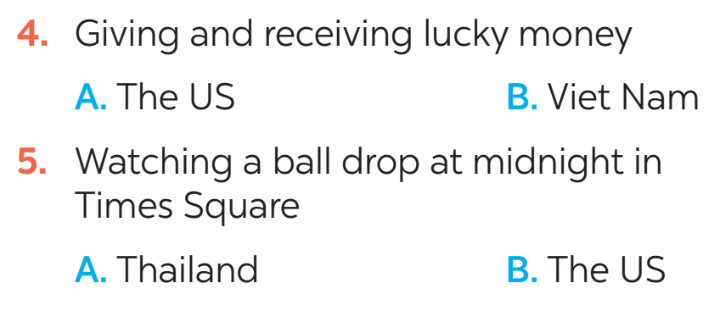
FURTHER PRACTICE
5
New Years around the world.
People around the world celebrate New Years differently. Choose the tradition below.

Slide 19
CONSOLIDATION
1
Wrap-up
What have we learnt in this lesson?
identify the topic of the unit
use lexical items related to Tet holiday.
identify the language features that are covered in the lesson.

Slide 20
CONSOLIDATION
2
Homework
- Learn vocabulary by heart.
- Practice talking about Tet Holiday.

Slide 21
Website: hoclieu.vn
Fanpage: facebook.com/www.tienganhglobalsuccess.vn/

