Slide 1
Scotland
North Ireland
GREAT BRITAIN
THE
UNITED KINGDOM
Wales
England

Slide 2
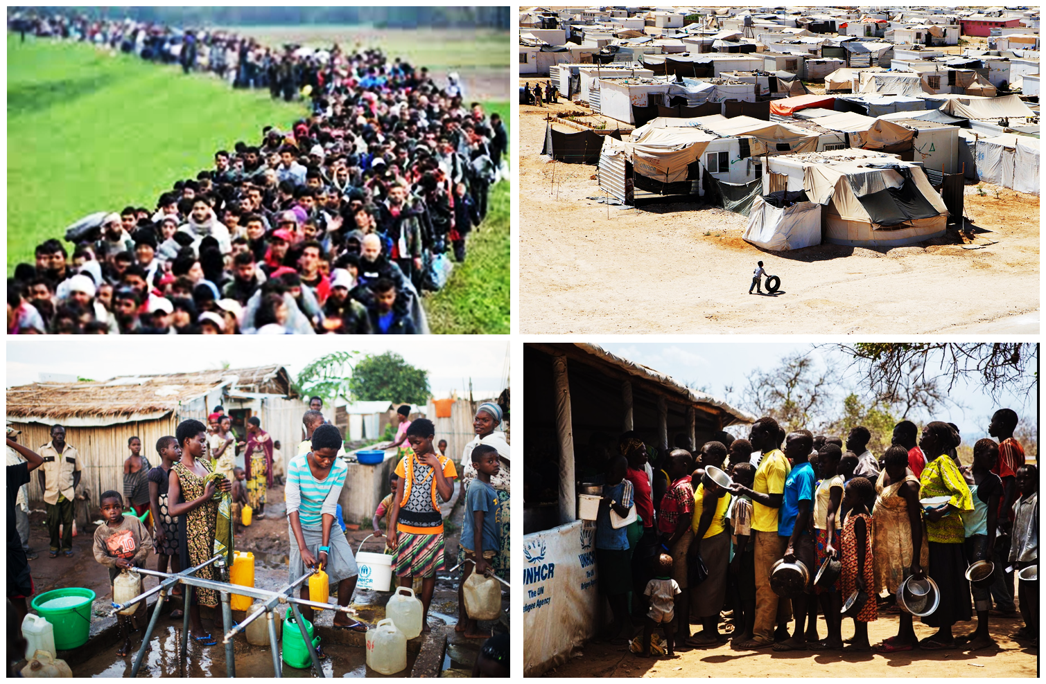
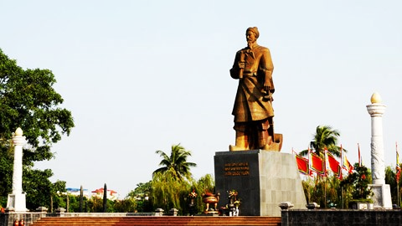
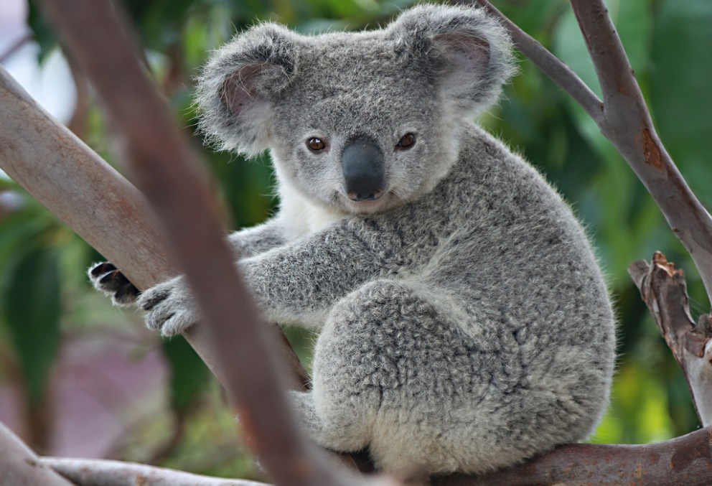
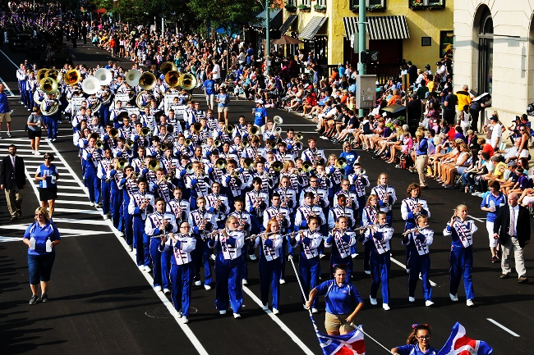
* VOCABULARY:
1. spectacle (n) /ˈspek.tɪ.kl̩/
2. spectacular (a) /spekˈtæk.jə.lər/
3. icon /'aikɔn/ (n) iconic /ai'kɔnik/(a)
4. symbolise /'simbəlaiz/(v)
5. loch /lɔk/(n)
6. unique /ju:'ni:k/(a)
7. parade /pə'reid/v)
8. monument /'mɒnjumənt/(n)
9. refugee /refju'dʒi:/(n)
10. Koala /kəʊ'ɑ:lə/ (n)
: Cảnh tượng
: đẹp mắt, hùng vĩ
: biểu tượng
: tượng trưng
: hồ, vịnh nhỏ
: độc nhất, độc đáo
: (cuộc) diễu hành
: đài tưởng niệm
: người tị nạn
: Gấu có túi

Slide 3
1. Write the names for the people who belong to these places. Then listen and repeat the words.
Country | People
1. the USA
2. England
3. Scotland
4. Wales
5. Ireland
6. Canada
7. Australia
8. New Zealand
1. the Americans
2. the English
3. the Scottish / the Scots
4. the Welsh
5. the Irish
6. the Canadians
7. the Australians
8. the New Zealanders

Slide 4
2. Change the words into a noun (N), an adjective (A) or a verb (V).
1. | Historic (a) | N = history
2. | Symbol (n) | V =
3. | Legend (n) | A =
4. | Iconic (a) | N =
5. | Spectacle (n) | A =
6. | Festive (a) | N =
7. | Scenery (n) | A =
8. | Attraction (n) | V =
symbolise
legendary
icon
spectacular
festival
scenic
attract

Slide 5
3. Use the words in the box to complete the sentences.
1. The Golden Gate Bridge in San Francisco is an _______ of this famous city.
2. Big Ben is a major monument in London which _______ the United Kingdom.
3. New Zealand is famous for the _______ beauty of its mountains and forests.
4. Australia is home to _______ animals like the kangaroo and koala, which are native to Australia.
5. The Glastonbury Festival in England is a celebration of music and it _______ thousands of people.
icon symbolises scenic unique attracts
icon
symbolises
scenic
unique
attracts

Slide 6
4. Match the words/ phrases with the pictures.
parade state loch cattle station monument castle
parade
1. 2. 3.
castle
loch
cattle station
4. 5. 6.
monument
states

Slide 7
Stress in words ending in -ese and -ee
5. Listen and repeat the words.
-ese | -ee
1. Cantonese | 5. employee
2. Taiwanese | 6. adoptee
3. Japanese | 7. addressee
4. Portuguese | 8. interviewee
’
’
’
’
’
’
’
’

Slide 9
6. Mark the stress in the underlined words. Then listen and repeat the sentences.
1. One-fifth of the people in the world are Chinese.
2. A refugee is a person who is forced to leave a country.
3. My daughter is a trainee.
4. Japanese is the language of Japan.
5. This printer has a two-year guarantee.
Chi'nese
refu'gee
trai'nee
Japa'nese
guaran'tee

Slide 10
Homework
Practice “Stress in words ending in -ese and –ee”
Prepare for the next lesson: A closer look 2
(Page 19 – 20)

