Slide 2
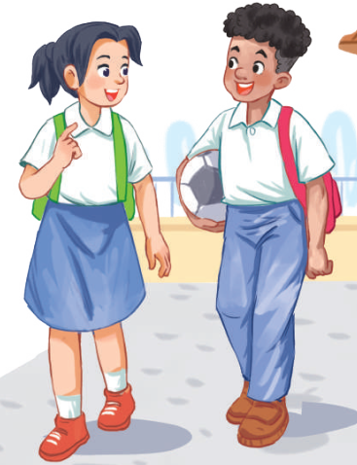
Unit
7
TRAFFIC
LESSON 1: GETTING STARTED
Meeting in the school yard
Unit
HOBBIES

Slide 3
OBJECTIVES
By the end of the lesson, students will be able to gain:
an overview about the topic Traffic.
vocabulary to talk about means of transport

Slide 4
LESSON 1: GETTING STARTED
WARM-UP
Miming game
PRESENTATION
Vocabulary
Listen and read.
Task 1: Read the conversation and choose the correct answer.
Task 2: Write one word from the conversation to complete each sentence.
Task 3: Look at the pictures and write a word under each.
PRACTICE
PRODUCTION
Task 4: Game: Find someone who …
CONSOLIDATION
Wrap-up
Homework

Slide 5
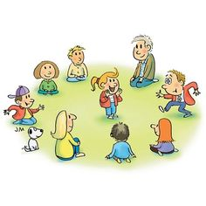
LESSON 1: GETTING STARTED
WARM-UP
Miming game
Aims of the stage:
To activate students’ knowledge on the topic of the unit
To enhance students’ skills of cooperating with teammates

Slide 6
LESSON 1: GETTING STARTED
WARM-UP
Miming game
PRESENTATION
Vocabulary
Listen and read.

Slide 7
PRESENTATION
cycle (v)
/ˈsaɪkl/
đạp xe

Slide 8
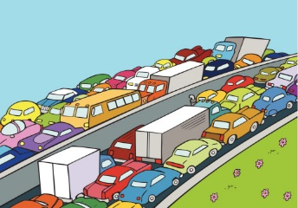
PRESENTATION
traffic jam (n. phr.)
/ˈtræfɪk dʒæm/
tắc đường

Slide 9
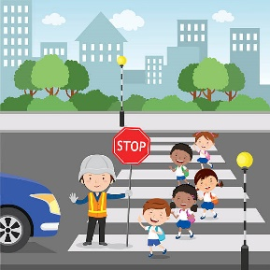
PRESENTATION
cross the road (v. phr.)
/krɒs ðə rəʊd/
băng qua đường

Slide 10
PRESENTATION
rush hour (n. phr.)
/ˈrʌʃ aʊə(r)/
giờ cao điểm

Slide 11
PRESENTATION
New words | Pronunciation | Meaning
cycle (v) | /ˈsaɪkl/ | đạp xe
traffic jam (n. phr.) | /ˈtræfɪk dʒæm/ | tắc đường
cross the road (v. phr.) | /krɒs ðə rəʊd/ | băng qua đường
rush hour (n. phr.) | /ˈrʌʃ aʊə(r)/ | giờ cao điểm

Slide 12
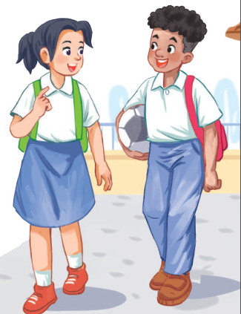
PRESENTATION
1
LISTEN AND READ.
Lan: Hi, Mark. How are you?
Mark: Good, thanks. And you?
What did you do last Sunday?
Lan: I’m fine. Last Sunday afternoon,
I cycled round the lake near my home.
Mark: That sounds really healthy.
By the way, do you often cycle to
school too?
Lan: Yes, but sometimes my mum takes me on her motorbike.
Mark: How far is it from your home
to school?
Lan: It’s about two kilometres.
Mark: How long does it take you to
cycle there?
Lan: About 10 minutes. Sometimes,
when there are traffic jams, it takes
longer.
Mark: You should be careful, especially when you cross the road.
Lan: Right. The roads get really crowded.
Mark: Hey, how about going cycling
round the lake this Sunday?
Lan: Great! Can you come to my house at 3 p.m.?
Mark: OK, Lan. See you then.

Slide 13
LESSON 1: GETTING STARTED
WARM-UP
Miming game
PRESENTATION
Vocabulary
Listen and read.
Task 1: Read the conversation and choose the correct answer.
Task 2: Write one word from the conversation to complete each sentence.
Task 3: Look at the pictures and write a word under each.
PRACTICE

Slide 14
PRACTICE
2
Read the conversation again and choose the correct answer.
1. How does Lan often go to school?
A. By bicycle. B. By motorbike. C. On foot.
2. It normally takes Lan ___ to get to school.
A. two minutes B. ten minutes C. twenty minutes
3. Lan and Mark agree to go cycling ______.
A. tomorrow B. every day C. at the weekend

Slide 15
PRACTICE
3
Write one word from the conversation to complete each sentence.
1. Last Sunday afternoon, Lan ______ round the lake near her home.
2. Mark says to Lan: “You ______ be careful, especially when you cross the road.
3. Traffic ______ are a problem in big cities.
4. – ______ does your mum go shopping?
– She often walks.
5. This road is very __________ during the rush hours.
cycled
should
jams
How
crowded

Slide 16
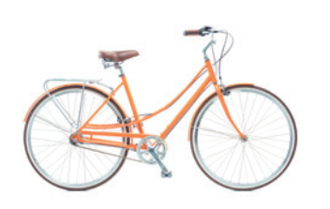
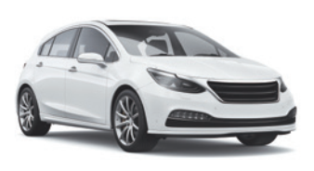
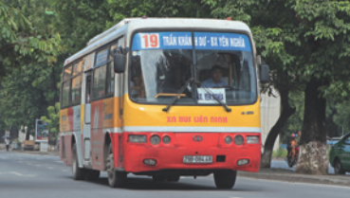
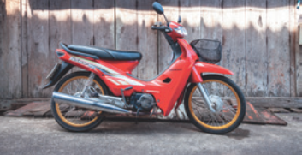
PRACTICE
4
Look at the pictures and write a word under each.
bicycle
car
1. _______________
2. _______________
bus
motorbike
3. _______________
4. _______________

Slide 17
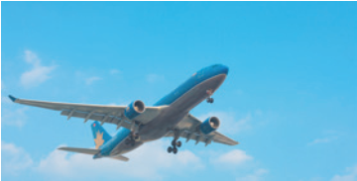
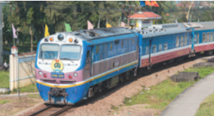
PRACTICE
3
Look at the pictures and write a word under each.
plane/ airplane
train
5. _______________
6. _______________
boat
ship
7. _______________
8. _______________

Slide 18
LESSON 1: GETTING STARTED
WARM-UP
Miming game
PRESENTATION
Vocabulary
Listen and read.
Task 1: Read the conversation and choose the correct answer.
Task 2: Write one word from the conversation to complete each sentence.
Task 3: Look at the pictures and write a word under each.
PRACTICE
PRODUCTION
Task 4: Game: Find someone who …

Slide 19
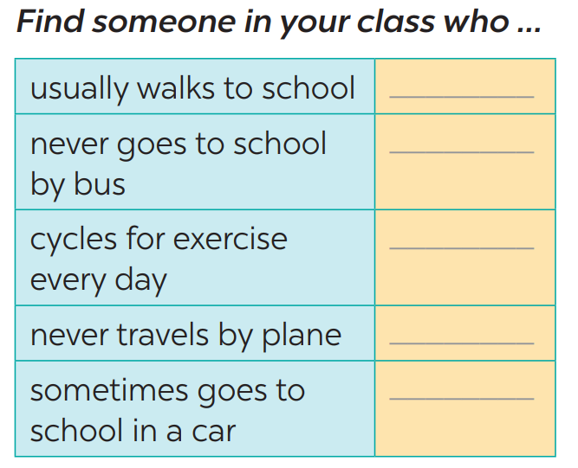
PRODUCTION
4
Find someone who … Write your friends’ names in the blanks. Then report to the class

Slide 20
LESSON 1: GETTING STARTED
WARM-UP
Miming game
PRESENTATION
Vocabulary
Listen and read.
Task 1: Read the conversation and choose the correct answer.
Task 2: Write one word from the conversation to complete each sentence.
Task 3: Look at the pictures and write a word under each.
PRACTICE
PRODUCTION
Task 4: Game: Find someone who …
CONSOLIDATION
Wrap-up
Homework

Slide 21
CONSOLIDATION
1
WRAP-UP
Topic of the unit
TRAFFIC
Vocabulary
MEANS OF TRANSPORT
TRAFFIC PROBLEMS

Slide 22
CONSOLIDATION
2
HOMEWORK
Do exercises in the workbook.
Prepare the vocabulary for the next lesson: A closer look 1

Slide 23
Website: sachmem.vn
Fanpage: facebook.com/sachmem.vn/

