Slide 1


NGO MAY HIGHT SCHOOL
Welcome to my class

Slide 2
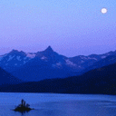



Our school will shine today
Our school will shine
Our school will shine today
All down the line
Our school will shine today
Our school will shine
When the sun goes down
When the moon goes up
Our school will shine
Good morning Everybody
OUR SCHOOL WILL SHINE
WELCOME TO MY CLASS

Slide 3

Warm up
The USA
England
Scotland
Canada
Singapore
Australia
New Zealand
Wales
Ireland
The American
The English
The Scottish/Scots
The Canadians
The Singaporeans
The Australian
The New Zealanders
The Welsh
The Irish

Slide 4
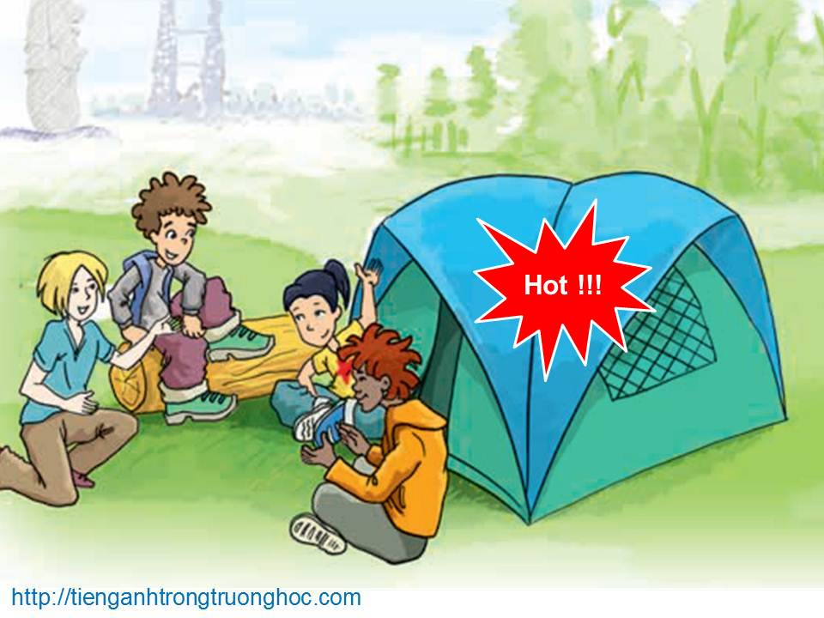
      UNIT 8: ENGLISH SPEAKING COUNTRIES
      LESSON 4: COMMUNICATION
English 8

Slide 5


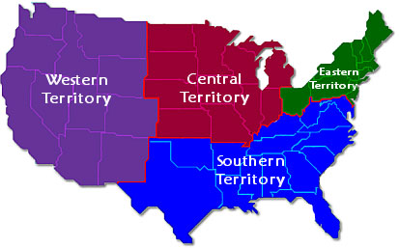
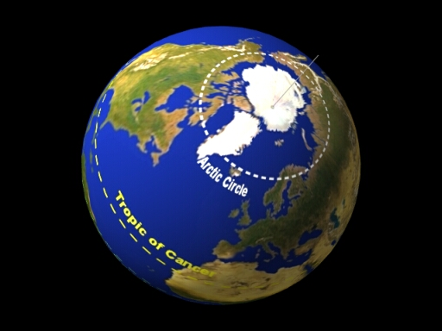
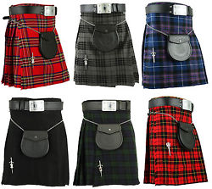
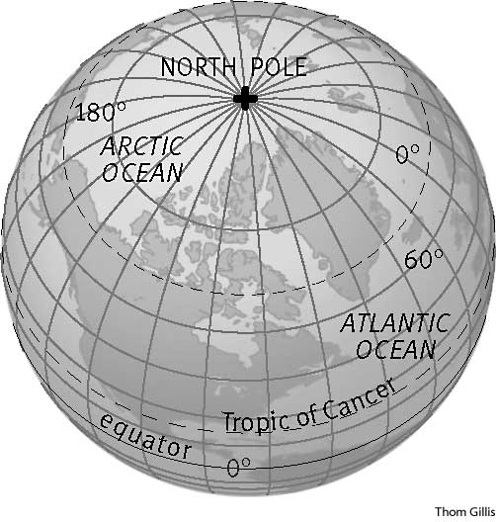
A/ content:
I.vocabulary :
territory (n) /ˈterɪtər.i/
North Pole (n)
Arctic Circle (n) /ˈɑːk.tɪk/
kilt (n) /kɪlt/ :
lãnh thổ
Cực Bắc
Vòng Bắc cực
Váy ca-rô của đàn ông Scotland

Slide 6
II-Games:
Activity 1. Do the quiz and choose the correct answers.
Do the quiz
Activity 2. Write the names of the countries next to their facts.
Names of the countries
Activity 3a. Work in groups. Choose a country and together find out as much about it as possible. Then prepare a small introduction of that country. Don’t say the name of the country.
How much do you know

Slide 7




Welcome To
Big Board Facts

Slide 8

Big Board Facts
Nếu muốn thử lại game, phải close và reopen file
Do the Quiz
5
10
15
20
25
Do the Quiz
5
10
15
20
25
Names of the countries
5
10
15
20
25
How much do you know
5
10
15
20
25
How much do you know
5
10
15
20
25
Team Scores
Big Points
Question
Team A
Team B
Notes:
Note: Nếu muốn thử lại, phải close và reopen file

Slide 9
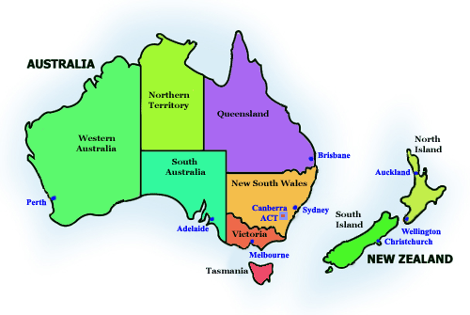
Do the quiz
Question for 5 Points
1. _______ are both surrounded by the sea.
  A. The UK and the USA
B. Canada and New Zealand
C. Australia and New Zealand
  D. The USA and Australia
Back to board
Notes:
Key: 1C

Slide 10
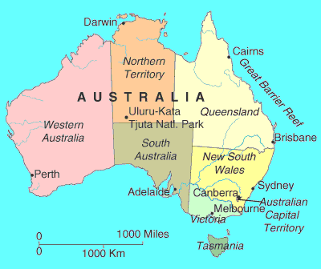
Do the quiz
Question for 10 Points
2. Of these countries, _______ is the youngest
  A. Australia
B. Canada
C. the USA
  D. the United Kingdom
Back to board
Notes:
Key: 2A

Slide 11
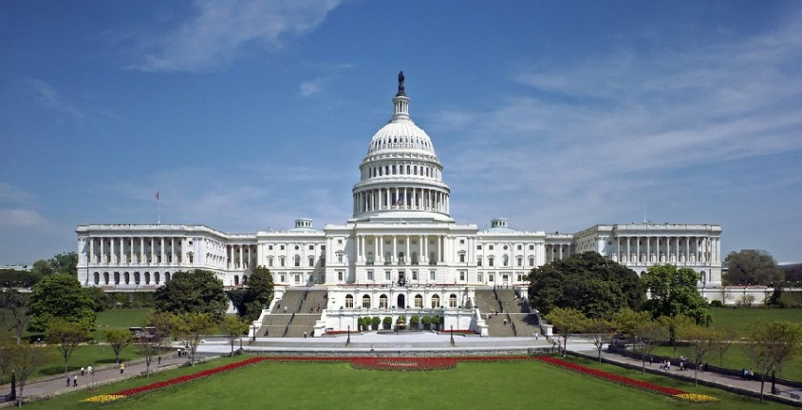
Do the quiz
Question for 15 Points
3. The capital of New Zealand is _______
A. Canberra
B. Washington D.C.
C. Wellington
D. Ottawa
Back to board
Notes:
Key: 3C

Slide 12
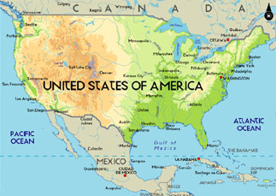
Do the quiz
Question for 20 Points
4. _______ is the most diverse in geography and climate.
A. Canada
B. The USA
C. The United Kingdom
D. New Zealand
Back to board
Notes:
Key: 4B

Slide 13
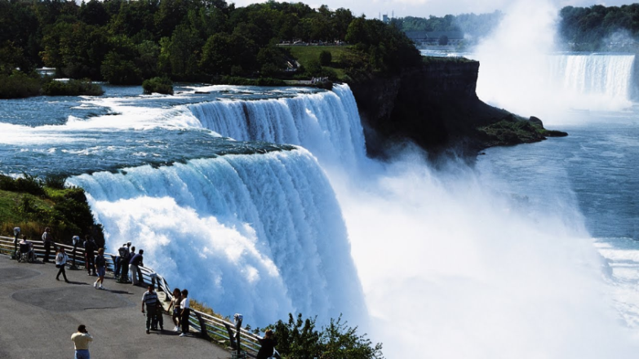
Do the quiz
Question for 25 Points
5. Niagara Falls is a spectacular waterfall in ____
A. Wales
B. Canada
C. England
D. Australia
Back to board
Notes:
Key:5B

Slide 14
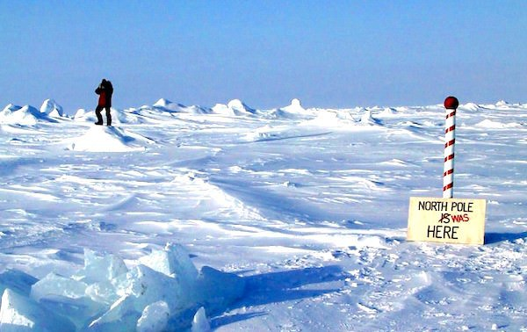
Do the quiz
Question for 5 Points
6. __________ is closest to the North Pole.
A. America
B. Canada
C. New Zealand
D. Australia
Back to board
Notes:
Key: 6B

Slide 15
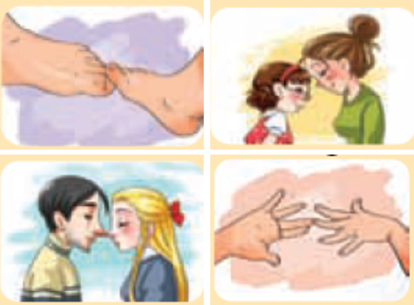
Do the quiz
Question for 10 Points
7. Which picture below illustrates the way the Maori of New Zealand greet each other?
A. touching toes
B. touching foreheads
C. touching noses
D. touching hands
Back to board
Notes:
Key: 7C

Slide 16
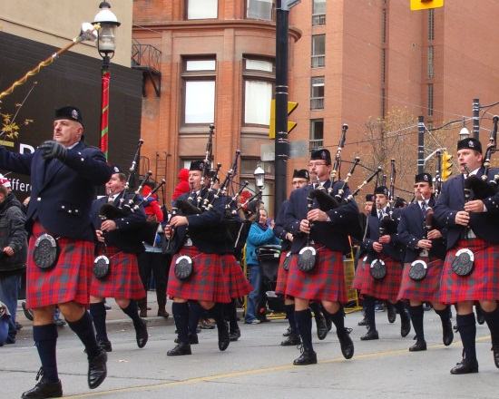
Do the quiz
Question for 15 Points
8. A kilt is the traditional garment for _______ .
A. Scottish men
B. the Maori in New Zealand
C. the Americans
D. the Aborigines in Australia
Back to board
Notes:
Key: 8A

Slide 17
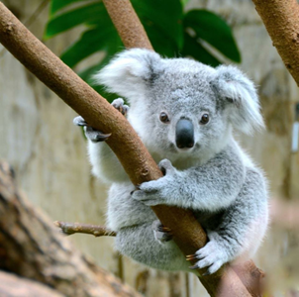
Do the quiz
Question for 20 Points
9. This animal, the _______ , is a symbol of Australia.
A. kangaroo
B. koala
C. rabbit
D. emu
Back to board
Notes:
Key: 9B

Slide 18
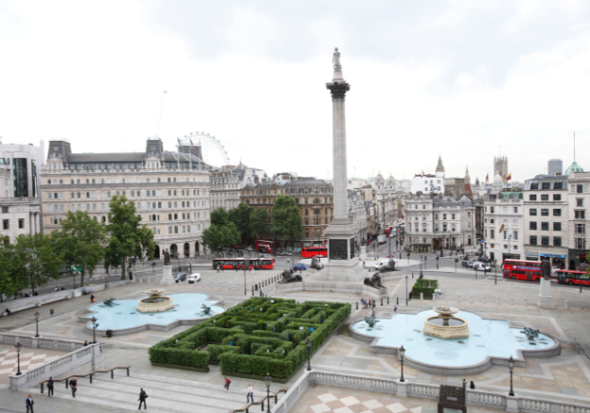
Do the quiz
Question for 25 Points
10. _______ is in London
A. Trafalgar Square
B. Times Square
C. Sky Tower
D. Ayers Rock
Back to board
Notes:
Key: 10A

Slide 19

Names of the Countries
Question for 5 Points
Information | Country
1. It is made up of 50 states.
the USA
Back to board

Slide 20
Names of the Countries
Question for 10 Points
Information | Country
2. It has the smallest population.
New Zealand
Back to board

Slide 21
Names of the Countries
Question for 15 Points
Information | Country
3. It has the most famous football clubs in the world.
United Kingdom
Back to board

Slide 22
Names of the Countries
Question for 20 Points
Information | Country
4. It has part of its territory inside the Arctic Circle.
Canada
Back to board

Slide 23
Names of the Countries
Question for 25 Points
Information | Country
5. It is both a country and a continent.
Australia
Back to board

Slide 24
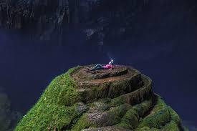
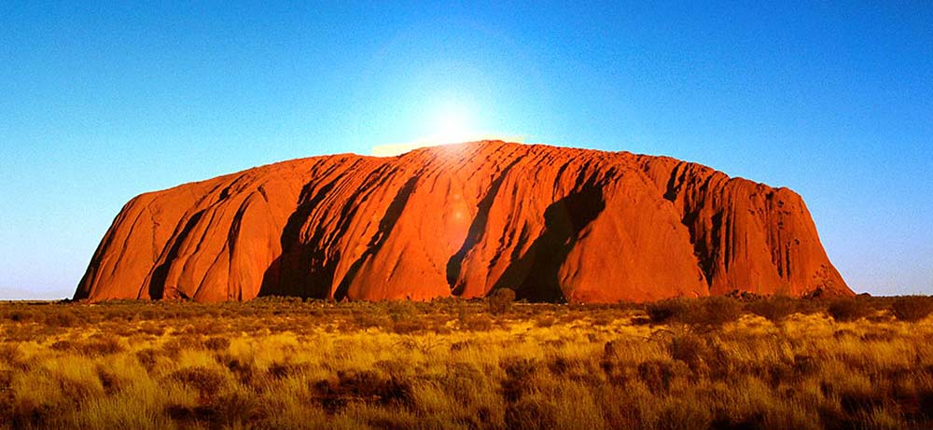
How much do you know
Question for 5 Points
It is considered one of the largest natural cave in the world that people discovered few years ago.
Son Doong cave
Back to board

Slide 25
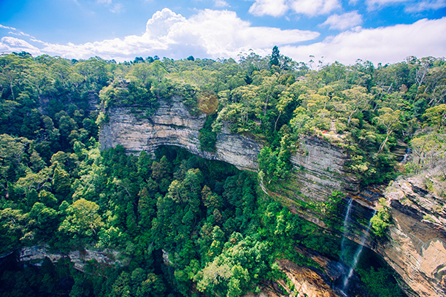
How much do you know
Question for 10 Points
It is A UNESCO World Heritage Site .
Blue Mountains National Park
Back to board

Slide 26
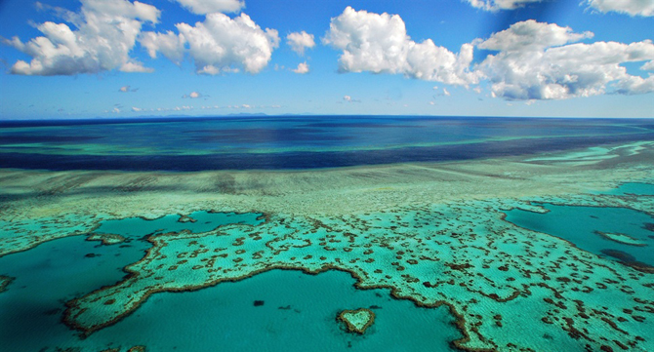
How much do you know
Question for 15 Points
It is one of the seven wonders of the natural world, the park stretches for 2,300 km along the state of Queensland, on this country’s east coast
Great Barrier Reef Marine Park/
Back to board

Slide 27
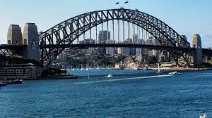
How much do you know
Question for 20 Points
It is one of this country most famous icons and is the largest steel arch bridge in the world
Sydney Harbour Bridge
Back to board

Slide 28
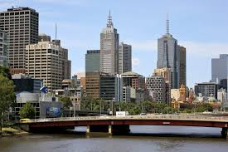
How much do you know
Question for 25 Points
It is the second largest city in Australia.
Melbourne
Back to board

Slide 29
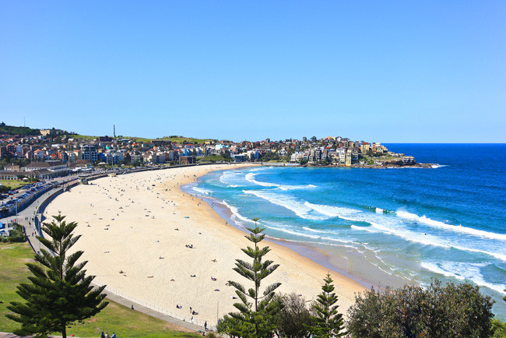
How much do you know
Question for 5 Points
It is one of the world’s most famous beaches
Bondi Beach
Back to board

Slide 30
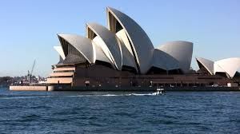
How much do you know
Question for 10 Points
It in Sydney is one of the most distinctive and famous 20th-century buildings, and one of the most famous performing arts venues in the world.
The Sydney Opera House
Back to board

Slide 31
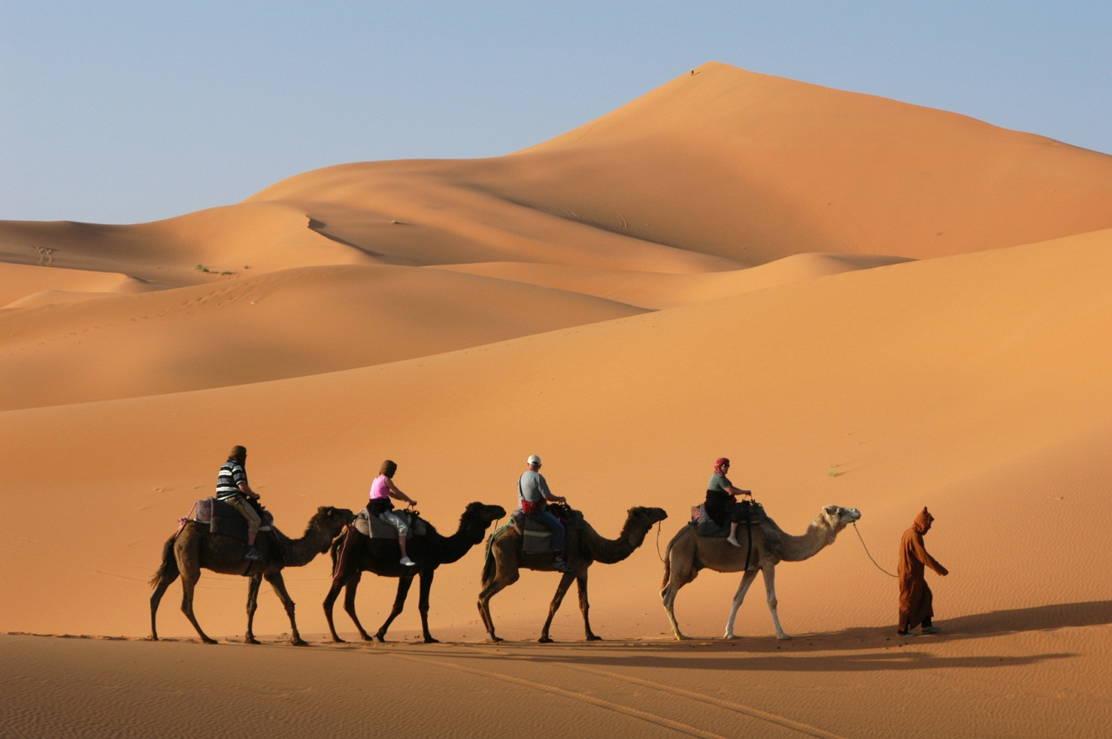
How much do you know
Question for 15 Points
It is the world’s largest hot desert?
The Sahara Desert
Back to board

Slide 32
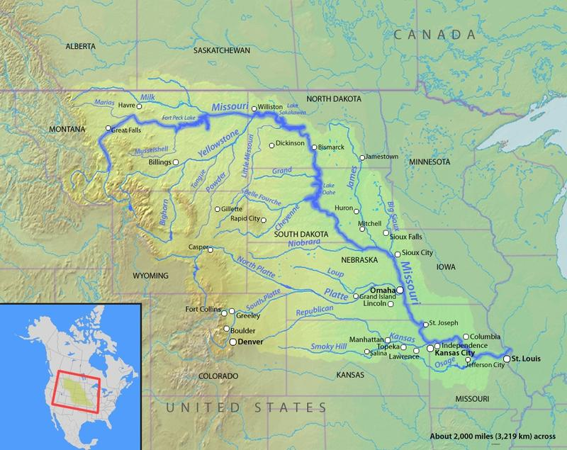
How much do you know
Question for 20 Points
It is the longest river in the USA
Missouri River
Back to board

Slide 33
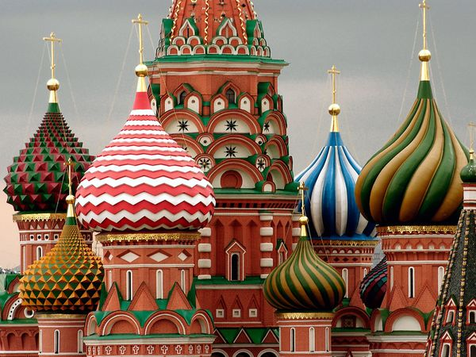
How much do you know
Question for 25 Points
This square is the largest country in the World
Russia’s : 17.1 million square kilometres
Back to board

Slide 34
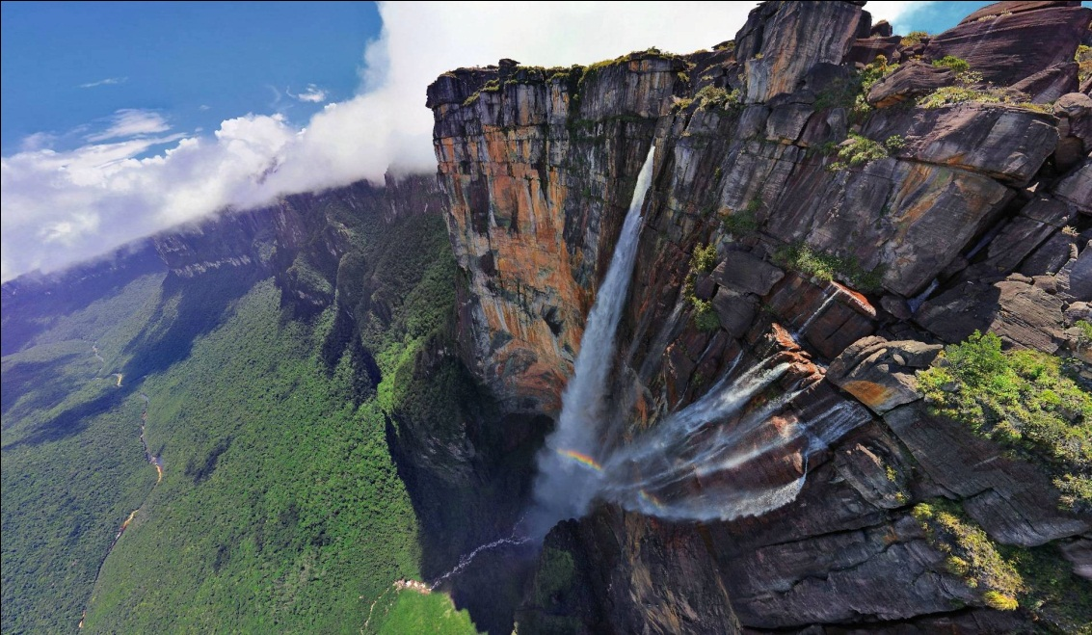
“Big Points - 30”
Question
This Venezuelan waterfall drops 3,212 feet. That is 15 times higher than Niagra Falls. Name this waterfall.
25
30
29
28
27
26
24
23
22
21
20
19
18
17
16
15
14
13
12
11
10
9
8
7
6
5
4
3
2
1
Angel Falls
Back to board

Slide 35
Activity 3b. Each group then presents their introduction to the class. The class...
1. tries to find out which country it is
2. votes for the most informative and interesting introduction

Slide 36
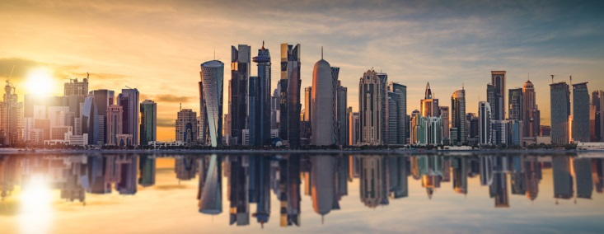

Ex: Which country of national football team that was beaten by U23 Viet Nam in the semi-final of 2018 AFC U-23 Championship?
Qatar

Slide 37

II. Homework
  Learn the lesson well.
  Do C1, 2 (P14-15)
  Prepare for the next lesson : Skills 1

