Slide 1
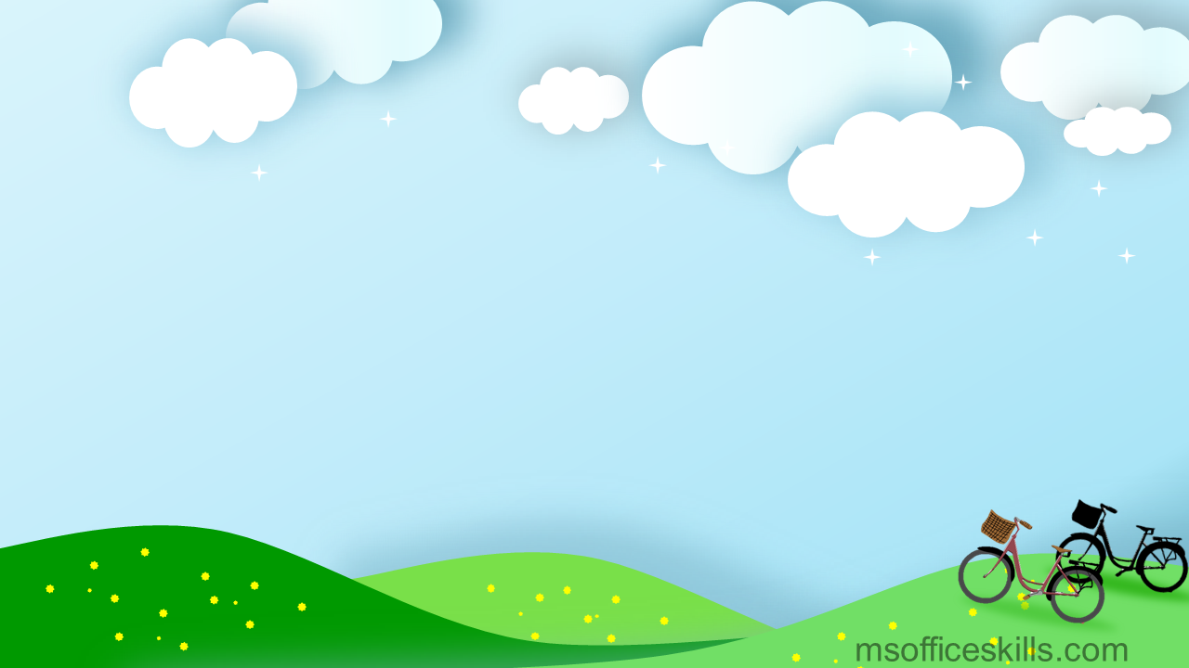
Class : 8 A

Slide 2
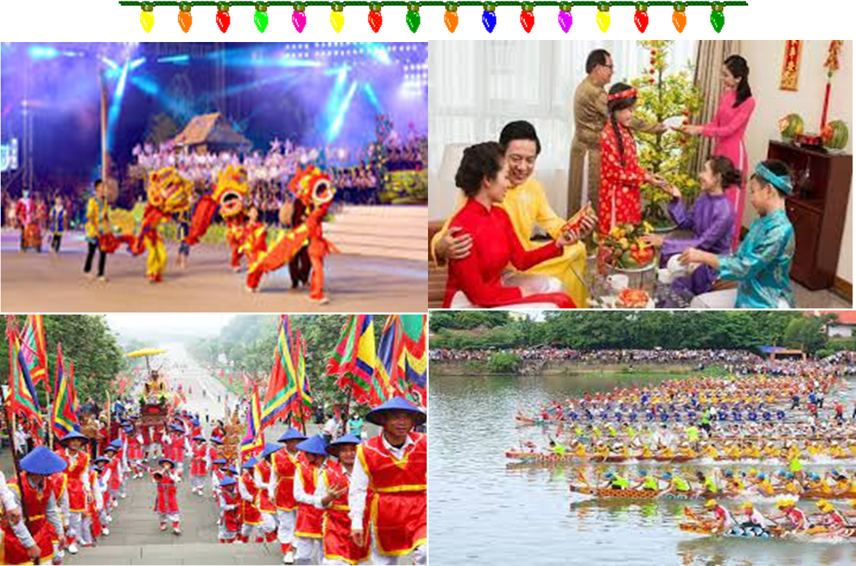
Flip the puzzle pieces to guess the keyword.
2
3
4
1
2
3
4
1
5
6
7
8
5
6
7
8
FESTIVALS

Slide 3
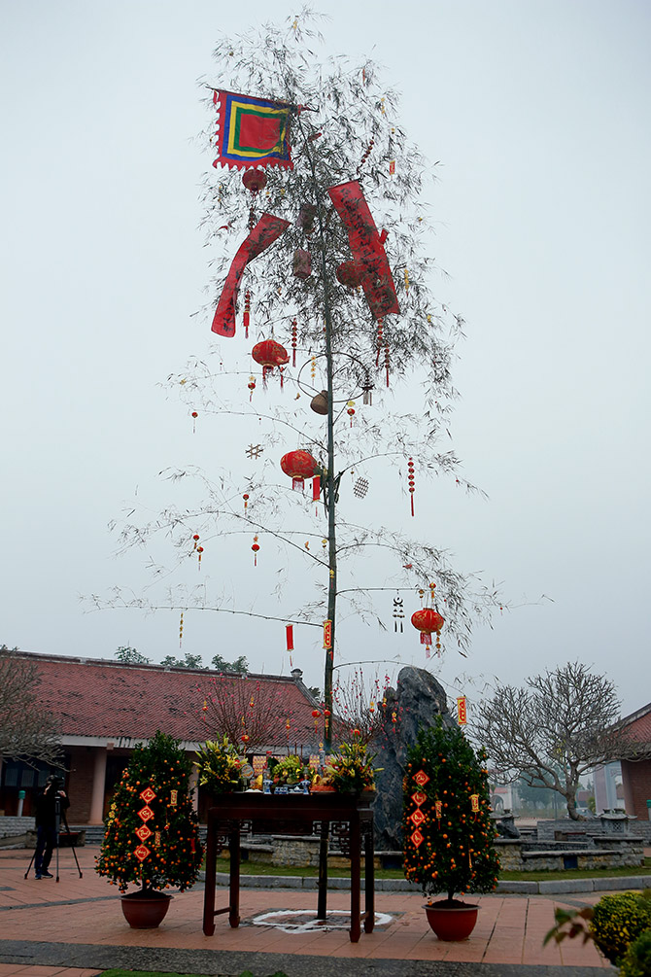
What is this?
HẾT GIỜ
It’s a bamboo pole

Slide 4
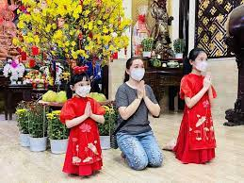
Many Asians go to Buddhist temples to _____ for good luck
HẾT GIỜ
Pray

Slide 5
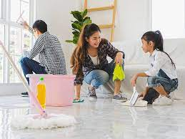
People often ………their houses before Tet comes
HẾT GIỜ
clean

Slide 6
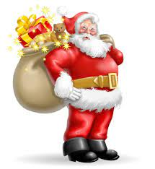
Who does Santa Claus usually bring gifts to at Christmas?
HẾT GIỜ
chidren

Slide 7
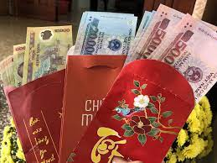
At Tet children often get …………
HẾT GIỜ
Lucky money

Slide 8
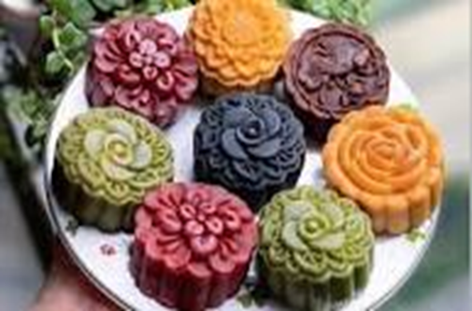
What cake is this?
HẾT GIỜ
This is moon cake

Slide 9
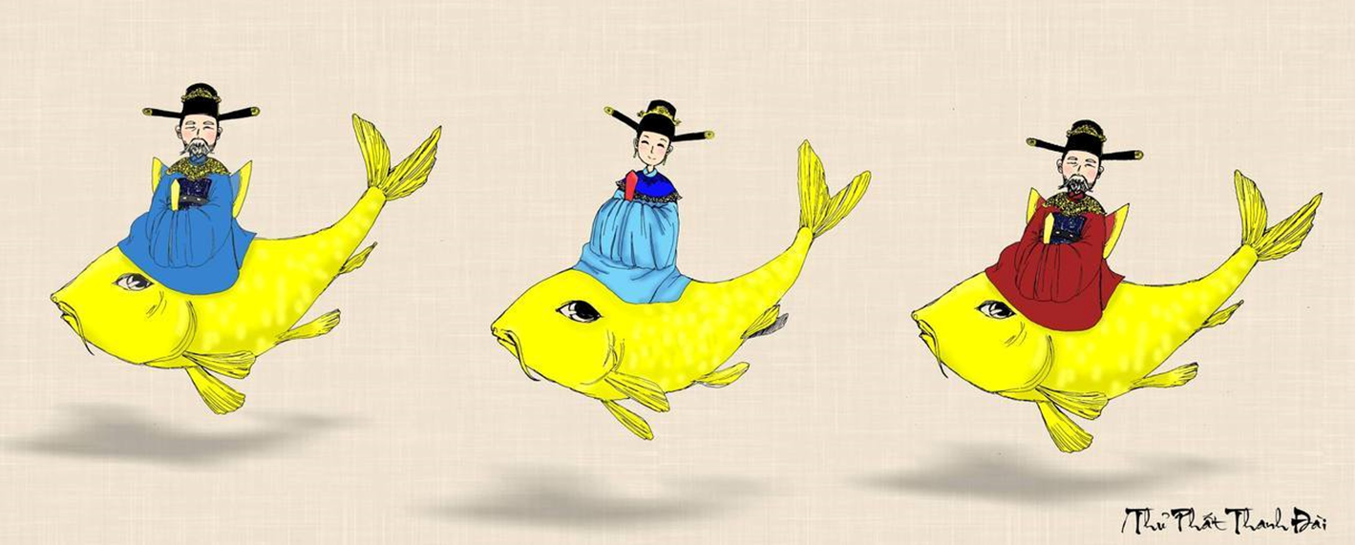
The ……….. Gods Worshipping Ceremony on the 23rd day of
the twelfth lunar month
HẾT GIỜ
Kitchen

Slide 10
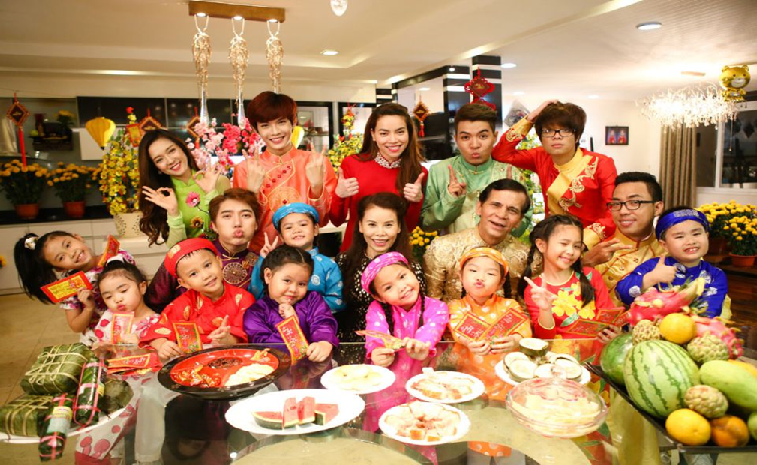
We have a tradition of holding a family ____ on the first day of Tet .
HẾT GIỜ
reunion

Slide 11
* WARM-UP
1. Have you ever been to a Festival?
2. Do you like it?
3. Can you describe it?
-When and Where is the festival celebrated?
-What activities there are?
-What do you and your family do during the festival?)

Slide 12
Suggested answers:
Yes, I have been to the Full Moon festival, ... /
No, I haven’t
2. Yes, I do / No, I don’t
3. I celebrated the Full Moon festival on the 15th day of the 8th Lunar Month in our country. We can eat moon cake during this Festival. We can give gifts to others. We can appreciate the Moon,….

Slide 13
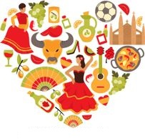
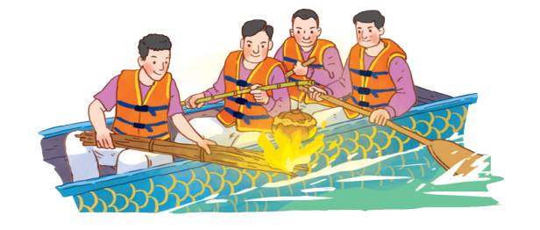
Unit
5
OUR CUSTOMS AND TRADITIONS
Unit
ETHNIC GROUPS OF VIET NAM
LESSON 5: SKILLS 1
LESSON 3: A CLOSER LOOK 2
HOBBIES
READING
SPEAKING

Slide 14
* Vocabulary
release (v):
thả
/rɪˈliːs/

Slide 15
contestant (n):
thí sinh, người thi đấu
/kənˈtestənt/

Slide 16
- family bonding:
sự gắn kết tình cảm gia đình
/ˌfæməli ˈbɒndɪŋ/

Slide 17
New words | Pronunciation | Meaning
release (v) | /rɪˈliːs/ | thả
contestant (n) | /kənˈtestənt/ | thí sinh, người thi đấu
family bonding | /ˌfæməli ˈbɒndɪŋ/ | sự gắn kết tình cảm gia đình

Slide 18
I. READING
1
Work in pairs. Look at the picture and answer the following questions.
1. What are the men doing?
- They are rowing a boat. They are cooking rice on an open fire.
2. When do you think this event occurs?
- This event may occur in a festival in the North of Vietnam.

Slide 19
2
Read the text. Choose the correct answer A, B, or C.
A village festival day
I live in a small village in northern Viet Nam. Every year, people in my village look forward to the third day of Tet. It is one of our most important festival days.
In the morning, we gather along the riverside to watch some competitions. First, there is a special boat race. Some team members cook rice on the boat while others row the boat as fast as they can. The fastest team with well-cooked rice wins the race. Then, the referee releases a duck into the middle of the river. Contestants jump into the river to catch it. The atmosphere becomes loud with the sound of drums and cheers of festival goers.
At noon, there is a village party at the communal house for the elders. Each family also holds a home party. We cook traditional dishes like sticky rice and steamed chicken. Sometimes, we include food that children love, such as bun cha or even pizzas!
The village festival helps us maintain our traditions, connect with other people, and strengthen our family bonds.

Slide 20
2
Read the text. Choose the correct answer A, B, or C.
1. What is the text mainly about?
A. A local tradition.
B. A family tradition.
C. A cooking contest..
2. To win the boat race, a team must ______.
A. row the boat more quickly than the other teams B. row the boat the fastest and properly cook the rice
C. cook rice properly and catch the duck

Slide 21
2
Read the text. Choose the correct answer A, B, or C.
3. The phrase “releases a duck” in the text means ______.
A. gives it freedom
B. catches it
C. takes it home
4. Why is the festival important?
A. Because it is exciting.
B. Because people win valuable prizes.
C. Because it keeps some village traditions alive.

Slide 22
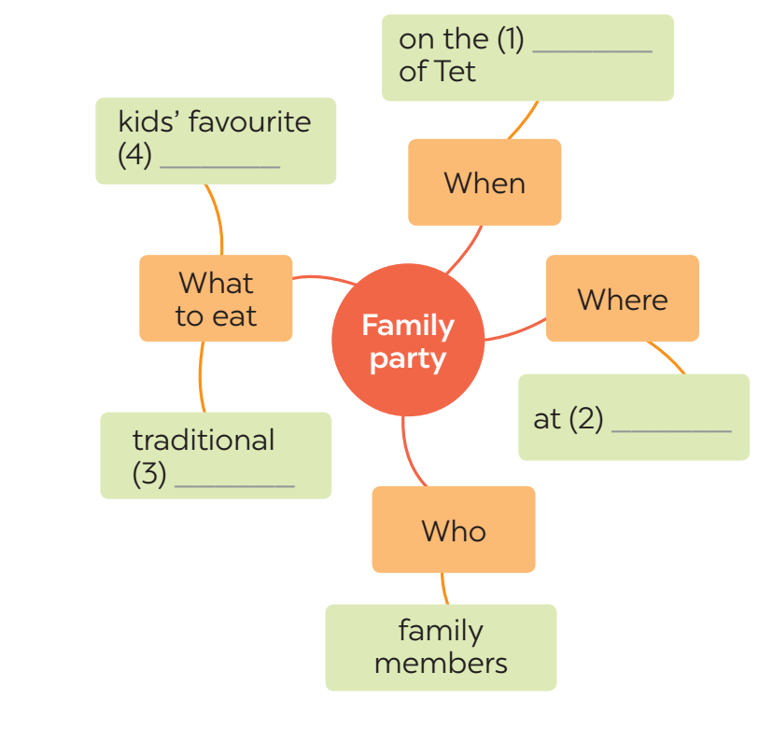
3
Read the text again. Complete the mind map about a family party.
third day
food
home
dishes

Slide 23
II. SPEAKING
4
Work in pairs. Put the questions (A - E) in the correct blanks (1 - 5) to make a complete dialogue. Then role-play it.
Nick: (1) ______ Lan: Well, I join birthday parties of all my family members. Nick: (2) ______ Lan: In a Vietnamese restaurant. But sometimes we break with tradition by going to a Western one. Nick: (3) ______ Lan: Everyone in my family.
Nick: (4) ______ Lan: Well, the birthday person opens the gifts. and everyone has some good food. Nick: (5) ______ Lan: Yes, I always look forward to them. They are a great time for family bonding.

Slide 24
II. SPEAKING
4
Work in pairs. Put the questions (A - E) in the correct blanks (1 - 5) to make a complete dialogue. Then role-play it.
Nick: (1) Lan, what family event do you often take part in? Lan: Well, I join birthday parties of all my family members. Nick: (2) Where do you hold these parties Lan: In a Vietnamese restaurant. But sometimes we break with tradition by going to a Western one. Nick: (3) Who joins you at these parties? Lan: Everyone in my family.
Nick: (4) And what do you do at parties? Lan: Well, the birthday person opens the gifts. and everyone has some good food. Nick: (5) Do you like these parties? Lan: Yes, I always look forward to them. They are a great time for family bonding.

Slide 25
II. SPEAKING
5
Make notes about a normal family event that you take part in. Use the questions below as cues.
1. What is the event?
2. Where and when does it happen?
3. Who joins with you?
4. What do you often do at that event?
5. Do you like it or not? Why or why not?
Now work in pairs. Make a dialogue asking and answering about the event. You can use your notes.
It’s the family reunion party at the end of the year
It holds in my grandparents’ house.
Every family members gather at my grandparent’s house.
We enjoy delicious food and talk together
Yes, I always look forward to them. It is a great time for family bonding.

Slide 26
5
5
Make notes about a normal family event that you take part in. Use the questions below as cues.
Now work in pairs. Make a dialogue asking and answering about the event. You can use your notes.
1. What is the event?
2. Where and when does it happen?
3. Who joins with you?
4. What do you often do at that event?
-The event is a birthday party.
-It happens on one of my family member's birthday. It is held in my our house.
-My family members join with me.
- I always buy a birthday cake.
5. Do you like it or not? Why or why not?
Yes, I like it a lot. Because it's an oppotunity to bring everyone together.

Slide 27
5
Make notes about a normal family event that you take part in. Use the questions below as cues.
1. What is the event?
2. Where and when does it happen?
3. Who joins with you?
4. What do you often do at that event?
5. Do you like it or not? Why or why not?
Now work in pairs. Make a dialogue asking and answering about the event. You can use your notes.
Full Moon Festival
On the 15th day of the 8th Lunar Month in Asia
My family, my friends,…
Eat moon cake, hang lantern....
Yes, I do. Because I can celebrate with my family.

Slide 28
* CONSOLIDATION
+ Reading:
Read for specific information about village festival day.
+ Speaking:
Talk about family event.

Slide 29
* Homework
Do exercises in the workbook.
Prepair lesson 6 (Skills 2)

Slide 30
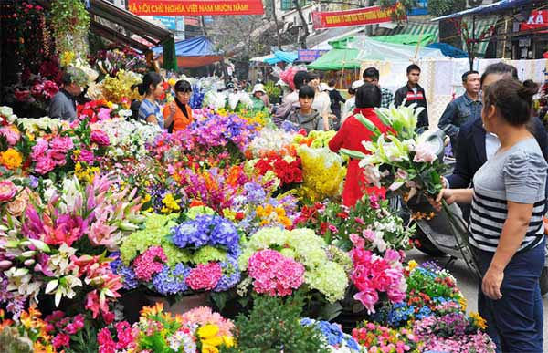
It’s actually a bamboo ………pole…….
Many Asians go to Buddhist temples to ___pray__ for good luck
People often clean their houses before Tet comes
on what holiday does santa claus usually appear? Christmas
At Tet children often get lucky ……………money…
This is moon cake
We have a tradition of holding a family ______ on the first day of Tet. A. reunion B. work C. meal
My family often buys ornamental trees and flowers to decorate the house at Tet
The Kitchen Gods Worshipping Ceremony on the 23rd day of the twelfth lunar month

Slide 31
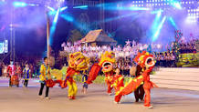
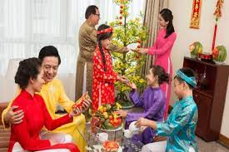
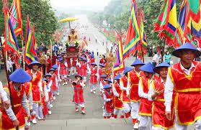
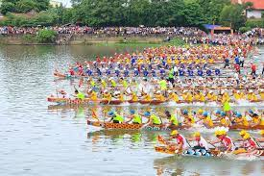

Slide 32
TRÒ CHƠI LẬT MẢNH GHÉP
FESTIVALS

